Slide 1
Methods of Proof
Rosen 1.7, 1.8
Lecture 4: September 25

Slide 2
Some terminology
Theorem: a mathematical statement that can be shown to be true
Proposition: less important theorem
Axiom (postulate): a statement that is assumed to be true
Lemma: less important theorem that is helpful in the proof of other results
Corollary: a theorem that can be established directly from a theorem that has been proved
Conjecture: a statement proposed to be true, but not proven yet

Slide 3
Basic Definitions
An integer n is an even number
if there exists an integer k such that n = 2k.
An integer n is an odd number
if there exists an integer k such that n = 2k+1.

Slide 4




Proving an Implication
Goal: If P, then Q. (P implies Q)
Method 1: Write assume P, then show that Q logically follows.
Claim:
If
, then
Reasoning:
When x=0, it is true.
When x grows, 4x grows faster than x³ in that range.
Proof:
When

Slide 5
Direct Proofs
The sum of two even numbers is even.
Proof
x = 2m, y = 2n
x+y = 2m+2n
= 2(m+n)
The product of two odd numbers is odd.
Proof
x = 2m+1, y = 2n+1
xy = (2m+1)(2n+1)
= 4mn + 2m + 2n + 1
= 2(2mn+m+n) + 1.

Slide 6
Divisibility
a “divides” b (a|b):
b = ak for some integer k
5|15 because 15 = 3∙5
n|0 because 0 = n∙0
1|n because n = 1∙n
n|n because n = n∙1
A number p > 1 with no positive integer divisors other than 1 and itself
is called a prime. Every other number greater than 1 is called composite.
2, 3, 5, 7, 11, and 13 are prime,
4, 6, 8, and 9 are composite.

Slide 7
Simple Divisibility Facts
1. If a | b, then a | bc for all c.
2. If a | b and b | c, then a | c.
3. If a | b and a | c, then a | sb + tc for all s and t.
4. For all c ≠ 0, a | b if and only if ca | cb.
Proof of (1)
a | b
b = ak
bc = ack
bc = a(ck)
a|bc
a “divides” b (a|b):
b = ak for some integer k

Slide 8
Simple Divisibility Facts
1. If a | b, then a | bc for all c.
2. If a | b and b | c, then a | c.
3. If a | b and a | c, then a | sb + tc for all s and t.
4. For all c ≠ 0, a | b if and only if ca | cb.
Proof of (2)
a | b => b = ak₁
b | c => c = bk₂
=> c = ak₁k₂
=> a|c
a “divides” b (a|b):
b = ak for some integer k

Slide 9
Simple Divisibility Facts
1. If a | b, then a | bc for all c.
2. If a | b and b | c, then a | c.
3. If a | b and a | c, then a | sb + tc for all s and t.
4. For all c ≠ 0, a | b if and only if ca | cb.
Proof of (3)
a | b => b = ak₁
a | c => c = ak₂
sb + tc
= sak₁ + tak₂
= a(sk₁ + tk₂)
=> a|(sb+tc)
a “divides” b (a|b):
b = ak for some integer k

Slide 10
Proving an Implication
Goal: If P, then Q. (P implies Q)
Method 1: Write assume P, then show that Q logically follows.
Claim:
If r is irrational, then √r is irrational.
How to begin with?
What if I prove “If √r is rational, then r is rational”, is it equivalent?
Yes, this is equivalent;
proving “if P, then Q” is equivalent to proving “if not Q, then not P”.

Slide 11
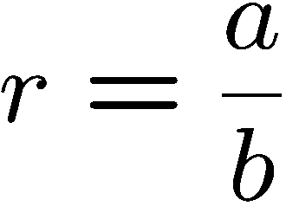
Rational Number
R is rational ⬄ there are integers a and b such that
numerator
and b ≠ 0.
denominator
Is 0.281 a rational number?
Is 0 a rational number?
If m and n are non-zero integers, is (m+n)/mn a rational number?
Is the sum of two rational numbers a rational number?
Is x=0.12121212…… a rational number?
Yes, 281/1000
Yes, 0/1
Yes
Yes, a/b+c/d=(ad+bc)/bd
Note that 100x-x=12, and so x=12/99.

Slide 12
Proving an Implication
Goal: If P, then Q. (P implies Q)
Method 2: Prove the contrapositive, i.e. prove “not Q implies not P”.
Claim:
If r is irrational, then √r is irrational.
Proof:
We shall prove the contrapositive –
“if √r is rational, then r is rational.”
Since √r is rational, √r = a/b for some integers a,b.
So r = a²/b². Since a,b are integers, a²,b² are integers.
Therefore, r is rational.
Q.E.D.

Slide 13
Proving an “if and only if”
Goal: Prove that two statements P and Q are “logically equivalent”,
that is, one holds if and only if the other holds.
Example:
An integer is even if and only if the its square is even.
Method 1: Prove P implies Q and Q implies P.
Method 1’: Prove P implies Q and not P implies not Q.
Method 2: Construct a chain of if and only if statement.

Slide 14
Proof by Contraposition
An integer is even if and only if the its square is even.
Method 1: Prove P implies Q and Q implies P.
Statement: If m is even, then m² is even
Proof:
m = 2k
m² = 4k²
Statement: If m² is even, then m is even
Proof:
m² = 2k
m = √(2k)
??

Slide 15
Proof by Contraposition
An integer is even if and only if the its square is even.
Method 1’: Prove P implies Q and not P implies not Q.
Statement: If m² is even, then m is even
Contrapositive: If m is odd, then m² is odd.
Proof (the contrapositive):
Since m is an odd number, m = 2k+1 for some integer k.
So m² = (2k+1)²
= (2k)² + 2(2k) + 1
= 2(2k² + 2k) + 1
So m² is an odd number.

Slide 16
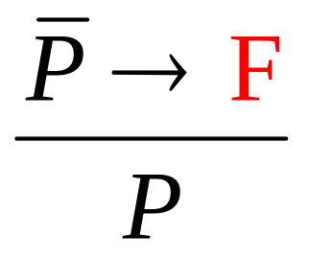

Proof by Contradiction
To prove P, you prove that not P would lead to ridiculous result,
and so P must be true.
You are working as a clerk.
If you have won Mark 6, then you would not work as a clerk.
You have not won Mark 6.

Slide 17

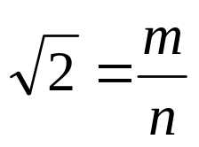
Proof by Contradiction
Theorem: is irrational.
Proof (by contradiction):
Suppose was rational.
Choose m, n integers without common prime factors (always possible) such that
Show that m and n are both even, thus having a common factor 2,
a contradiction!

Slide 18

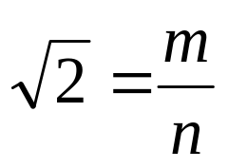

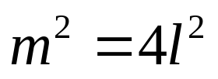
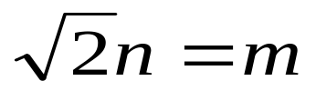
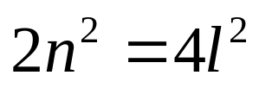

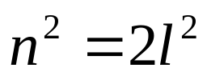
Proof by Contradiction
Theorem: is irrational.
Proof (by contradiction):
Want to prove both m and n are even.
so can assume
so m is even.
so n is even.

Slide 19
Divisibility by a Prime
Theorem. Any integer n > 1 is divisible by a prime number.
Let n be an integer.
If n is a prime number, then we are done.
Otherwise, n = ab, both are smaller than n.
If a or b is a prime number, then we are done.
Otherwise, a = cd, both are smaller than a.
If c or d is a prime number, then we are done.
Otherwise, repeat this argument, since the numbers are
getting smaller and smaller, this will eventually stop and
we have found a prime factor of n.
Idea of induction.

Slide 20
Infinitude of the Primes
Theorem. There are infinitely many prime numbers.
Proof (by contradiction):
Let p₁, p₂, …, p_{N} be all the primes.
Consider p₁p₂…p_{N} + 1.
Claim: if p divides a, then p does not divide a+1.
Proof (by contradiction):
a = cp for some integer c
a+1 = dp for some integer d
=> 1 = (d-c)p, contradiction because p>=2.
So none of p₁, p₂, …, p_{N} can divide p₁p₂…p_{N} + 1, a contradiction.

Slide 21




Proof by Cases
e.g. want to prove a nonzero number always has a positive square.
x is positive or x is negative
if x is positive, then x² > 0.
if x is negative, then x² > 0.
x² > 0.
A proof by cases must cover all possible cases that arise in a theorem

Slide 22
The Square of an Odd Integer
Idea 0: find counterexample.
3² = 9 = 8+1, 5² = 25 = 3x8+1 …… 131² = 17161 = 2145x8 + 1, ………
Idea 1: prove that n² – 1 is divisible by 8.
n² – 1 = (n-1)(n+1) = ??…
Idea 2: consider (2k+1)²
(2k+1)²
= 4k²+4k+1
= 4(k²+k)+1
If k is even, then both k² and k are even, and so we are done.
If k is odd, then both k² and k are odd, and so k²+k even, also done.
So n² = (2k+1)² = 4(2m)+1

Slide 23
Proof by Cases
Show that there are no solutions in integers x and y of x² + 3y² = 8.
When |x| ≥ 3, x² > 8
When |y| ≥ 2, 3y² > 8
This leaves possible x = {−2, −1, 0, 1, 2} and possible y = {−1, 0, 1}
Possible x² are 0, 1, 4 and possible 3y² are 0 and 3
Largest sum of possible values for x² and 3y² is 7
Consequently, it is impossible for x² + 3y² = 8 to hold when x and y are integers

Slide 24
Mistakes in proofs
What is wrong with this proof “1=2”?
  a=b (given)
  a²=ab (multiply both sides of 1 by a)
  a²-b² =ab-b² (subtract b² from both sides of 2)
  (a-b)(a+b)=b(a-b) (factor both sides of 3)
  a+b=b (divide both sides of 4 by a-b)
  2b=b (replace a by b in 5 as a=b and simply)
  2=1 (divide both sides of 6 by b)

Slide 25
What is wrong with this proof?
“Theorem”: If n² is positive, then n is positive
“Proof”: Suppose n² is positive. As the statement “If n is positive, then n² is positive” is true, we conclude that n is positive
The mistake occurs when one or more steps of a proof are based on the truth of the statement being proved
Counterexample: n = -1

Slide 26
In Summary
Direct Proofs (cases/induction)
H₁ ∧ H₂ ∧ ⋯ ∧ H_{n} ⟹ C
Proofs of the Contrapositive
¬C ⟹ (H₁ ∧ H₂ ∧ ⋯ ∧ H_{n})
Proofs by Contradiction
H₁ ∧ H₂ ∧ ⋯ ∧ H_{n} ∧ ¬C ⟹ a contradiction

Slide 27
Challenge for the Bored – Rational vs Irrational
Question: If a and b are irrational, can a^{b} be rational??
We know that √2 is irrational, what about √2^{√2} ?

