Slide 1
Functions
Rosen 2.3, 2.5
f( ) =
A
B
Lecture 5: October 2

Slide 2
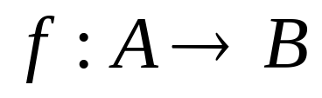


Functions
function, f, from set A to set B
associates an element , with an element
The domain of f is A.
The codomain of f is B.
For every input there is exactly one output.

Slide 3
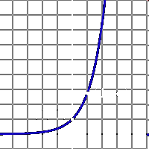

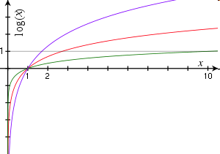

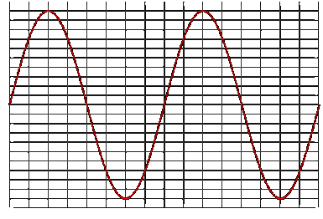


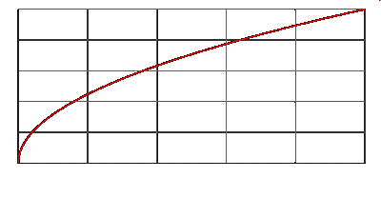
Functions
domain = R
codomain = R⁺-{0}
domain = R⁺-{0}
codomain = R
domain = R
codomain = [0,1]
domain = R⁺
codomain = R⁺

Slide 4
Functions
f(S) = |S|
domain = the set of all sets
codomain = non-negative integers
domain = the set of all strings
codomain = non-negative integers
f(string) = length(string)
not a function,
since one input could have
more than one output
f(student-name) = student-ID
f(x) = is-prime(x)
domain = positive integers
codomain = {T,F}

Slide 5
Functions
Let f₁ and f₂ be functions from A to R.
Then the sum and the product of f₁ and f₂ are also functions from A to R defined by:
(f₁ + f₂)(x) = f₁(x) + f₂(x)
(f₁f₂)(x) = f₁(x) f₂(x)
Example:
f₁(x) = 3x, f₂(x) = x + 5
(f₁ + f₂)(x) = f₁(x) + f₂(x) = 3x + x + 5 = 4x + 5
(f₁f₂)(x) = f₁(x) f₂(x) = 3x (x + 5) = 3x² + 15x

Slide 6
Functions
We already know that the range of a function f:A→B is the set of all images of elements a∈A.
If we only regard a subset S⊆A, the set of all images of elements s∈S is called the image of S.
If f(a)=b, b is the image of a and a is preimage of b
We denote the image of S by f(S):
f(S) = {f(s) | s∈S}

Slide 7

Increasing/decreasing functions
Increasing (decreasing):
If f(x)≤f(y) (f(x)≥f(y)), whenever x<y and x, y are in the domain of f
Strictly increasing (decreasing):
If f(x)<f(y) (f(x) > f(y)) whenever x<y, and x, y are in the domain of f
A function that is either strictly increasing or decreasing must be one-to-one

Slide 8

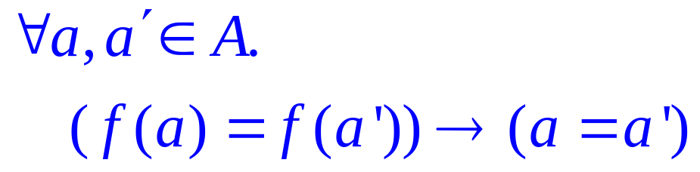
Injections (One-to-One)
is an injection iff no two inputs have the same output.
f( ) =
≤ 1 arrow in
A
B
|A| ≤ |B|

Slide 9
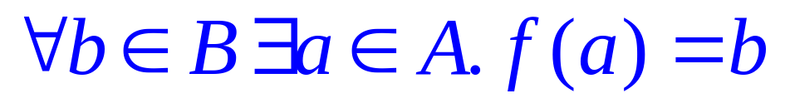
Surjections (Onto)
is a surjection iff every output is possible.
f( ) =
1 arrow in
A
B
|A| ≥ |B|

Slide 10

Bijections (one-and-one correspondence)
is a bijection iff it is surjection and injection.
exactly one arrow in
f( ) =
A
B
|A| = |B|
Identity function:

Slide 11
In-Class Exercises
Function | Domain | Codomain | Injective? | Surjective? | Bijective?
f(x)=sin(x) | Real | Real
f(x)=2^{x} | Real | Positive real
f(x)=x² | Real | Non-negative real
Reverse string | Bit strings of length n | Bit strings of length n
No
No
No
Yes
Yes
Yes
No
Yes
No
Yes
Yes
Yes
Whether a function is injective, surjective, bijective
depends on its domain and the codomain.

Slide 12
Inverse Sets
A
B
Given an element y in B, the inverse set of y := f⁻¹(y) = {x in A | f(x) = y}.

Slide 13
Inverse Function
Informally, an inverse function f⁻¹ is to “undo” the operation of function f.
exactly one arrow in
f( ) =
A
B
There is an inverse function f⁻¹ for f if and only if f is a bijection.

Slide 14
Composition of Functions
Two functions f:X->Y’, g:Y->Z so that Y’ is a subset of Y,
then the composition of f and g is the function g。f: X->Z, where
g。f(x) = g(f(x)).
f
Y’
g
X
Z
Y

Slide 15
In-Class Exercises
Function f | Function g | g。f injective? | g。f surjective? | g。f bijective?
f:X->Y f surjective | g:Y->Z g injective
f:X->Y f surjective | g:Y->Z g surjective
f:X->Y f injective | g:Y->Z g surjective
f:X->Y f bijective | g:Y->Z g bijective
f:X->Y | f⁻¹:Y->X
No
No
No
No
Yes
No
No
No
No
Yes
Yes
Yes
Yes
Yes
Yes

Slide 16

Pigeonhole Principle
If more pigeons
than pigeonholes,

Slide 17
Pigeonhole Principle
then some hole must have at least two pigeons!
Pigeonhole principle
A function from a larger set to a smaller set cannot be injective.
(There must be at least two elements in the domain that have
the same image in the codomain.)

Slide 18
Example
Question: Let A = {1,2,3,4,5,6,7,8}
If five integers are selected from A,
must a pair of integers have a sum of 9?
Consider the pairs {1,8}, {2,7}, {3,6}, {4,5}.
The sum of each pair is equal to 9.
If we choose 5 numbers from this set,
then by the pigeonhole principle,
both elements of some pair will be chosen,
and their sum is equal to 9.

Slide 19
Birthday Paradox
In a group of 366 people, there must be two people having the same birthday.
Suppose n <= 365, what is the probability that in a random set of n people,
some pair of them will have the same birthday?
We can think of it as picking n random numbers from 1 to 365 without repetition.
There are 365^{n} ways of picking n numbers from 1 to 365.
There are 365·364·363·…·(365-n+1) ways of
picking n numbers from 1 to 365 without repetition.
So the probability that no pairs have the same birthday is
equal to 365·364·363·…·(365-n+1) / 365^{n}
This is smaller than 50% for 23 people, smaller than 1% for 57 people.

Slide 20
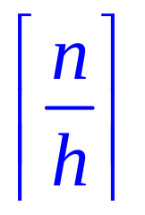
Generalized Pigeonhole Principle
Generalized Pigeonhole Principle
If n pigeons and h holes,
then some hole has at least
pigeons.
♠ ♥ ♣ ♦

Slide 21
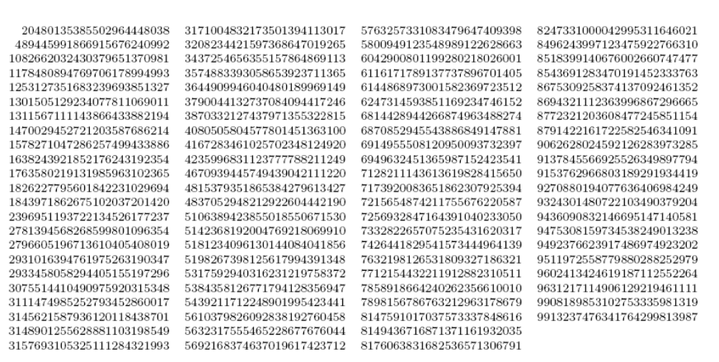
Subset Sum
Two different subsets of the 90 25-digit numbers shown above have the same sum.

Slide 22

Subset Sum
90 numbers, each with at most 25 digits.
So the total sum is at most 90x10²⁵
Let A be the set of all subsets of the 90 numbers.
(pigeons)
Let B be the set of integers from 0 to 90x10²⁵.
(pigeonholes)
By pigeonhole principle, there are two different subsets with the same sum.
This is an example of a non-constructive proof.

Slide 23
Cardinality
Functions are useful to compare the sizes of two different sets.
Question: Are all infinite sets having the same cardinality?
Two sets A and B have the same cardinality if and only if
there is a bijection between A and B.
A set is countable if it has the same cardinality
as the set of positive integers.
When an infinite set S is countable, we denote the cardinality of S by ℕ₀, i.e., |S|= ℕ₀

Slide 24
Integers vs Positive Integers
Is the set of integers countable?
Define a bijection between the positive integers and all integers
1 2 3 4 5 6 7 8 . . .
0 1 −1 2 −2 3 −3 4 . . .
n/2, if n is even;
−(n − 1)/2, if n is odd.
f(n) =
So, the set of integers is countable.

Slide 25
Odd Positive Integers vs Positive Integers
Is the set of odd positive integers countable?
Define a bijection between the positive integers and odd positive integers
1 2 3 4 5 6 7 8 . . .
1 3 5 7 9 11 13 15 . . .
f(n) = 2n − 1
So, the set of odd positive integers is countable.

Slide 26
Rational Numbers vs Positive Integers
Question: Is the set of rational number countable?
The set of “pair of integers” (a,b) is not smaller than the set of rational number.
We want to show that the set of “pair of integers”
is countable, by defining a bijection to the set of positive integers.
This would then imply the set of rational is countable.

Slide 27
Rational Numbers vs Positive Integers
(0, 0), (0, 1), (0,−1), (0, 2), (0,−2), (0, 3), (0,−3), . . .
(1, 0), (1, 1), (1,−1), (1, 2), (1,−2), (1, 3), (1,−3), . . .
(−1, 0),(−1, 1),(−1,−1),(−1, 2),(−1,−2),(−1, 3), (−1,−3), . . .
(2, 0), (2, 1), (2,−1), (2, 2), (2,−2), (2, 3), (2,−3), . . .
(−2, 0),(−2, 1),(−2,−1),(−2, 2),(−2,−2), (−2, 3),(−2,−3), . . .
If you map the set of positive integers to the top row first,
then you will not be able to reach the second row.
The trick is to visit the rational numbers diagonal by diagonal.
Each diagonal is finite, so eventually every pair will be visited.
Therefore, there is a bijection from the set of positive integers,
to the set of pair of integers, and so the set of rational numbers is countable.

Slide 28
Real Numbers vs Positive Integers
Question 1: Is the set of real number countable?
Theorem: No surjection mapping positive integers to real numbers.
Also, show that power sets can be proved to be uncountable.
Challenge for the Bored!!!

