Slide 1
Sets, Sequences, and Summations
Rosen 2.1, 2.2, 2.4
A
B
C
Lecture 6: October 9

Slide 2
Sets
A set is a collection of mathematical objects,
with the collection treated as a single mathematical object.
Examples:
real numbers, ℝ
complex numbers, ℂ
integers, ℤ
natural numbers ℕ
rational numbers ℚ
empty set, ∅

Slide 3
Defining Sets
Sets can be defined directly:
e.g. {1,2,4,8,16,32,…},
{CSC1209,MTH3105,…}
Order, number of occurence are not important.
e.g. {A,B,C} = {C,B,A} = {A,A,B,C,B}
A set can be an element of another set.
{1, {2}, {3,{4}} }

Slide 4
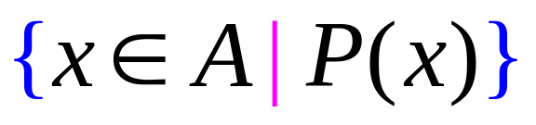
Defining Sets by Predicates
The set of elements, x, in A such that P(x) is true.
The set of prime numbers:

Slide 5

Membership
{7, “Albert”, π/2, T}
x is an element of A
x is in A
Examples:
π/2 ∈ {7, “Albert”,π/2, T}
π/3 ∉ {7, “Albert”,π/2, T}
14/2 ∉ {7, “Albert”,π/2, T}

Slide 6


Containment
A is a subset of B
A is contained in B
Every element of A is also an element of B.
A
B
A is a proper subset of B

Slide 7


Examples
Z R,
{3} {5,7,3}
∅ ⊆ every set,
A ⊆ A
prime odd
{a, {b}, c} {a, b, c}
{{b}} ≠ {b}

Slide 8
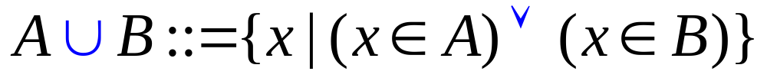
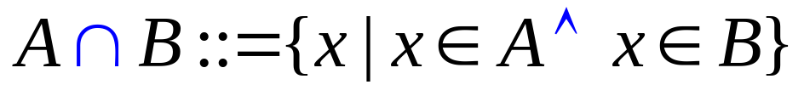
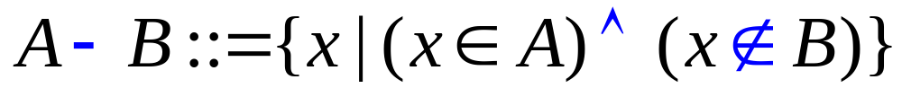
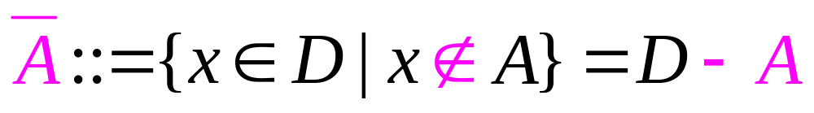
Basic Operations on Sets
union:
intersection:
difference:
complement:

Slide 9


Examples
A = {1, 3, 6, 8, 10} B = {2, 4, 6, 7, 10}
A B = {6, 10}, A B = {1, 2, 3, 4, 6, 7, 8, 10} A-B = {1, 3, 8}
A ⊕ B = ???
prime even = {2}, even odd = Ø
A = { x | x = 2k for some integer k}, B = { x | x = 3k for some integer k}
A B = { x | x = 6k for some integer k}
A B = { x | x is either a multiple of 2 or a multiple of 3 (or both) }
A – B = { x | x is even but not a multiple of 3 }
Let D be the set of integers, then A = odd

Slide 10
Partitions of Sets
Two sets are disjoint if their intersection is empty.
A collection of nonempty sets {A₁, A₂, …, A_{n}} is a partition of a set A
if and only if
A₁, A₂, …, A_{n} are mutually disjoint.
Example. Let A be the set of integers.
A₁ be the set of integers  1 (mod 3)
A₂ be the set of integers  2 (mod 3)
A₃ be the set of integers  0 (mod 3)
{A₁, A₂, A₃} is a partition of A

Slide 11
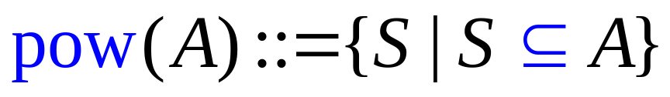
Power Sets
power set:
pow({a,b}) = {Ø, {a}, {b}, {a,b}}
pow({a,b,c}) = {Ø, {a}, {b}, {c}, {a,b}, {a,c}, {b,c}, {a,b,c}}
pow({a,b,c,d}) = {Ø, {a}, {b}, {c}, {d},
{a,b}, {a,c}, {b,c}, {a,d}, {b,d}, {c,d},
{a,b,c}, {a,b,d}, {a,c,d}, {b,c,d}, {a,b,c,d}}
If A has n elements, then the pow(A) has 2^{n} elements.

Slide 12
Set Identities
Distributive Law:
(1)
(2)
A
B
A
B
C
C
(1)
(2)

Slide 13

Set Identities
Distributive Law:
If you insist on proving this law more formally…
S₁
S₂
A
S₃
B
S₄
S₅
S₆
S₇
C
There are even more formal proofs in the textbook…

Slide 14



Set Identities
De Morgan’s Law:

Slide 15

Set Identities
De Morgan’s Law:

Slide 16
Exercises

Slide 17
Sequences - 2.4
Ordered list of elements
  e.g., 1, 2, 3, 5, 8 is a sequence with 5 elements
  1, 3, 9, 27, 81, …, 30, …, is an infinite sequence
Sequence {a_{n}}: a function from a subset of the set of integers (usually either the set of {0, 1, 2, …} or the set {1, 2, 3, …}) to a set S
Use a_{n} to denote the image of the integer n
Call a_{n} a term of the sequence

Slide 18
Sequences
Example: {a_{n}} where a_{n}=1/n
  a₁, a₂, a₃, a₄, …
  1, ½, 1/3, ¼,…
When the elements of an infinite set can be listed, the set is called countable
We showed that the set of positive rational numbers is countable, but the set of real numbers is not

Slide 19
Geometric progression
Geometric progression: a sequence of the form
a, ar, ar², ar³,…, ar^{n}
where the initial term a and common ratio r are real numbers
Can be written as f(x)=a ∙ r^{x}
The sequences {b_{n}} with b_{n}=(-1)^{n}, {c_{n}} with c_{n}=2∙5^{n}, {d_{n}} with d_{n}=6 ∙(1/3)^{n} are geometric progression
  b_{n} : 1, -1, 1, -1, 1, …
  c_{n}: 2, 10, 50, 250, 1250, …
  d_{n:} 6, 2, 2/3, 2/9, 2/27, …

Slide 20
Arithmetic progression
Arithmetic progression: a sequence of the form
  a, a+d, a+2d, …, a+nd
  where the initial term a and the common difference d are real numbers
Can be written as f(x)=a+dx
{s_{n}} with s_{n}=-1+4n, {t_{n}} with t_{n}=7-3n
  {s_{n}}: -1, 3, 7, 11, …
  {t_{n}}: 7, 4, 1, -2, …

Slide 21
Recurrence relations
Express a_{n} in terms of one or more of the previous terms of the sequence
Example: a_{n}=a_{n-1}+3 for n=1,2,3,… and a₁=2
  a₂=a₁+3=2+3=5, a₃=a₂+3=(2+3)+3=2+3x2=8, a₄=a₃+3=(2+3+3)+3=2+3+3+3=2+3x3=11
  a_{n}=2+3(n-1)
  a_{n}=a_{n-1}+3=(a_{n-2}+3)+3=a_{n-2}+3x2
  =(a_{n-3}+3)+3x2=a_{n-3}+3x3
  =a₂+3(n-2)=(a₁+3)+3(n-2)=2+3(n-1)

Slide 22
Fibonacci sequence
f₀=0, f₁=1, f_{n}=f_{n-1}+f_{n-2}, for n=2, 3, 4
  f₂=f₁+f₀=1+0=1
  f₃=f₂+f₁=1+1=2
  f₄=f₃+f₂=2+1=3
  f₅=f₄+f₃=3+2=5
  f₆=f₅+f₄=5+3=8
  …

Slide 23
Special integer sequences
Finding some patterns among the terms
Are terms obtained from previous terms
  by adding the same amount or an amount depends on the position in the sequence?
  by multiplying a particular amount?
  By combining previous terms in a certain way?
  In some cycle?
Examples
Find formulate for the sequences with the following 5 terms
  1, ½, ¼, 1/8, 1/16
  1, 3, 5, 7, 9
  1, -1, 1, -1, 1
The first 10 terms: 1, 2, 2, 3, 3, 3, 4, 4, 4, 4
The first 10 terms: 5, 11, 17, 23, 29, 35, 41, 47, 53, 59

Slide 24
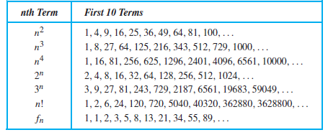
More Examples
Conjecture a simple formula for {a_{n}} where the first 10 terms are:
1, 7, 25, 79, 241, 727, 2185, 6559, 19681, 59047
© Rosen 2.4 Table 1

Slide 25
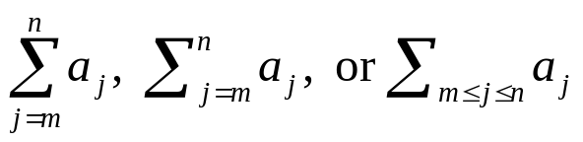

Summations
The sum of terms: a_{m}, a_{m+1}, …, a_{n} from {a_{n}}
that represents
  Here j is the index of summation (can be replaced arbitrarily by i or k)
  The index runs from the lower limit m to upper limit n
  The usual laws for arithmetic applies

Slide 26
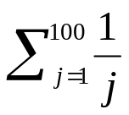


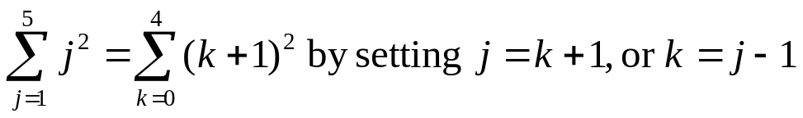
Examples
Express the sum of the first 100 terms of the sequence {a_{n}} where a_{n}=1/n, n=1, 2, 3, …
What is the value of
What is the value of
Shift index:

Slide 27
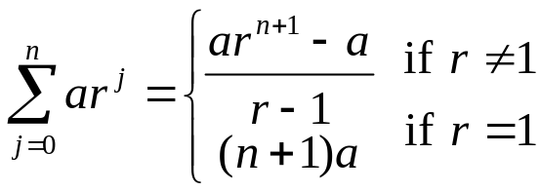
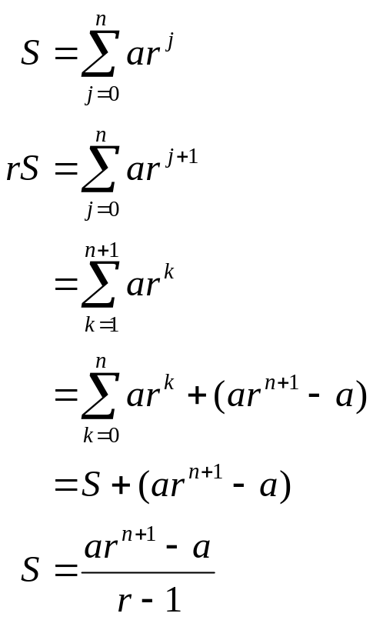
Geometric series
Geometric series: sums of geometric progressions

Slide 28
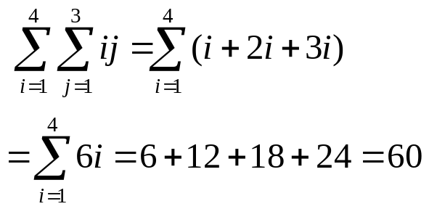
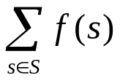
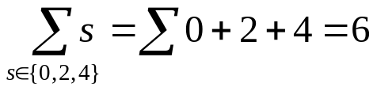
Double summations
Often used in programs
Can also write summation to add values of a function of a set

Slide 29
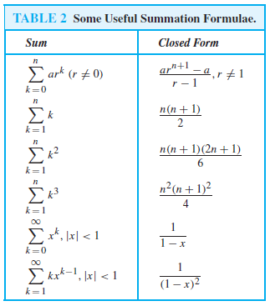
© Rosen 2.4 Table 2

Slide 30
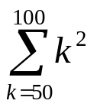
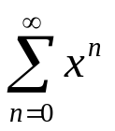
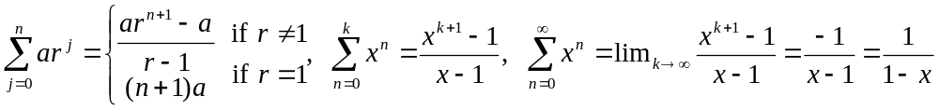
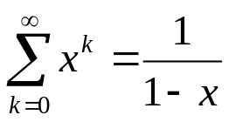
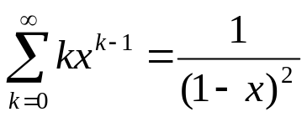
Examples
Find
Let x be a real number with |x|<1, Find
Differentiating both sides of

Slide 31
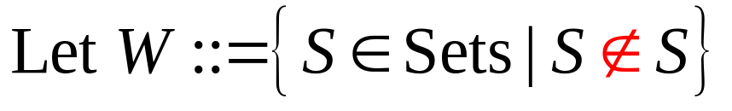
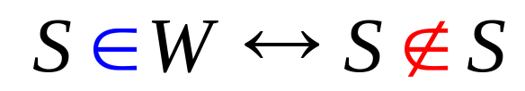
Russell’s Paradox
so
Is W in W?
Let us call a set "abnormal" if it is a member of itself, and "normal" otherwise
For example, take the set of all squares. That set is not itself a square, and therefore is not a member of the set of all squares. So it is "normal"
On the other hand, if we take the complementary set that contains all non-squares, that set is itself not a square and so should be one of its own members. It is "abnormal"

Slide 32
Halting Problem
Now we study one of the most famous problems in computer science.
The halting problem: Can we write a program which detects infinite loop?
We want a program H that given any program P and input I:
H(P,I) returns “halt” if P will terminate given input I;
H(P,I) returns “loop forever” if P will not terminate given input I.
The halting problem: Does such a program H exist?
Note that the program H can not just simulate the program P on input I;
if P halts on I, then H can return halt successfully;
but if P loops forever on I, then H will also loop forever.

Slide 33
Halting Problem
We want a program H that given any program P and input I:
H(P,I) returns “halt” if P will terminate given input I;
H(P,I) returns “loop forever” if P will not terminate given input I.
The halting problem: Does such a program H exist?
Prove by contradiction:
Suppose, by way of contradiction, that H exists.
Both P and I are binary strings.
H should be able to determine if P will terminate given itself as the input.
That is, H(P,P) will either returns “halt” or “loop forever”.

Slide 34
Barber’s Paradox
There is a male barber who shaves all those men,
and only those men,
who do not shave themselves.
Does the barber shave himself?
If the barber does not shave himself, he must abide by the rule and shave himself
If he does shave himself, according to the rule he will not shave himself

