Slide 1
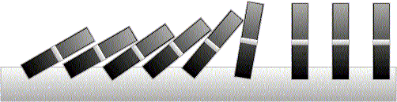
Induction
Rosen 5
Lecture 8: December 06

Slide 2


Odd Powers Are Odd
Fact: If m is odd and n is odd, then nm is odd.
Proposition: for an odd number m, m^{k} is odd for all non-negative integer k.
Let P(i) be the proposition that m^{i} is odd.
Idea of induction.
P(1) is true by definition.
P(2) is true by P(1) and the fact.
P(3) is true by P(2) and the fact.
P(i+1) is true by P(i) and the fact.
So P(i) is true for all i.

Slide 3
Divisibility by a Prime
Theorem. Any integer n > 1 is divisible by a prime number.
Let n be an integer.
If n is a prime number, then we are done.
Otherwise, n = ab, both are smaller than n.
If a or b is a prime number, then we are done.
Otherwise, a = cd, both are smaller than a.
If c or d is a prime number, then we are done.
Otherwise, repeat this argument, since the numbers are
getting smaller and smaller, this will eventually stop and
we have found a prime factor of n.
We have seen this Example already!

Slide 4
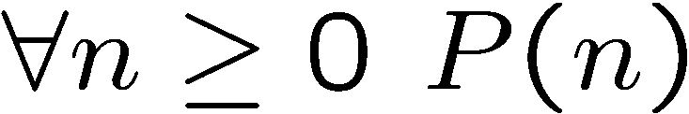
Idea of Induction
Objective: Prove
This is to prove
The idea of induction is to first prove P(0) unconditionally,
then use P(0) to prove P(1)
then use P(1) to prove P(2)
and repeat this to infinity…

Slide 5
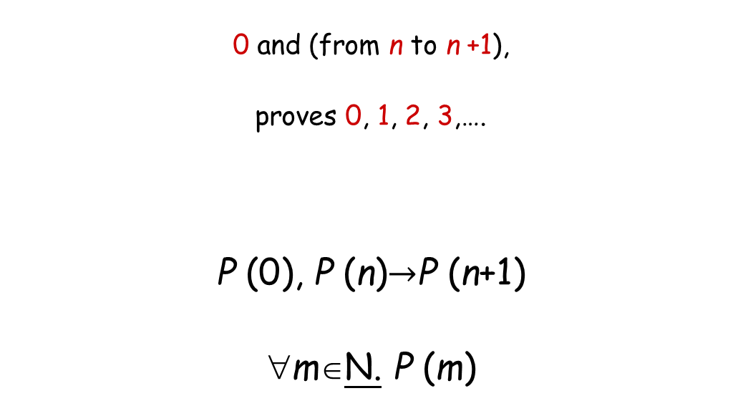
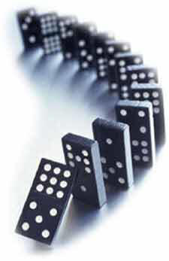
The Induction Rule
Much easier to prove with P(n) as an assumption.
Very easy to prove
For any n>=0
Like domino effect…

Slide 6
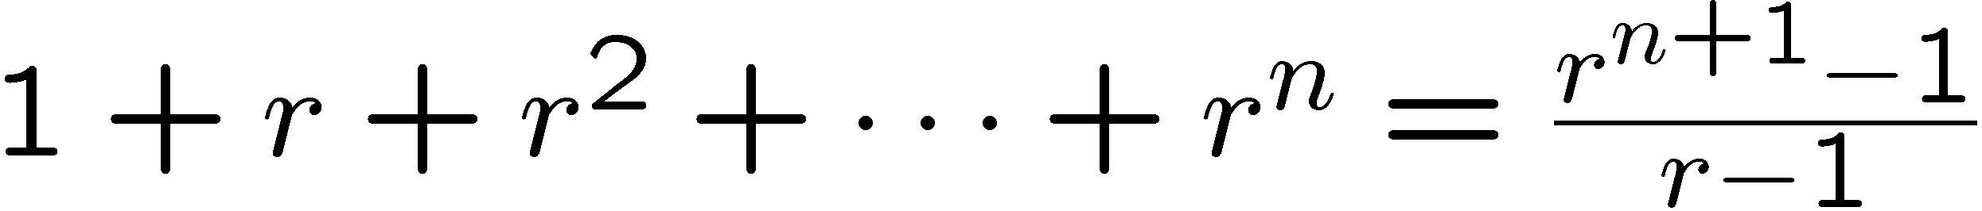

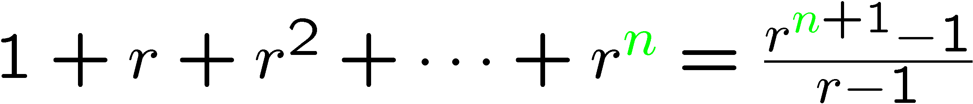
Proof by Induction
Let’s prove:
Statements in green form a template for inductive proofs.
Proof: (by induction on n)
The induction hypothesis, P(n), is:

Slide 7
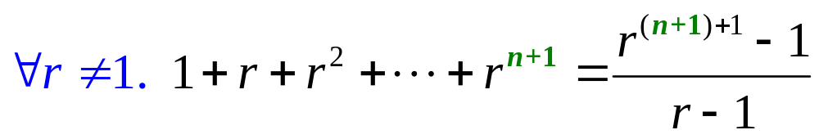
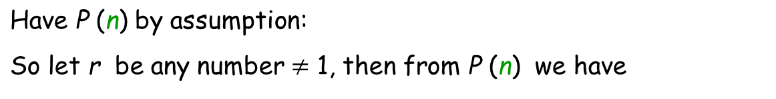
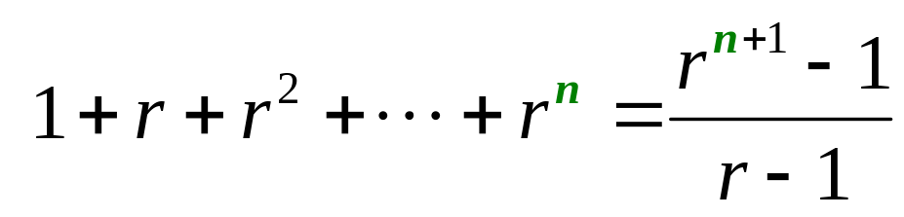
Proof by Induction
Induction Step: Assume P(n) for some n ≥ 0 and prove P(n + 1):
How do we proceed?

Slide 8
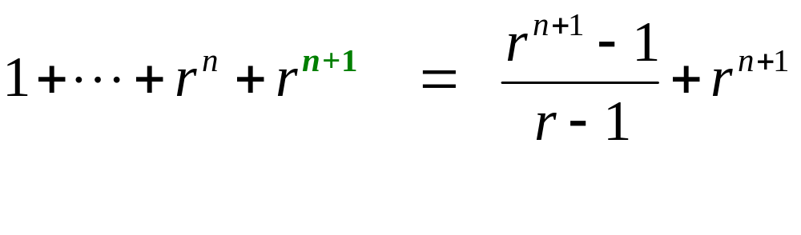
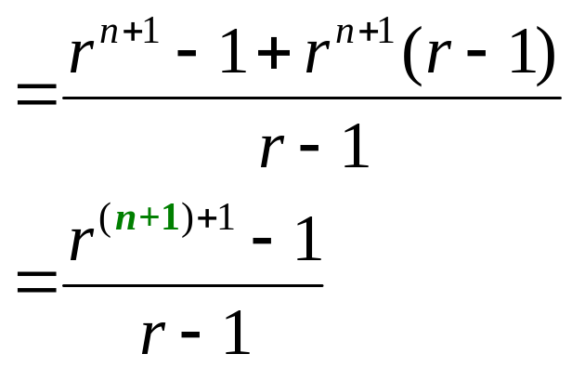
Proof by Induction
adding r ^{n+1} to both sides,
which is P (n+1). This completes the induction proof.

Slide 9
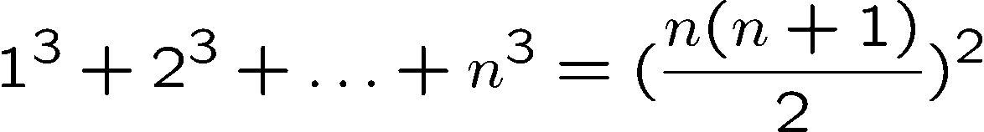

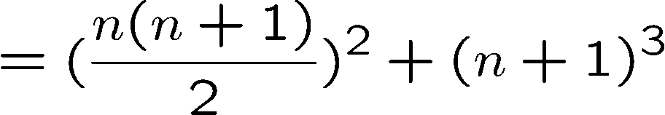

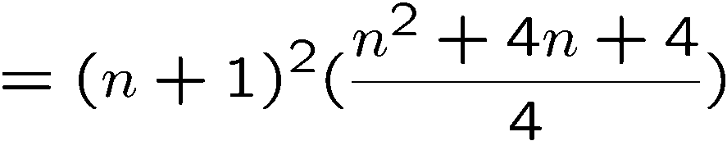
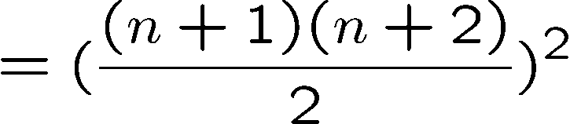
Proving a Summation
Let P(n) be the induction hypothesis that the statement is true for n.
Base case: P(1) is true
Induction step: assume P(n) is true, prove P(n+1) is true.
by induction

Slide 10
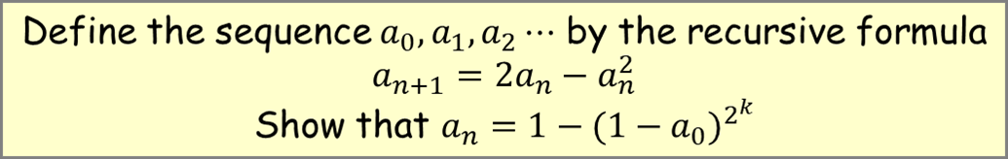





Proving an Equality
Induction step: assume P(n) is true, prove P(n+1) is true.
by induction

Slide 11






Proving a Property
Base Case (n = 1):
Induction Step: Assume P(i) for some i ≥ 1 and prove P(i + 1):
Assume
is divisible by 3, prove
Is divisible by 3.
Divisible by 3
Divisible by 3 by induction

Slide 12









Proving an Inequality
Base Case (n = 3):
Induction Step: Assume P(i) for some i ≥ 3 and prove P(i + 1):
Assume
, prove
by induction
since i >= 3

Slide 13
Unstacking Game
Start: a stack of boxes
Move: split any stack into two stacks of sizes a,b>0
Scoring: ab points
Keep moving: until stuck
Overall score: sum of move scores
a+b
a
b

Slide 14
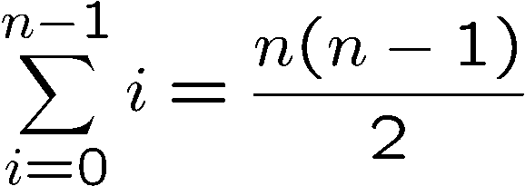
Unstacking Game
What is the best way to play this game?
Suppose there are n boxes.
What is the score if we just take the box one at a time?
n
n-1
1

Slide 15
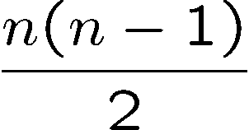
Unstacking Game
What is the best way to play this game?
2n
n
n
Suppose there are n boxes.
What is the score if we cut the stack into half each time?
Not better than the first strategy!
Say n=8, then the score is 1x4x4 + 2x2x2 + 4x1 = 28
first round
second
third
Say n=16, then the score is 8x8 + 2x28 = 120

Slide 16
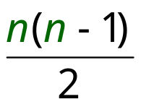
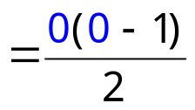
Unstacking Game
Claim: Every way of unstacking gives the same score.
Claim: Starting with size n stack, final score will be
Proof: by Induction with Claim(n) as hypothesis
Base case n = 0:
score = 0
Claim(0) is okay.

Slide 17
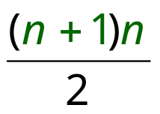
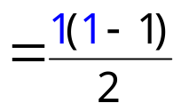
Unstacking Game
Inductive step. assume for n-stack,
and then prove C(n+1):
(n+1)-stack score =
Case n+1 = 1. verify for 1-stack:
score = 0
C(1) is okay.

Slide 18
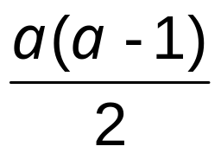
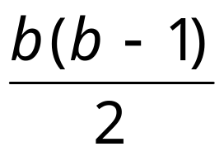
Unstacking Game
Case n+1 > 1. So split into an a-stack and b-stack,
where a + b = n +1.
(a + b)-stack score = ab + a-stack score + b-stack score
by induction:
a-stack score =
b-stack score =

Slide 19
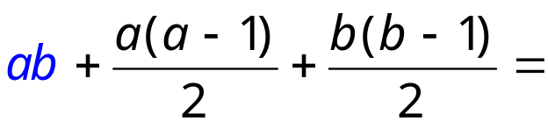
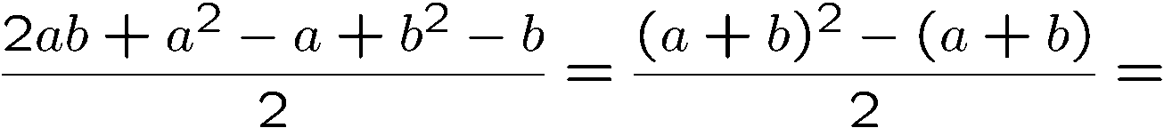
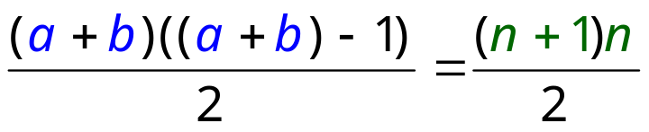
Unstacking Game
(a + b)-stack score = ab + a-stack score + b-stack score
so C(n+1) is okay.
We’re done!

Slide 20
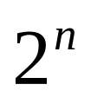

Puzzle
Goal: tile the squares, except one in the middle for Bill.

Slide 21

Puzzle
There are only L-shaped tiles covering three squares:
For example, for 8 x 8 puzzle might tile for Bill this way:

Slide 22

Puzzle
Theorem: For any 2^{n} x 2^{n} puzzle, there is a tiling with Bill in the middle.
Did you remember that we proved
is divisble by 3?
Proof: (by induction on n)
P(n) ::= can tile 2^{n} x 2^{n} with Bill in middle.
Base case: (n=0)
(no tiles needed)

Slide 23
Puzzle
Induction step: assume can tile 2^{n} x 2^{n},
prove can handle 2^{n+1} x 2^{n+1}.
Now what??
+
1
n
2

Slide 24
Strong Induction
Strong induction
Prove P(0).
Then prove P(n+1) assuming all of
P(0), P(1), …, P(n) (instead of just P(n)).
Conclude n.P(n)
equivalent
Ordinary induction
0 → 1, 1 → 2, 2 → 3, …, n-1 → n.
So by the time we got to n+1, already know all of
P(0), P(1), …, P(n)

Slide 25
Prime Products
Claim: Every integer > 1 is a product of primes.
Proof: (by strong induction)
Base case is easy.
Suppose the claim is true for all 2 <= i < n.
Consider an integer n.
If n is prime, then we are done.
So n = k·m for integers k, m where n > k,m >1.
Since k,m smaller than n,
By the induction hypothesis, both k and m are product of primes
        k = p₁⋅ p₂⋅ ⋅ ⋅ p₉₄
        m = q₁⋅ q₂⋅ ⋅ ⋅ q₂₁₄

Slide 26
Prime Products
Claim: Every integer > 1 is a product of primes.
…So
n = k⋅ m = p₁⋅ p₂⋅ ⋅ ⋅ p₉₄⋅ q₁⋅ q₂⋅ ⋅ ⋅ q₂₁₄
is a prime product.
∴ This completes the proof of the induction step.

Slide 27
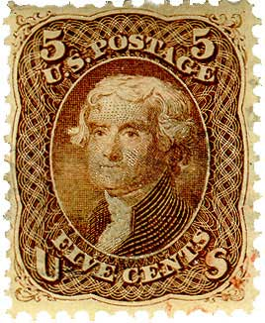

Postage by Strong Induction
Available stamps:
5¢
3¢
What amount can you form?
Theorem: Can form any amount ≥ 8¢
Prove by strong induction on n.
P(n) ::= can form (n +8)¢.
Challenge for the Bored!

