Slide 1
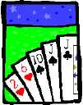
Basic Counting
Lecture 9: November 13

Slide 2
Sum Rule
A
B
If sets A and B are disjoint, then
|A ∪ B| = |A| + |B|
Class has 43 women, 54 men, so total enrollment = 43 + 54 = 97
26 lower case letters, 26 upper case letters, and 10 digits,
so total characters = 26+26+10 = 62

Slide 3

Product Rule
Given two sets A and B, the Cartisean product
If |A| = m and |B| = n, then
|A × B| = mn.
A = {a, b, c, d}, B = {1, 2, 3}
A × B = {(a,1),(a,2),(a,3),
(b,1),(b,2),(b,3),
(c,1),(c,2),(c,3),
(d,1),(d,2),(d,3) }
If there are 4 men and 3 women, there are
possible married couples.

Slide 4
Product Rule: Counting Strings
The number of length-4 strings from alphabet B ::= {0,1}
  = |B × B × B × B|
  = 2 · 2 · 2 · 2 = 2⁴
m^{n}.
The number of length-n strings from an alphabet of size m is

Slide 5
Example: Counting Passwords
How many passwords satisfy the following requirements?
between 6 & 8 characters long
starts with a letter
case sensitive
other characters: digits or letters
L ::= {a,b,…,z,A,B,…,Z}
D ::= {0,1,…,9}

Slide 6
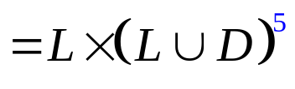

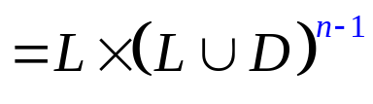
Example: Counting Passwords
L ::= {a,b,…,z,A,B,…,Z}
D ::= {0,1,…,9}
P₆ =

Slide 7
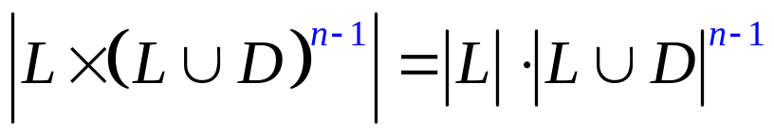
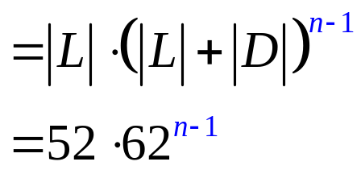
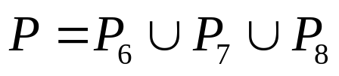
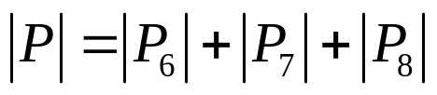

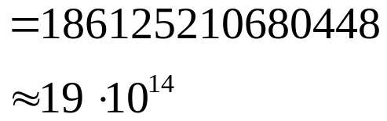
Example: Counting Passwords
The set of Passwords:

Slide 8
At Least One Seven
How many # 4-digit numbers with at least one 7?
count by 1st occurrence of 7:
  7xxx + o7xx + oo7x + ooo7
  10³ + 9·10² + 9²·10 + 9³ = 3439
Method 1:
(counting by partitioning)
Method 2:
|4-digit numbers with at least one 7|=
|4-digit numbers| - |those with no 7s|
= 10⁴ – 9⁴
= 3439
(counting the complement)

Slide 9
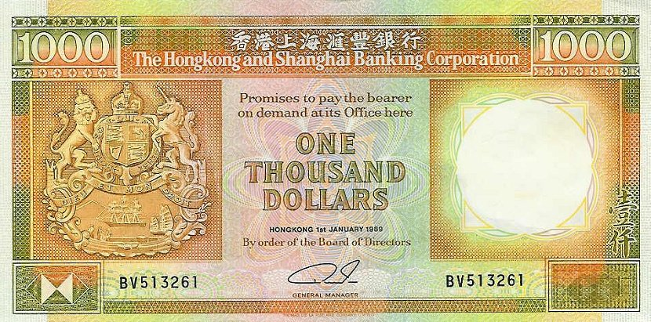
Defective Dollars
A dollar is defective if some digit appears
more than once in the 6-digit serial number.
How common are nondefective dollars?

Slide 10
Defective Dollars
How common are nondefective dollars?
10 possible choices for the first digit,
9 possible choices for the second digit, and so on…
So, there are 10x9x8x7x6x5
= 151200 serial number with all its digit different
There are totally 10⁶ = 1000000 serial numbers.
So, only about 15% of dollars are nondefective.

Slide 11
Generalized Product Rule
Q a set of length-k sequences. If there are:
n₁ possible 1st elements in sequences,
n₂ possible 2nd elements for each first entry,
n₃ possible 3rd elements for each 1st & 2nd,
…
then,
|Q| = n₁ · n₂ · n₃ · … · n_{k}

Slide 12
Permutations
A permutation of a set S is a sequence that
contains every element of S exactly once.
For example, here are all six permutations of the set {a, b, c}:
(a, b, c) (a, c, b) (b, a, c)
(b, c, a) (c, a, b) (c, b, a)
How many permutations of an n-element set are there?

Slide 13
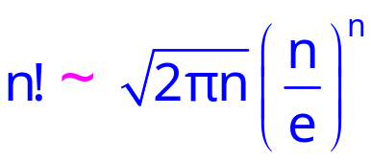
Permutations
How many permutations of an n-element set are there?
There are n choices for the first element.
For each of these, there are n − 1 remaining choices for
the second element.
For every combination of the first two elements, there
are n − 2 ways to choose the third element, and so forth.
Thus, there are a total of
n · (n − 1) · (n − 2) · · · 3 · 2 · 1 = n!
permutations of an n-element set.
Stirling’s formula:

Slide 14
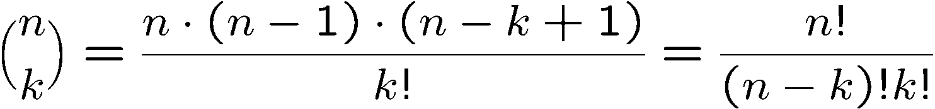
Combinations
How many subsets of k elements of an n-element set?
There are n choices for the first element.
For each of these, there are n − 1 remaining choices for
the second element.
There are n – k + 1 remaining choices for the last element.
Thus, there are a total of
n · (n − 1) · (n − 2) · · · (n – k + 1) to choose k elements.

Slide 15
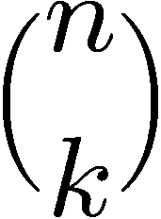
Splitting into 2 Sets
How many n-bit sequences contain k zeros and (n − k) ones?
Once the positions of k zeros are fixed,
the positions of (n-k) ones are fixed.
How many ways to split 12 people into 3 groups of 4 people?

Slide 16
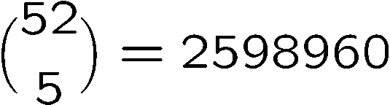
Poker Hands
There are 52 cards in a deck.
Each card has a suit and a value.
(♠ ♥ ♦ ♣)
4 suits
13 values
(2, 3, 4, 5, 6, 7, 8, 9, 10, J, Q, K, A)
Five-Card Draw is a card game in which each player
is initially dealt a hand, a subset of 5 cards.
How many different hands?

Slide 17
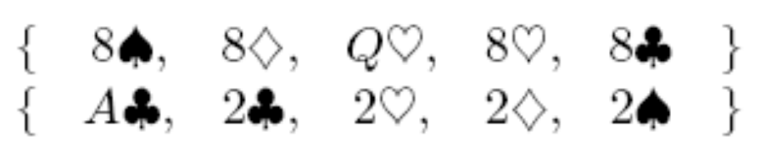
Example 1: Four of a Kind
A Four-of-a-Kind is a set of four cards with the same value.
How many different hands contain a Four-of-a-Kind?

Slide 18

Example 1: Four of a Kind
A hand with a Four-of-a-Kind is completely described by a sequence specifying:
1. The value of the four cards.
2. The value of the extra card.
3. The suit of the extra card.
There are 13 choices for (1), 12 choices for (2), and 4 choices for (3).
By generalized product rule, there are 13x12x4 = 624 hands.
Only 1 hand in about 4165 has a Four-of-a-Kind!

Slide 19
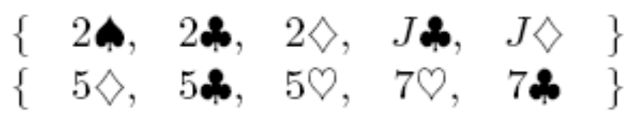
Example 2: Full House
A Full House is a hand with three cards of one value and two cards of another value.
How many different hands contain a Full House?

Slide 20
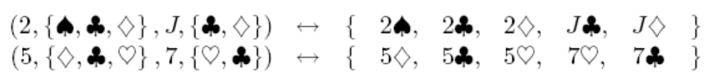
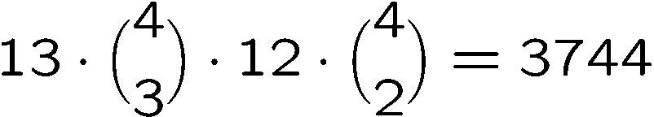
Example 2: Full House
There is a bijection between Full Houses and sequences specifying:
1. The value of the triple, which can be chosen in 13 ways.
2. The suits of the triple, which can be selected in (4 3) ways.
3. The value of the pair, which can be chosen in 12 ways.
4. The suits of the pair, which can be selected in (4 2) ways.
By generalized product rule, there are
Only 1 hand in about 634 has a Full House!

Slide 21

Example 3: Two Pairs
How many hands have Two Pairs; that is,
two cards of one value, two cards of another value, and one card of a third value?

Slide 22
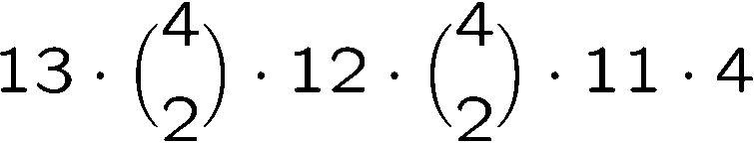
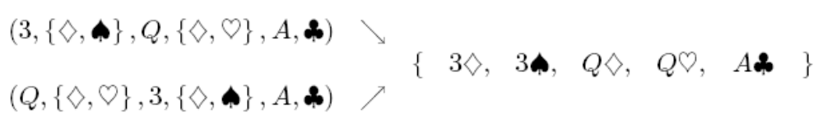
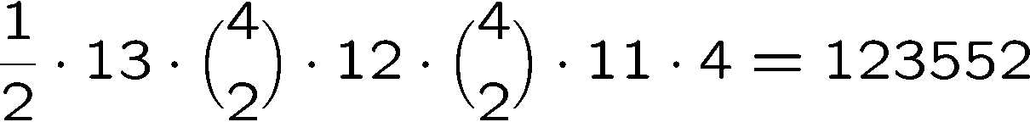
Example 3: Two Pairs
1. The value of the first pair, which can be chosen in 13 ways.
2. The suits of the first pair, which can be selected (4 2) ways.
3. The value of the second pair, which can be chosen in 12 ways.
4. The suits of the second pair, which can be selected in (4 2) ways
5. The value of the extra card, which can be chosen in 11 ways.
6. The suit of the extra card, which can be selected in 4 ways.
Number of Two pairs =
Double
Count!
So the answer is

Slide 23

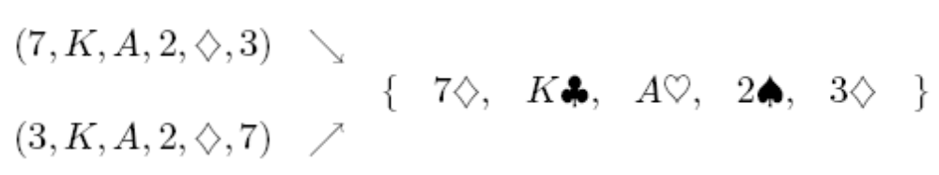
Example 4: Every Suit
How many hands contain at least one card from every suit?
1. The value of each suit, which can be selected in 13x13x13x13 ways.
2. The suit of the extra card, which can be selected in 4 ways.
3. The value of the extra card, which can be selected in 12 ways.
Double count!
So the answer is 13⁴x4x12/2 = 685464

Slide 24
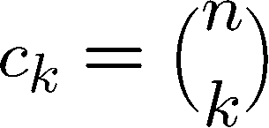
Binomial Theorem
We can compute the coefficients by simple counting arguments.
n times
Each term corresponds to selecting 1 or x from each of the n factors.
c_{k} is number of terms with exactly k x’s are selected from n factors.

Slide 25
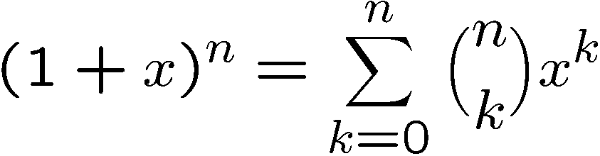
Binomial Theorem
(1+X)⁰ =
1
(1+X)¹ =
1 + 1X
(1+X)² =
1 + 2X + 1X²
(1+X)³ =
1 + 3X + 3X² + 1X³
(1+X)⁴ =
1 + 4X + 6X² + 4X³ + 1X⁴

Slide 26
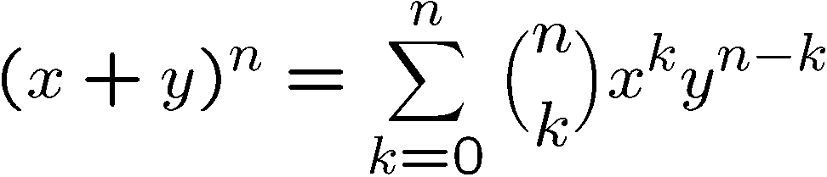
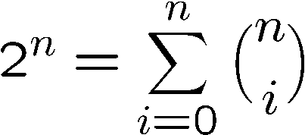
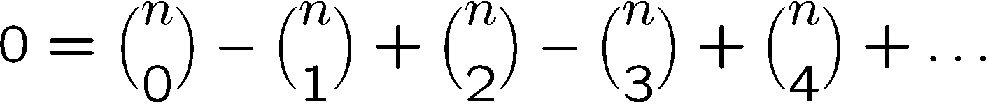
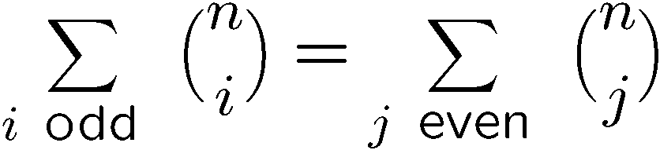
Binomial Coefficients
In general we have the following identity:
When x=1, y=1, it says that
When x=1, y=-1, it says that

Slide 27
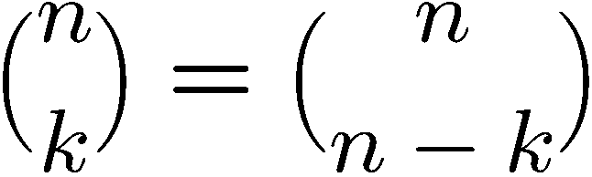
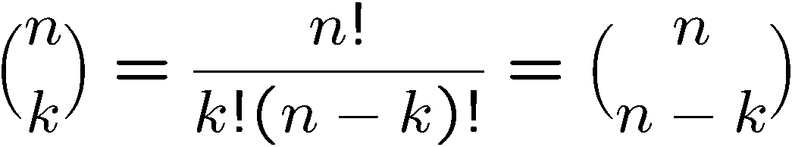
Proving Identities
Direct proof:
Combinatorial proof:
Number of ways to choose k items from n items
= number of ways to choose n-k items from n items

Slide 28
Finding a Combinatorial Proof
A combinatorial proof is an argument that establishes an algebraic fact by relying on counting principles.
Many such proofs follow the same basic outline:
1. Define a set S.
2. Show that |S| = n by counting one way.
3. Show that |S| = m by counting another way.
4. Conclude that n = m.
Double counting

Slide 29
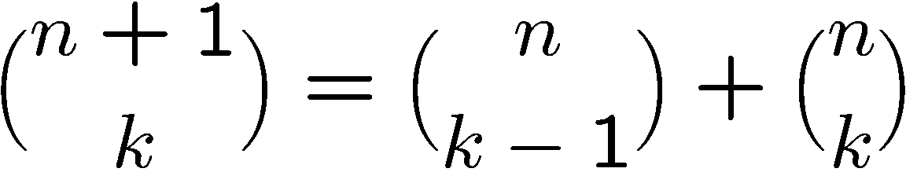
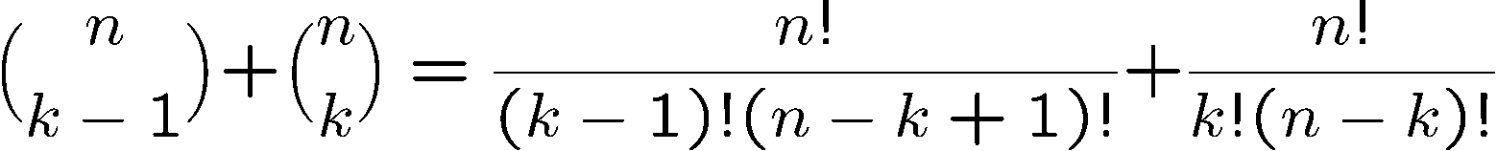
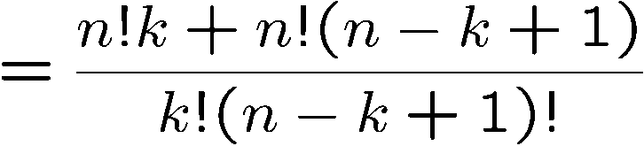
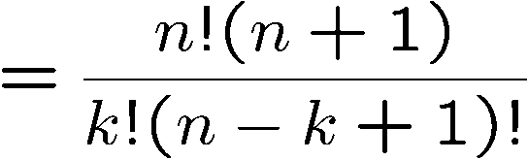
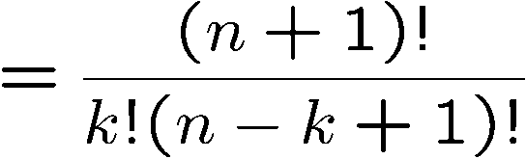
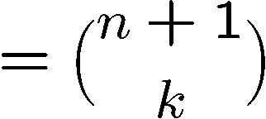
Proving Identities
Pascal’s Formula
Direct proof:
Direct proof:

Slide 30
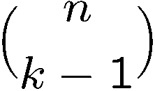

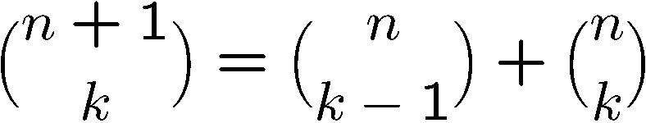
Proving Identities
Pascal’s Formula
Combinatorial proof:
The LHS is number of ways to choose k elements from n+1 elements.
Let the first element be x.
If we choose x, then we need to choose k-1 elements
from the remaining n elements, and number of ways to do so is
If we don’t choose x, then we need to choose k elements
from the remaining n elements, and number of ways to do so is
This partitions the ways to choose k elements from n+1 elements,
therefore

Slide 31
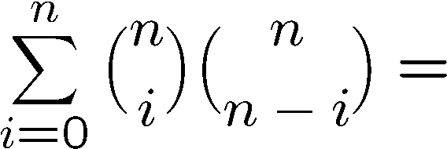
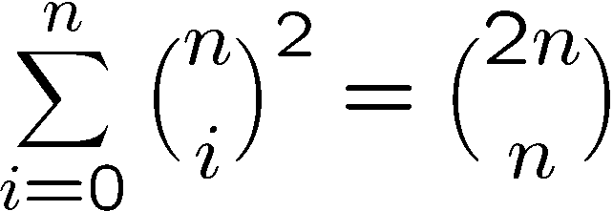
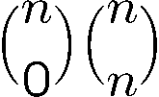
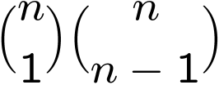
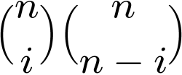
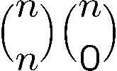
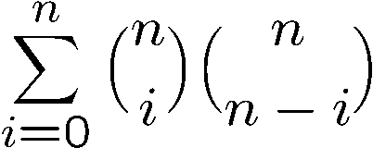
Combinatorial Proof
Consider we have 2n balls, n of them are red, and n of them are blue.
The RHS is number of ways to choose n balls from the 2n balls.
To choose n balls, we can
- choose 0 red ball and n blue balls, number of ways =
- choose 1 red ball and n-1 blue balls, number of ways =
…
choose i red balls and n-i blue balls, number of ways =
…
choose n red balls and 0 blue ball, number of ways =
Hence number of ways to choose n balls is also equal to

Slide 32
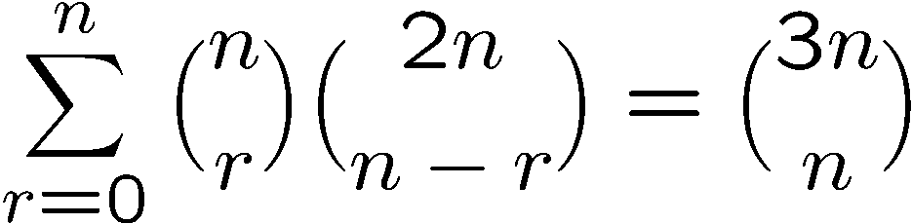
More Combinatorial Proof
Let S be all n-card hands that can be dealt from a deck containing
n red cards (numbered 1, . . . , n) and 2n black cards (numbered 1, . . . , 2n).
The right hand side = # of ways to choose n cards from these 3n cards.
The left hand side = # of ways to choose r cards from red cards x
# of ways to choose n-r cards from black cards
= # of ways to choose n cards from these 3n cards
= the right hand side.

