Slide 1
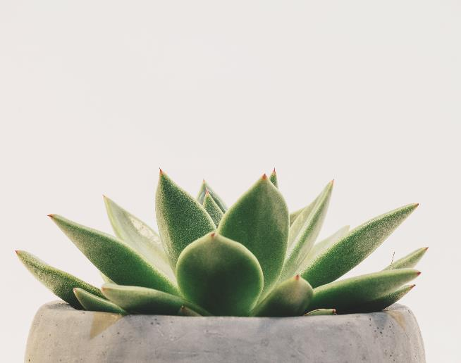
pLant it
My Anniversary
My Tree

Slide 2
Problem ID : PID638
Challenge Title : My Celebration – My Tree
Name of the Office : R C Technical Institute Ahmedabad
Challenge
Description with
Context : A Mobile App to donate, plant a Tree on celebratory occasions like
Birthday, Anniversary etc.
Users : General Public, AMC/City Plantation Team, Industry Organization
Team
Expected Outcomes : A Mobile app for
General public through which they can book to plant a tree.
AMC / City Plantation team to Track requirements
Industry Organization team to manage funds and Plantation requirements
General Public to track their tagged tree status
Selfie with my tree feature
Impact : Green cover of Ahmedabad City will improve.

Slide 3

About Us
Plant It has a mission for enhancing environmentally sound policies and practices. A new initiative with an aim to maintain and enhance the natural, eco system. It includes human development objectives. The idea of Plant It is having a global approach for friendly environment making progress on social and environment development as well. As vivid management helps the economy in reducing ecological scarcities, Plant It aims to make contribution to the green economy; Plant It is highly active in enhancing of sustainable development globally.
“The hope of thousands of leaves starts from one leaf”
Our initiative is to spread greenery on each and event event of our registered member. Whether it's your birthday, anniversary or any other function in your family, you can book any plant of your choice and Plant It will deliver the plant to your address. Plant it in your house or near by and you'll get reminders to post a picture to track the growth of the plant at some intervals of time.

Slide 4
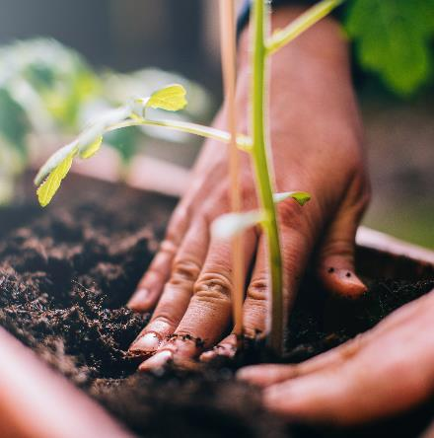
THE PLANTING CYCLE
PLANTING
FEEDING
WATERING
HARVESTING

Slide 5
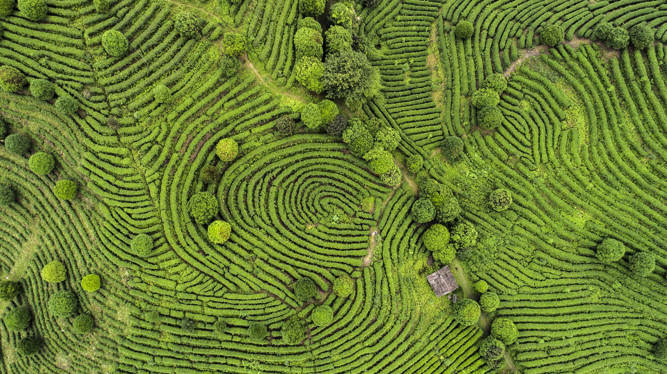
Contact us
Email : plantit1212@gmail.com
Phone : 7984548502,
9879633351
Created By : Patel Hely

