Slide 1
Boat

Slide 2
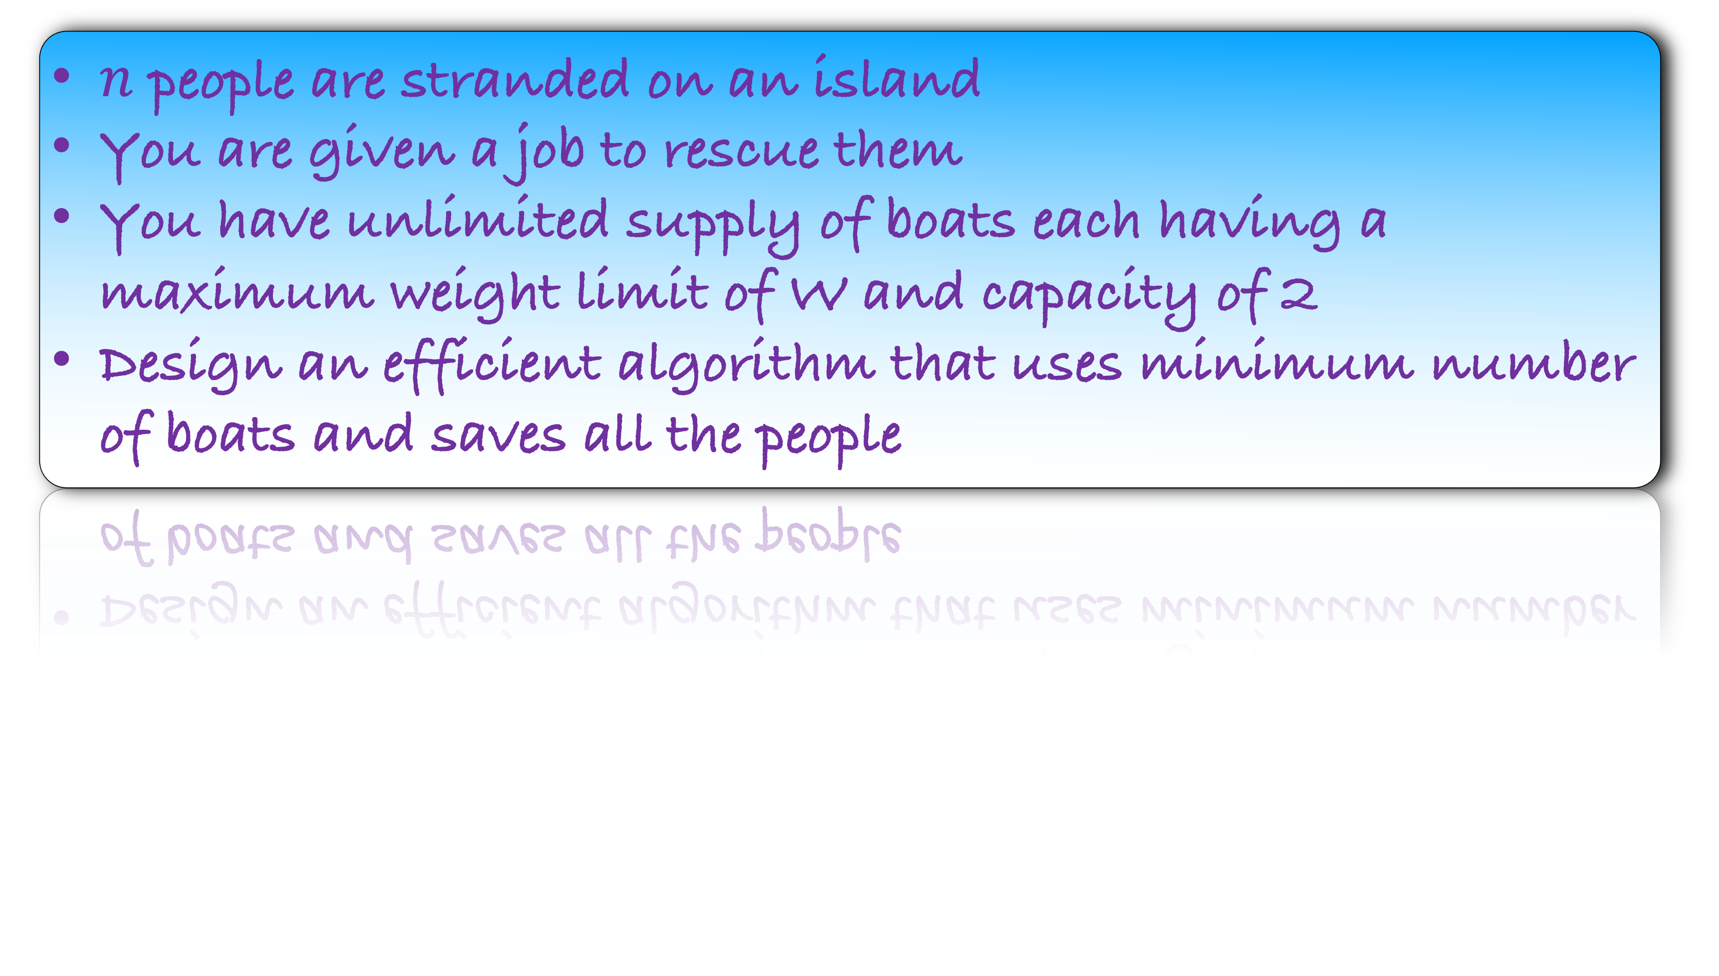
$n$ people are stranded on an island
You are given a job to rescue them
You have unlimited supply of boats each having a maximum weight limit of W and capacity of 2
Design an efficient algorithm that uses minimum number of boats and saves all the people
This is one of the ”easy” problems in the problem set
But its analysis may not be so easy
How would you solve this problem?

Slide 3
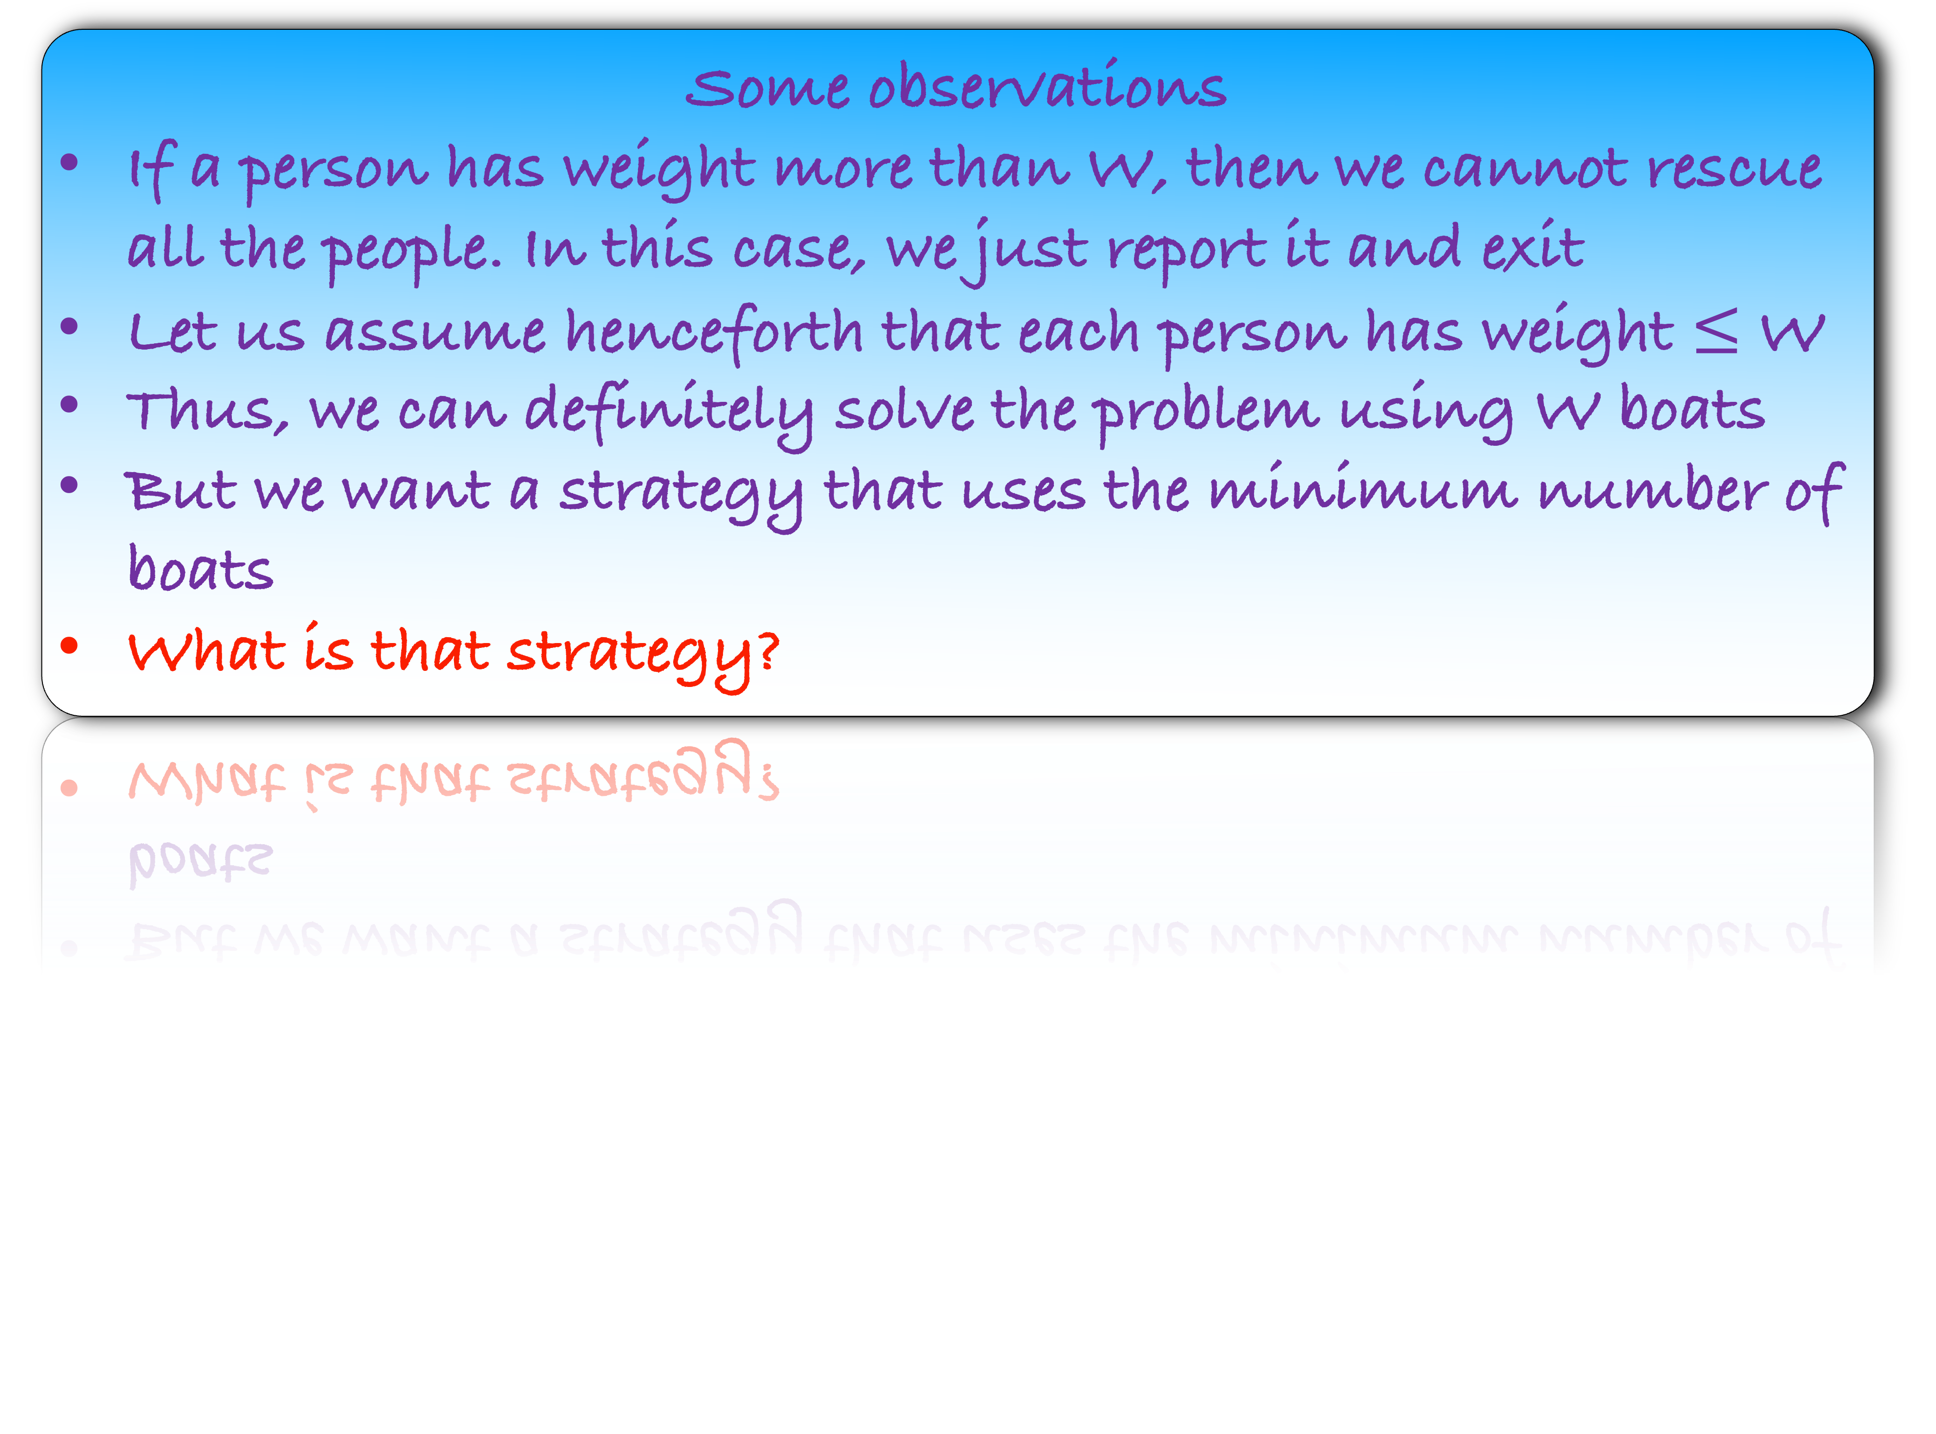
Some observations
If a person has weight more than W, then we cannot rescue all the people. In this case, we just report it and exit
Let us assume henceforth that each person has weight $≤$ W
Thus, we can definitely solve the problem using W boats
But we want a strategy that uses the minimum number of boats
What is that strategy?
Look at the person with maximum weight
It makes sense to pair this person with

Slide 4
Some observations
If a person has weight more than W, then we cannot rescue all the people. In this case, we just report it and exit
Let us assume henceforth that each person has weight $≤$ W
Thus, we can definitely solve the problem using W boats
But we want a strategy that uses the minimum number of boats
What is that strategy?
Look at the person with maximum weight
It makes sense to pair this person with minimum weight person, if possible.

Slide 5








20
10
40
5
30
2
15
40

Slide 6
40
30
20
15
10
5
2
40

Slide 7
30
20
15
10
5
2
40
40
40

Slide 8
30
20
15
10
5
2
40
40
40

Slide 9
20
15
10
5
2
30
40

Slide 10
20
15
10
5
30
2
40
40

Slide 11
20
15
10
5
30
2
40
40

Slide 12
15
10
20
5
40
40

Slide 13
15
10
20
5
40
40

Slide 14
Implementation
15
10
40

Slide 15
Implementation
15
10
40

Slide 16
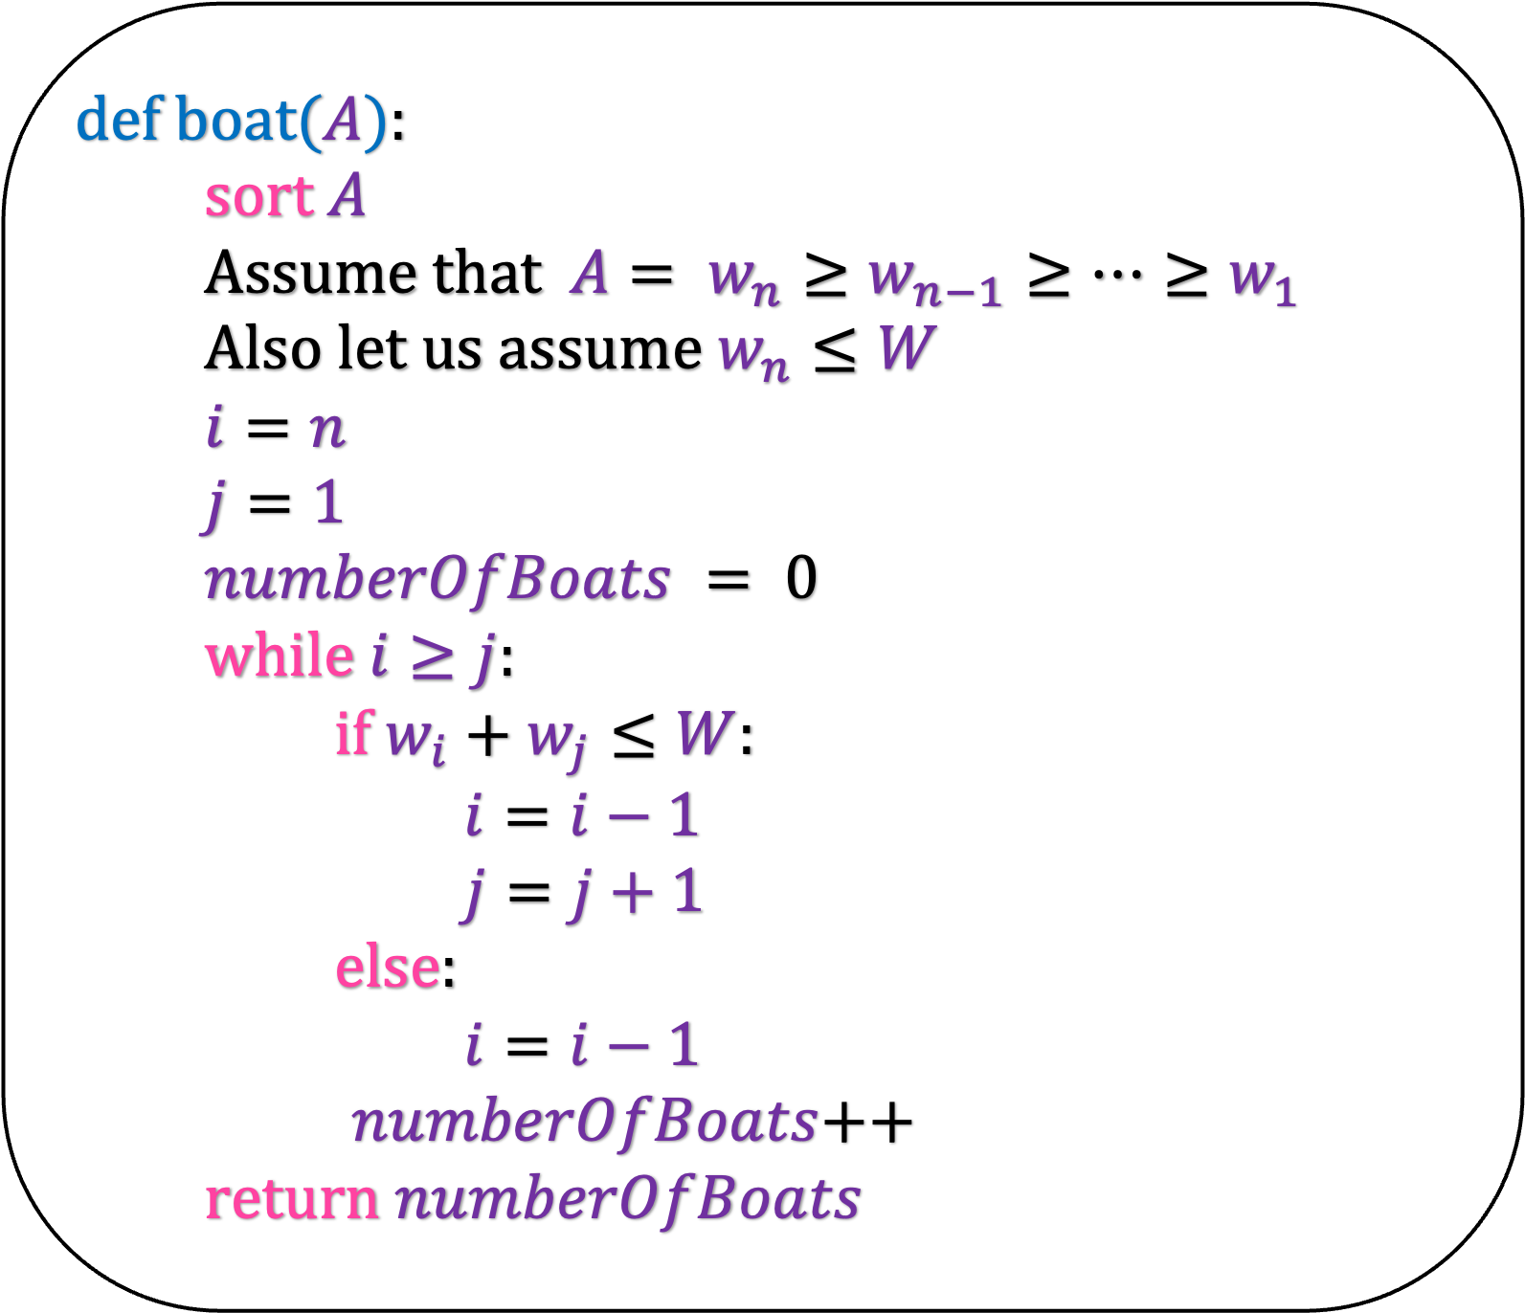
def b$oat(A$):
sort $A$
Assume that $A= w_{n}≥w_{n−1}≥…≥w_{1}$
Also let us assume $w_{n}≤W$
$i=n$
$j=1$
$numberOfBoats = 0$
while $i≥j$:
if $w_{i}+w_{j}≤W$:
$i=i−1$
$j=j+1$
else:
$i=i−1$
$numberOfBoats$++
return $numberOfBoats$
Disclaimer:
This program may not run for some corner cases
Check if there are any corner case errors and try to write a bug-free version of the program

Slide 17

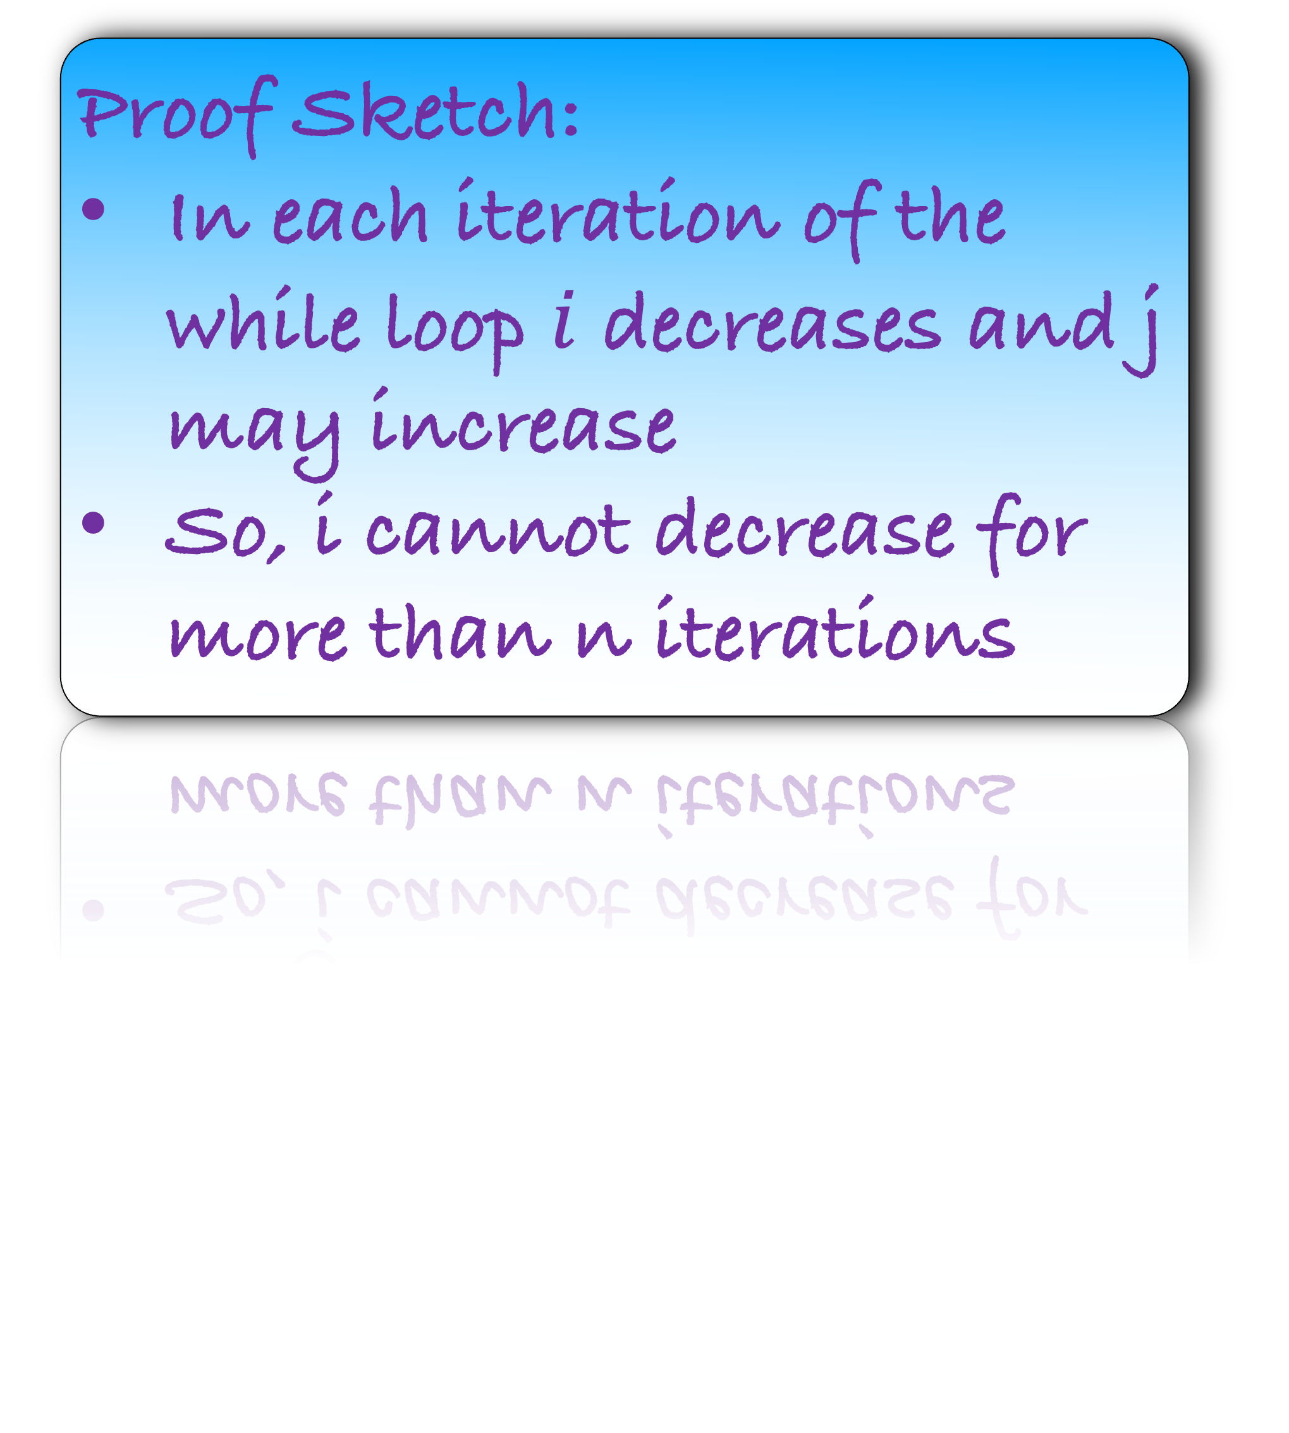

def b$oat(A$):
sort $A$
Assume that $A= w_{n}≥w_{n−1}≥…≥w_{1}$
Also let us assume $w_{n}≤W$
$i=n$
$j=1$
$numberOfBoats = 0$
while $i≥j$:
if $w_{i}+w_{j}≤W$:
$i=i−1$
$j=j+1$
else:
$i=i−1$
$numberOfBoats$++
return $numberOfBoats$
O($n\log{n}$)
Proof Sketch:
In each iteration of the while loop $i$ decreases and j may increase
So, i cannot decrease for more than n iterations
O($n$)
What is the running time of this algorithm?

Slide 18
Correctness

Slide 19
How would you prove that your algorithm is correct?
Proof Strategy:
Greedy stays ahead: But what is the measure?
Exchange argument
Take-Away
Even for such a simple problem, the analysis is not easy
One has to think hard to find a pattern in our algorithm

Slide 20

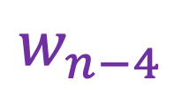

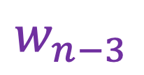


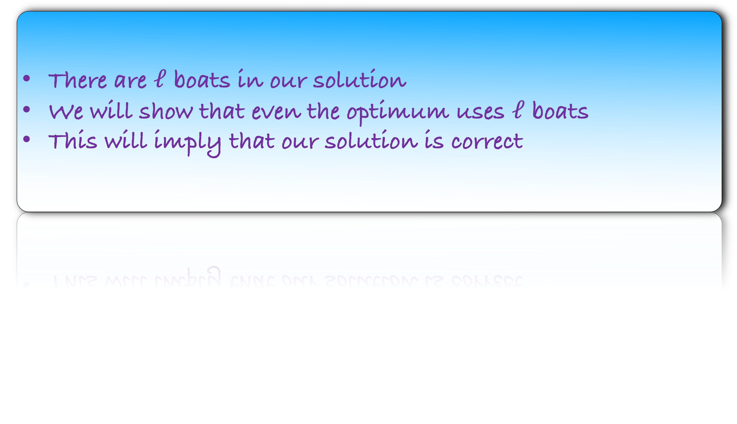
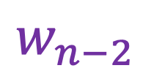
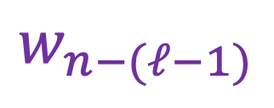



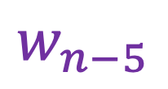
$$w_{n}$$
$$w_{n−1}$$
$$w_{n−2}$$
$$w_{n−3}$$
$$w_{n−4}$$
$$w_{n−5}$$
$$…$$
$$w_{n−(ℓ−1)}$$
$$w_{1}$$
$$w_{2}$$
$$w_{3}$$
$$w_{n−ℓ}$$
There are $ℓ$ boats in our solution
We will show that even the optimum uses $ℓ$ boats
This will imply that our solution is correct

Slide 21
$$w_{n}$$
$$w_{n−1}$$
$$w_{n−2}$$
$$w_{n−3}$$
$$w_{n−4}$$
$$w_{n−5}$$
$$…$$
$$w_{n−(ℓ−1)}$$
$$w_{1}$$
$$w_{2}$$
$$w_{3}$$
$$w_{n−ℓ}$$
In our solution, we have sorted the boats by the weight of heaviest person aboard
Let us imagine the OPT, again sorted by the weight of heaviest person aboard

Slide 24

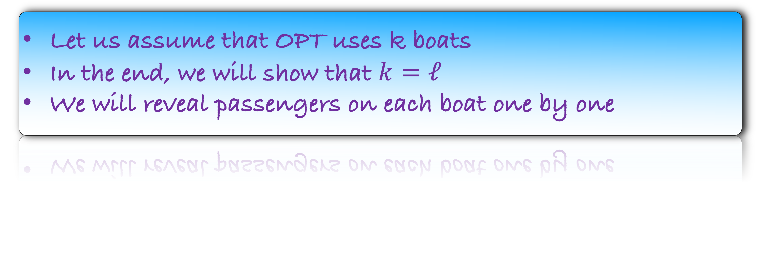

Our Solution
$$w_{n}$$
$$w_{n−1}$$
$$w_{n−2}$$
$$w_{n−3}$$
$$w_{n−4}$$
$$w_{n−5}$$
$$…$$
$$w_{n−(ℓ−1)}$$
$$w_{1}$$
$$w_{2}$$
$$w_{3}$$
$$w_{n−ℓ}$$
$$…$$
OPT
Let us assume that OPT uses k boats
In the end, we will show that $k=ℓ$
We will reveal passengers on each boat one by one

Slide 25
Our Solution
$$w_{n}$$
$$w_{n−1}$$
$$w_{n−2}$$
$$w_{n−3}$$
$$w_{n−4}$$
$$w_{n−5}$$
$$…$$
$$w_{n−(ℓ−1)}$$
$$w_{1}$$
$$w_{2}$$
$$w_{3}$$
$$w_{n−ℓ}$$
$$…$$
OPT
Who is surely on the first boat of OPT?

Slide 26
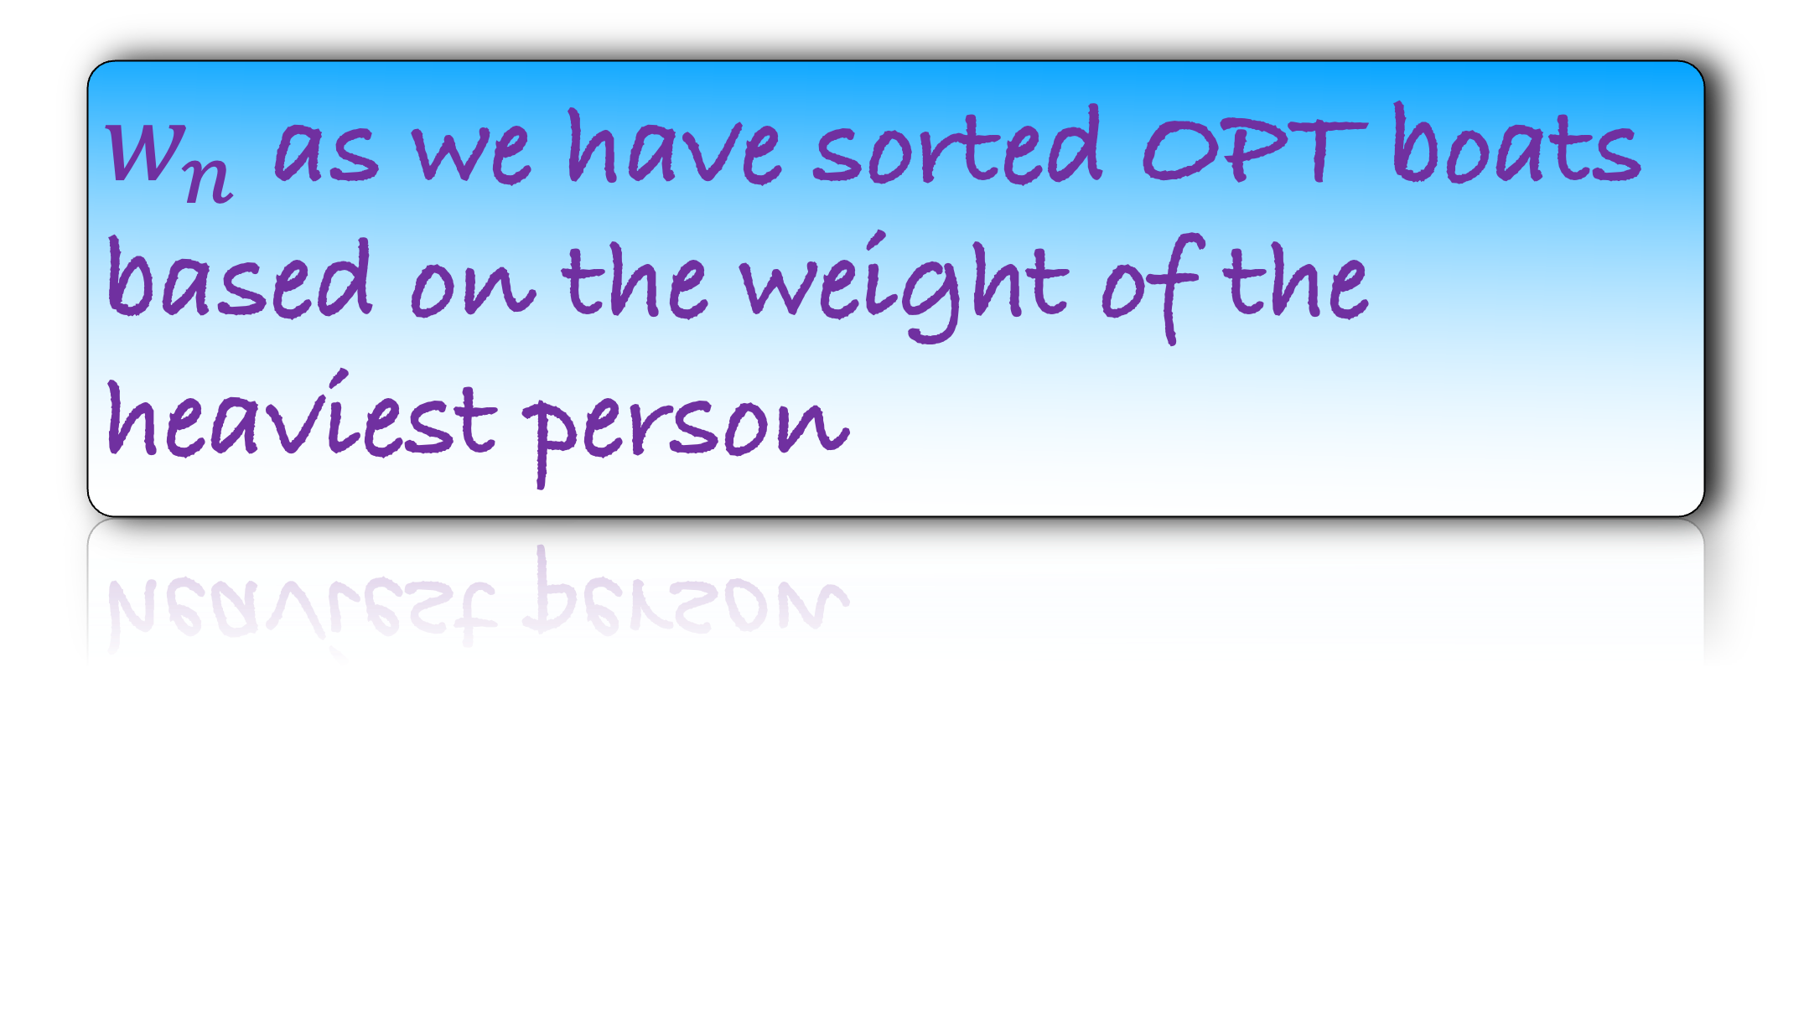

Our Solution
$$w_{n}$$
$$w_{n−1}$$
$$w_{n−2}$$
$$w_{n−3}$$
$$w_{n−4}$$
$$w_{n−5}$$
$$…$$
$$w_{n−(ℓ−1)}$$
$$w_{1}$$
$$w_{2}$$
$$w_{3}$$
$$w_{n−ℓ}$$
$$w_{n}$$
$$…$$
OPT
Who is surely on the first boat of OPT?
$w_{n}$ as we have sorted OPT boats based on the weight of the heaviest person

Slide 27
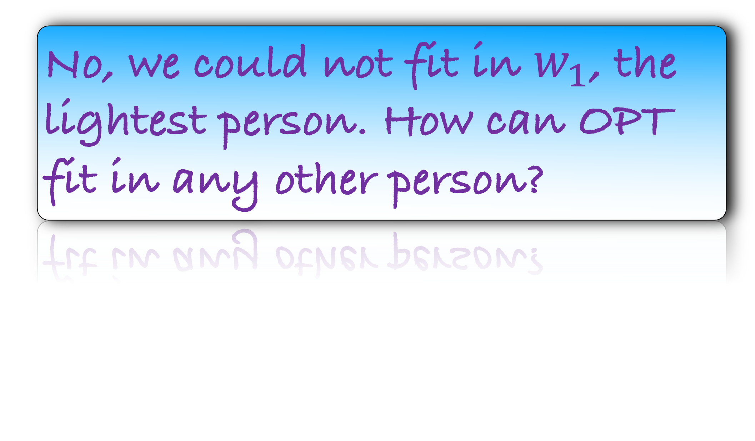
Our Solution
$$w_{n}$$
$$w_{n−1}$$
$$w_{n−2}$$
$$w_{n−3}$$
$$w_{n−4}$$
$$w_{n−5}$$
$$…$$
$$w_{n−(ℓ−1)}$$
$$w_{1}$$
$$w_{2}$$
$$w_{3}$$
$$w_{n−ℓ}$$
$$w_{n}$$
$$…$$
OPT
Is there any other person on the first boat of OPT?
No, we could not fit in $w_{1}$, the lightest person. How can OPT fit in any other person?

Slide 28

Our Solution
$$w_{n}$$
$$w_{n−1}$$
$$w_{n−2}$$
$$w_{n−3}$$
$$w_{n−4}$$
$$w_{n−5}$$
$$…$$
$$w_{n−(ℓ−1)}$$
$$w_{1}$$
$$w_{2}$$
$$w_{3}$$
$$w_{n−ℓ}$$
$$w_{n}$$
$$…$$
OPT
Lemma: There exists an optimum solution where the first boat is the same as ours

Slide 29
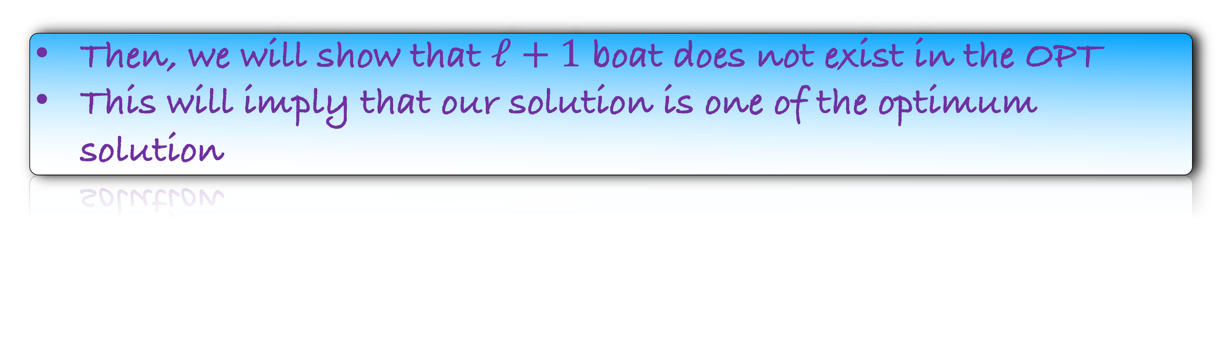
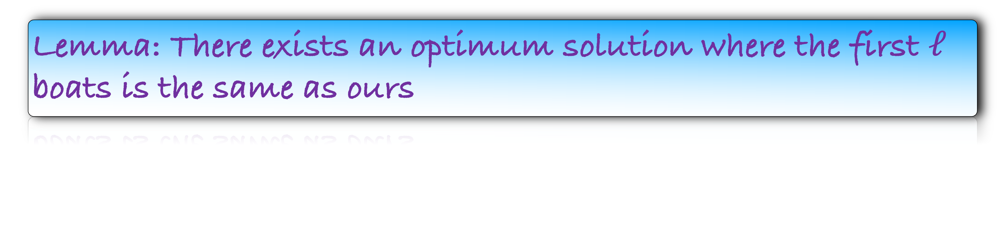
Lemma: There exists an optimum solution where the first boat is the same as ours
Lemma: There exists an optimum solution where the first and second boat is the same as ours
Lemma: There exists an optimum solution where the first $ℓ$ boats is the same as ours
Then, we will show that $ℓ+1$ boat does not exist in the OPT
This will imply that our solution is one of the optimum solution
This is the exchange argument

Slide 30


Our Solution
$$w_{n}$$
$$w_{n−1}$$
$$w_{n−2}$$
$$w_{n−3}$$
$$w_{n−4}$$
$$w_{n−5}$$
$$…$$
$$w_{n−(ℓ−1)}$$
$$w_{1}$$
$$w_{2}$$
$$w_{3}$$
$$w_{n−ℓ}$$
$$w_{n}$$
$$…$$
OPT
Time to reveal the second boat

Slide 31
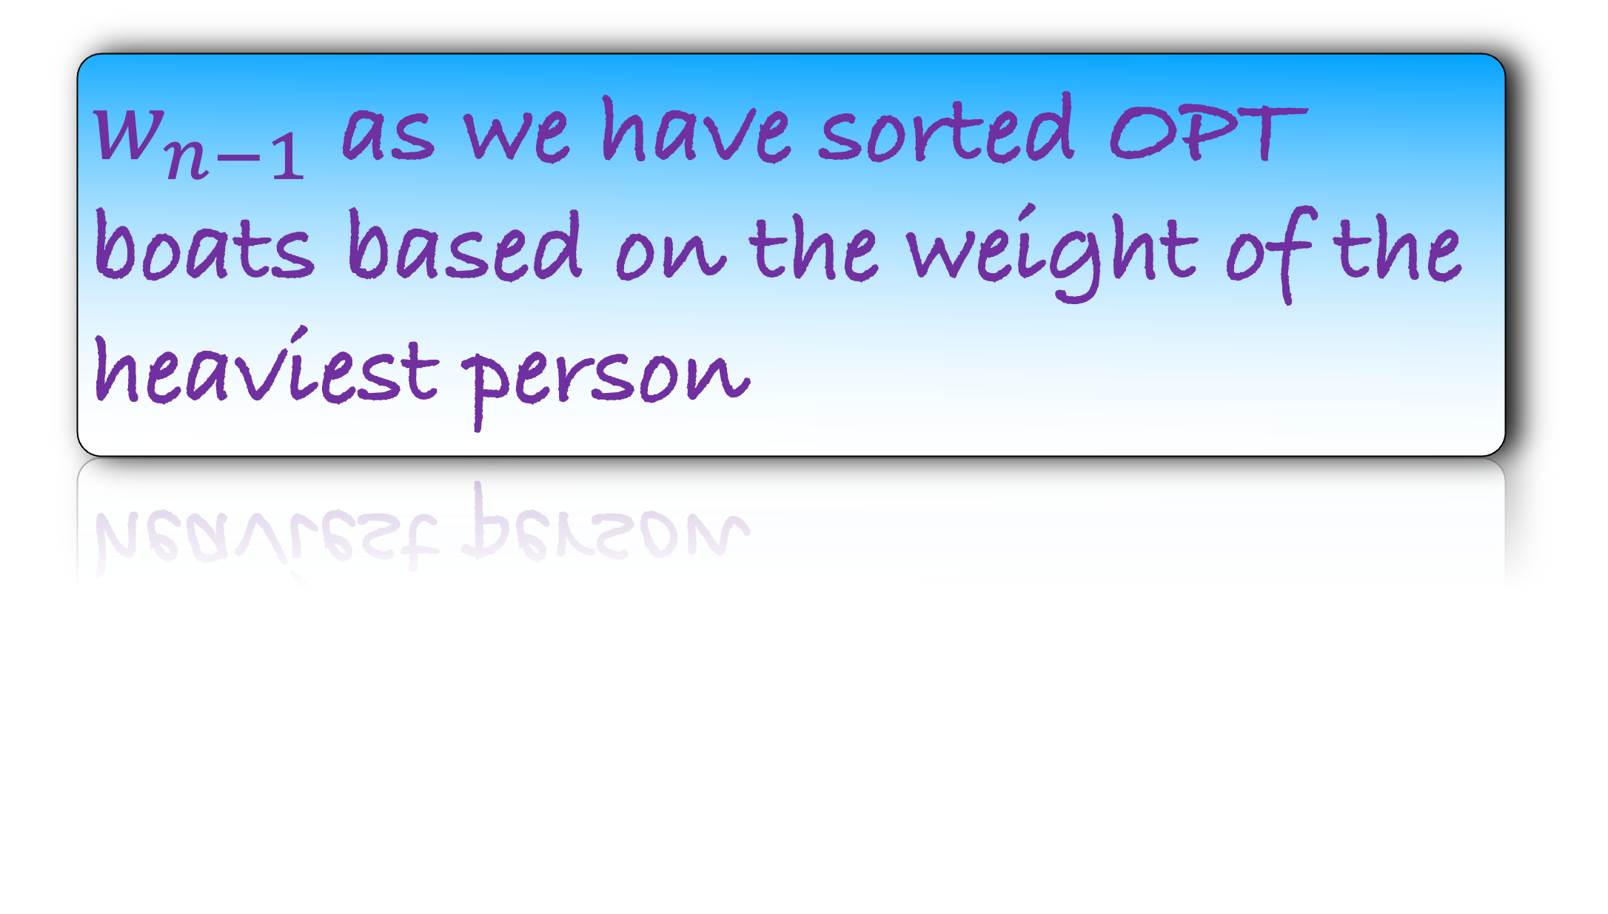
Our Solution
$$w_{n}$$
$$w_{n−1}$$
$$w_{n−2}$$
$$w_{n−3}$$
$$w_{n−4}$$
$$w_{n−5}$$
$$…$$
$$w_{n−(ℓ−1)}$$
$$w_{1}$$
$$w_{2}$$
$$w_{3}$$
$$w_{n−ℓ}$$
$$w_{n}$$
$$w_{n−1}$$
$$…$$
OPT
Who is surely on the second boat of OPT?
$w_{n−1}$ as we have sorted OPT boats based on the weight of the heaviest person

Slide 32
Our Solution
$$w_{n}$$
$$w_{n−1}$$
$$w_{n−2}$$
$$w_{n−3}$$
$$w_{n−4}$$
$$w_{n−5}$$
$$…$$
$$w_{n−(ℓ−1)}$$
$$w_{1}$$
$$w_{2}$$
$$w_{3}$$
$$w_{n−ℓ}$$
$$w_{n}$$
$$w_{n−1}$$
$$…$$
OPT
Is there any other person on the second boat of OPT?
No, we could not fit in $w_{1}$, the lightest person. How can OPT fit in any other person?

Slide 33
Our Solution
$$w_{n}$$
$$w_{n−1}$$
$$w_{n−2}$$
$$w_{n−3}$$
$$w_{n−4}$$
$$w_{n−5}$$
$$…$$
$$w_{n−(ℓ−1)}$$
$$w_{1}$$
$$w_{2}$$
$$w_{3}$$
$$w_{n−ℓ}$$
$$w_{n}$$
$$w_{n−1}$$
$$…$$
OPT
Lemma: There exists an optimum solution where the first and second boat is the same as ours
Time to reveal the third boat

Slide 34

Our Solution
$$w_{n}$$
$$w_{n−1}$$
$$w_{n−2}$$
$$w_{n−3}$$
$$w_{n−4}$$
$$w_{n−5}$$
$$…$$
$$w_{n−(ℓ−1)}$$
$$w_{1}$$
$$w_{2}$$
$$w_{3}$$
$$w_{n−ℓ}$$
$$w_{n}$$
$$w_{n−1}$$
$$w_{n−2}$$
$$…$$
OPT
Is there any other person on the third boat of OPT?
May be or may not be
In fact there can be three cases

Slide 35
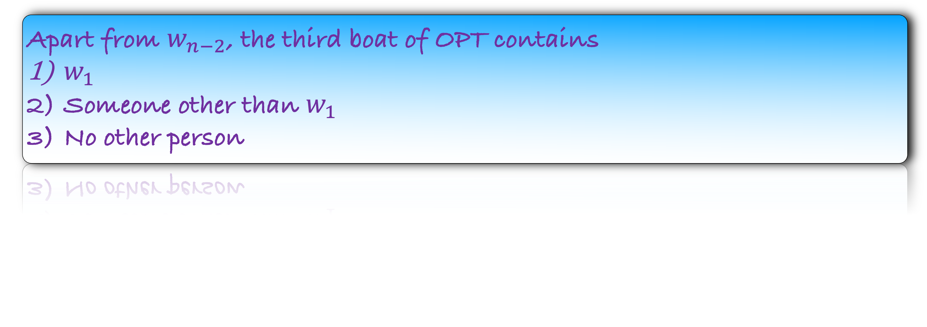
Our Solution
$$w_{n}$$
$$w_{n−1}$$
$$w_{n−2}$$
$$w_{n−3}$$
$$w_{n−4}$$
$$w_{n−5}$$
$$…$$
$$w_{n−(ℓ−1)}$$
$$w_{1}$$
$$w_{2}$$
$$w_{3}$$
$$w_{n−ℓ}$$
$$w_{n}$$
$$w_{n−1}$$
$$w_{n−2}$$
$$…$$
OPT
Apart from $w_{n−2}$, the third boat of OPT contains
$w_{1}$
Someone other than $w_{1}$
No other person

Slide 36

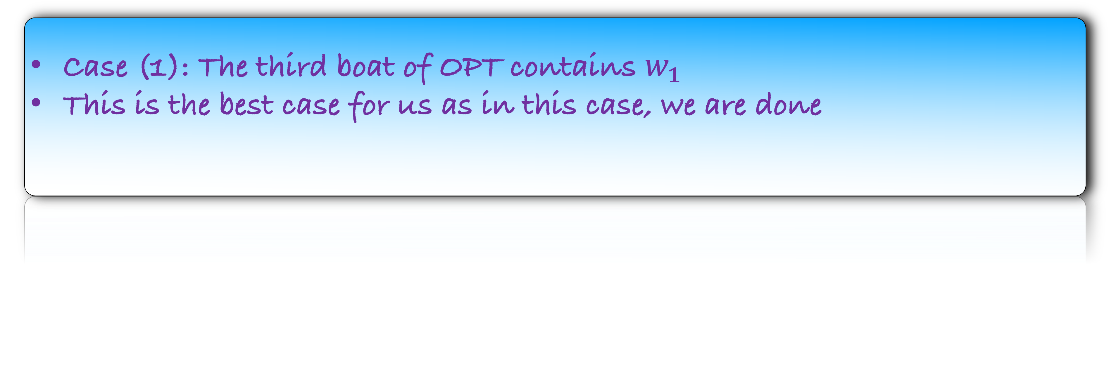
Our Solution
$$w_{n}$$
$$w_{n−1}$$
$$w_{n−2}$$
$$w_{n−3}$$
$$w_{n−4}$$
$$w_{n−5}$$
$$…$$
$$w_{n−(ℓ−1)}$$
$$w_{1}$$
$$w_{2}$$
$$w_{3}$$
$$w_{n−ℓ}$$
$$w_{n}$$
$$w_{n−1}$$
$$w_{n−2}$$
$$w_{1}$$
$$…$$
OPT
Case (1): The third boat of OPT contains $w_{1}$
This is the best case for us as in this case, we are done

Slide 37
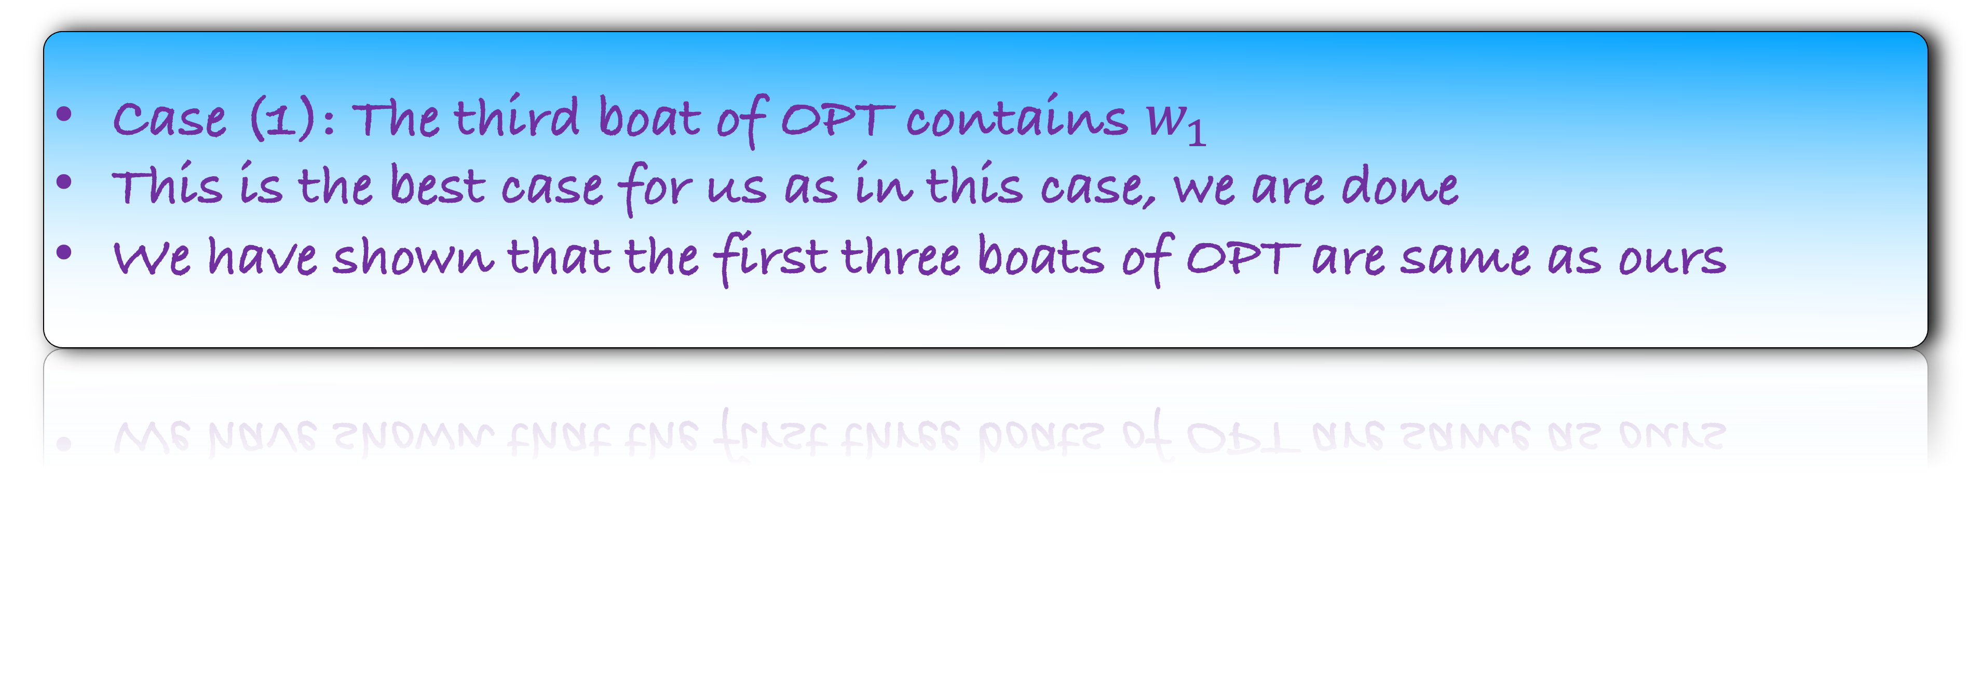
Our Solution
$$w_{n}$$
$$w_{n−1}$$
$$w_{n−2}$$
$$w_{n−3}$$
$$w_{n−4}$$
$$w_{n−5}$$
$$…$$
$$w_{n−(ℓ−1)}$$
$$w_{1}$$
$$w_{2}$$
$$w_{3}$$
$$w_{n−ℓ}$$
$$w_{n}$$
$$w_{n−1}$$
$$w_{n−2}$$
$$w_{1}$$
$$…$$
OPT
Case (1): The third boat of OPT contains $w_{1}$
This is the best case for us as in this case, we are done
We have shown that the first three boats of OPT are same as ours

Slide 38
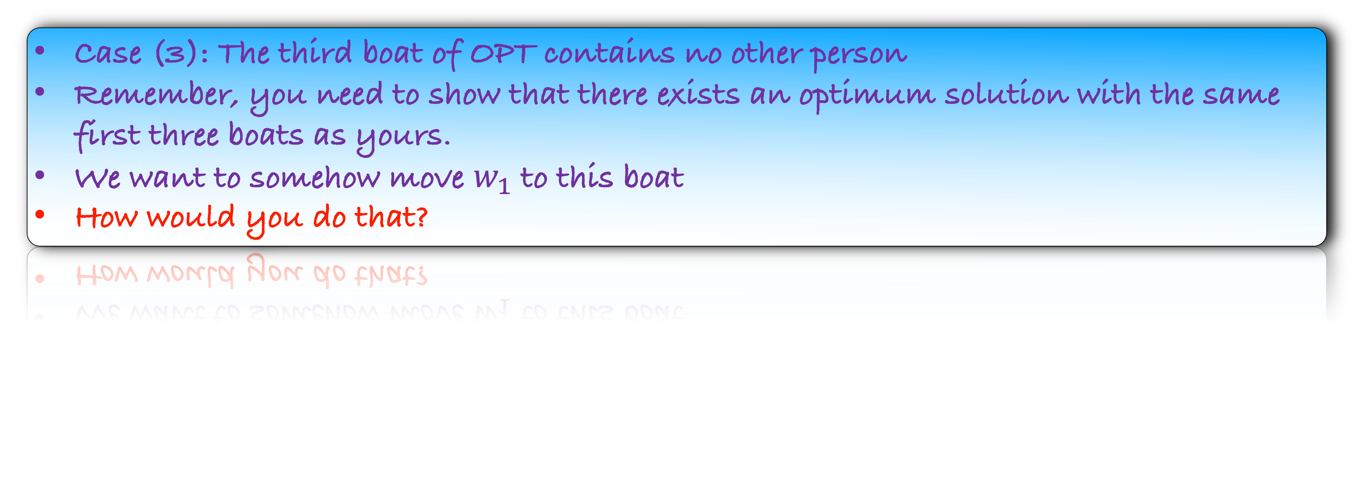
Our Solution
$$w_{n}$$
$$w_{n−1}$$
$$w_{n−2}$$
$$w_{n−3}$$
$$w_{n−4}$$
$$w_{n−5}$$
$$…$$
$$w_{n−(ℓ−1)}$$
$$w_{1}$$
$$w_{2}$$
$$w_{3}$$
$$w_{n−ℓ}$$
$$w_{n}$$
$$w_{n−1}$$
$$w_{n−2}$$
$$…$$
OPT
Case (3): The third boat of OPT contains no other person
Remember, you need to show that there exists an optimum solution with the same first three boats as yours.
We want to somehow move $w_{1}$ to this boat
How would you do that?

Slide 39
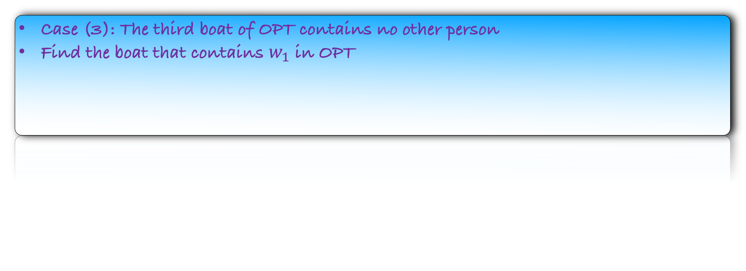
Our Solution
$$w_{n}$$
$$w_{n−1}$$
$$w_{n−2}$$
$$w_{n−3}$$
$$w_{n−4}$$
$$w_{n−5}$$
$$…$$
$$w_{n−(ℓ−1)}$$
$$w_{1}$$
$$w_{2}$$
$$w_{3}$$
$$w_{n−ℓ}$$
$$w_{n}$$
$$w_{n−1}$$
$$w_{n−2}$$
$$…$$
OPT
Case (3): The third boat of OPT contains no other person
Find the boat that contains $w_{1}$ in OPT

Slide 40

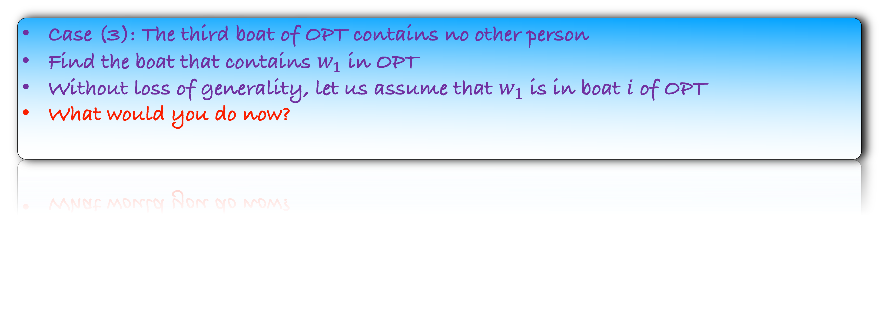
Our Solution
$$w_{n}$$
$$w_{n−1}$$
$$w_{n−2}$$
$$w_{n−3}$$
$$w_{n−4}$$
$$w_{n−5}$$
$$…$$
$$w_{n−(ℓ−1)}$$
$$w_{1}$$
$$w_{2}$$
$$w_{3}$$
$$w_{n−ℓ}$$
$$w_{n}$$
$$w_{n−1}$$
$$w_{n−2}$$
$$w_{1}$$
$$…$$
OPT
Case (3): The third boat of OPT contains no other person
Find the boat that contains $w_{1}$ in OPT
Without loss of generality, let us assume that $w_{1}$ is in boat $i$ of OPT
What would you do now?

Slide 41

Our Solution
$$w_{n}$$
$$w_{n−1}$$
$$w_{n−2}$$
$$w_{n−3}$$
$$w_{n−4}$$
$$w_{n−5}$$
$$…$$
$$w_{n−(ℓ−1)}$$
$$w_{1}$$
$$w_{2}$$
$$w_{3}$$
$$w_{n−ℓ}$$
$$w_{n}$$
$$w_{n−1}$$
$$w_{n−2}$$
$$w_{1}$$
$$…$$
OPT
Case (3): The third boat of OPT contains no other person
Note that we have removed a person from boat i, which is fine. The number of boats in OPT does not change

Slide 42
Our Solution
$$w_{n}$$
$$w_{n−1}$$
$$w_{n−2}$$
$$w_{n−3}$$
$$w_{n−4}$$
$$w_{n−5}$$
$$…$$
$$w_{n−(ℓ−1)}$$
$$w_{1}$$
$$w_{2}$$
$$w_{3}$$
$$w_{n−ℓ}$$
$$w_{n}$$
$$w_{n−1}$$
$$w_{n−2}$$
$$w_{1}$$
$$…$$
OPT
Case (3): The third boat of OPT contains no other person
Note that we have removed a person from boat i, which is fine. The number of boats in OPT does not change
Now, we are done with this case

Slide 43

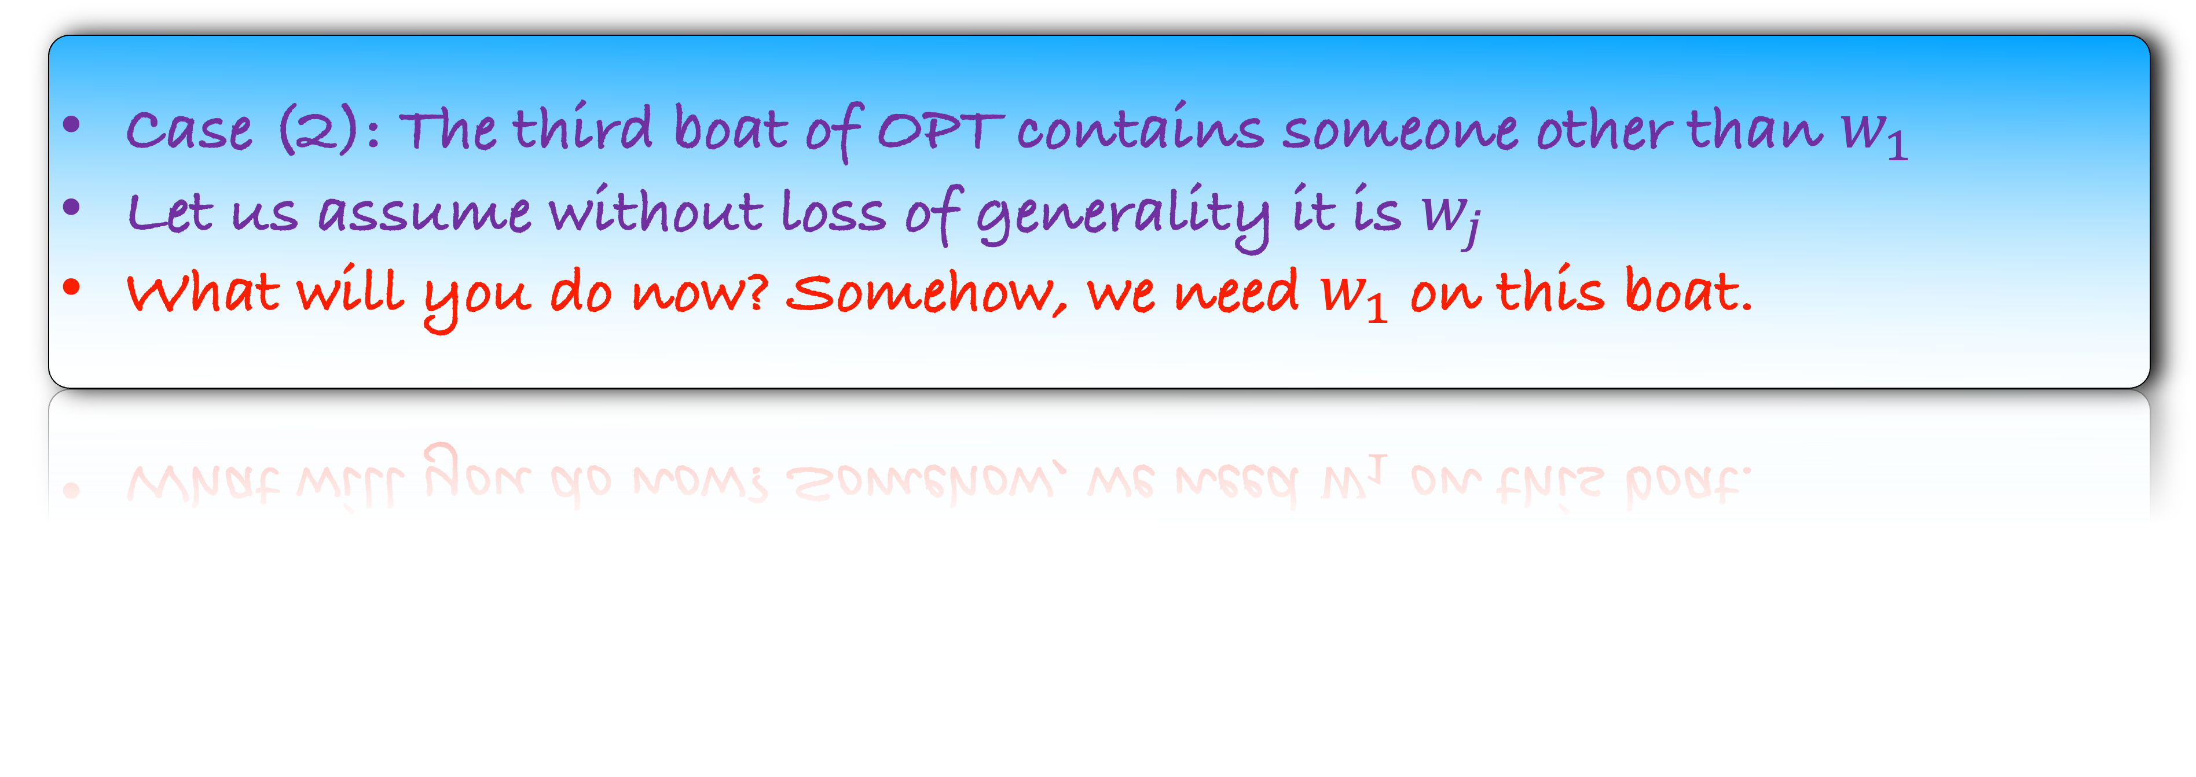
Our Solution
$$w_{n}$$
$$w_{n−1}$$
$$w_{n−2}$$
$$w_{n−3}$$
$$w_{n−4}$$
$$w_{n−5}$$
$$…$$
$$w_{n−(ℓ−1)}$$
$$w_{1}$$
$$w_{2}$$
$$w_{3}$$
$$w_{n−ℓ}$$
$$w_{n}$$
$$w_{n−1}$$
$$w_{n−2}$$
$$w_{j}$$
$$…$$
OPT
Case (2): The third boat of OPT contains someone other than $w_{1}$
Let us assume without loss of generality it is $w_{j}$
What will you do now? Somehow, we need $w_{1}$ on this boat.

Slide 44

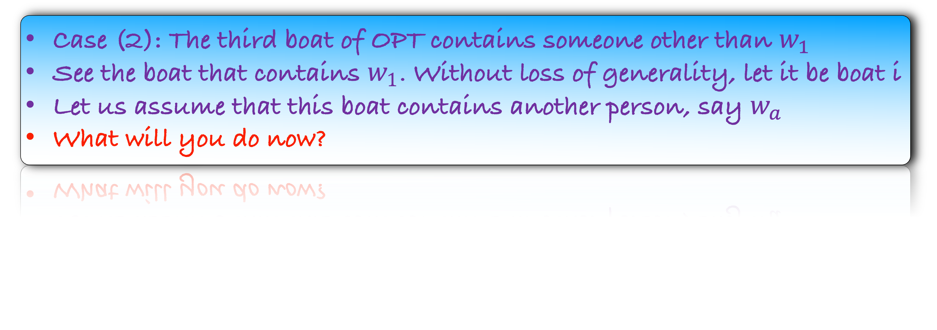

Our Solution
$$w_{n}$$
$$w_{n−1}$$
$$w_{n−2}$$
$$w_{n−3}$$
$$w_{n−4}$$
$$w_{n−5}$$
$$…$$
$$w_{n−(ℓ−1)}$$
$$w_{1}$$
$$w_{2}$$
$$w_{3}$$
$$w_{n−ℓ}$$
$$w_{n}$$
$$w_{n−1}$$
$$w_{n−2}$$
$$w_{a}$$
$$w_{j}$$
$$w_{1}$$
$$…$$
OPT
Case (2): The third boat of OPT contains someone other than $w_{1}$
See the boat that contains $w_{1}$. Without loss of generality, let it be boat i
Let us assume that this boat contains another person, say $w_{a}$
What will you do now?

Slide 45
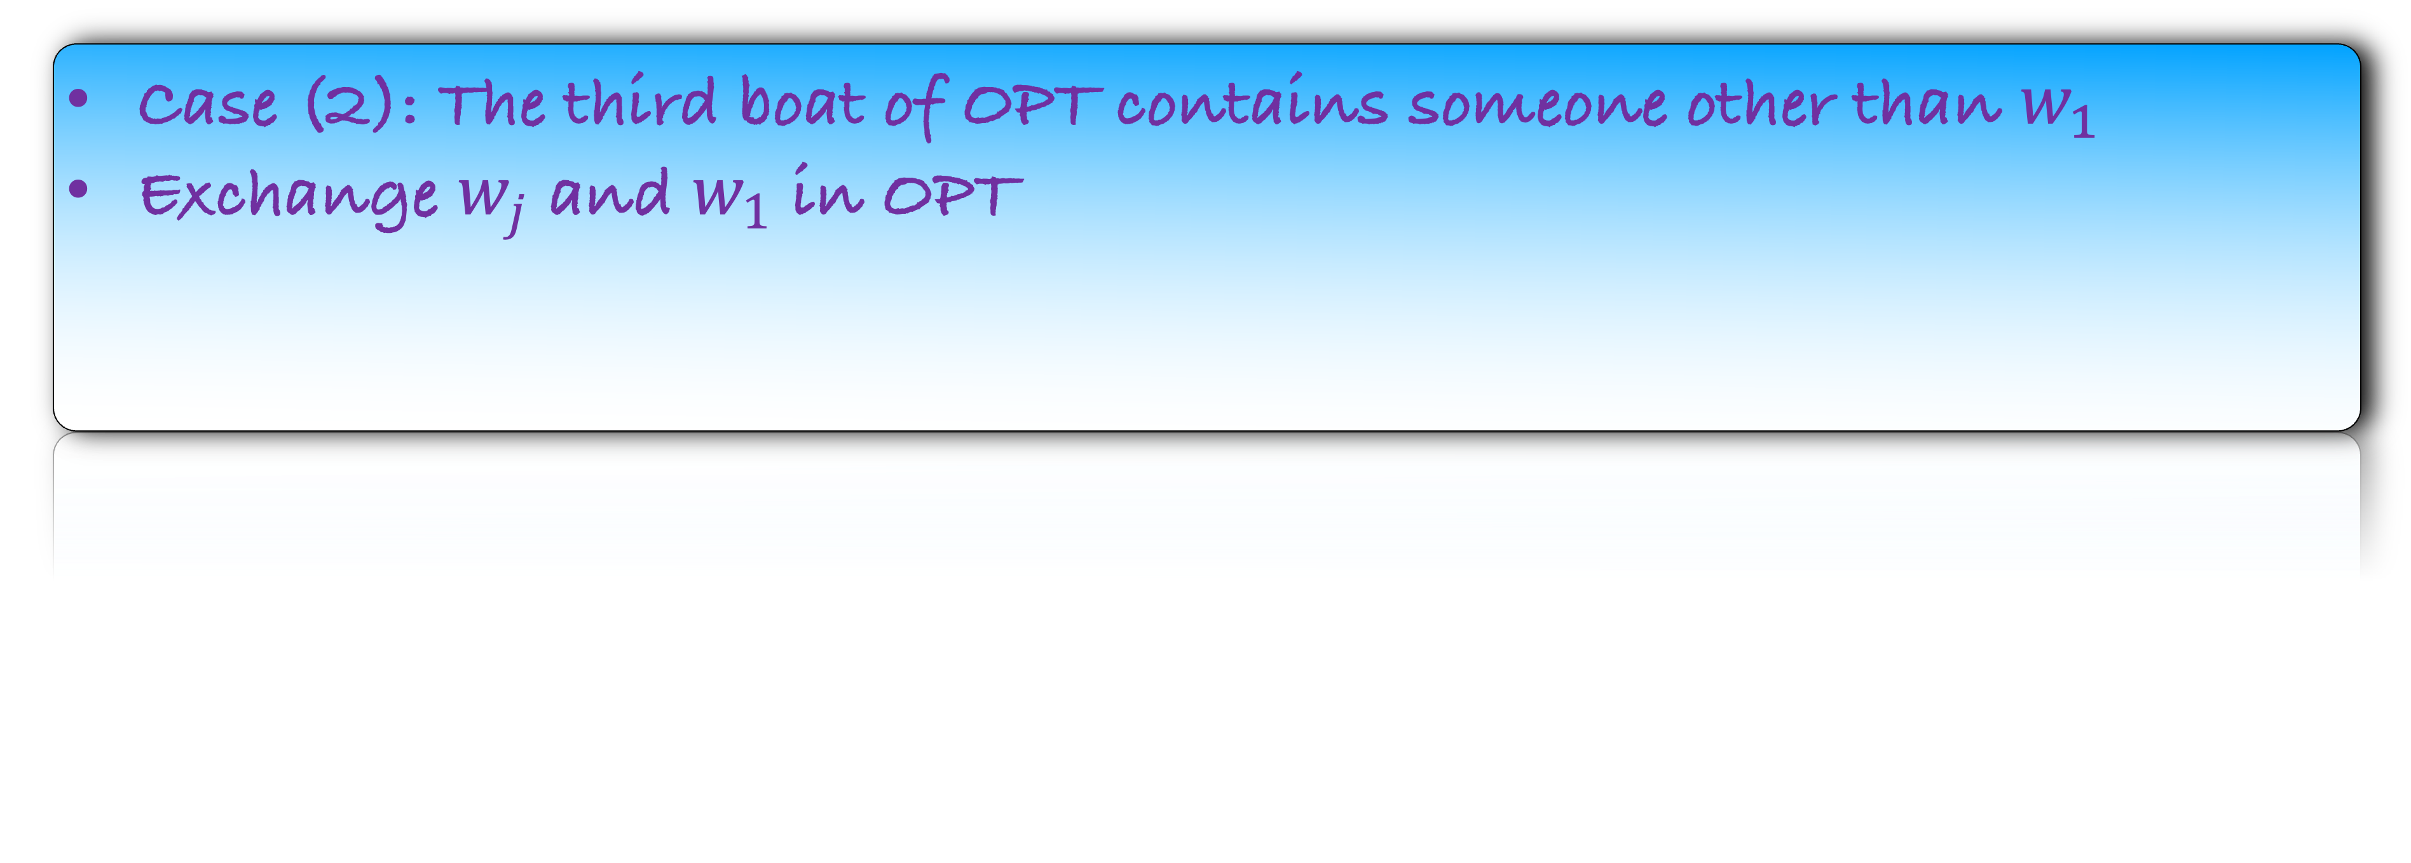
Our Solution
$$w_{n}$$
$$w_{n−1}$$
$$w_{n−2}$$
$$w_{n−3}$$
$$w_{n−4}$$
$$w_{n−5}$$
$$…$$
$$w_{n−(ℓ−1)}$$
$$w_{1}$$
$$w_{2}$$
$$w_{3}$$
$$w_{n−ℓ}$$
$$w_{n}$$
$$w_{n−1}$$
$$w_{n−2}$$
$$w_{a}$$
$$w_{j}$$
$$w_{1}$$
$$…$$
OPT
Case (2): The third boat of OPT contains someone other than $w_{1}$
Exchange $w_{j}$ and $w_{1}$ in OPT

Slide 46

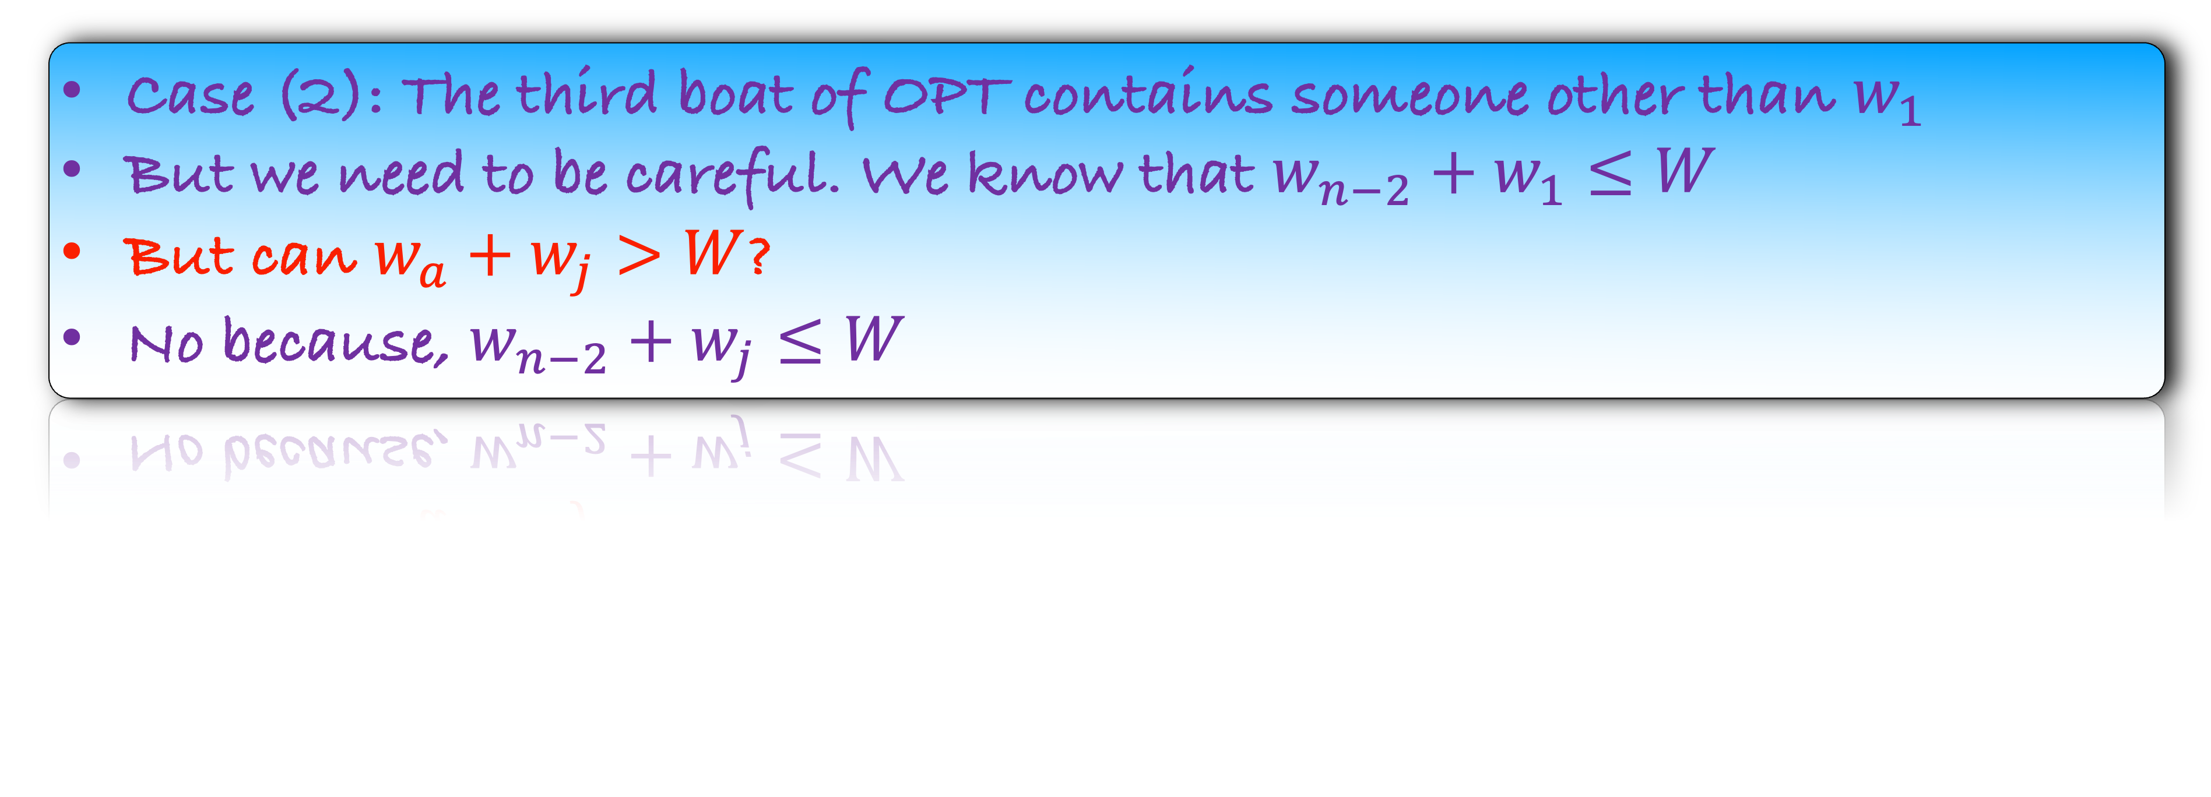

Our Solution
$$w_{n}$$
$$w_{n−1}$$
$$w_{n−2}$$
$$w_{n−3}$$
$$w_{n−4}$$
$$w_{n−5}$$
$$…$$
$$w_{n−(ℓ−1)}$$
$$w_{1}$$
$$w_{2}$$
$$w_{3}$$
$$w_{n−ℓ}$$
$$w_{n}$$
$$w_{n−1}$$
$$w_{n−2}$$
$$w_{a}$$
$$w_{1}$$
$$w_{j}$$
$$…$$
OPT
Case (2): The third boat of OPT contains someone other than $w_{1}$
But we need to be careful. We know that $w_{n−2}+w_{1}≤W$
But can $w_{a}+w_{j}>W$?
No because, $w_{n−2}+w_{j}≤W$

Slide 47
Our Solution
$$w_{n}$$
$$w_{n−1}$$
$$w_{n−2}$$
$$w_{n−3}$$
$$w_{n−4}$$
$$w_{n−5}$$
$$…$$
$$w_{n−(ℓ−1)}$$
$$w_{1}$$
$$w_{2}$$
$$w_{3}$$
$$w_{n−ℓ}$$
$$w_{n}$$
$$w_{n−1}$$
$$w_{n−2}$$
$$w_{1}$$
$$…$$
OPT
Lemma: There is an optimum that starts with our first three boats
We have seen the proof via pictures
Let us now write it

Slide 48

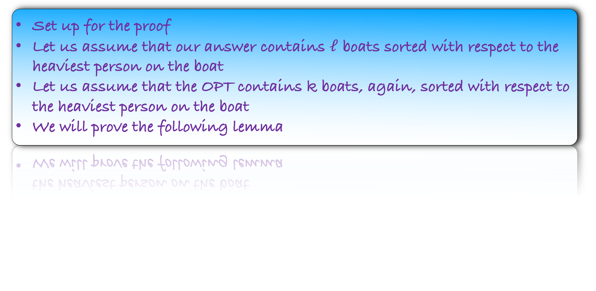
Set up for the proof
Let us assume that our answer contains $ℓ$ boats sorted with respect to the heaviest person on the boat
Let us assume that the OPT contains k boats, again, sorted with respect to the heaviest person on the boat
We will prove the following lemma
Lemma: For all $1≤i≤ℓ$, there is an optimum that contains our first $i$ boats

Slide 49
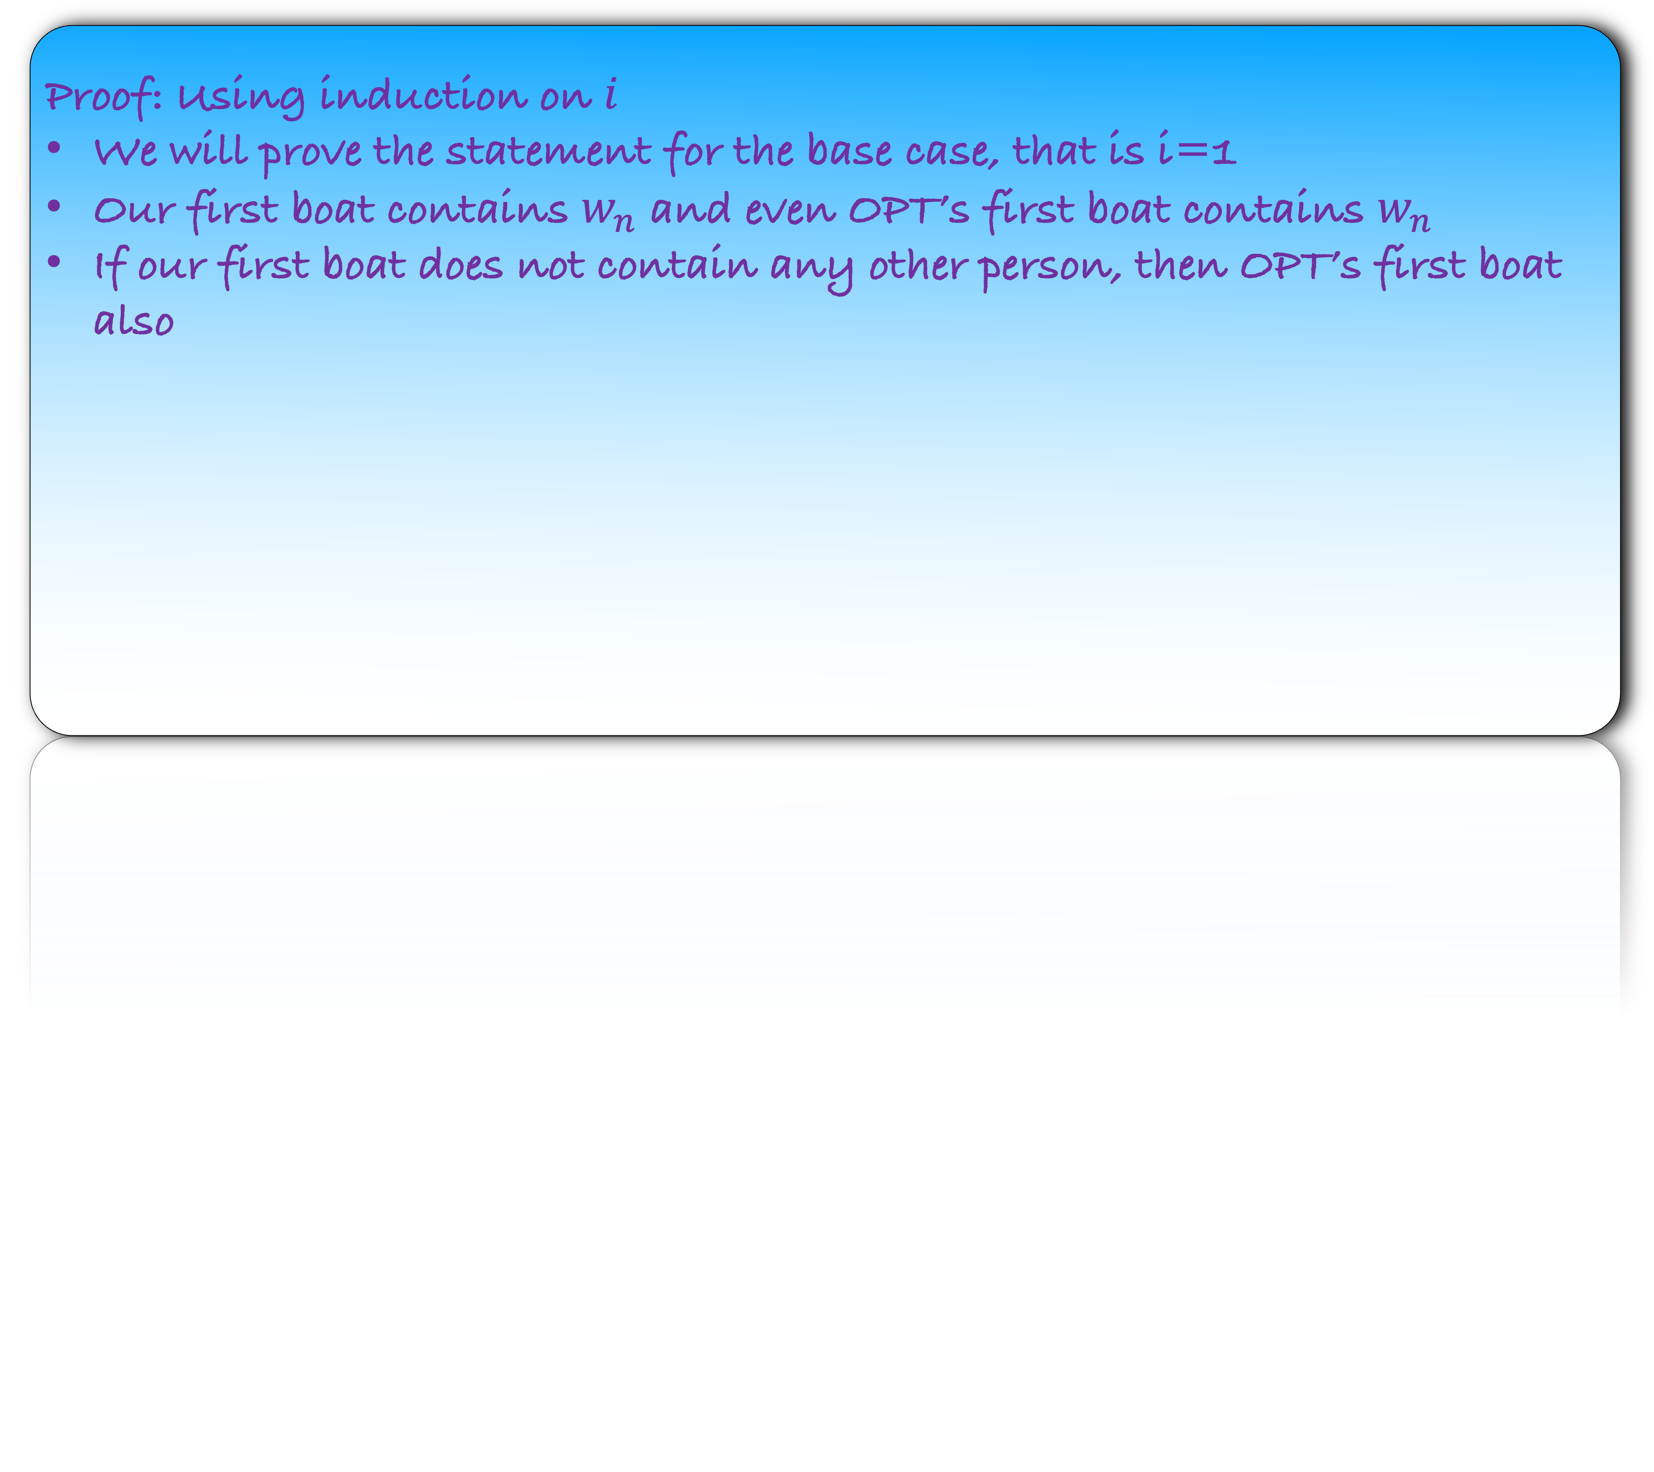

Lemma: For all $1≤i≤ℓ$, there is an optimum that contains our first $i$ boats
Proof: Using induction on $i$
We will prove the statement for the base case, that is i=1
Our first boat contains $w_{n}$ and even OPT’s first boat contains $w_{n}$
If our first boat does not contain any other person, then OPT’s first boat also

Slide 50
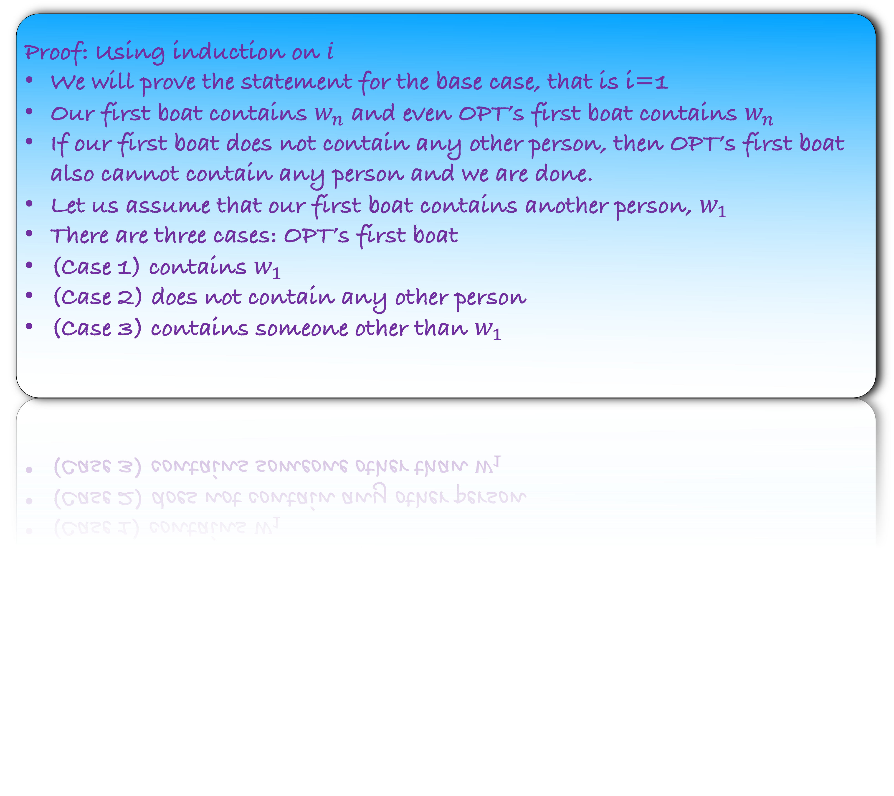
Lemma: For all $1≤i≤ℓ$, there is an optimum that contains our first $i$ boats
Proof: Using induction on $i$
We will prove the statement for the base case, that is i=1
Our first boat contains $w_{n}$ and even OPT’s first boat contains $w_{n}$
If our first boat does not contain any other person, then OPT’s first boat also cannot contain any person and we are done.
Let us assume that our first boat contains another person, $w_{1}$
There are three cases: OPT’s first boat
(Case 1) contains $w_{1}$
(Case 2) does not contain any other person
(Case 3) contains someone other than $w_{1}$

Slide 51
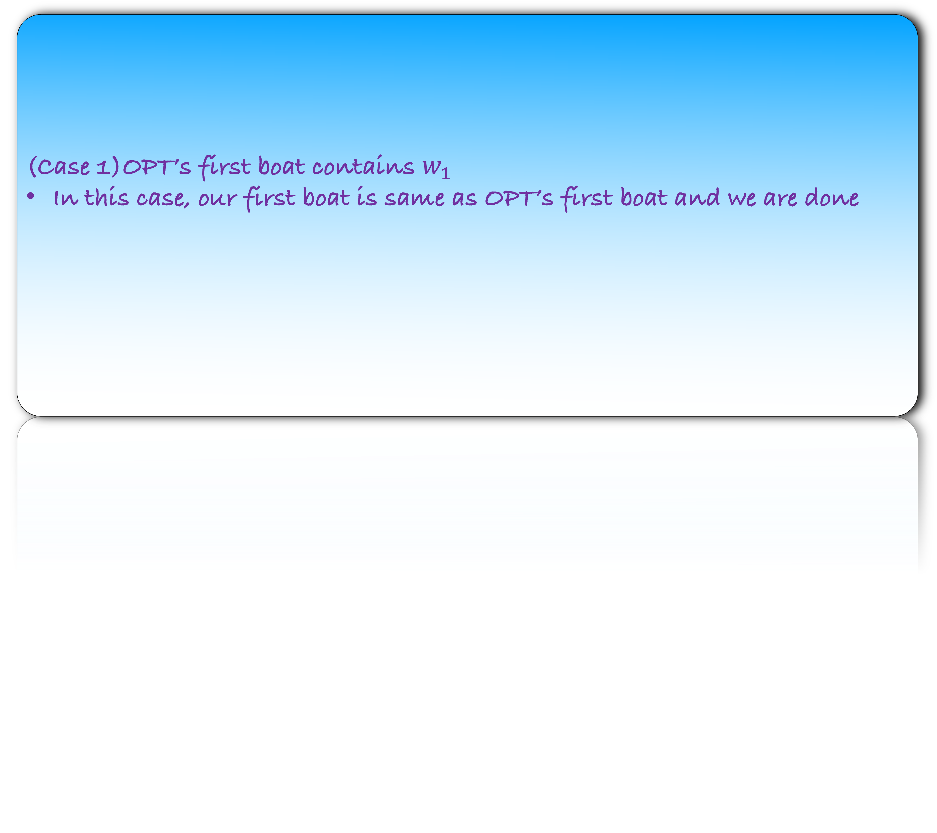
Lemma: For all $1≤i≤ℓ$, there is an optimum that contains our first $i$ boats
(Case 1)OPT’s first boat contains $w_{1}$
In this case, our first boat is same as OPT’s first boat and we are done

Slide 52
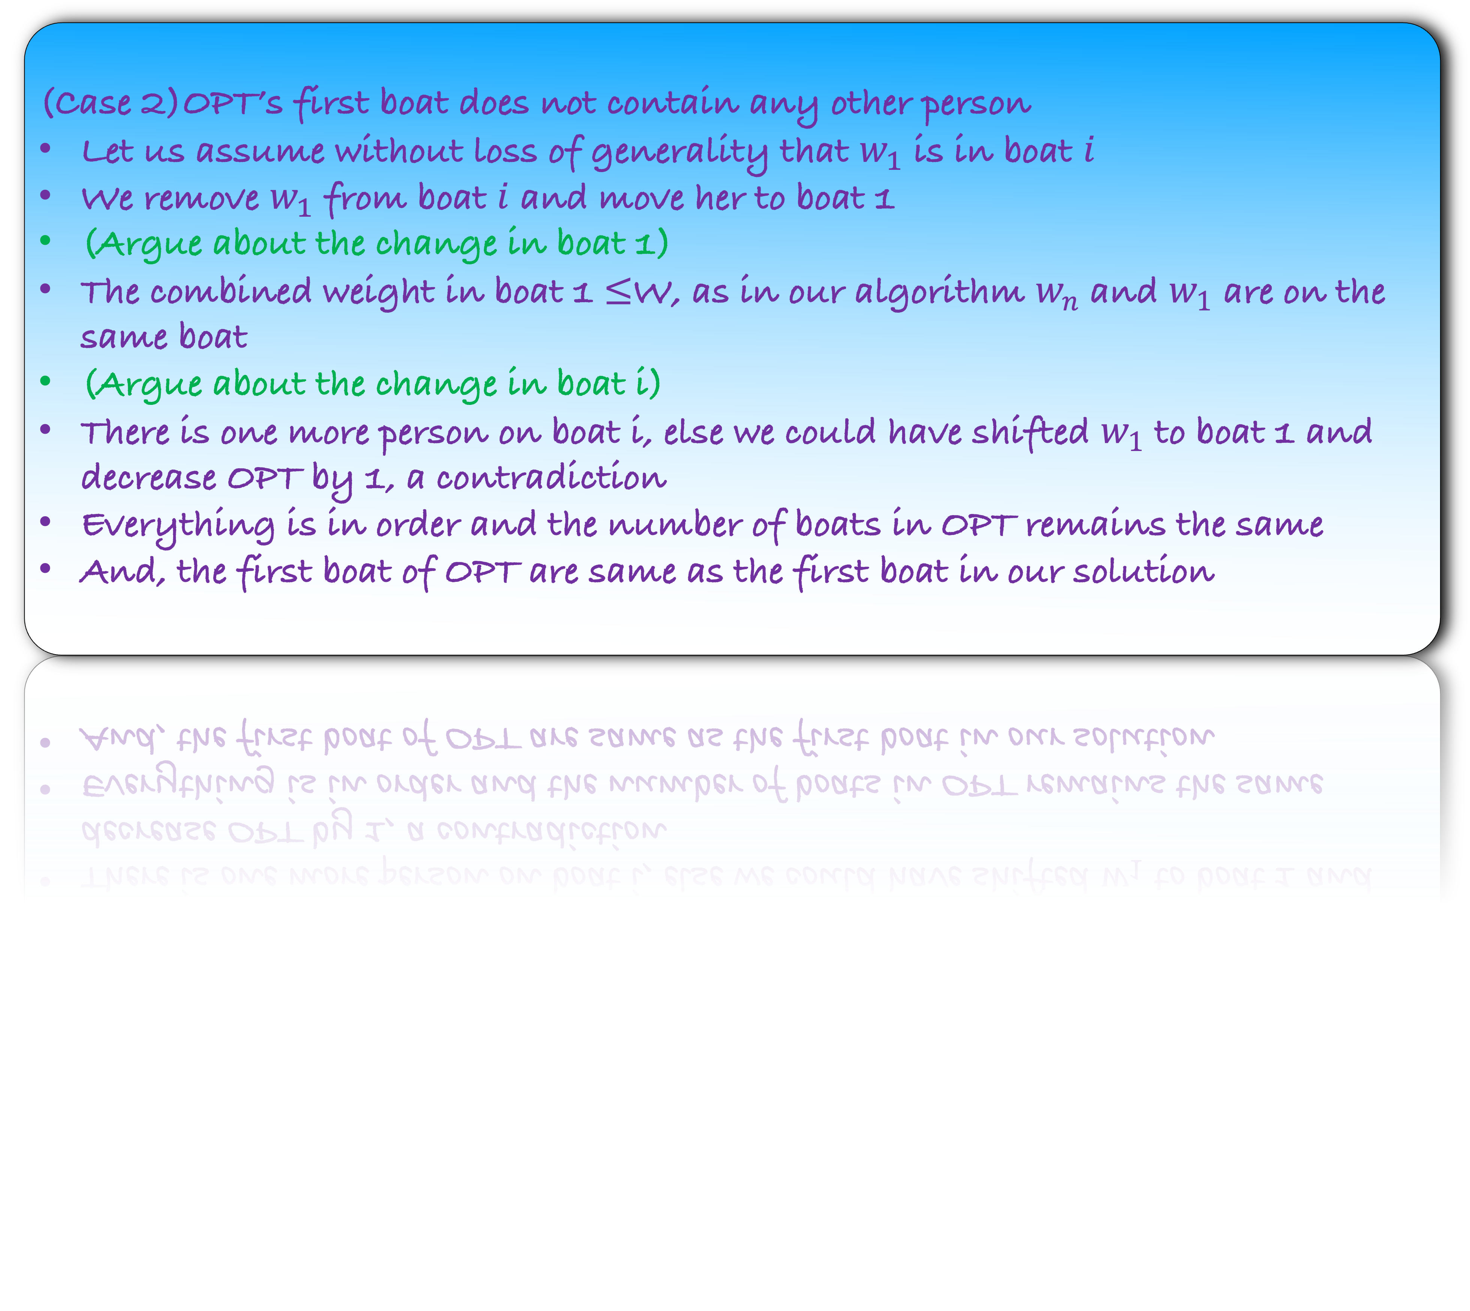
Lemma: For all $1≤i≤ℓ$, there is an optimum that contains our first $i$ boats
(Case 2)OPT’s first boat does not contain any other person
Let us assume without loss of generality that $w_{1}$ is in boat $i$
We remove $w_{1}$ from boat $i$ and move her to boat 1
(Argue about the change in boat 1)
The combined weight in boat 1 $≤$W, as in our algorithm $w_{n}$ and $w_{1}$ are on the same boat
(Argue about the change in boat i)
There is one more person on boat i, else we could have shifted $w_{1}$ to boat 1 and decrease OPT by 1, a contradiction
Everything is in order and the number of boats in OPT remains the same
And, the first boat of OPT are same as the first boat in our solution

Slide 53
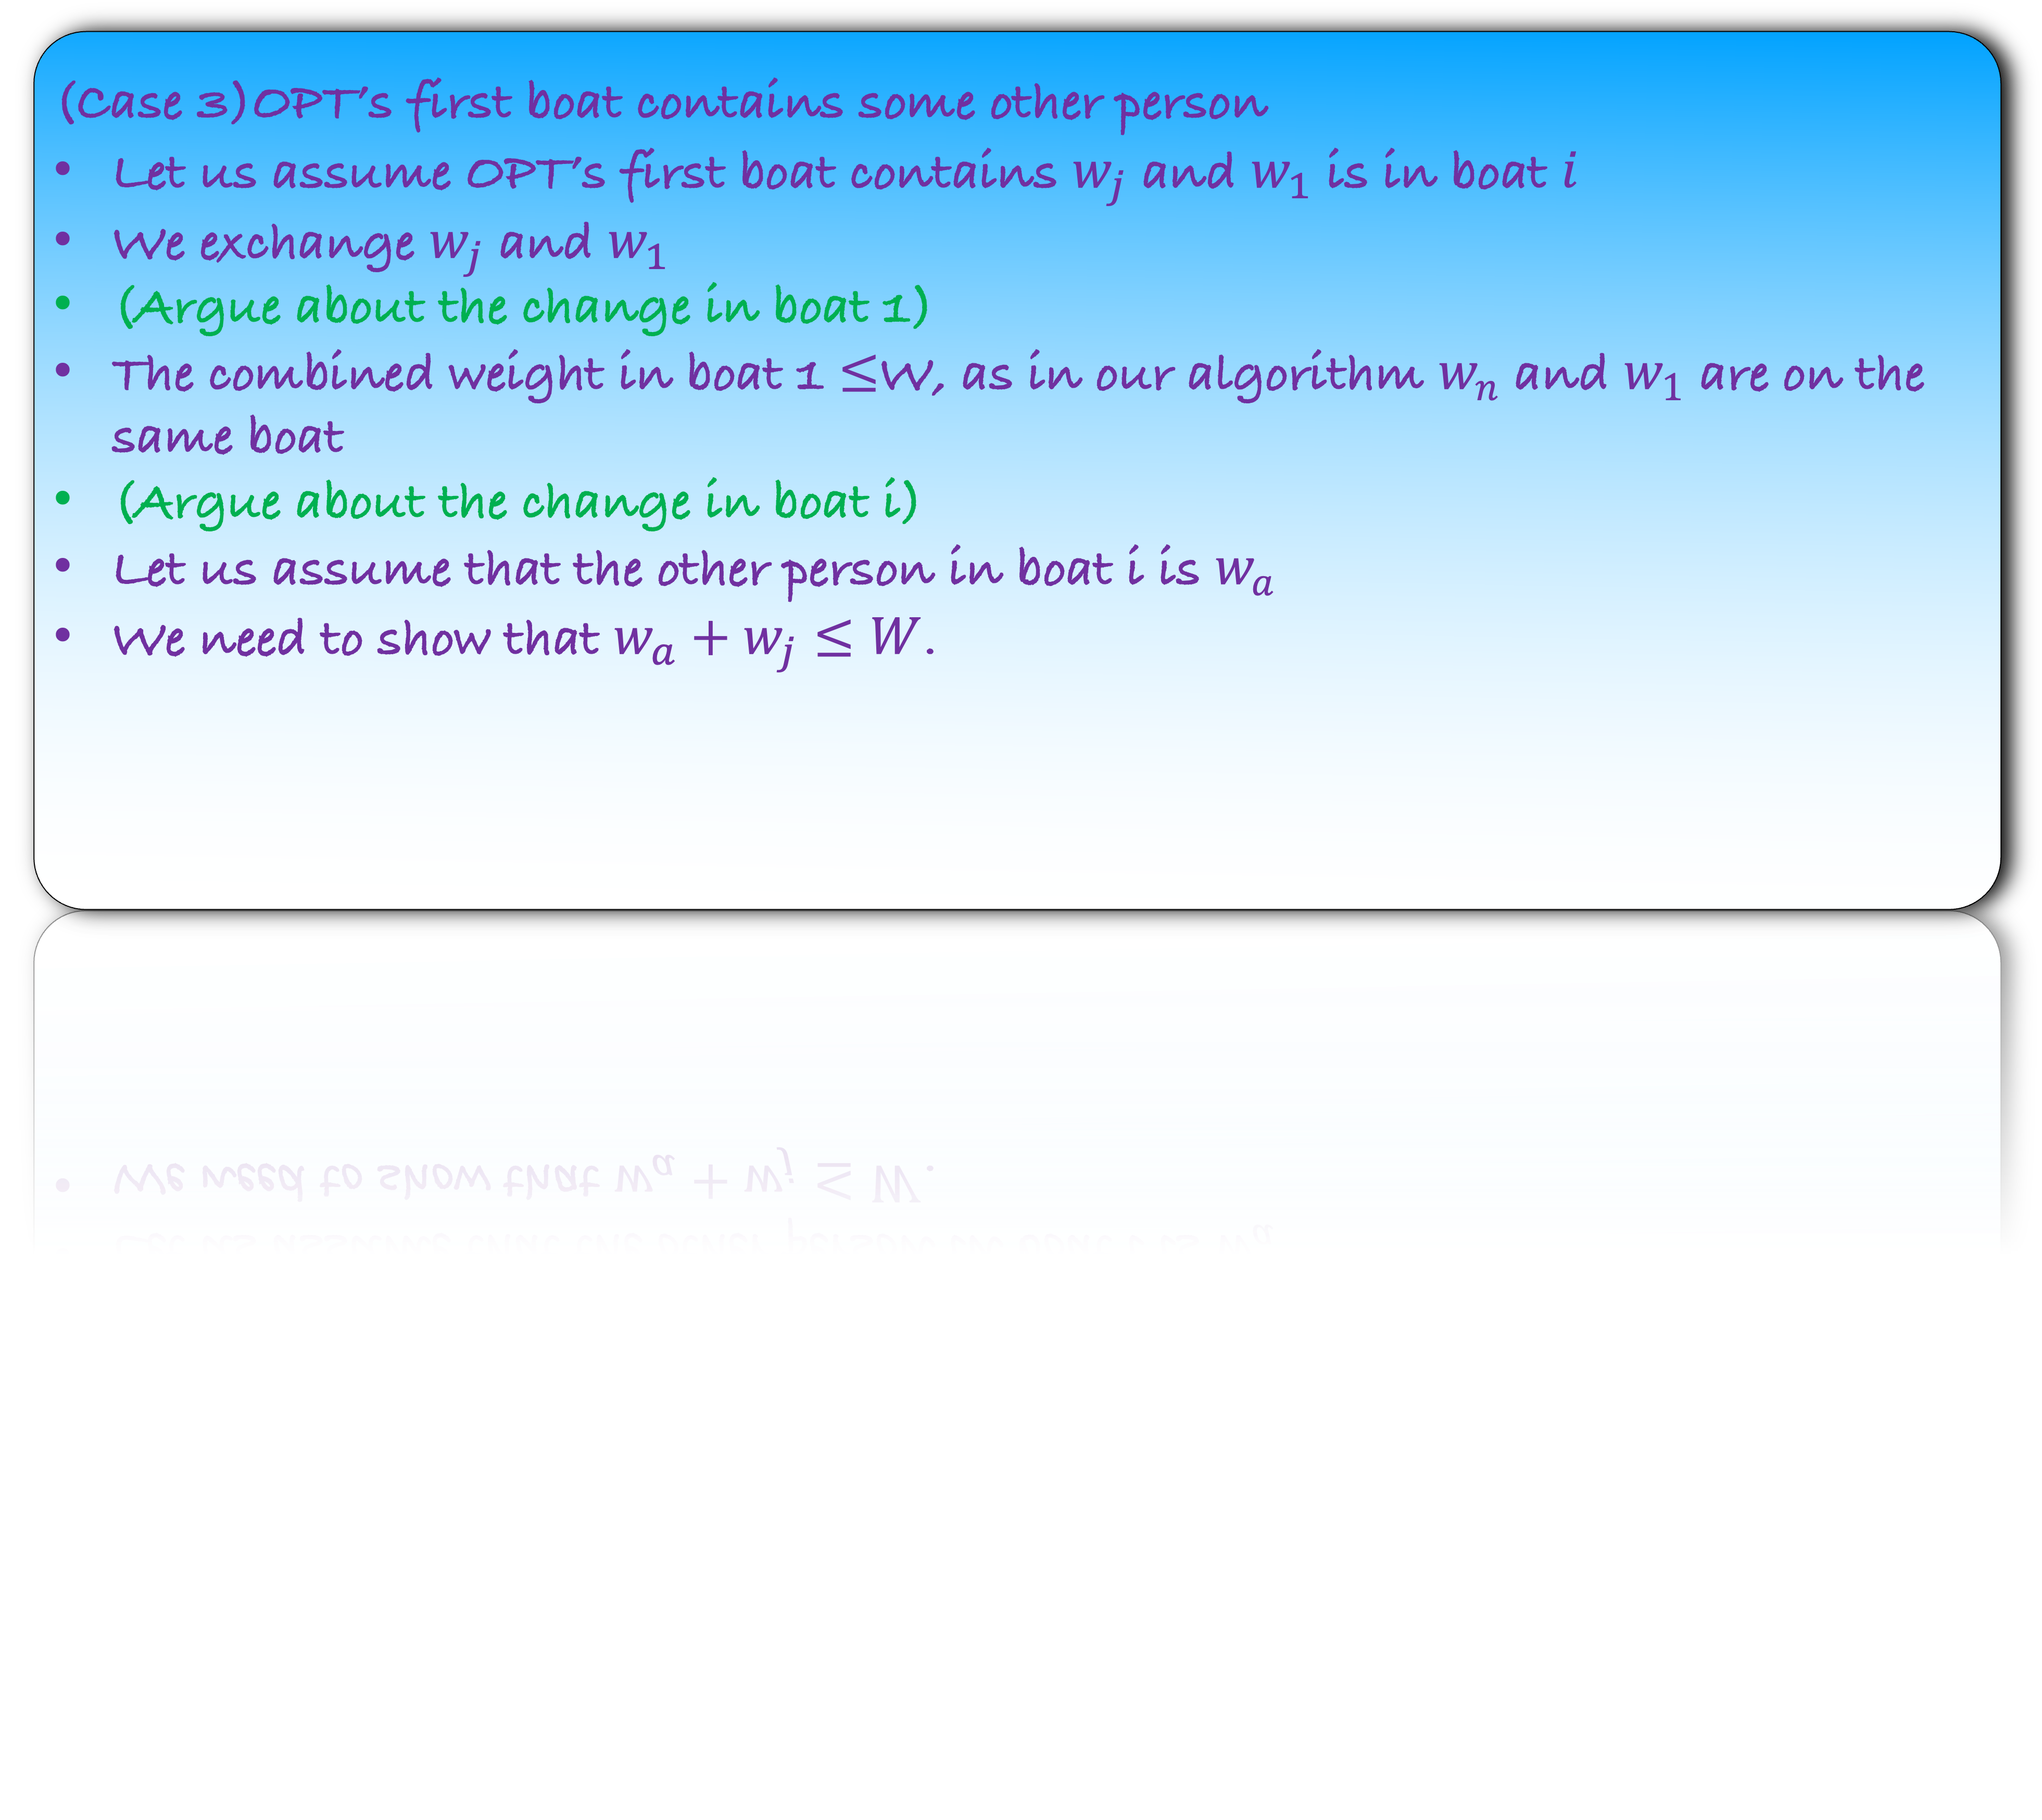
Lemma: For all $1≤i≤ℓ$, there is an optimum that contains our first $i$ boats
(Case 3)OPT’s first boat contains some other person
Let us assume OPT’s first boat contains $w_{j}$ and $w_{1}$ is in boat $i$
We exchange $w_{j}$ and $w_{1}$
(Argue about the change in boat 1)
The combined weight in boat 1 $≤$W, as in our algorithm $w_{n}$ and $w_{1}$ are on the same boat
(Argue about the change in boat i)
Let us assume that the other person in boat i is $w_{a}$
We need to show that $w_{a}+w_{j}≤W$.

Slide 54
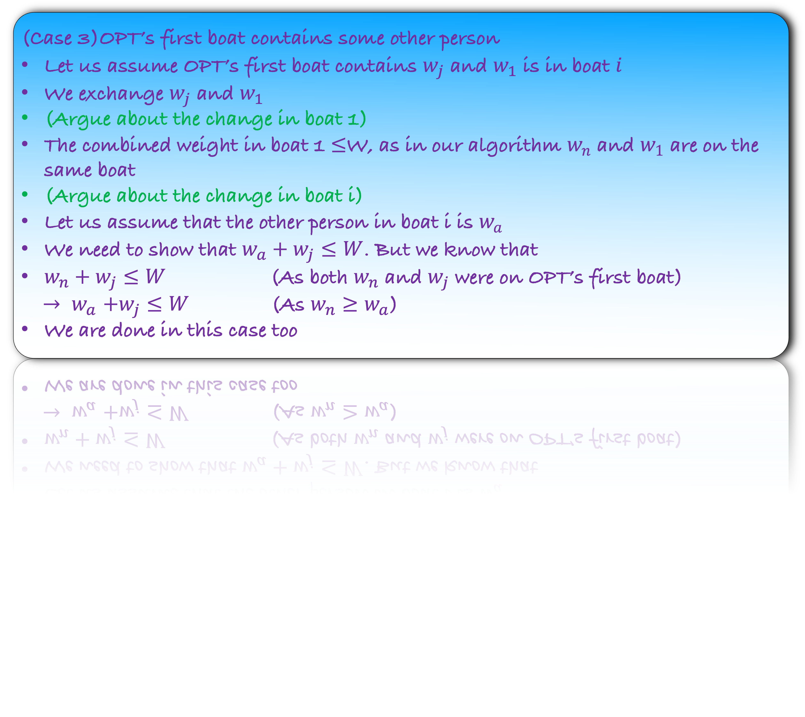
Lemma: For all $1≤i≤ℓ$, there is an optimum that contains our first $i$ boats
(Case 3)OPT’s first boat contains some other person
Let us assume OPT’s first boat contains $w_{j}$ and $w_{1}$ is in boat $i$
We exchange $w_{j}$ and $w_{1}$
(Argue about the change in boat 1)
The combined weight in boat 1 $≤$W, as in our algorithm $w_{n}$ and $w_{1}$ are on the same boat
(Argue about the change in boat i)
Let us assume that the other person in boat i is $w_{a}$
We need to show that $w_{a}+w_{j}≤W$. But we know that
$w_{n}+w_{j}≤W$ (As both $w_{n}$ and $w_{j}$ were on OPT’s first boat)
${→ w}_{a}+w_{j}≤W$ (As $w_{n}≥w_{a}$)
We are done in this case too

Slide 55
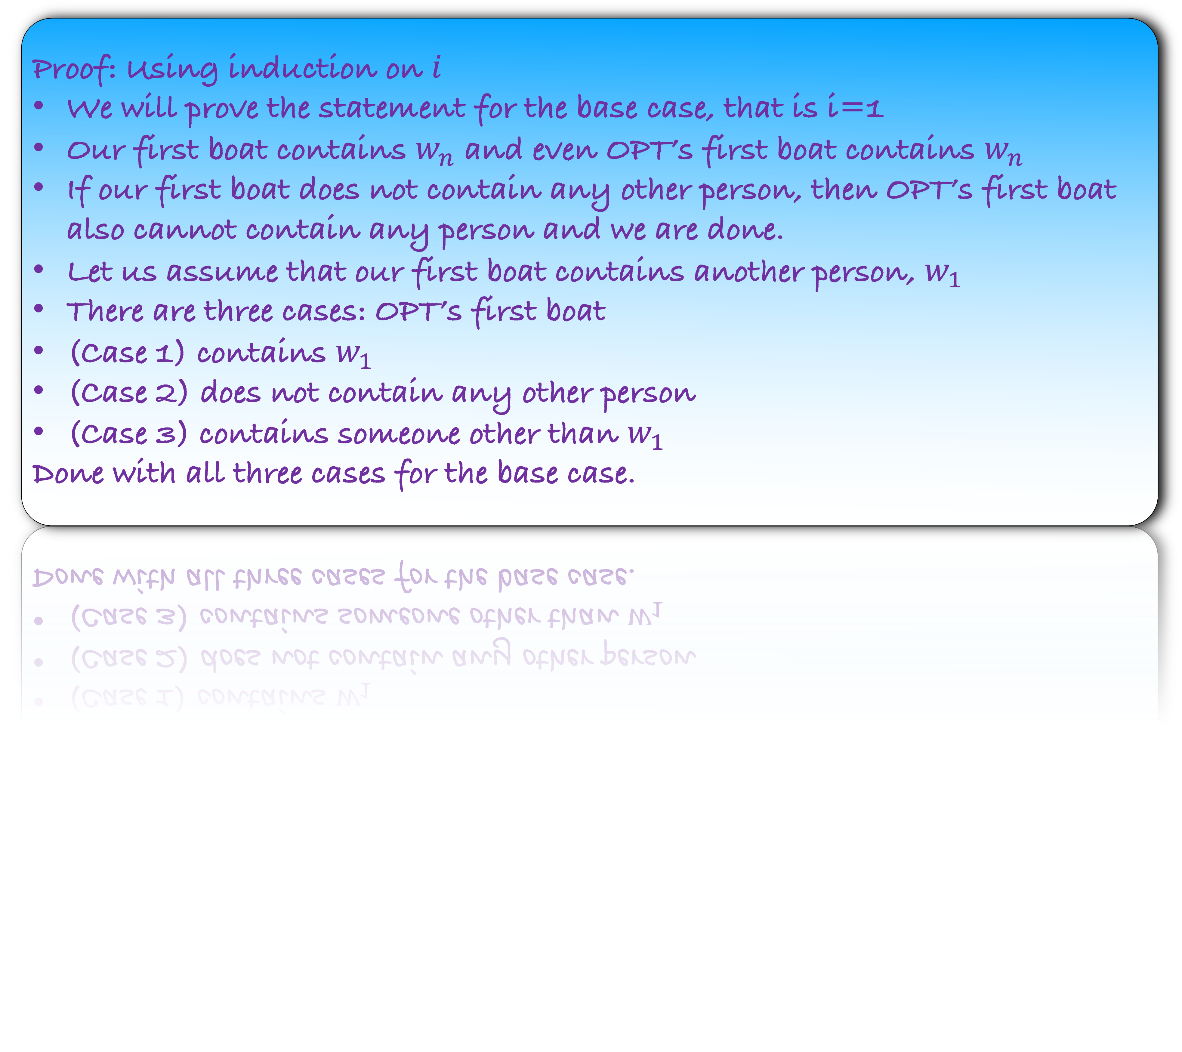
Lemma: For all $1≤i≤ℓ$, there is an optimum that contains our first $i$ boats
Proof: Using induction on $i$
We will prove the statement for the base case, that is i=1
Our first boat contains $w_{n}$ and even OPT’s first boat contains $w_{n}$
If our first boat does not contain any other person, then OPT’s first boat also cannot contain any person and we are done.
Let us assume that our first boat contains another person, $w_{1}$
There are three cases: OPT’s first boat
(Case 1) contains $w_{1}$
(Case 2) does not contain any other person
(Case 3) contains someone other than $w_{1}$
Done with all three cases for the base case.

Slide 56
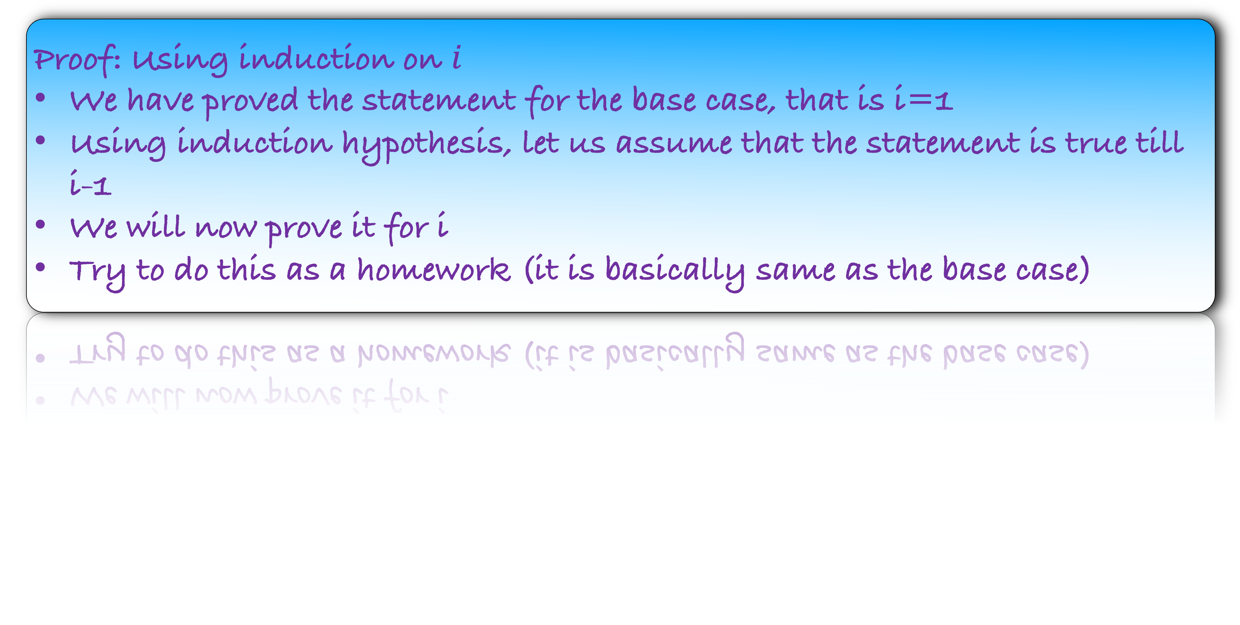
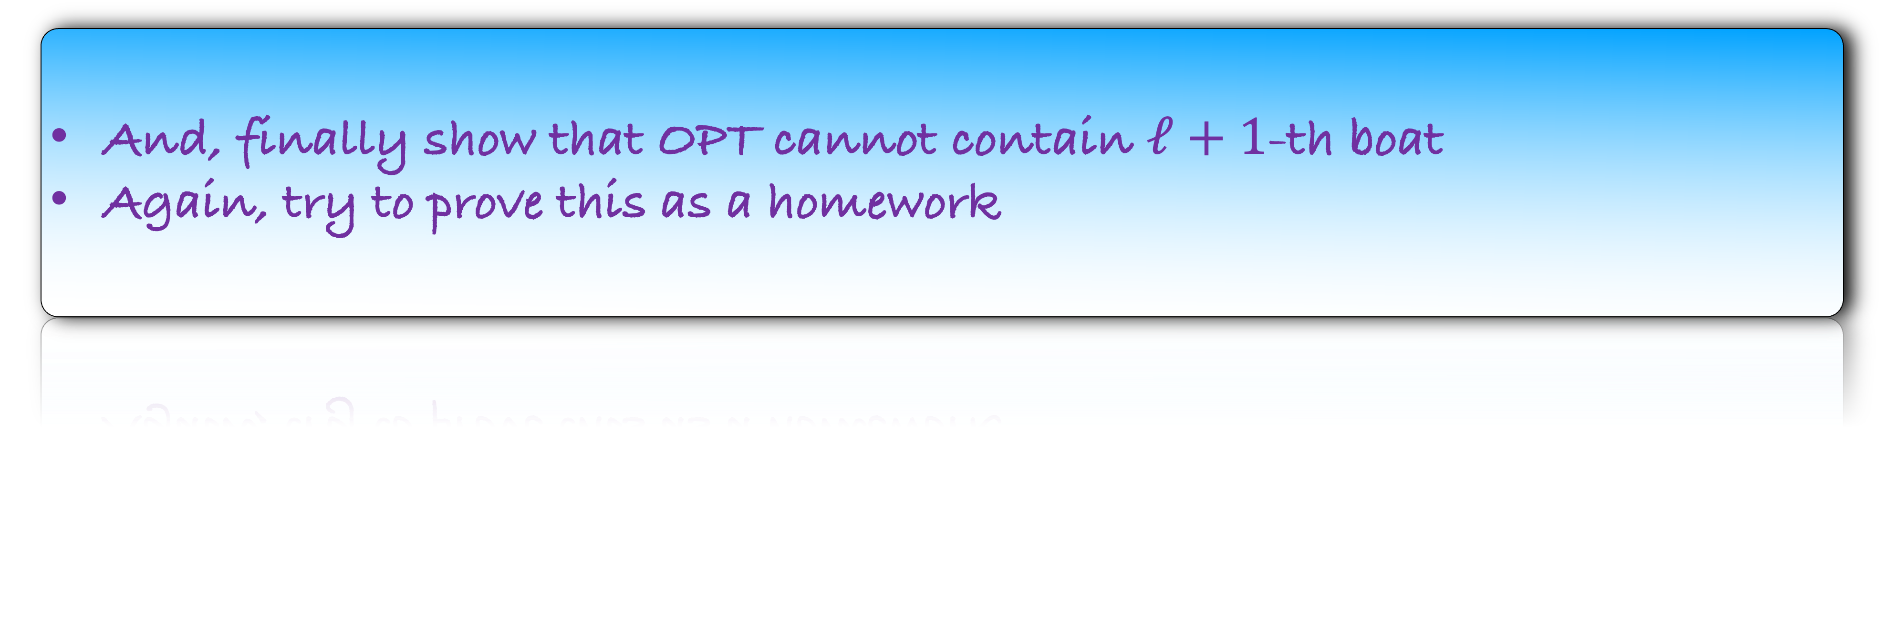
Lemma: For all $1≤i≤ℓ$, there is an optimum that contains our first $i$ boats
Proof: Using induction on $i$
We have proved the statement for the base case, that is i=1
Using induction hypothesis, let us assume that the statement is true till i-1
We will now prove it for i
Try to do this as a homework (it is basically same as the base case)
And, finally show that OPT cannot contain $ℓ+1$-th boat
Again, try to prove this as a homework

Slide 57
Take-Away
We have seen an elaborate example of Exchange argument
In the proof, we gradually change any OPT to our solution which ensuring optimality at each step
And finally, the OPT is same as our answer

