Slide 1
Metro

Slide 2
In the planning for Gandhinagar Metro, the government has identified few locations where we need to build a Metro Station.

Slide 3
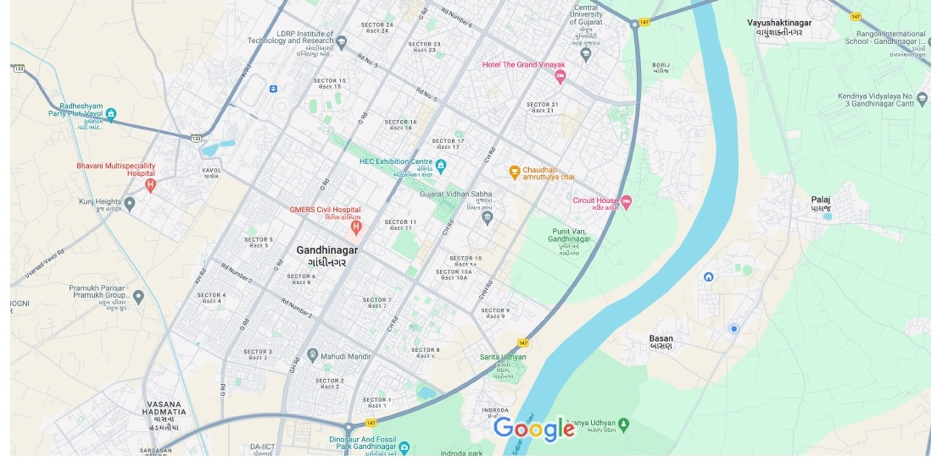

Slide 4
In the planning for Gandhinagar Metro, the government has identified few locations where we need to build a Metro Station.
We also know the total cost it will take to build metro lines between any two metro stations. For example, to make a railway line from IITGN to DAIICT, it will cost 7 crores.

Slide 6
5
10
9
1
7
6
3
4
8
2

Slide 7
In the planning for Gandhinagar Metro, the government has identified few locations where we need to build a Metro Station.
We also know the total cost it will take to build metro lines between any two metro stations. For example, to make a railway line from IITGN to DAIICT, it will cost 7 crores.
Design an algorithm that connects all the metro stations in least amount of money.

Slide 8
Formal Definition: Given a weighted undirected graph G on m edges and n vertices, find a subgraph of minimum weight that spans all the vertices of G.
Observation: Such a subgraph is always a tree as we can always remove edges that create a cycle.

Slide 9
Minimum Spanning Tree

Slide 10
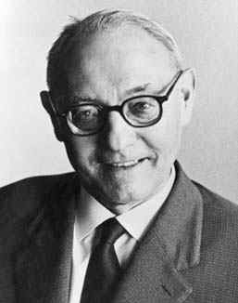
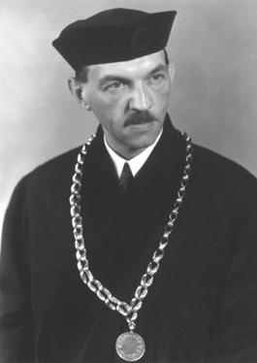
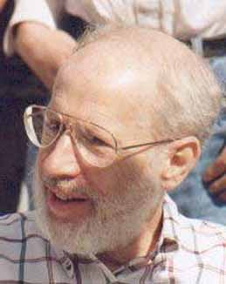
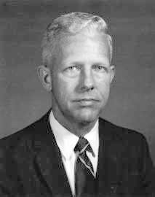
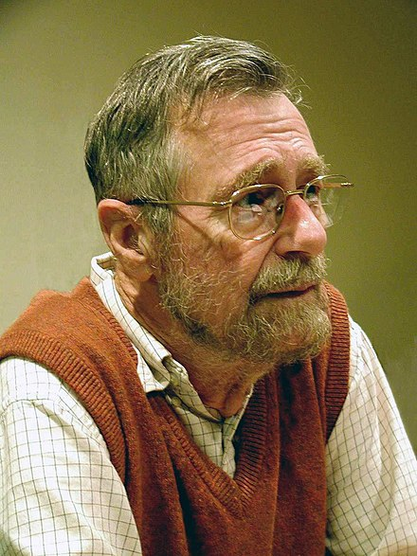
History
Otakar Boruvka
Vojtěch Jarník
Joseph Kruskal
Robert Prim
Edsger Dijkstra
1926
1930
1956
1957
1959
All these algorithm take O(m log n) time

Slide 11
There are more follow up work but we will see them towards the end of this presentation.
How would you solve this problem?

Slide 12
Cut Property: Let (S,V-s) be a cut in the graph, then the minimum weight edge from S to V-S lies in the minimum spanning tree.
5
10
11
9
1
7
6
3
2
8
4

Slide 13
Cut Property: Let (S,V-s) be a cut in the graph, then the minimum weight edge from S to V-S lies in the minimum spanning tree.
5
11
10
9
1
V-S
6
7
2
3
S
8
4

Slide 14
Cut Property: Let (S,V-s) be a cut in the graph, then the minimum weight edge from S to V-S lies in the minimum spanning tree.
5
11
10
9
1
V-S
6
7
2
3
S
8
4

Slide 15
Proof:
Let us assume that the edge (b,e) is not in the minimum spanning tree T.
5
d
a
11
V-S
10
1
9
b
S
7
6
2
3
f
8
c
e
4

Slide 16
Proof:
Let us assume that the edge (b,e) is not in the minimum spanning tree T.
Add edge (b,e) to the tree T
5
d
a
11
V-S
10
1
9
b
S
7
6
2
3
f
8
c
e
4

Slide 17
Proof:
Let us assume that the edge (b,e) is not in the minimum spanning tree T.
Add edge (b,e) to the tree T.
This creates a cycle.
There is an edge in this cycle which crosses the cut (other than the edge (b,e))
In this example, it is (c,e)
Observation: w(c,e) > w(b,e)
If we remove (c,e) from T and add (b,e) to T, we will get a spanning tree with less weight than T.
5
d
a
11
V-S
10
1
9
b
S
7
6
2
3
f
8
c
e
4

Slide 18
Proof:
Let us assume that the edge (b,e) is not in the minimum spanning tree T.
Add edge (b,e) to the tree T.
This creates a cycle.
There is an edge in this cycle which crosses the cut (other than the edge (b,e))
In this example, it is (c,e)
Observation: w(c,e) > w(b,e)
If we remove (c,e) from T and add (b,e) to T, we will get a spanning tree with less weight than T.
But this is a contradiction as we assumed that T is the minimum spanning tree.
This implies that our assumption was wrong.
(b,e) is in the minimum spanning tree T.
5
d
a
11
V-S
10
1
9
b
S
7
6
2
3
f
8
c
e
4

Slide 19
Cut Property: Let (S,V-S) be a cut in the graph, then the minimum weight edge from S to V-S lies in the minimum spanning tree.
This is a greedy property.

Slide 20
Prims Algorithm
Robert Prim
1957

Slide 21
Start with a trivial cut {a}, V-{a}.
5
d
a
Apply the cut property.
15
V-S
10
1
9
6
S
b
7
f
2
3
8
c
4
e

Slide 22
Start with a trivial cut {a}, V-{a}.
5
d
a
Apply the cut property.
15
V-S
10
1
9
6
S
b
7
f
2
3
8
c
4
e

Slide 23
Start with a trivial cut {a}, V-{a}.
5
d
a
Apply the cut property.
15
V-S
1
10
Apply the cut property again.
9
b
6
7
3
f
S
2
8
c
4
e

Slide 24
Start with a trivial cut {a}, V-{a}.
5
d
a
Apply the cut property.
15
V-S
1
10
Apply the cut property again.
9
b
6
7
3
f
S
2
8
c
4
e

Slide 25
Start with a trivial cut {a}, V-{a}.
5
d
a
Apply the cut property.
15
V-S
1
10
Apply the cut property again.
6
9
b
7
2
3
f
8
c
4
e
S

Slide 26
Start with a trivial cut {a}, V-{a}.
5
d
a
Apply the cut property.
15
V-S
1
10
Apply the cut property again.
6
9
Apply the cut property again.
b
7
2
3
f
8
c
4
e
S

Slide 27
Start with a trivial cut {a}, V-{a}.
5
d
a
Apply the cut property.
15
V-S
1
10
Apply the cut property again.
6
9
Apply the cut property again.
b
7
2
3
f
8
c
4
e
S

Slide 28
Start with a trivial cut {a}, V-{a}.
5
d
a
Apply the cut property.
15
V-S
1
10
Apply the cut property again.
6
9
Apply the cut property again.
b
7
3
f
2
8
c
4
e
S

Slide 29
Start with a trivial cut {a}, V-{a}.
5
d
a
Apply the cut property.
15
V-S
1
10
Apply the cut property again.
6
9
Apply the cut property again.
b
7
3
f
Apply the cut property again.
2
8
c
4
e
S

Slide 30
Start with a trivial cut {a}, V-{a}.
5
d
a
Apply the cut property.
15
V-S
1
10
Apply the cut property again.
6
9
Apply the cut property again.
b
7
3
f
Apply the cut property again.
2
8
c
4
e
S

Slide 31
Start with a trivial cut {a}, V-{a}.
a
Apply the cut property.
5
V-S
1
10
Apply the cut property again.
6
15
d
9
Apply the cut property again.
b
7
3
f
Apply the cut property again.
2
8
Apply the cut property again.
c
4
e
S

Slide 32
Start with a trivial cut {a}, V-{a}.
a
Apply the cut property.
5
V-S
1
10
Apply the cut property again.
6
15
d
9
Apply the cut property again.
b
7
3
f
Apply the cut property again.
2
8
Apply the cut property again.
c
4
e
S

Slide 33
Start with a trivial cut {a}, V-{a}.
a
Apply the cut property.
5
V-S
1
10
Apply the cut property again.
6
15
d
9
Apply the cut property again.
b
7
3
f
Apply the cut property again.
2
8
Apply the cut property again.
c
4
e
S

Slide 34
Implementation

Slide 35
For every vertex v in V-S, let e = (v,u) be the edge adjacent to v of minimum weight such that u is in S.
min(v) := weight of e
edge(v) := (u,v)
a
5
V-S
1
10
6
d
15
9
b
7
In this example
min(v) := 7
edge(v) := (b,v)
3
v
2
8
c
4
e
S

Slide 36
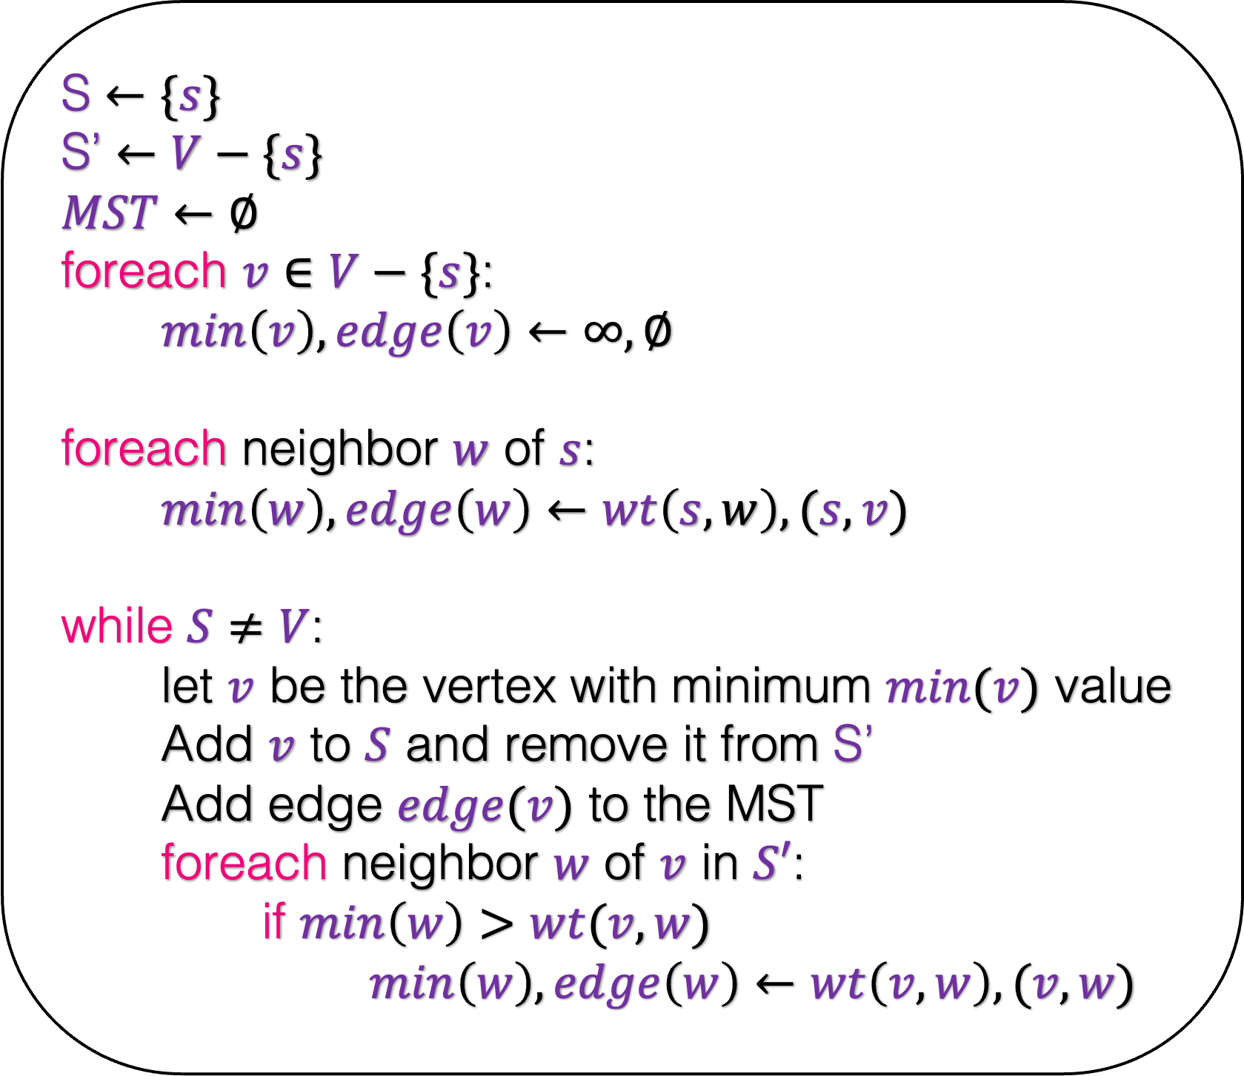
S $←\{s\}$
S’ $←V−\{s\}$
$MST$ $←∅$
foreach $v∈V−\{s\}$:
$min\left(v\right),edge\left(v\right)←∞,∅$
foreach neighbor $w$ of $s$:
$min\left(w\right),edge\left(w\right)←wt\left(s,w\right),(s,v)$
while $S≠V$:
let $v$ be the vertex with minimum $min(v)$ value
Add $v$ to $S$ and remove it from S’
Add edge $edge(v)$ to the MST
foreach neighbor $w$ of $v$ in $S′$:
if $min\left(w\right)>wt(v,w)$
$min\left(w\right),edge\left(w\right)←wt\left(v,w\right),(v,w)$

Slide 37
S $←\{s\}$
S’ $←V−\{s\}$
$MST$ $←∅$
foreach $v∈V−\{s\}$:
$min\left(v\right),edge\left(v\right)←∞,∅$
foreach neighbor $w$ of $s$:
$min\left(w\right),edge\left(w\right)←wt\left(s,w\right),(s,v)$
while $S≠V$:
let $v$ be the vertex with minimum $min(v)$ value
Add $v$ to $S$ and remove it from S’
Add edge $edge(v)$ to the MST
foreach neighbor $w$ of $v$ in $S′$:
if $min\left(w\right)>wt(v,w)$
$min\left(w\right),edge\left(w\right)←wt\left(v,w\right),(v,w)$
5
d
s
15
10
1
9
6
b
7
f
2
3
8
c
4
e
S
S’

Slide 38





S $←\{s\}$
S’ $←V−\{s\}$
$MST$ $←∅$
foreach $v∈V−\{s\}$:
$min\left(v\right),edge\left(v\right)←∞,∅$
foreach neighbor $w$ of $s$:
$min\left(w\right),edge\left(w\right)←wt\left(s,w\right),(s,v)$
while $S≠V$:
let $v$ be the vertex with minimum $min(v)$ value
Add $v$ to $S$ and remove it from S’
Add edge $edge(v)$ to the MST
foreach neighbor $w$ of $v$ in $S′$:
if $min\left(w\right)>wt(v,w)$
$min\left(w\right),edge\left(w\right)←wt\left(v,w\right),(v,w)$
$∞$
5
d
s
15
10
1
9
$∞$
6
$∞$
b
7
f
2
3
8
$∞$
c
4
e
$∞$
S
S’

Slide 39

S $←\{s\}$
S’ $←V−\{s\}$
$MST$ $←∅$
foreach $v∈V−\{s\}$:
$min\left(v\right),edge\left(v\right)←∞,∅$
foreach neighbor $w$ of $s$:
$min\left(w\right),edge\left(w\right)←wt\left(s,w\right),(s,v)$
while $S≠V$:
let $v$ be the vertex with minimum $min(v)$ value
Add $v$ to $S$ and remove it from S’
Add edge $edge(v)$ to the MST
foreach neighbor $w$ of $v$ in $S′$:
if $min\left(w\right)>wt(v,w)$
$min\left(w\right),edge\left(w\right)←wt\left(v,w\right),(v,w)$
$5$
5
d
s
15
10
1
9
$∞$
6
$∞$
b
7
f
2
3
8
$∞$
c
4
e
$∞$
S
S’

Slide 40
S $←\{s\}$
S’ $←V−\{s\}$
$MST$ $←∅$
foreach $v∈V−\{s\}$:
$min\left(v\right),edge\left(v\right)←∞,∅$
foreach neighbor $w$ of $s$:
$min\left(w\right),edge\left(w\right)←wt\left(s,w\right),(s,v)$
while $S≠V$:
let $v$ be the vertex with minimum $min(v)$ value
Add $v$ to $S$ and remove it from S’
Add edge $edge(v)$ to the MST
foreach neighbor $w$ of $v$ in $S′$:
if $min\left(w\right)>wt(v,w)$
$min\left(w\right),edge\left(w\right)←wt\left(v,w\right),(v,w)$
$5$
5
d
s
15
10
1
9
$∞$
6
$∞$
b
7
f
2
3
8
$∞$
c
4
e
$∞$
S
S’

Slide 41

S $←\{s\}$
S’ $←V−\{s\}$
$MST$ $←∅$
foreach $v∈V−\{s\}$:
$min\left(v\right),edge\left(v\right)←∞,∅$
foreach neighbor $w$ of $s$:
$min\left(w\right),edge\left(w\right)←wt\left(s,w\right),(s,v)$
while $S≠V$:
let $v$ be the vertex with minimum $min(v)$ value
Add $v$ to $S$ and remove it from S’
Add edge $edge(v)$ to the MST
foreach neighbor $w$ of $v$ in $S′$:
if $min\left(w\right)>wt(v,w)$
$min\left(w\right),edge\left(w\right)←wt\left(v,w\right),(v,w)$
$5$
5
d
s
15
10
1
9
$∞$
6
$$10$$
b
7
f
2
3
8
$∞$
c
4
e
$∞$
S
S’

Slide 42


S $←\{s\}$
S’ $←V−\{s\}$
$MST$ $←∅$
foreach $v∈V−\{s\}$:
$min\left(v\right),edge\left(v\right)←∞,∅$
foreach neighbor $w$ of $s$:
$min\left(w\right),edge\left(w\right)←wt\left(s,w\right),(s,v)$
while $S≠V$:
let $v$ be the vertex with minimum $min(v)$ value
Add $v$ to $S$ and remove it from S’
Add edge $edge(v)$ to the MST
foreach neighbor $w$ of $v$ in $S′$:
if $min\left(w\right)>wt(v,w)$
$min\left(w\right),edge\left(w\right)←wt\left(v,w\right),(v,w)$
$5$
5
d
s
15
10
1
9
$1$
6
$$10$$
b
7
f
2
3
8
$6$
c
4
e
$∞$
S
S’

Slide 43
S $←\{s\}$
S’ $←V−\{s\}$
$MST$ $←∅$
foreach $v∈V−\{s\}$:
$min\left(v\right),edge\left(v\right)←∞,∅$
foreach neighbor $w$ of $s$:
$min\left(w\right),edge\left(w\right)←wt\left(s,w\right),(s,v)$
while $S≠V$:
let $v$ be the vertex with minimum $min(v)$ value
Add $v$ to $S$ and remove it from S’
Add edge $edge(v)$ to the MST
foreach neighbor $w$ of $v$ in $S′$:
if $min\left(w\right)>wt(v,w)$
$min\left(w\right),edge\left(w\right)←wt\left(v,w\right),(v,w)$
$5$
5
d
s
15
10
1
9
$1$
6
$$10$$
b
7
f
2
3
8
$6$
c
4
e
$∞$
S
S’

Slide 44

S $←\{s\}$
S’ $←V−\{s\}$
$MST$ $←∅$
foreach $v∈V−\{s\}$:
$min\left(v\right),edge\left(v\right)←∞,∅$
foreach neighbor $w$ of $s$:
$min\left(w\right),edge\left(w\right)←wt\left(s,w\right),(s,v)$
while $S≠V$:
let $v$ be the vertex with minimum $min(v)$ value
Add $v$ to $S$ and remove it from S’
Add edge $edge(v)$ to the MST
foreach neighbor $w$ of $v$ in $S′$:
if $min\left(w\right)>wt(v,w)$
$min\left(w\right),edge\left(w\right)←wt\left(v,w\right),(v,w)$
$5$
5
d
s
15
1
10
9
$$10$$
b
7
f
3
6
2
8
c
4
e
$∞$
$6$
S
S’

Slide 45
S $←\{s\}$
S’ $←V−\{s\}$
$MST$ $←∅$
foreach $v∈V−\{s\}$:
$min\left(v\right),edge\left(v\right)←∞,∅$
foreach neighbor $w$ of $s$:
$min\left(w\right),edge\left(w\right)←wt\left(s,w\right),(s,v)$
while $S≠V$:
let $v$ be the vertex with minimum $min(v)$ value
Add $v$ to $S$ and remove it from S’
Add edge $edge(v)$ to the MST
foreach neighbor $w$ of $v$ in $S′$:
if $min\left(w\right)>wt(v,w)$
$min\left(w\right),edge\left(w\right)←wt\left(v,w\right),(v,w)$
$5$
5
d
s
15
1
10
9
$$10$$
b
7
f
3
6
2
8
c
4
e
$∞$
$6$
S
S’

Slide 46
S $←\{s\}$
S’ $←V−\{s\}$
$MST$ $←∅$
foreach $v∈V−\{s\}$:
$min\left(v\right),edge\left(v\right)←∞,∅$
foreach neighbor $w$ of $s$:
$min\left(w\right),edge\left(w\right)←wt\left(s,w\right),(s,v)$
while $S≠V$:
let $v$ be the vertex with minimum $min(v)$ value
Add $v$ to $S$ and remove it from S’
Add edge $edge(v)$ to the MST
foreach neighbor $w$ of $v$ in $S′$:
if $min\left(w\right)>wt(v,w)$
$min\left(w\right),edge\left(w\right)←wt\left(v,w\right),(v,w)$
$5$
5
d
s
15
1
10
9
$$10$$
b
7
f
3
6
2
8
c
4
e
$∞$
$6$
S
S’

Slide 47
S $←\{s\}$
S’ $←V−\{s\}$
$MST$ $←∅$
foreach $v∈V−\{s\}$:
$min\left(v\right),edge\left(v\right)←∞,∅$
foreach neighbor $w$ of $s$:
$min\left(w\right),edge\left(w\right)←wt\left(s,w\right),(s,v)$
while $S≠V$:
let $v$ be the vertex with minimum $min(v)$ value
Add $v$ to $S$ and remove it from S’
Add edge $edge(v)$ to the MST
foreach neighbor $w$ of $v$ in $S′$:
if $min\left(w\right)>wt(v,w)$
$min\left(w\right),edge\left(w\right)←wt\left(v,w\right),(v,w)$
$5$
5
d
s
15
1
10
9
$$10$$
b
7
f
3
6
2
8
c
4
e
$∞$
$6$
S
S’
Notes:
What am I doing here?

Slide 48
S $←\{s\}$
S’ $←V−\{s\}$
$MST$ $←∅$
foreach $v∈V−\{s\}$:
$min\left(v\right),edge\left(v\right)←∞,∅$
foreach neighbor $w$ of $s$:
$min\left(w\right),edge\left(w\right)←wt\left(s,w\right),(s,v)$
while $S≠V$:
let $v$ be the vertex with minimum $min(v)$ value
Add $v$ to $S$ and remove it from S’
Add edge $edge(v)$ to the MST
foreach neighbor $w$ of $v$ in $S′$:
if $min\left(w\right)>wt(v,w)$
$min\left(w\right),edge\left(w\right)←wt\left(v,w\right),(v,w)$
$5$
5
d
s
15
1
10
9
$$10$$
b
7
f
3
6
2
8
c
4
e
$∞$
$6$
S
S’

Slide 49

S $←\{s\}$
S’ $←V−\{s\}$
$MST$ $←∅$
foreach $v∈V−\{s\}$:
$min\left(v\right),edge\left(v\right)←∞,∅$
foreach neighbor $w$ of $s$:
$min\left(w\right),edge\left(w\right)←wt\left(s,w\right),(s,v)$
while $S≠V$:
let $v$ be the vertex with minimum $min(v)$ value
Add $v$ to $S$ and remove it from S’
Add edge $edge(v)$ to the MST
foreach neighbor $w$ of $v$ in $S′$:
if $min\left(w\right)>wt(v,w)$
$min\left(w\right),edge\left(w\right)←wt\left(v,w\right),(v,w)$
$5$
5
d
s
15
1
10
9
$$7$$
b
7
f
3
6
2
8
c
4
e
$∞$
$6$
S
S’

Slide 50


S $←\{s\}$
S’ $←V−\{s\}$
$MST$ $←∅$
foreach $v∈V−\{s\}$:
$min\left(v\right),edge\left(v\right)←∞,∅$
foreach neighbor $w$ of $s$:
$min\left(w\right),edge\left(w\right)←wt\left(s,w\right),(s,v)$
while $S≠V$:
let $v$ be the vertex with minimum $min(v)$ value
Add $v$ to $S$ and remove it from S’
Add edge $edge(v)$ to the MST
foreach neighbor $w$ of $v$ in $S′$:
if $min\left(w\right)>wt(v,w)$
$min\left(w\right),edge\left(w\right)←wt\left(v,w\right),(v,w)$
$5$
5
d
s
15
1
10
9
$$7$$
b
7
f
3
6
2
8
Visualize this algorithm fully.
c
4
e
$3$
$2$
S
S’

Slide 51
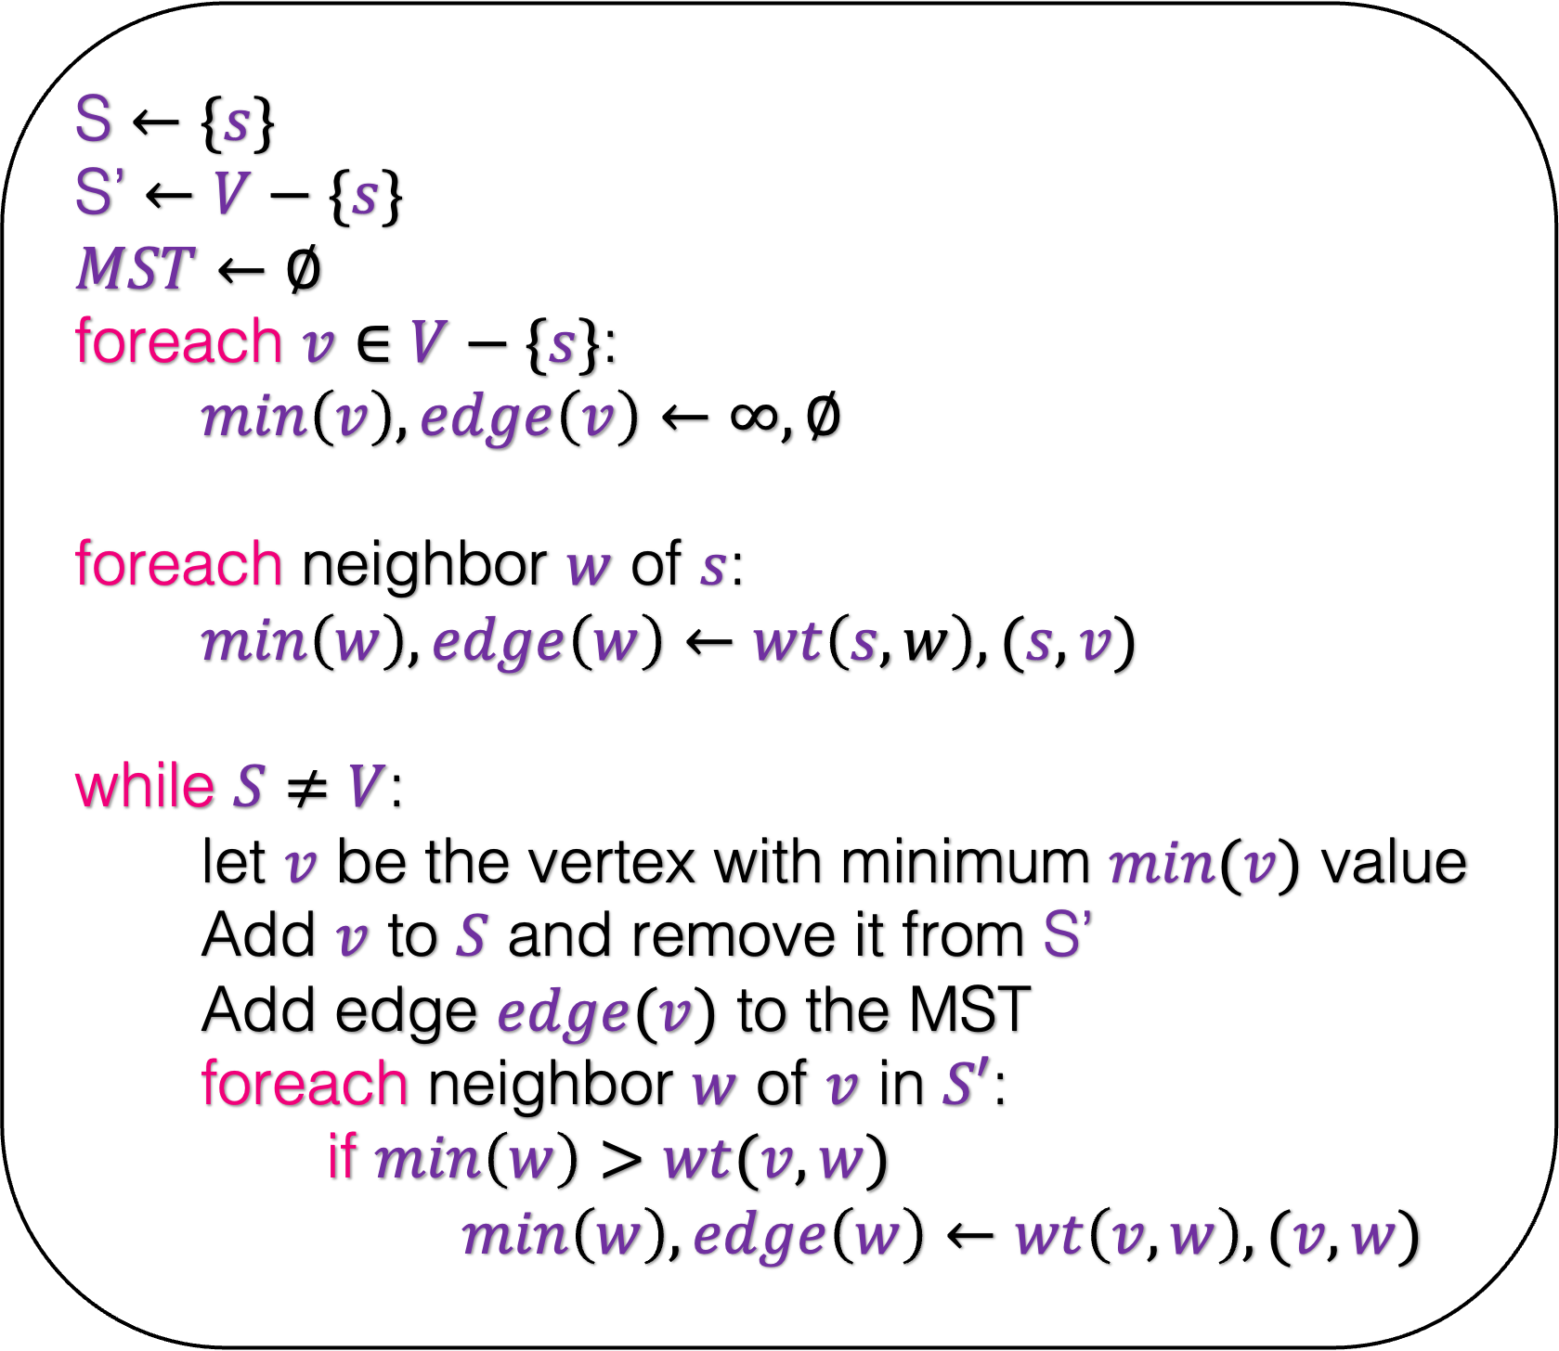
S $←\{s\}$
S’ $←V−\{s\}$
$MST$ $←∅$
foreach $v∈V−\{s\}$:
$min\left(v\right),edge\left(v\right)←∞,∅$
foreach neighbor $w$ of $s$:
$min\left(w\right),edge\left(w\right)←wt\left(s,w\right),(s,v)$
while $S≠V$:
let $v$ be the vertex with minimum $min(v)$ value
Add $v$ to $S$ and remove it from S’
Add edge $edge(v)$ to the MST
foreach neighbor $w$ of $v$ in $S′$:
if $min\left(w\right)>wt(v,w)$
$min\left(w\right),edge\left(w\right)←wt\left(v,w\right),(v,w)$
How would you implement this algorithm?
Use Heaps!!!

Slide 52



A quick detour: Heaps
Operations on Heaps
Inserting a key
Deleting the minimum
Decreasing a key
O($\log{n}$)
O($\log{n}$)
O($\log{n}$)

Slide 53

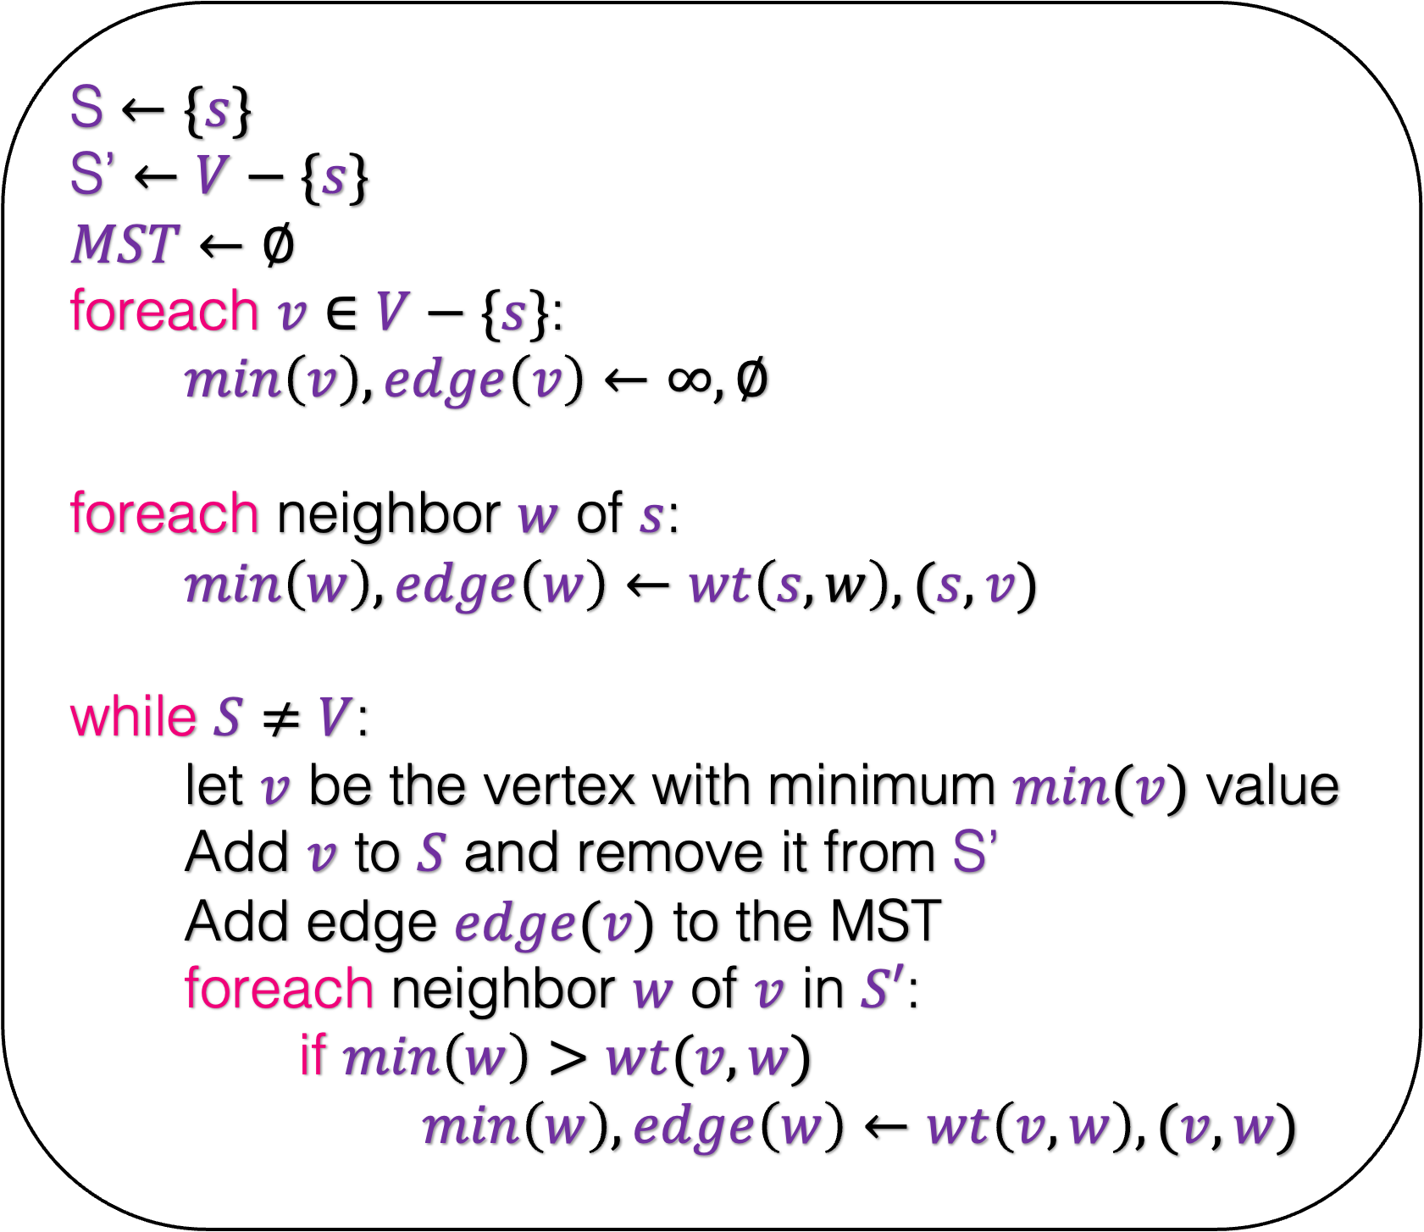



S $←\{s\}$
S’ $←V−\{s\}$
$MST$ $←∅$
foreach $v∈V−\{s\}$:
$min\left(v\right),edge\left(v\right)←∞,∅$
foreach neighbor $w$ of $s$:
$min\left(w\right),edge\left(w\right)←wt\left(s,w\right),(s,v)$
while $S≠V$:
let $v$ be the vertex with minimum $min(v)$ value
Add $v$ to $S$ and remove it from S’
Add edge $edge(v)$ to the MST
foreach neighbor $w$ of $v$ in $S′$:
if $min\left(w\right)>wt(v,w)$
$min\left(w\right),edge\left(w\right)←wt\left(v,w\right),(v,w)$
How would you implement this algorithm?
Use Heaps!!!
$$O(\log{n)}$$
$$O(\log{n)}$$
$$O(\log{n)}$$
$$O(\log{n)}$$

Slide 54



S $←\{s\}$
S’ $←V−\{s\}$
$MST$ $←∅$
foreach $v∈V−\{s\}$:
$min\left(v\right),edge\left(v\right)←∞,∅$
foreach neighbor $w$ of $s$:
$min\left(w\right),edge\left(w\right)←wt\left(s,w\right),(s,v)$
while $S≠V$:
let $v$ be the vertex with minimum $min(v)$ value
Add $v$ to $S$ and remove it from S’
Add edge $edge(v)$ to the MST
foreach neighbor $w$ of $v$ in $S′$:
if $min\left(w\right)>wt(v,w)$
$min\left(w\right),edge\left(w\right)←wt\left(v,w\right),(v,w)$
How would you implement this algorithm?
O($n\log{n}$)
Use Heaps!!!
O($deg(s)\log{n}$)
What is the running time of the algorithm?
O($deg(v)\log{n}$)

Slide 55
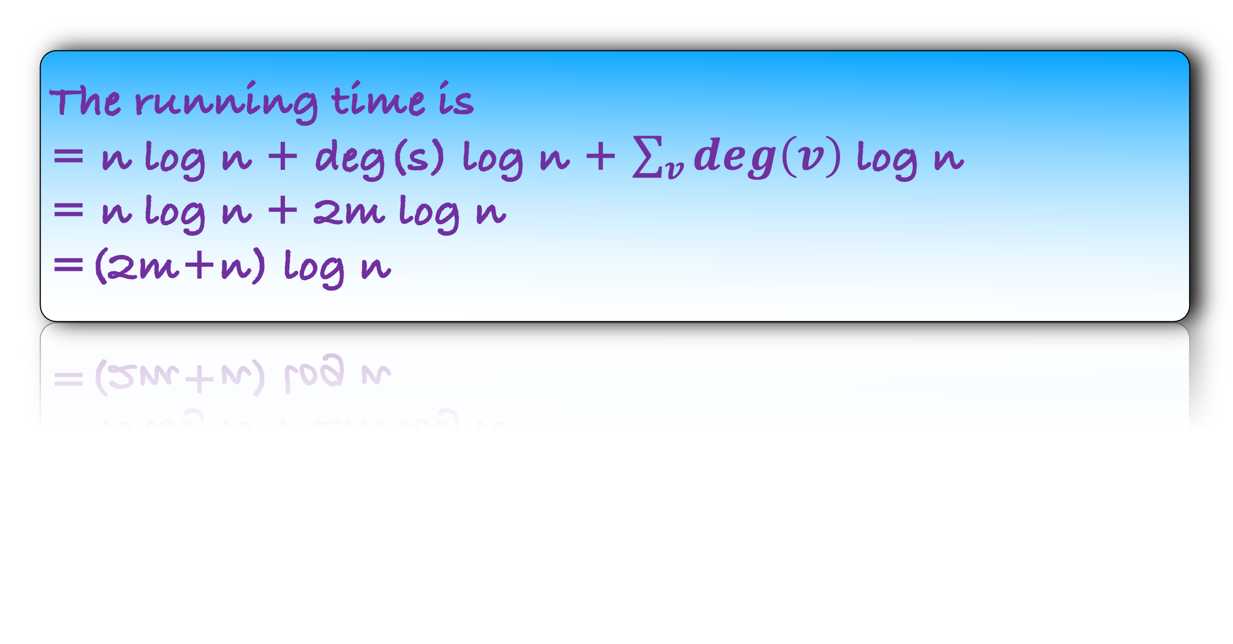
S $←\{s\}$
S’ $←V−\{s\}$
$MST$ $←∅$
foreach $v∈V−\{s\}$:
$min\left(v\right),edge\left(v\right)←∞,∅$
foreach neighbor $w$ of $s$:
$min\left(w\right),edge\left(w\right)←wt\left(s,w\right),(s,v)$
while $S≠V$:
let $v$ be the vertex with minimum $min(v)$ value
Add $v$ to $S$ and remove it from S’
Add edge $edge(v)$ to the MST
foreach neighbor $w$ of $v$ in $S′$:
if $min\left(w\right)>wt(v,w)$
$min\left(w\right),edge\left(w\right)←wt\left(v,w\right),(v,w)$
How would you implement this algorithm?
O($n\log{n}$)
Use Heaps!!!
O($deg(s)\log{n}$)
What is the running time of the algorithm?
Observation: Every time a vertex v is removed from the heap, we do a work of deg(v) log n
O($deg(v)\log{n}$)
The running time is
= n log n + deg(s) log n + $\sum_{v}{deg\left(v\right)}$ log n
= n log n + 2m log n
=(2m+n) log n

Slide 56
Write a complete code of Prim’s algorithm in your preferred programming language.

