Slide 1
Design Line Template Copy
From EXCEL template
This is a separate python script to copy and paste CPT and Lab data into excel design line template.
Deign lines should be entered manually in excel sheets after CPT and Lab data are plotted by this python tool

Slide 2
Main inputs
DL_input_file.xlsx - Excel file containing input data
Su_DL_template.xlsx – Excel template (change per parameter)
From GIR tool
All_CPTs.xlsx – cpt correlation data for all the locations
Lab_data_per_unit.xlsx – lab data per units (Inside lab_data_per_units folder)
Parameter comparison.xlsx – lab data per units (Inside parameter_comparison folder)

Slide 3
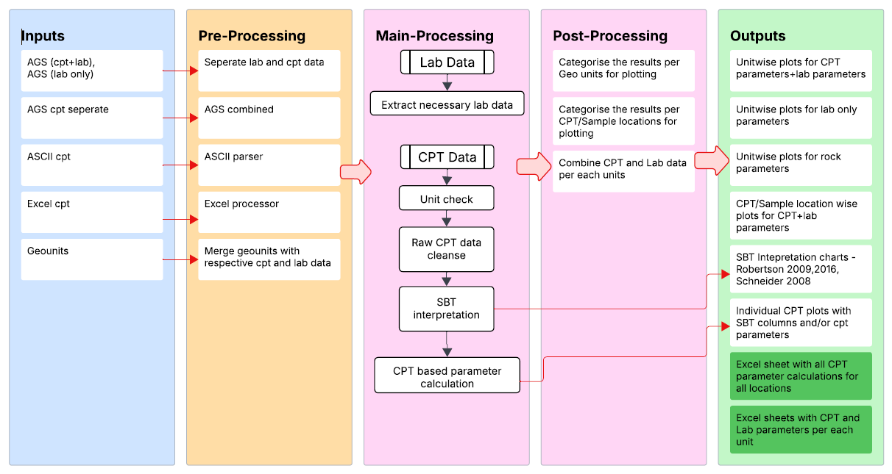
Flow diagram of the GIR python tool
Main Excel User Input
CPT Parameter comparison per location
Output files needed as inputs of DL_template_copy

Slide 4
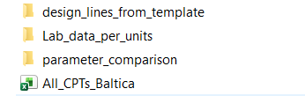
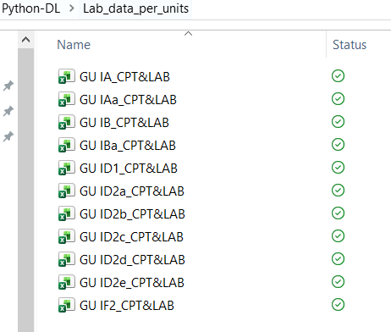
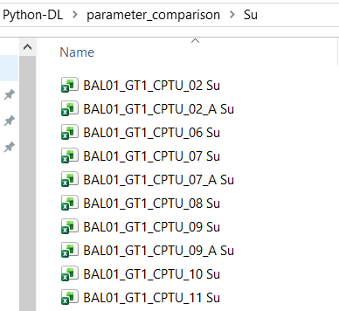
Inputs from GIR tool
Master CPT output file containing all locations
Lab data per units (saved in a folder)
CPT parameter comparison (saved in a folder)
OPTIONAL

Slide 5
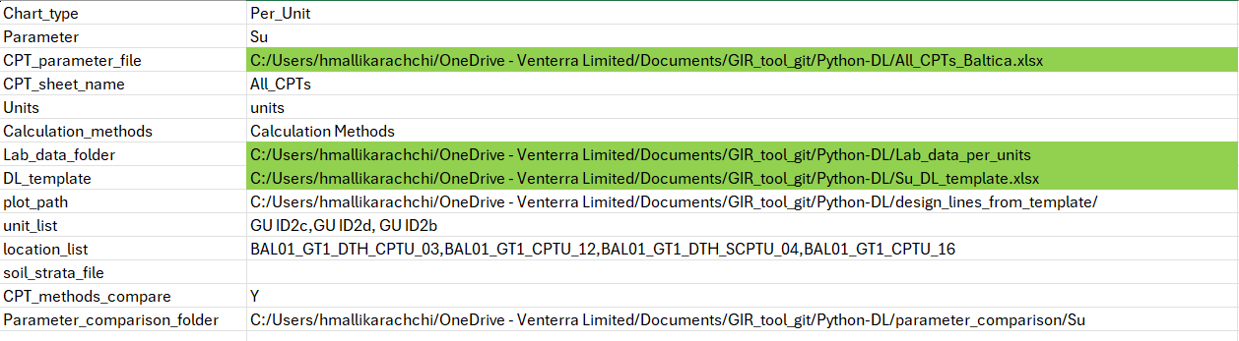
Main - DL_input_file.xlsx
Per_Location or Per_Unit
Outputs from GIR tool
Change DL_template based on parameter (with changed chart names, as modification to charts can not be done in python)
CPT_method compare is optional, if only different cpt correlations are plotted together

Slide 6
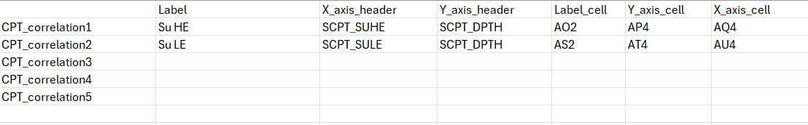
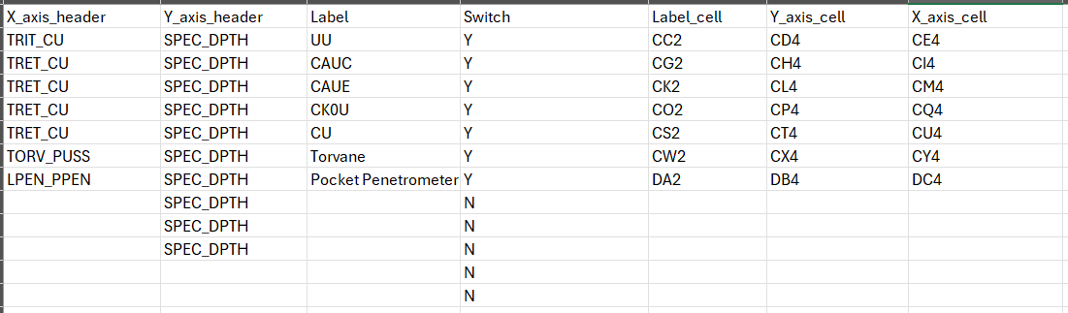
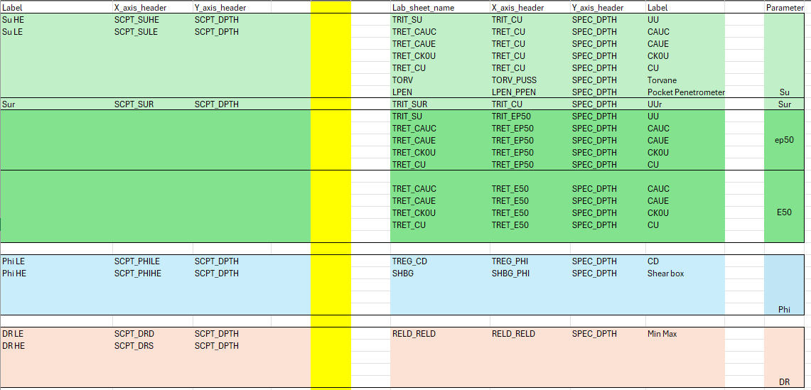
Plotting options - DL_input_file.xlsx
To_plot_CPT
To_plot_Lab
Copy
Depending on the required parameter, change To_plot_CPT and To_plot_Lab sheets
Tab Copy in input excel contains all labels, x-header, y-header options for all parameters.
(Don’t change cell names)
Copy from copy sheet and paste in To_plot_CPT and To_plot_Lab sheets

Slide 7
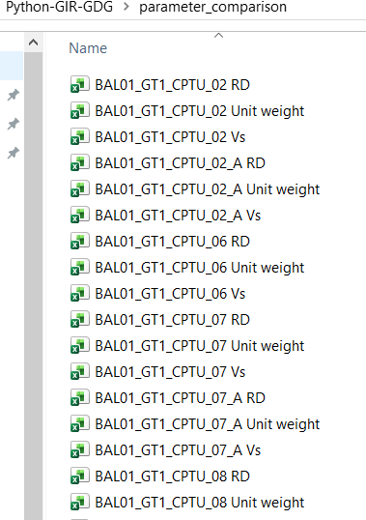
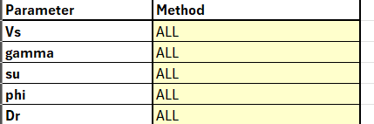
Optional: CPT method comparison (per units or per location)
GIR tool – set methods to ALL

Slide 8
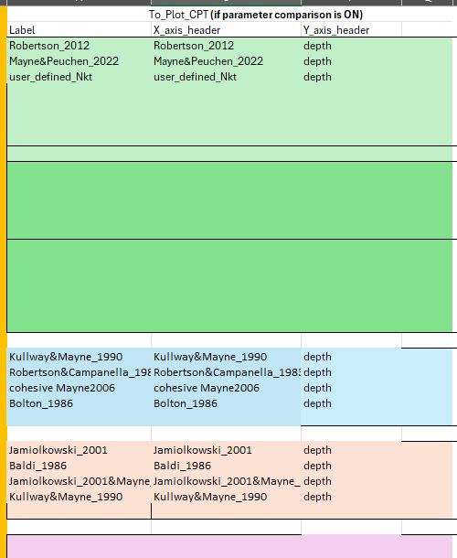
Optional: CPT method comparison
To_plot_CPT
Copy from copy sheet and paste in To_plot_CPT sheet
NO change in To_plot_LAB sheet

Slide 9
Limitations
Currently separate excel sheets are prepared for each location/unit (Can not combine)
Excel sheets should be manually combined

