Slide 1
WebGPT
(Task 2: Chat with Website Using RAG Pipeline)
By - Hema Boddupally, Final-year BTech Student at VMTW, Ghatkesar

Slide 2
Problem Statement
To implement a Retrieval-Augmented Generation (RAG) pipeline that allows users to interact with structured and unstructured data extracted from websites. The system will crawl, scrape, and store website content, convert it into embeddings, and store it in a vector database. Users can query the system for information and receive accurate, context-rich responses generated by a selected LLM.

Slide 3
Architecture

Slide 4
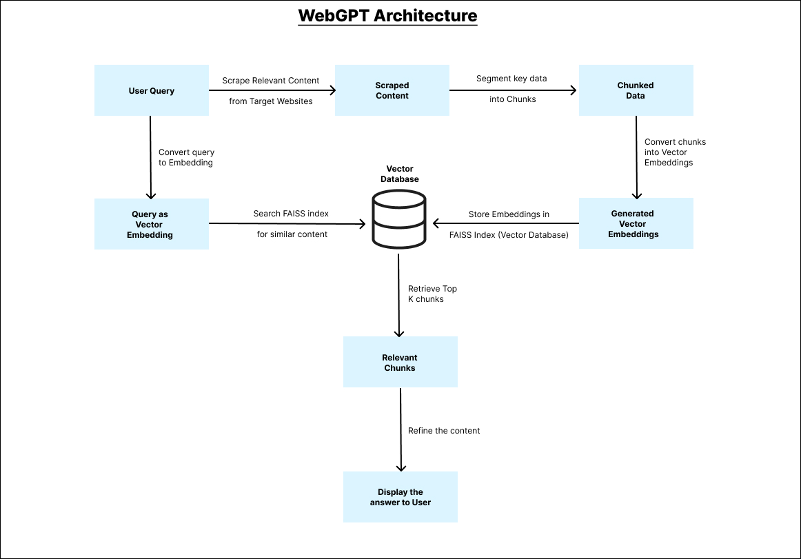

Slide 5
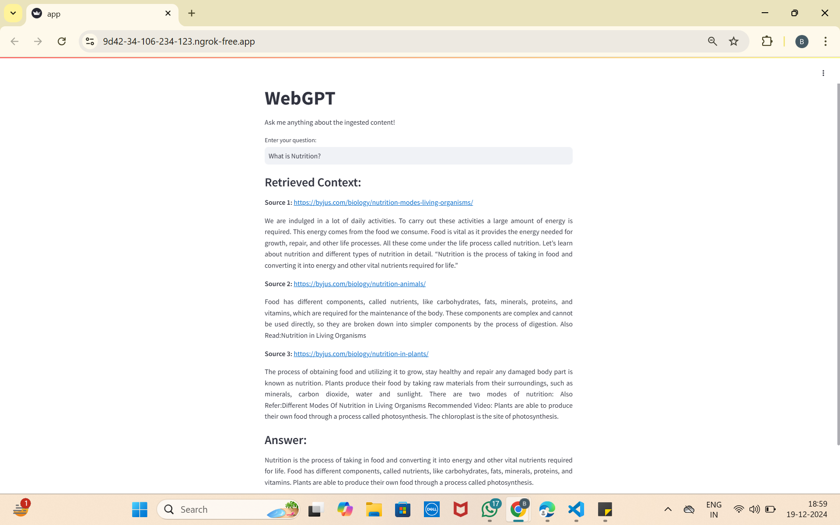
Demo

Slide 6
Code Walkthrough

Slide 7
Outcomes of Project

Slide 8
Thank You!

