Slide 1
Federated Traffic Sign Recognition under Non-IID Label Distributions: A GTSRB Study of FedAvg and FedProx
Student Name: Ma He
Faculty supervisor: Song Linqi
Institution: City University of Hong Kong
Submission date: 31 July 2026

Slide 2

Why Federated Learning for Traffic Sign Recognition?
Distributed Vehicle Data
Traffic-sign images are generated across different vehicles and driving environments.
Privacy-Preserving Collaboration
Federated learning enables vehicles to train a shared model without uploading raw images.
Non-IID Data Challenge
Different vehicles may observe different traffic-sign classes and class frequencies.
Research Question
How robust is FedAvg under non-IID label distributions, and can FedProx mitigate the resulting performance degradation?

Slide 3


Research Framework
Stage 1A Baseline
Stage 1B
Non-IID Analysis
Stage 1C FedProx
IID Setting
Centralized
Local-only
FedAvg
Non-IID Setting
Dirichlet Partition
α = 10, 1, 0.5, 0.1
FedProx
μ = 0 vs μ = 0.1
α = 0.5 and α = 0.1
Introduce controlled label skew using Dirichlet client partitions.
Establish the complete federated learning pipeline under an approximately IID setting.
Evaluate whether proximal regularisation improves robustness under strong label skew.
Severe degradation emerged at α = 0.1.
Control Principle:
Keep the dataset, model, client partitions and training budget fixed, and change one research factor at a time.

Slide 4

Dataset and Experimental Setup
Dataset
GTSRB traffic-sign classification
39,209 training images
12,630 official test images
43 traffic-sign classes
RGB images resized to 32 × 32
Federated Setting
5 simulated clients
All clients participate in each round
1 local epoch per communication round
Batch size: 64
Formal training budget: 160 rounds
Classification Model
Evaluation Metrics
Official Test Accuracy
Macro Class Accuracy
Test Loss
Controlled across comparisons: dataset, client partitions, model architecture, random seed, official test set and training budget.
Per-class Accuracy
Confusion Matrix

Slide 5
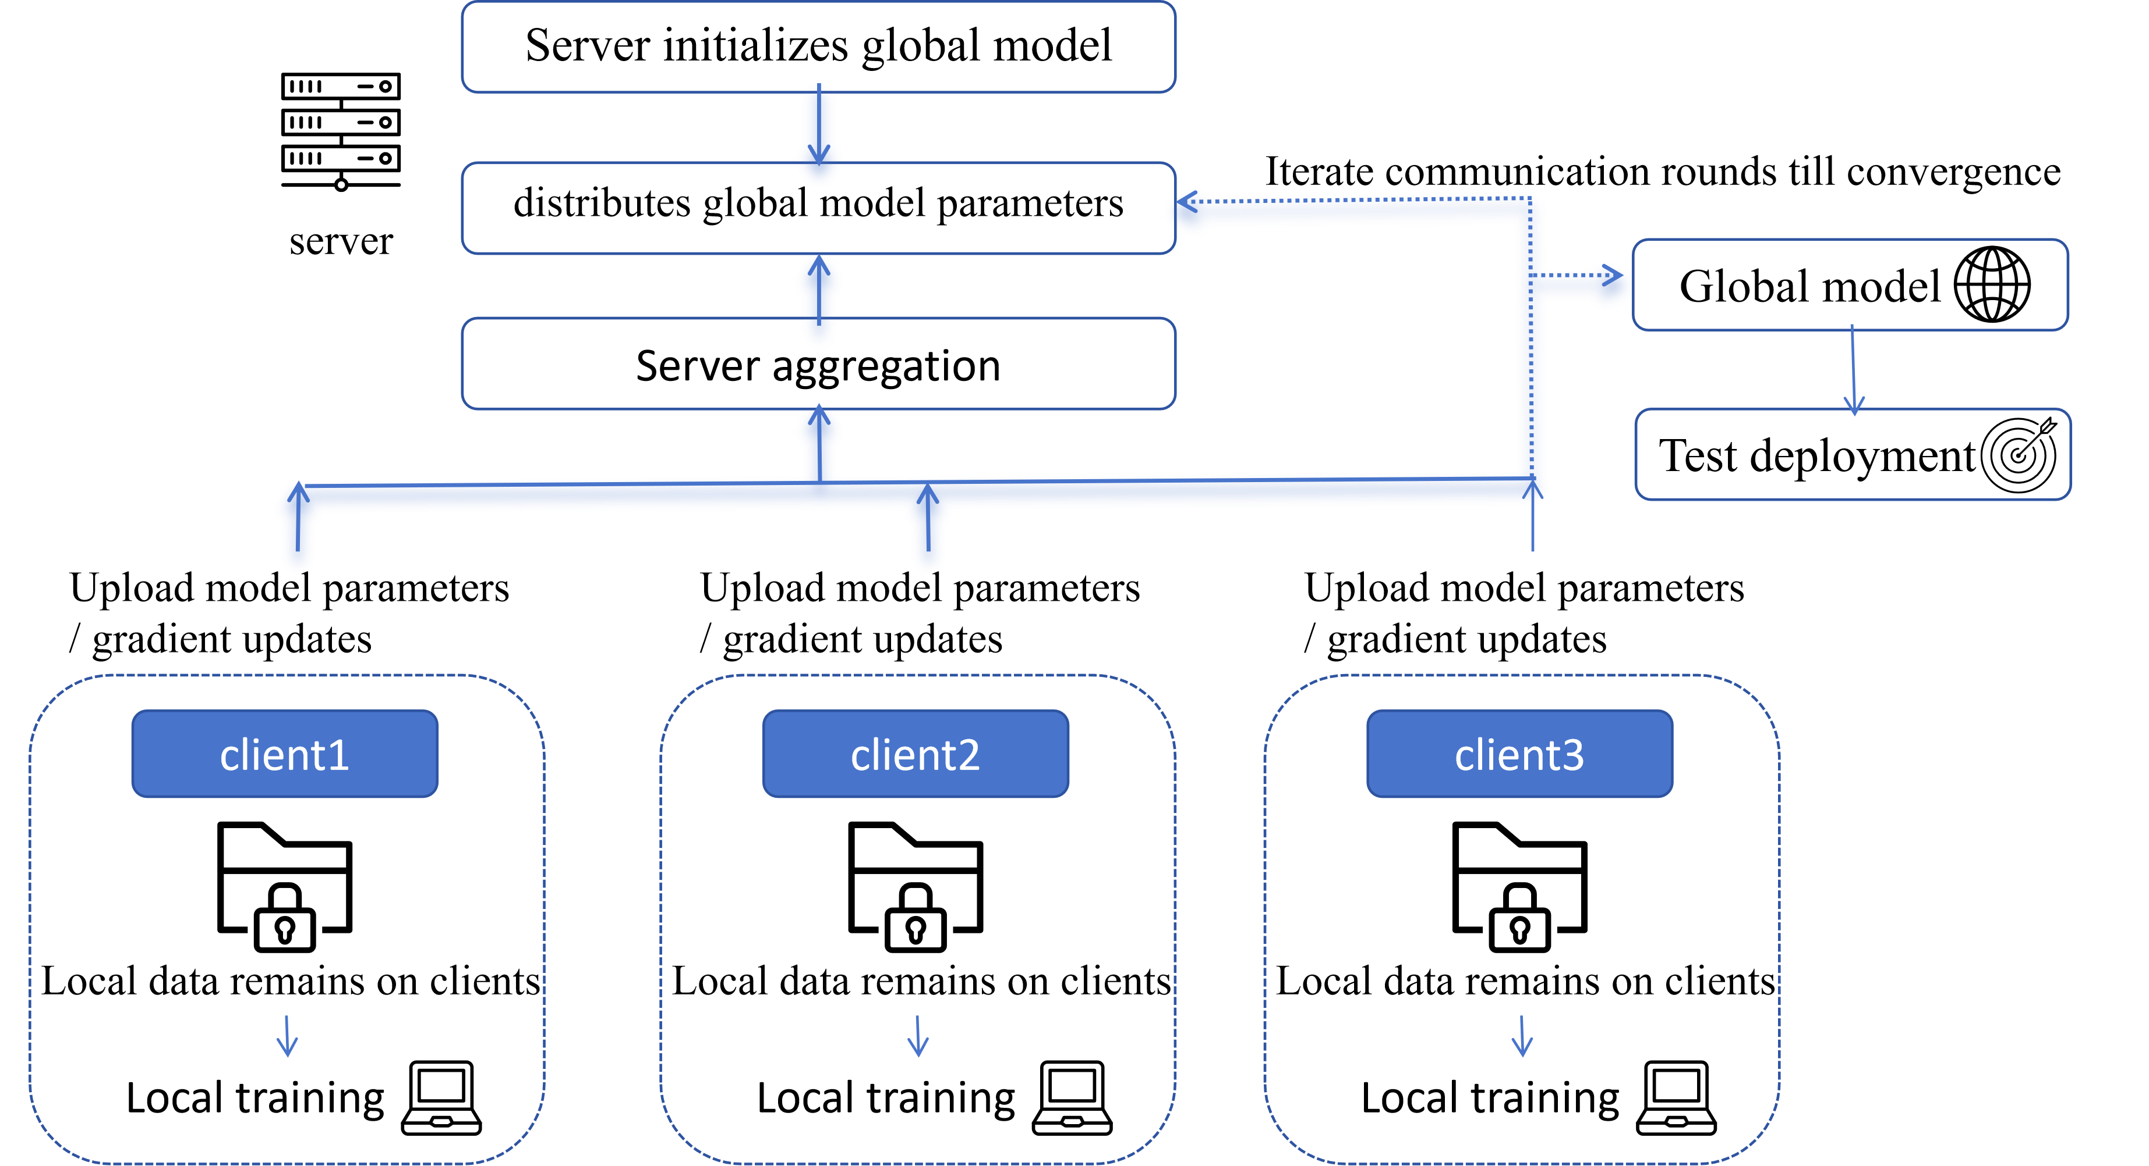


Federated Learning Workflow
Step1:Global Model Distribution
Server broadcasts the current global model
Step2:Local Training
Each client trains for one local epoch
Step3:Model Update Upload
Clients upload model parameters or updates
Step4:Weighted Aggregation
The server aggregates updates according to client sample sizes
Federated Learning Workflow
Illustration only; formal experiments used 5 clients
Step5:Next Communication Round
The updated global model is redistributed
Clients with more training samples receive larger aggregation weights.

Slide 6
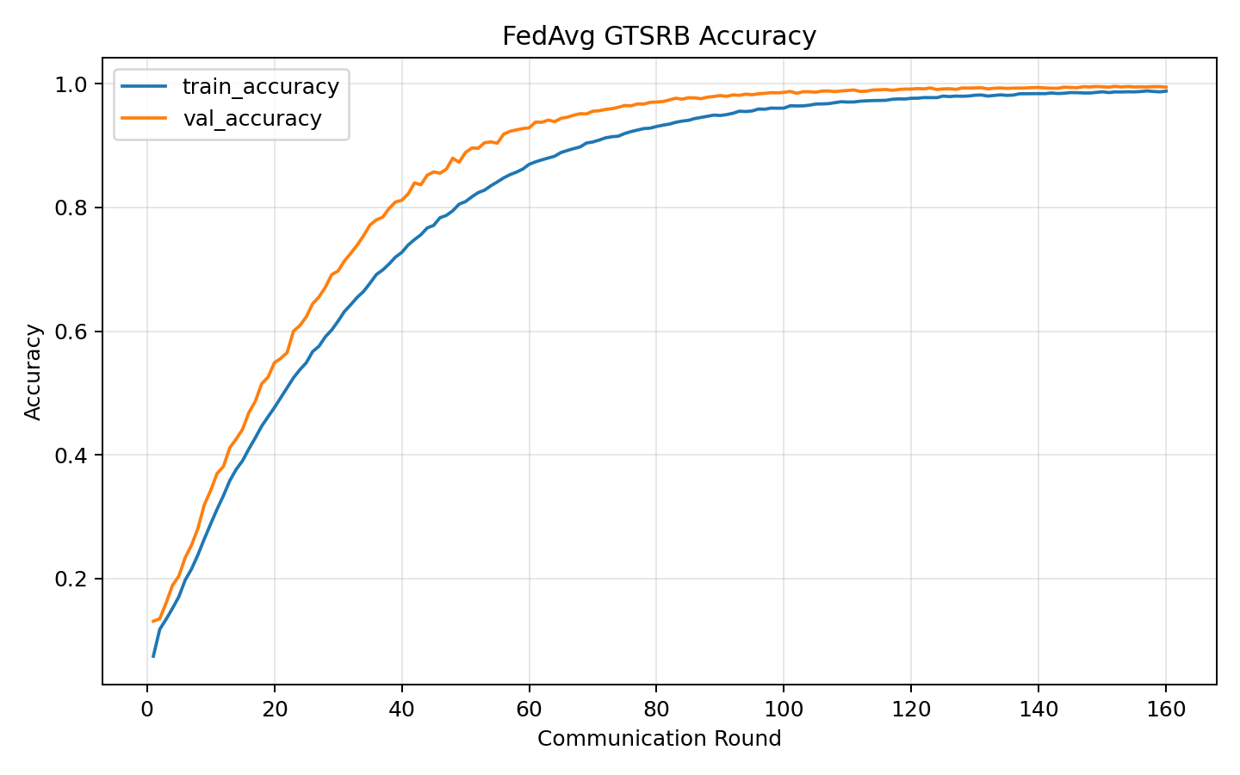
Stage 1A: Baseline Comparison
Centralized vs Local-only vs FedAvg under an approximately IID setting
Method | Test Accuracy | Macro Class Accuracy
Centralized | 91.16% | 88.44%
Local-only Mean | 60.11% | 49.67%
FedAvg | 92.60% | 89.44%
Local-only < FedAvg ≈ Centralized
FedAvg and Centralized used different training budgets; the numerical difference should not be interpreted as strict superiority.

Slide 7
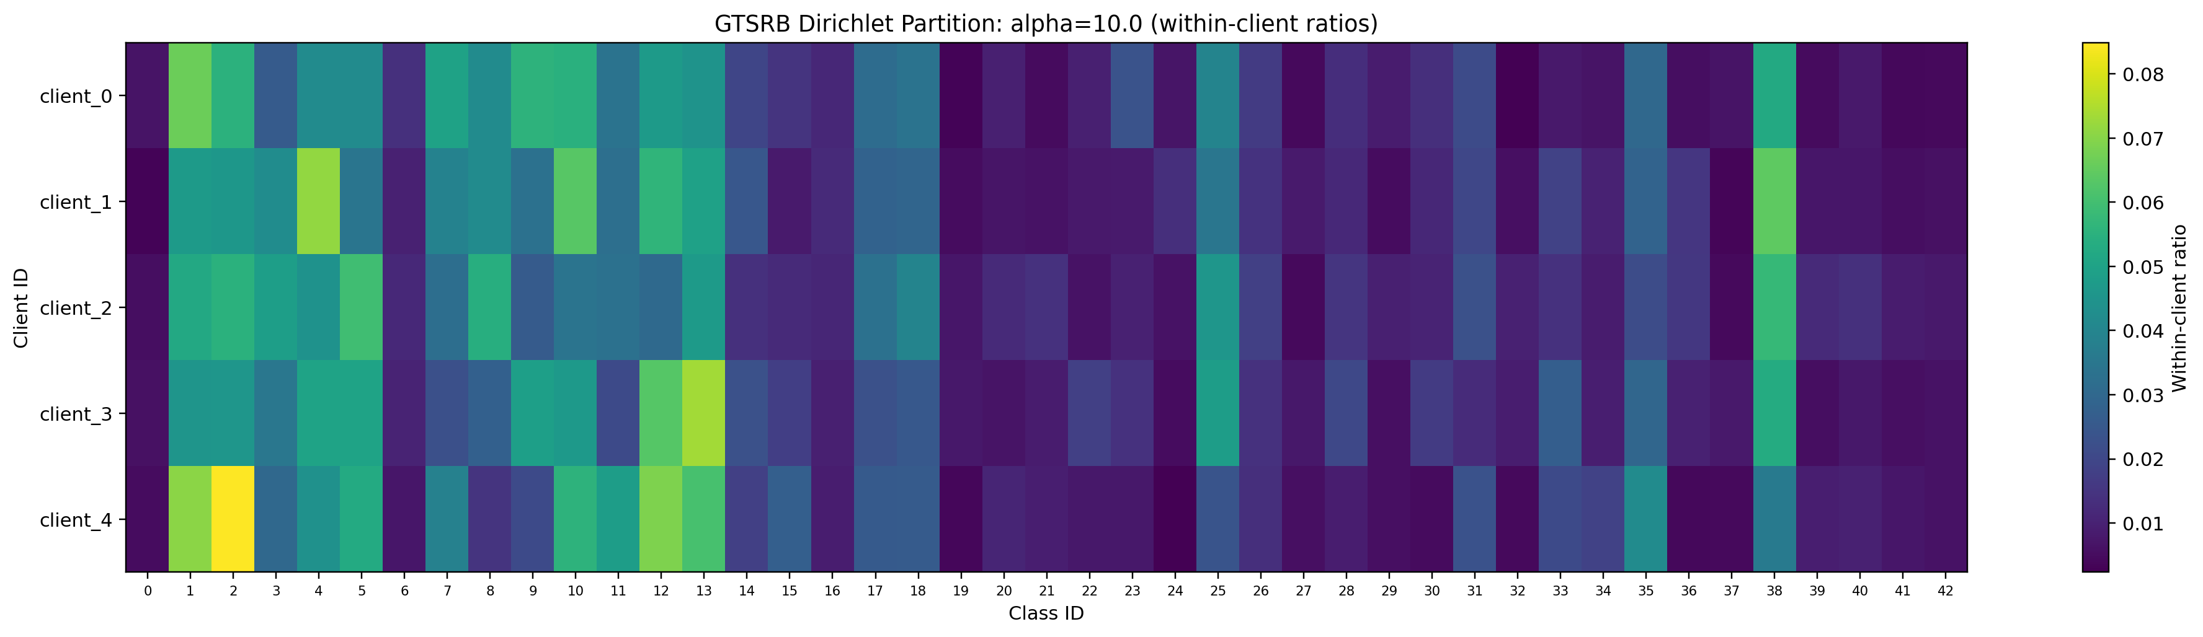
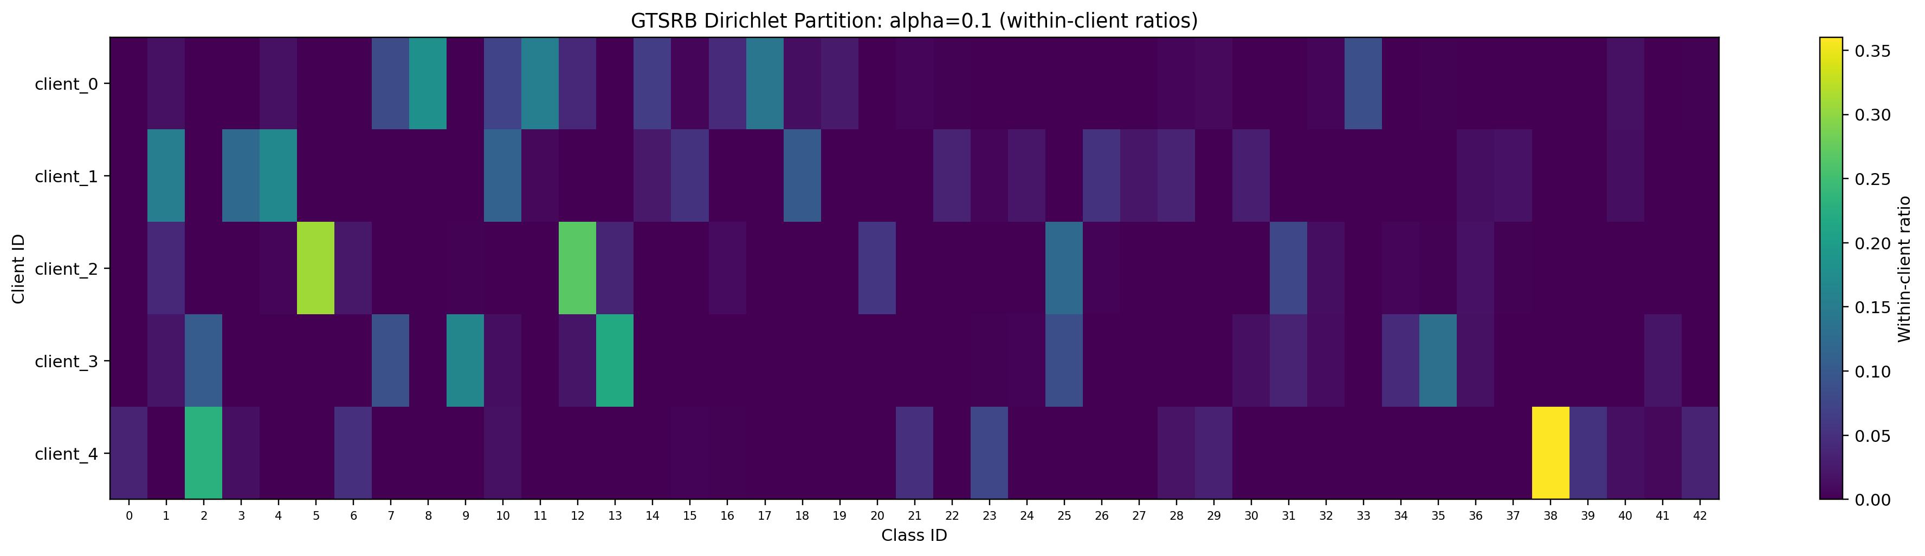
Stage 1B: Non-IID Client Data Distributions
Controlled label skew using Dirichlet partitions
Near-IID: α = 10
All five clients cover all 43 classes.
Mean JS divergence: 0.008
Extreme Non-IID: α = 0.1
Only 16–24 classes per client.
Mean JS divergence: 0.315
Only the client data allocation was changed; the model, training budget and official test set remained fixed.

Slide 8
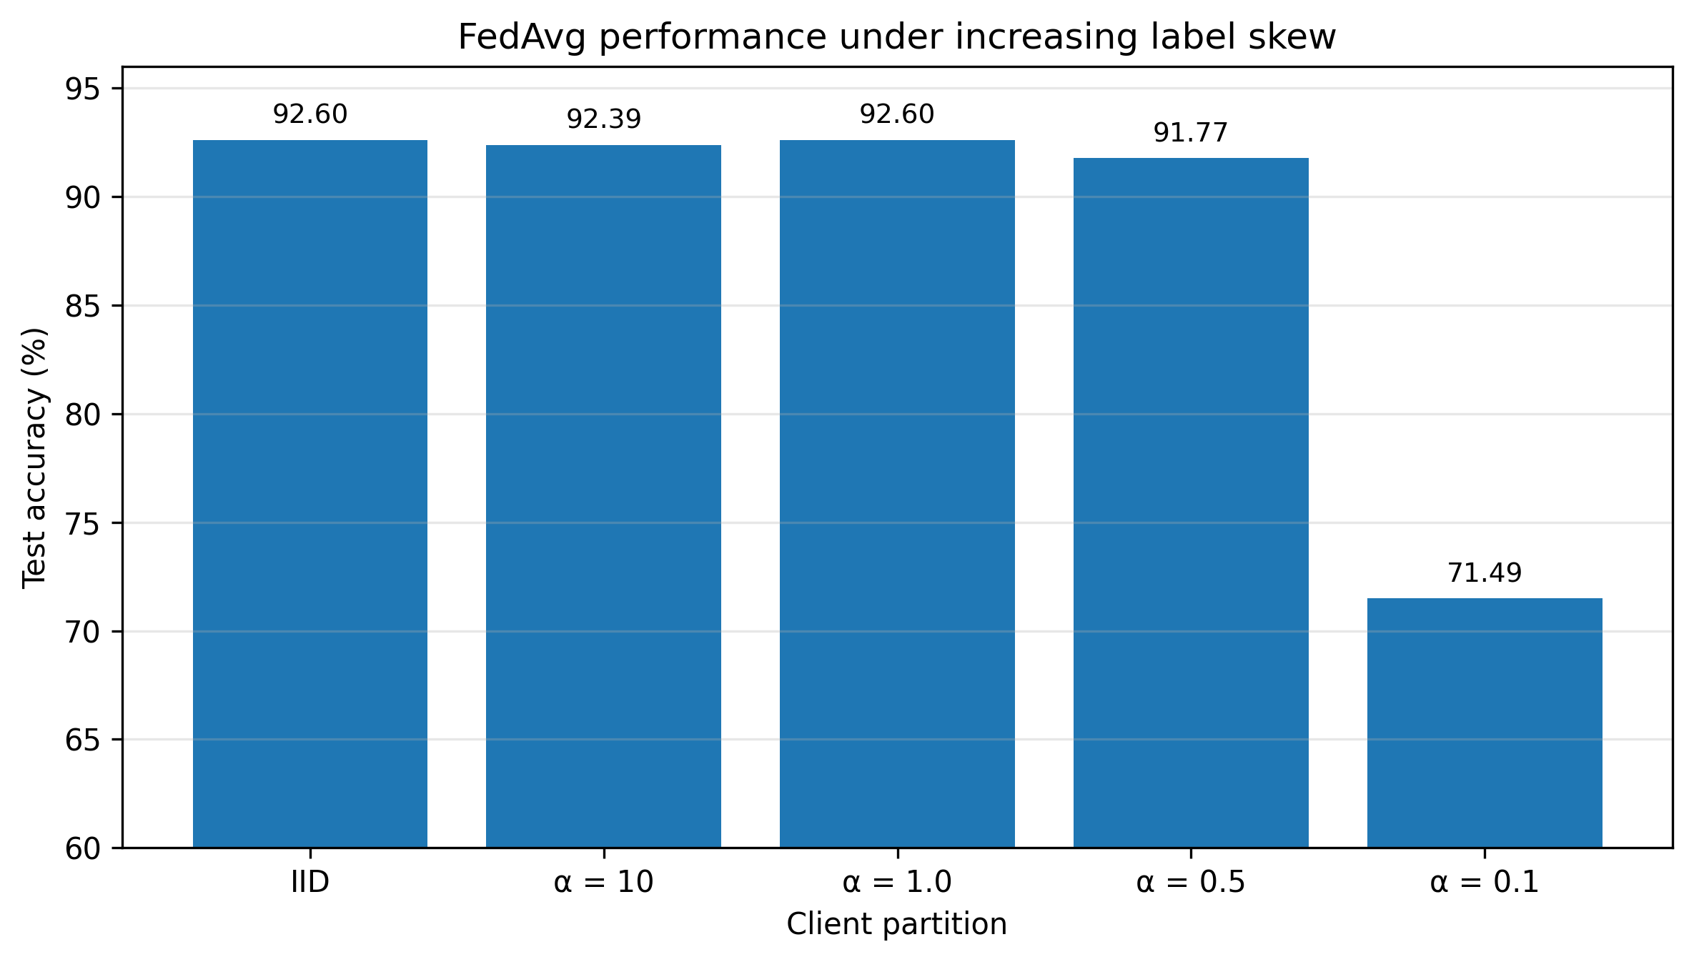
Stage 1B: FedAvg Performance under Increasing Non-IID
Overall performance remained stable until extreme label skew
Key Findings
α = 10 and α = 1.0
Performance remained close to the IID baseline.
α = 0.5
Test accuracy: 91.77%
Macro accuracy: 87.27%
α = 0.1
Test accuracy: 71.49%
Macro accuracy: 69.42%
Main Takeaway: FedAvg was robust to mild and moderate label skew, but degraded sharply under extreme heterogeneity.

Slide 9
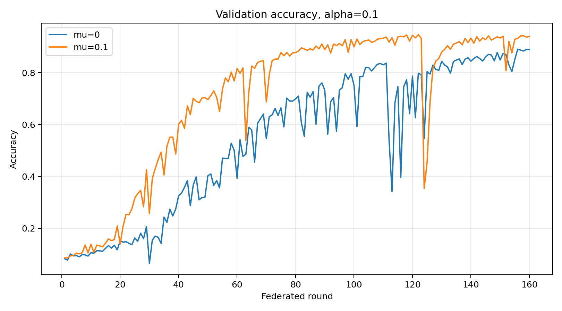
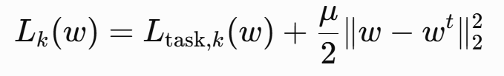
Stage 1C-A1: FedProx under Strong Label Skew
Constraining local models from drifting too far from the global model
μ = 0: FedAvg-equivalent control
μ = 0.1: FedProx with proximal regularisation
Same initial model, partition, data order, optimiser and training budget; only μ was changed.

Slide 10
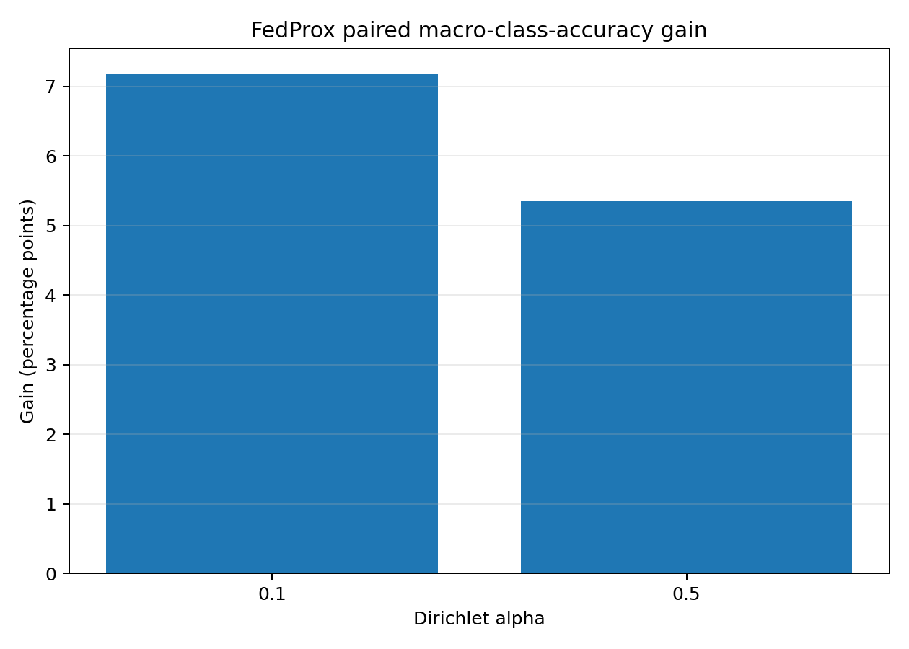
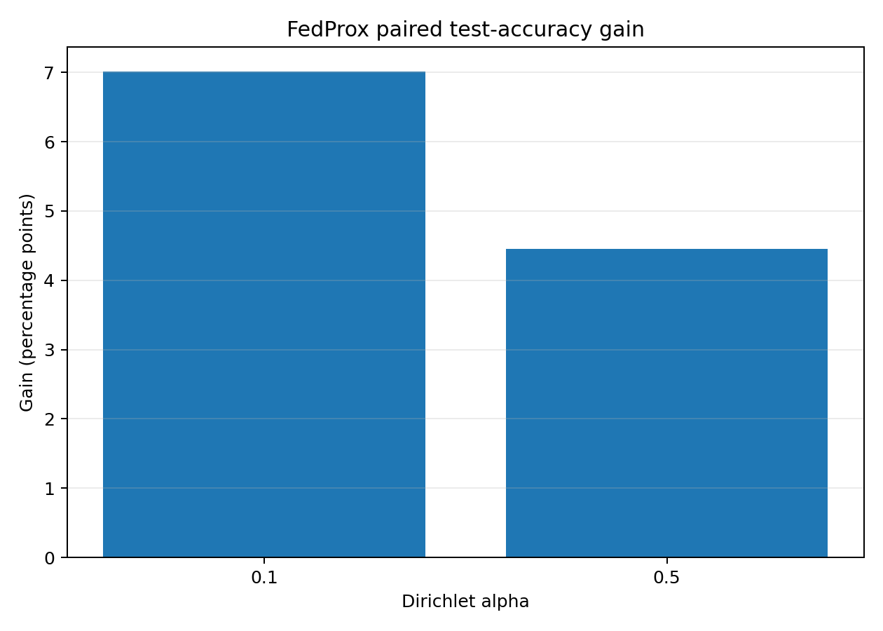
Stage 1C-A1: Strictly Paired FedProx Results
FedProx improved both overall and class-balanced performance
α = 0.1: Test +7.02 pp · Macro +7.19 pp
α = 0.5: Test +4.46 pp · Macro +5.35 pp

Slide 11
Conclusions, Limitations and Future Work
Limitations
Single random seed
Five simulated clients
Full client participation
One local epoch per round
GTSRB label-skew setting only
No statistical significance test
Key Conclusions
1. FedAvg was effective under approximately IID data.
It substantially outperformed Local-only training and achieved performance comparable to Centralized training.
2. FedAvg was robust to moderate label skew.
Performance remained stable at α ≥ 1, but class-level degradation appeared at α = 0.5.
3. Extreme label skew caused severe degradation.
At α = 0.1, both test and macro accuracy dropped sharply.
4. FedProx provided a consistent partial mitigation.
μ = 0.1 improved both overall and macro accuracy in the strictly paired experiments.
Future Work
1、SCAFFOLD: Correct client update directions using control variates.
2、MOON: Introduce representation-level contrastive learning.
3、FedBN: Study feature and scene heterogeneity with local BN states.
4、Communication Optimisation: Explore quantisation and sparsification.

Slide 12
Thank You
I sincerely thank my supervisor for the guidance and support throughout this project, and the CityUHK College of Computing for organising the Summer Research Workshop 2026.

