Slide 1





Server initializes global model
Iterate communication rounds till convergence
distributes global model parameters
server
Global model
Server aggregation
Test deployment
Upload model parameters / gradient updates
Upload model parameters / gradient updates
Upload model parameters / gradient updates
client1
client2
client3
Local data remains on clients
Local data remains on clients
Local data remains on clients
Local training
Local training
Local training

Slide 2
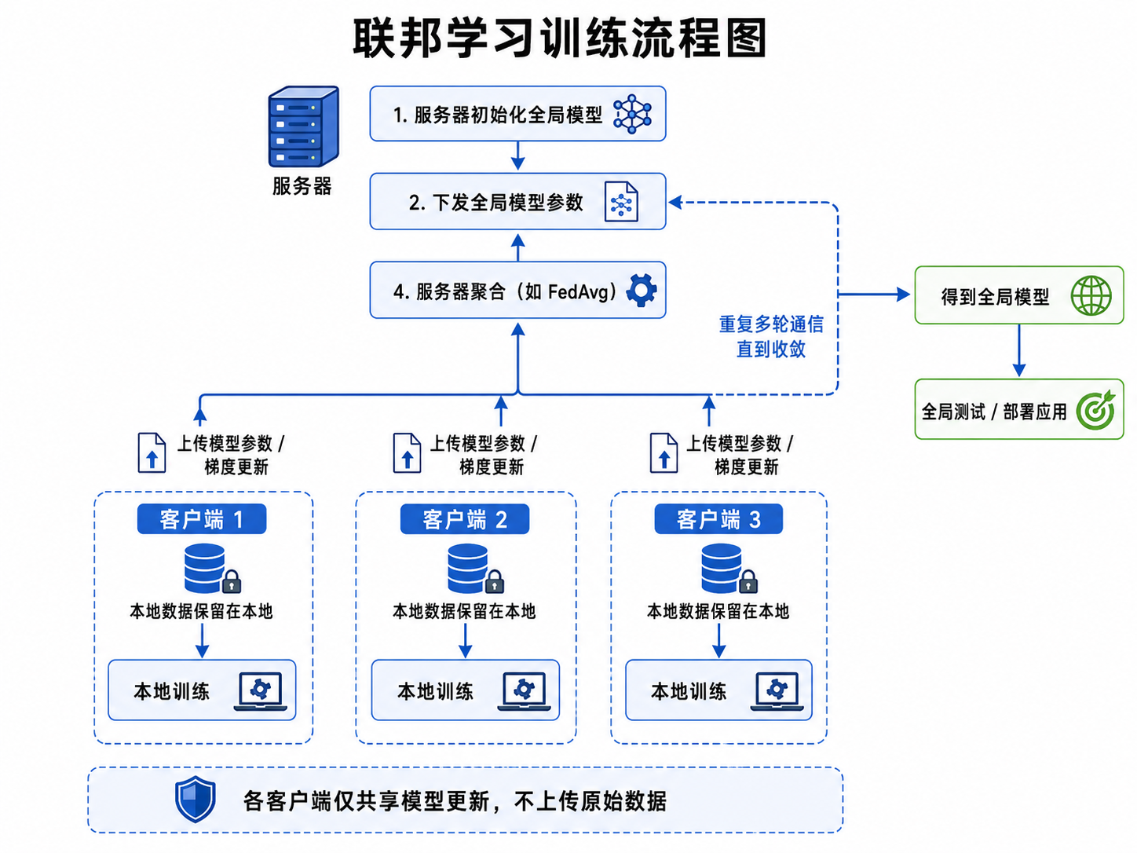

Slide 3
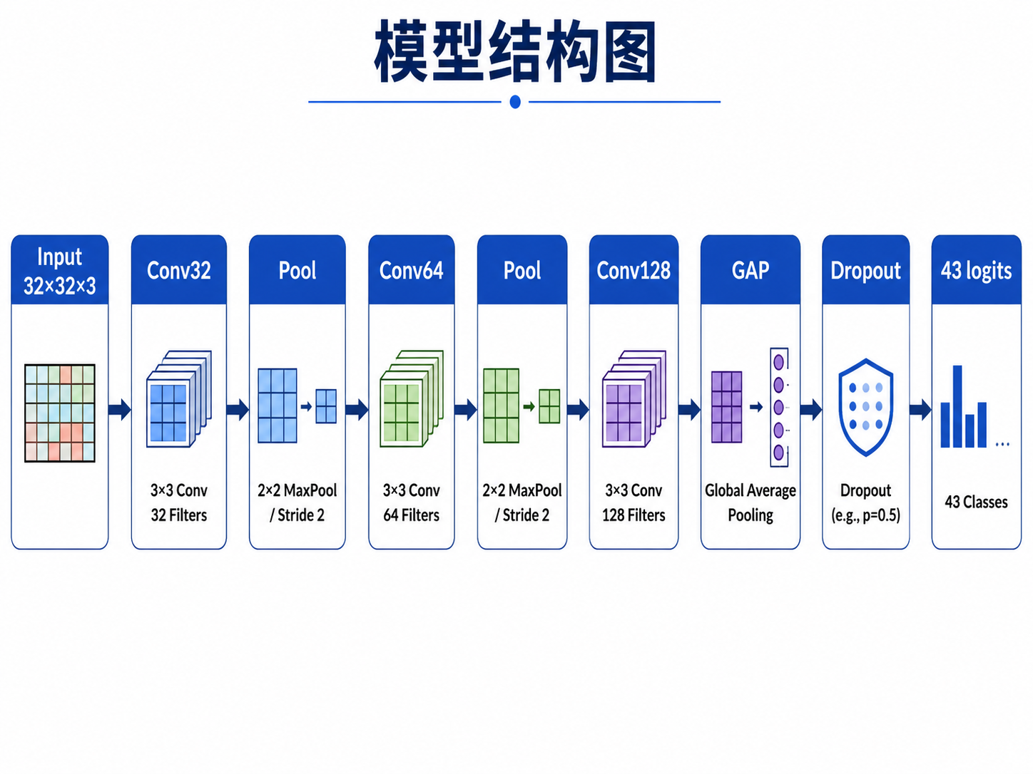

Slide 4
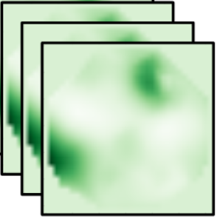
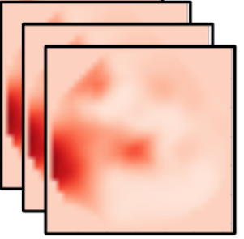
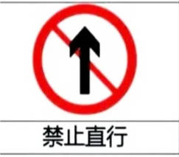
input
32×32×3
Conv2D
32×32×32
MaxPooling2D
16×16×32
Conv2D
6×16×64

Slide 5
