Slide 1
BlueStock Mutual Fund Analytics Capstone Project
Presented By: Hema Mallipudi

Slide 2
Problem Statement
Investors face challenges in:
Comparing mutual funds
Understanding risk-adjusted returns
Tracking investor behavior
Evaluating portfolio diversification

Slide 3
Objectives
Build ETL Pipeline
Create SQLite Database
Perform EDA
Calculate Performance Metrics
Build Power BI Dashboard
Perform Advanced Analytics

Slide 4
Project Architecture
Raw Data ↓ ETL Pipeline ↓ Data Cleaning ↓ SQLite Database ↓ EDA & Analytics → Power BI Dashboard → Business Insights

Slide 5
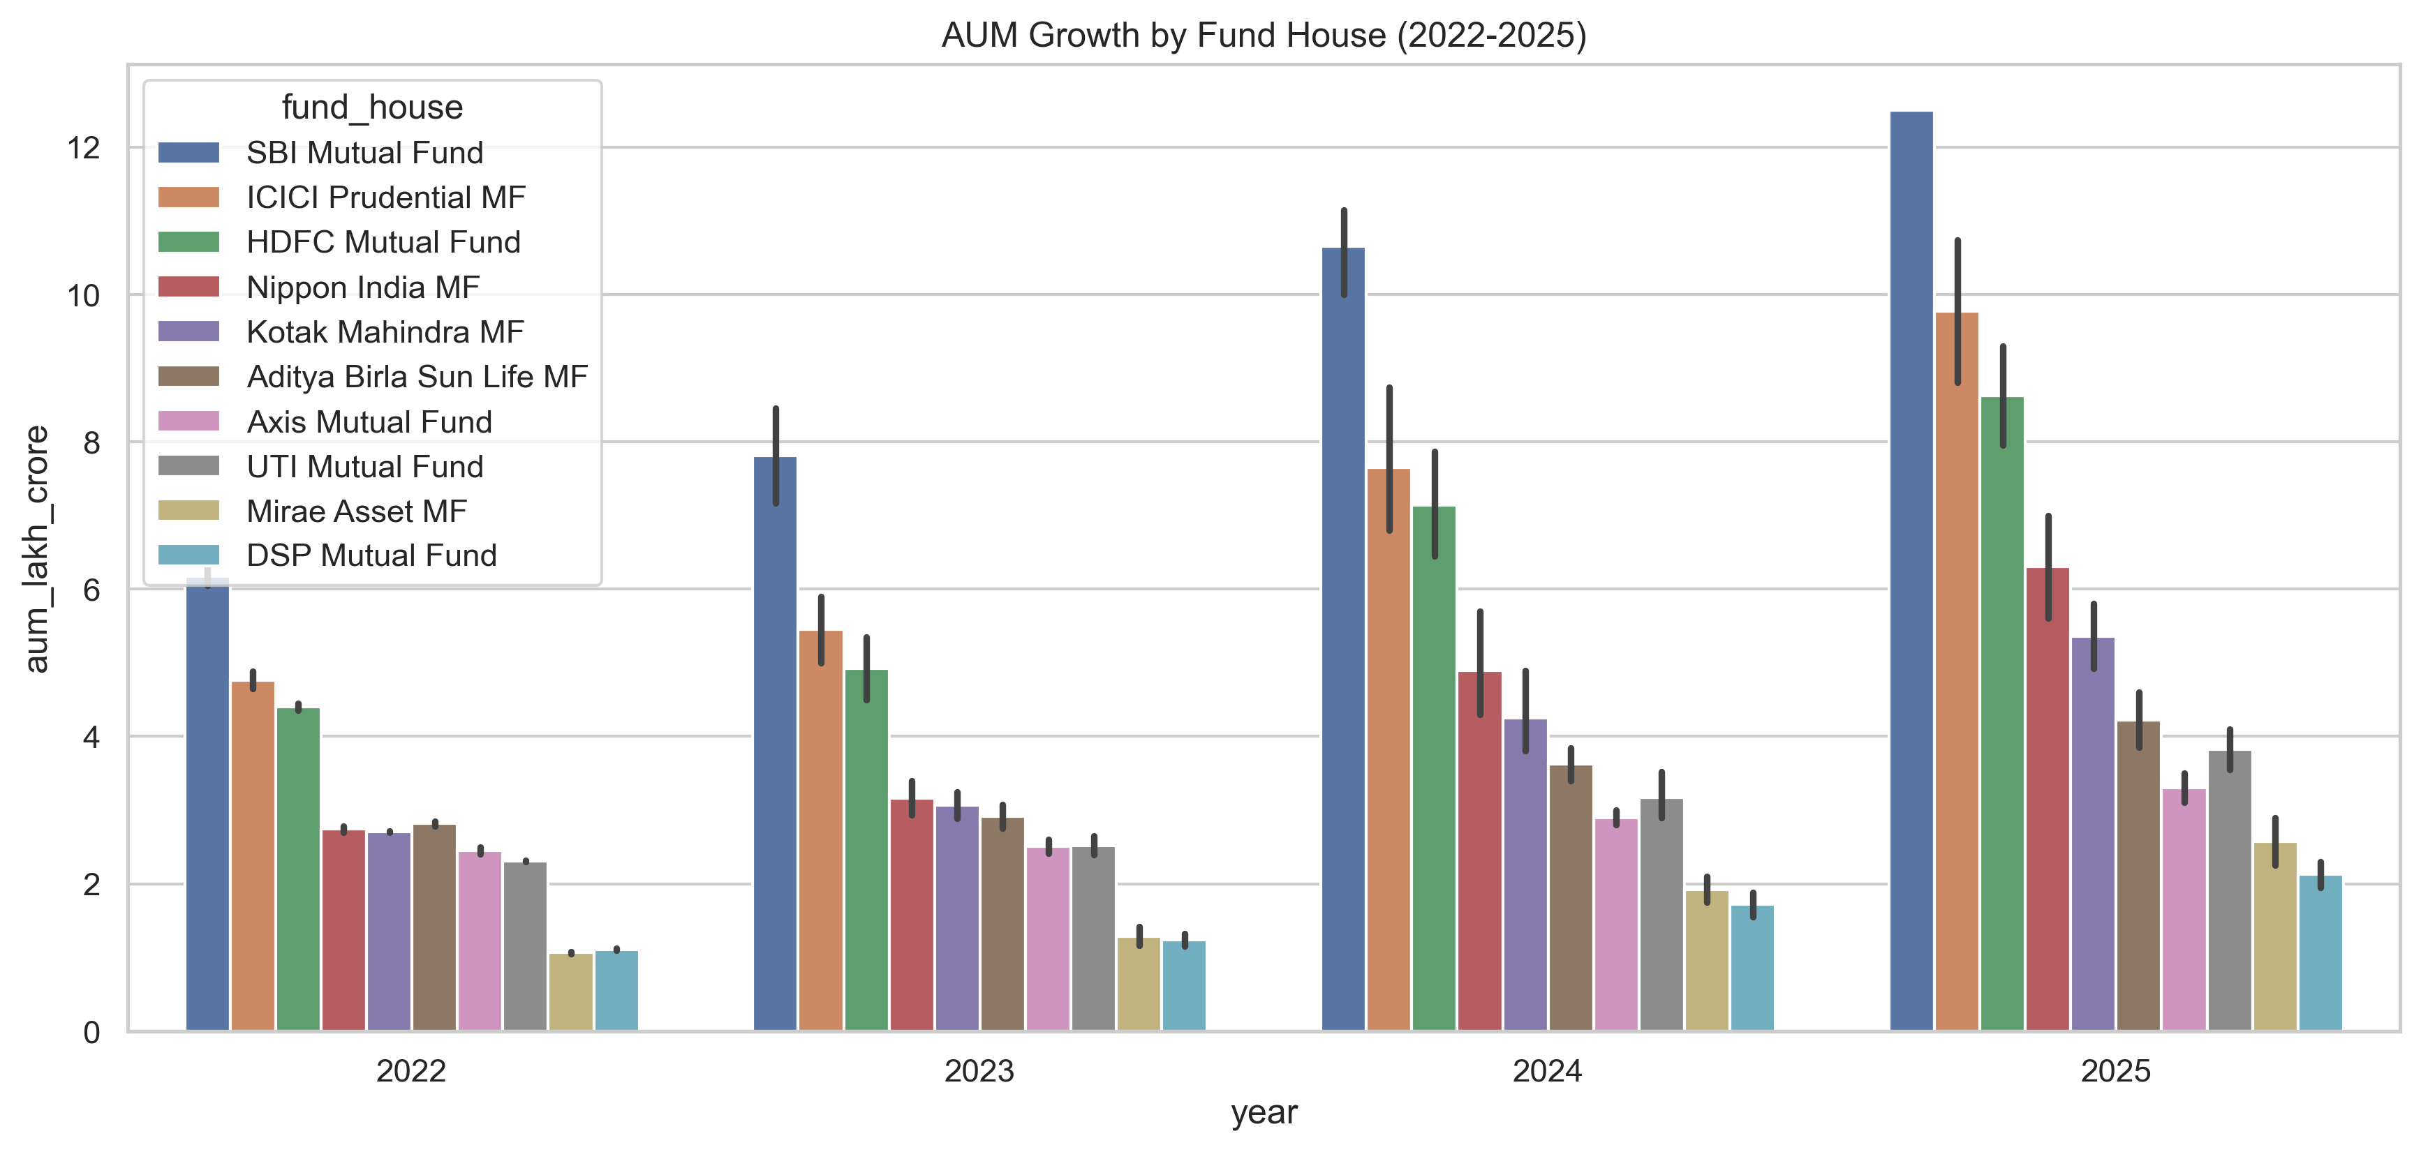
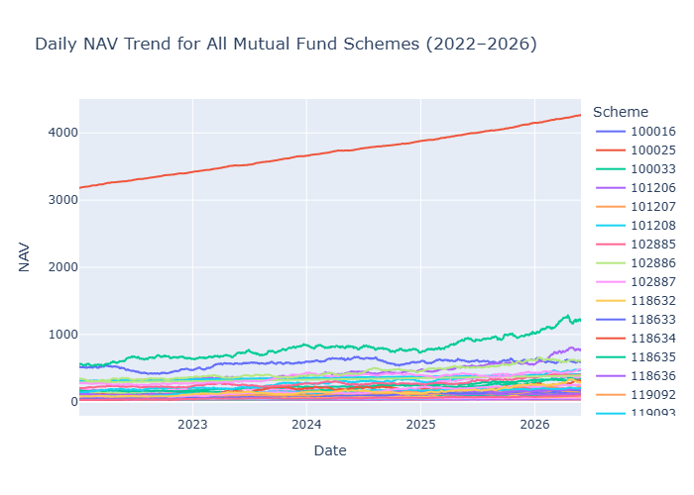
EDA Highlights
AUM Growth Analysis
Key Insight:
Large fund houses dominate industry AUM.
NAV Trend Analysis
Key Insight:
Equity funds showed consistent long-term growth.

Slide 6
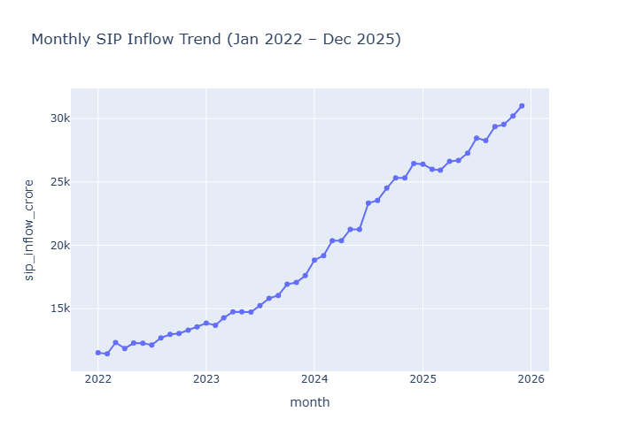
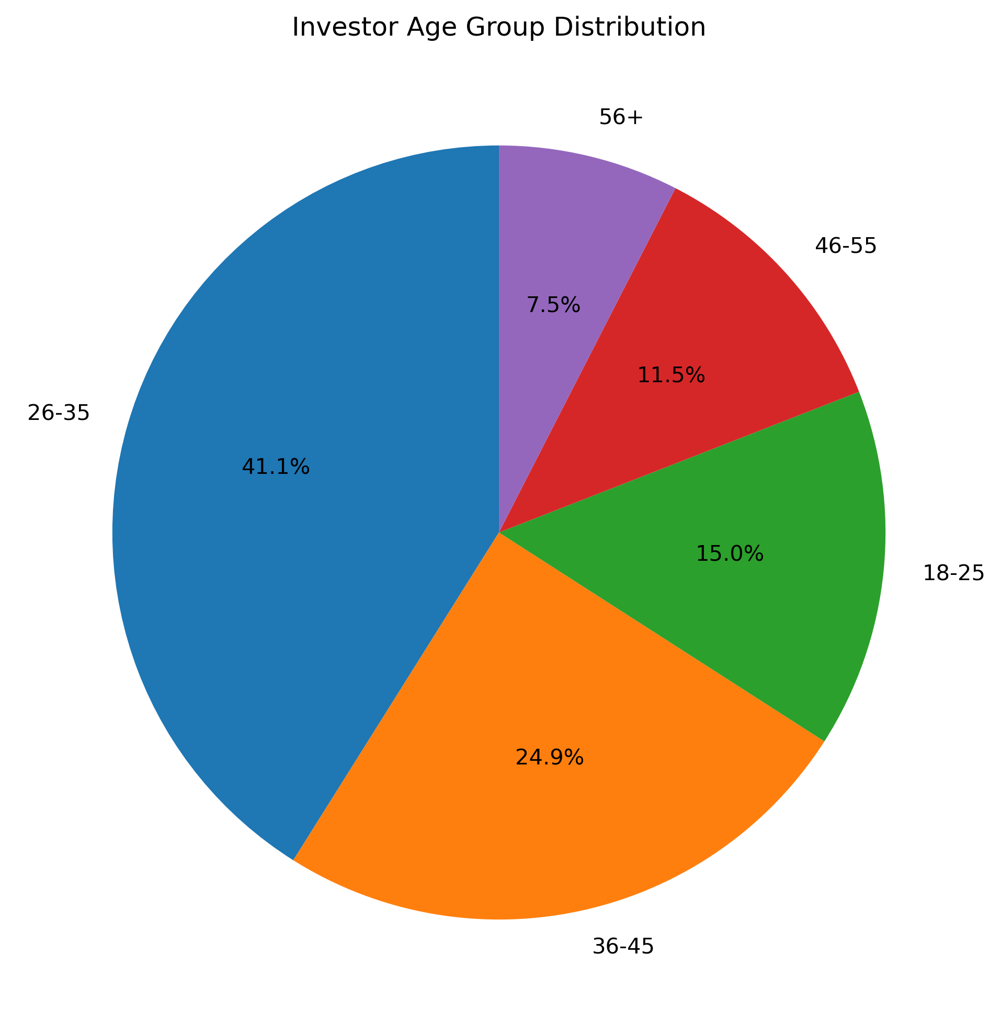
EDA Highlights – Part 2
SIP Inflow Analysis
Key Insight:
SIP participation increased steadily.
Investor Demographics
Key Insight:
26–35 age group contributed most investments.

Slide 7
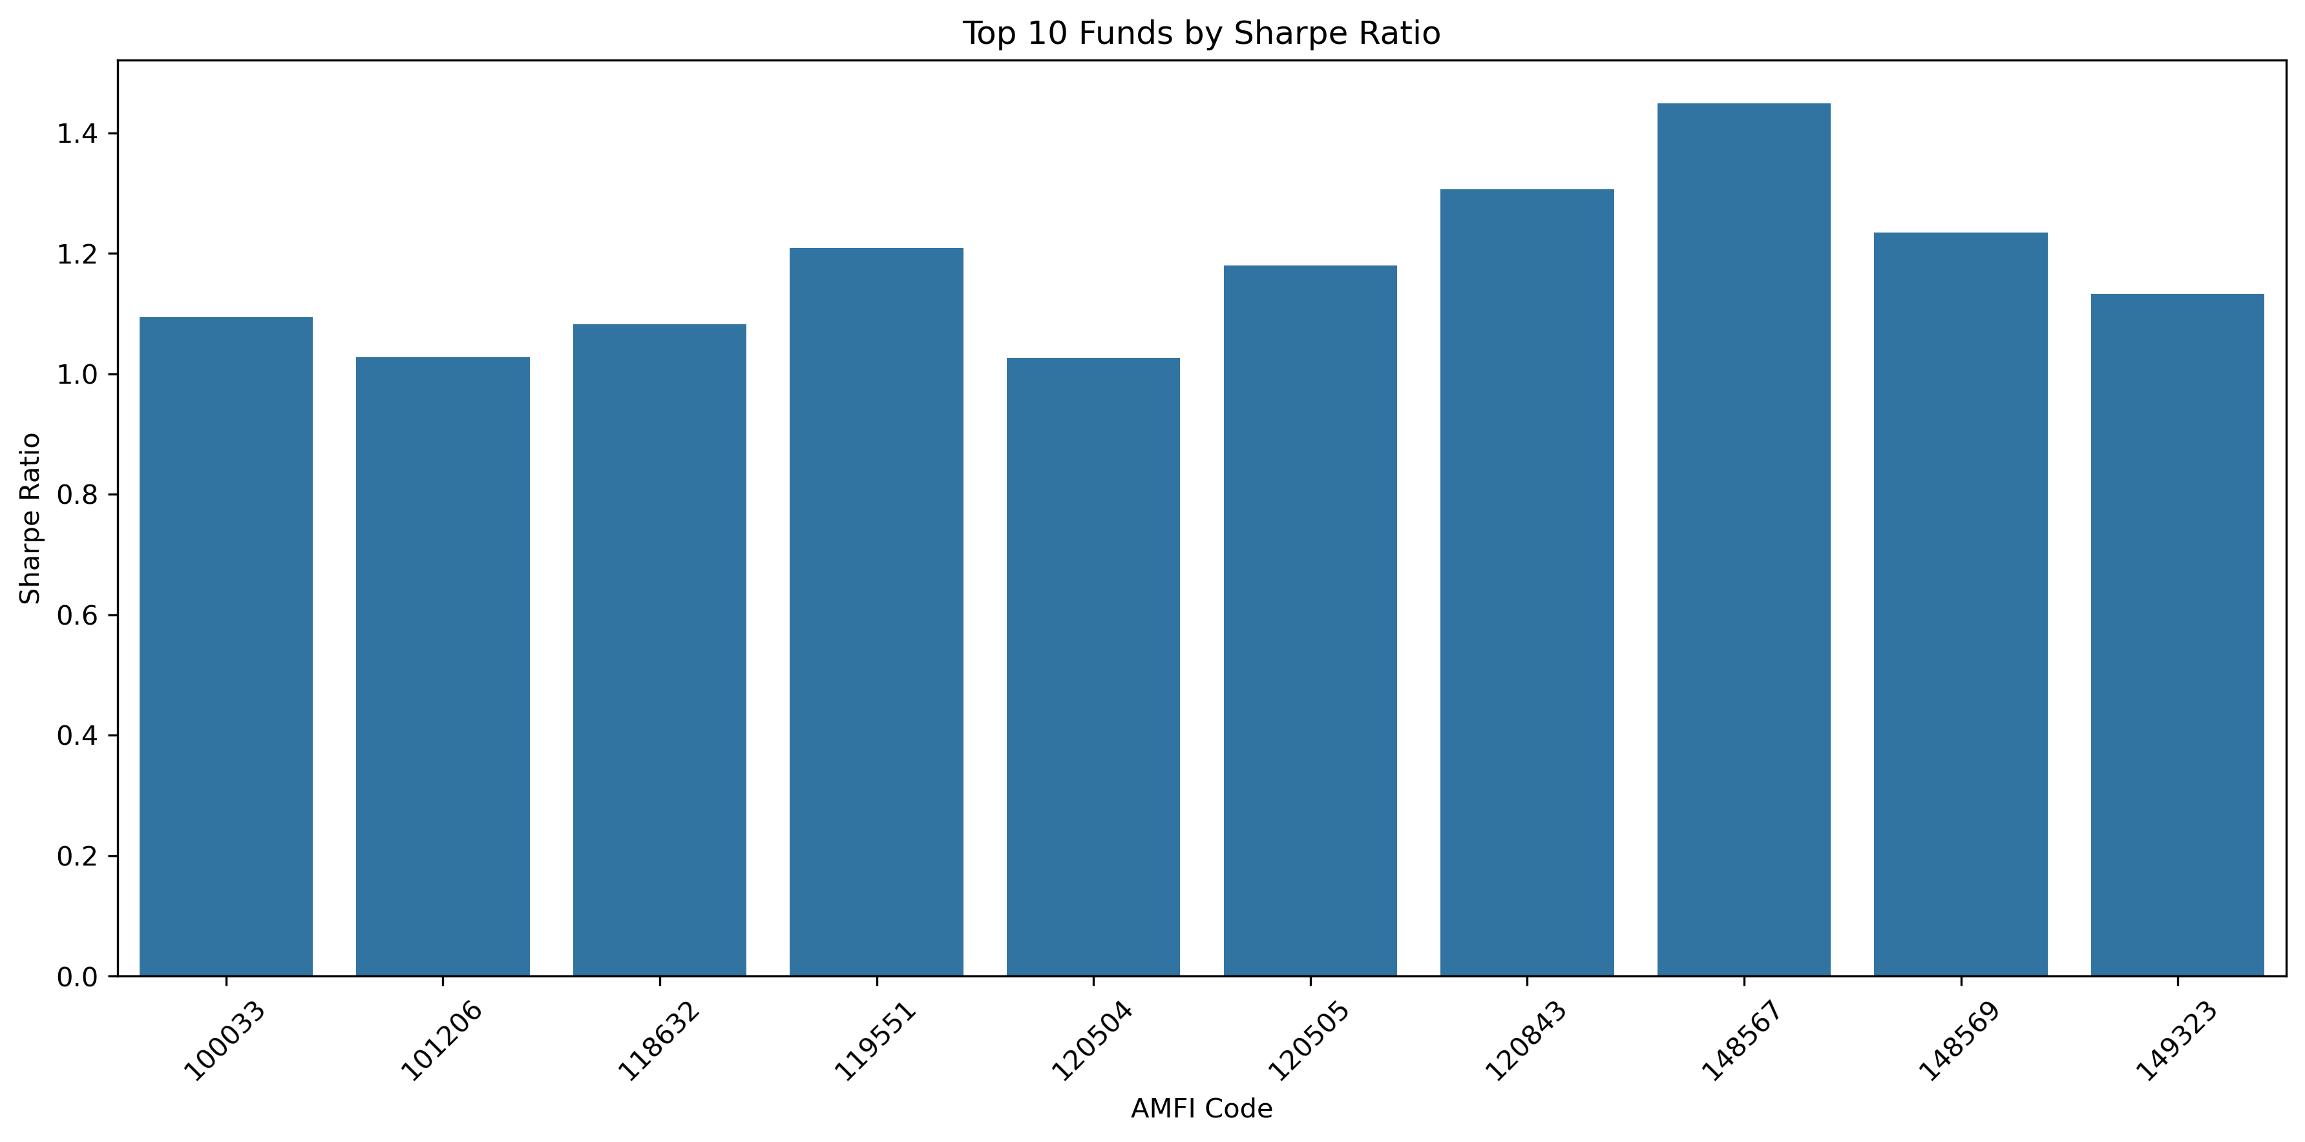
Performance Analytics – Part 1
Metrics Calculated
CAGR
Sharpe Ratio
Sortino Ratio
Key Findings
High Sharpe Ratio funds delivered better risk-adjusted returns.
Sortino Ratio highlighted downside protection.

Slide 8
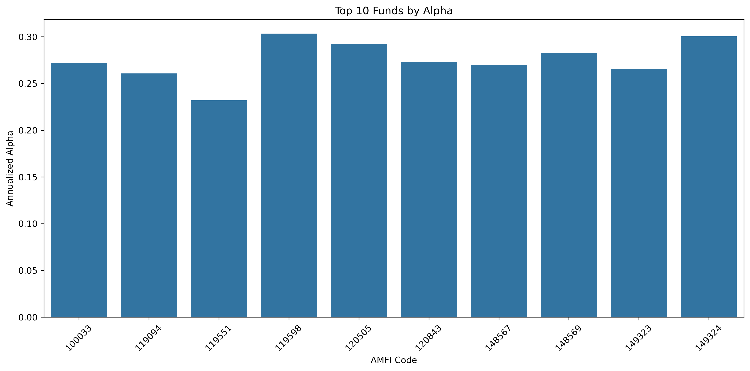
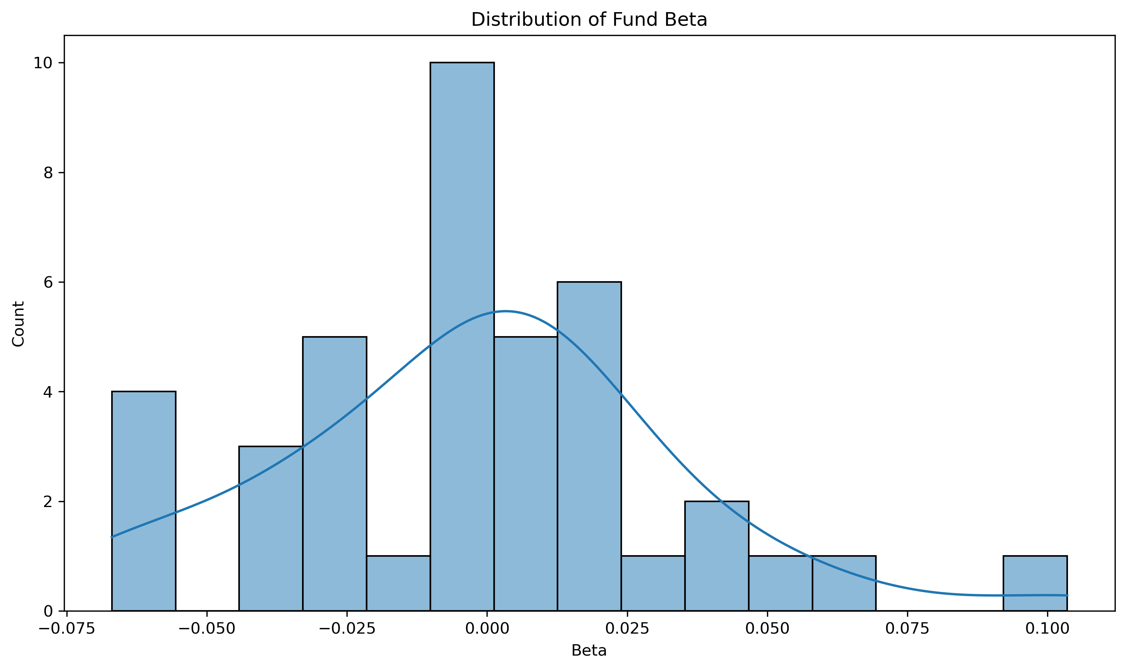
Performance Analytics – Part 2
Additional Metrics
Alpha
Beta
Maximum Drawdown
Key Findings
Some funds generated positive Alpha.
Beta identified aggressive vs defensive funds.

Slide 9
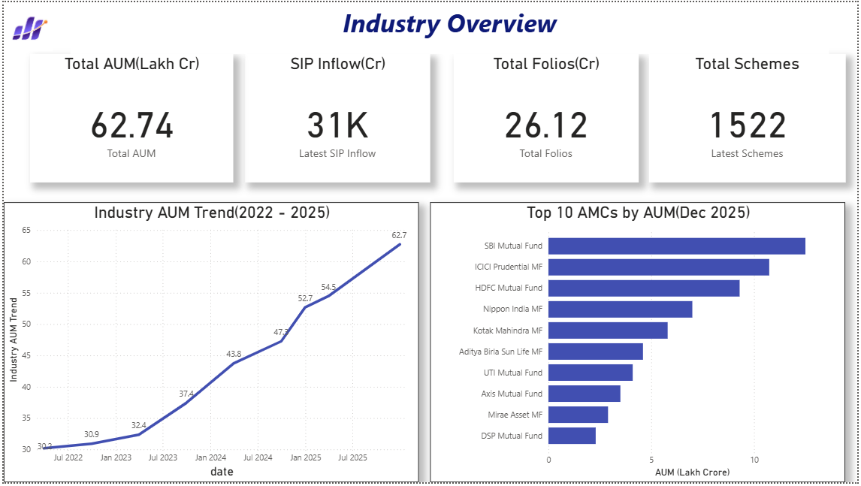
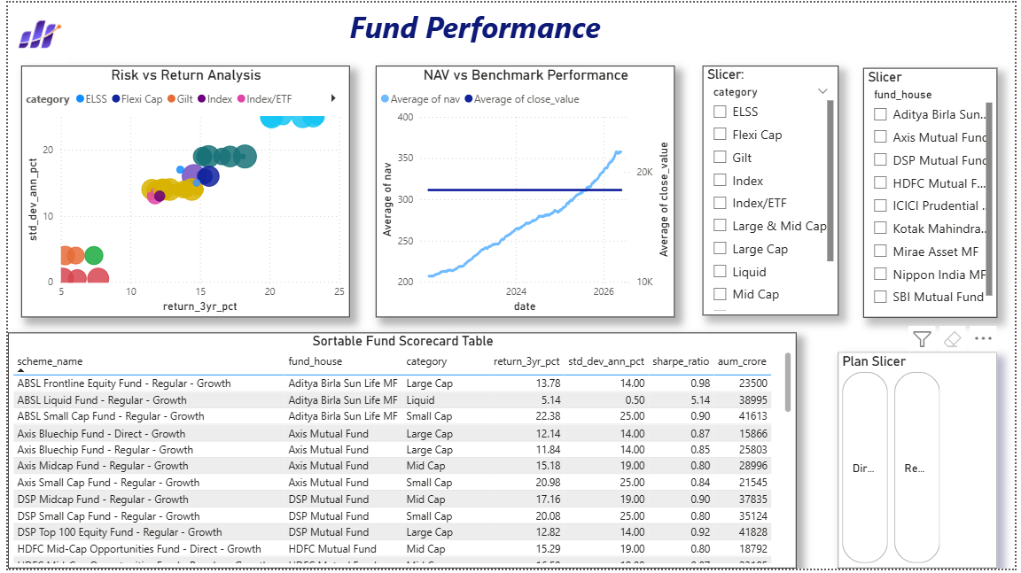
Dashboard – Industry Overview & Fund Performance

Slide 10
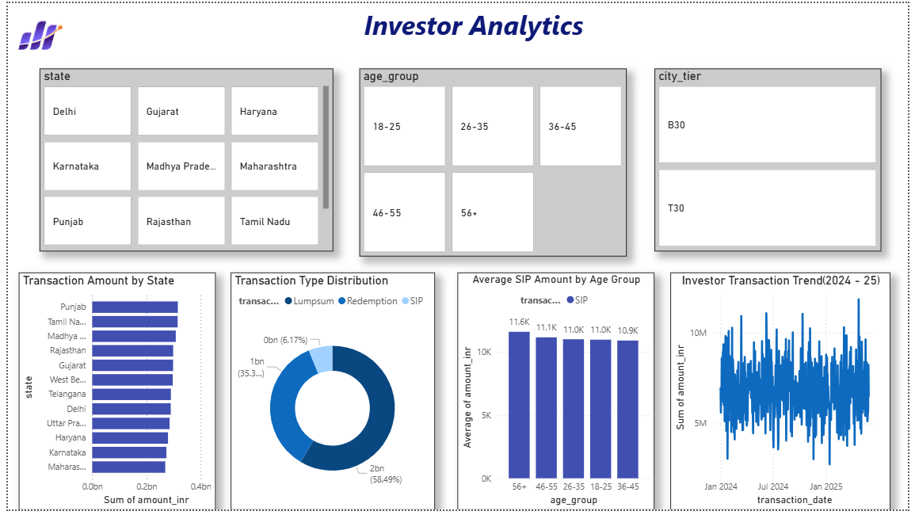
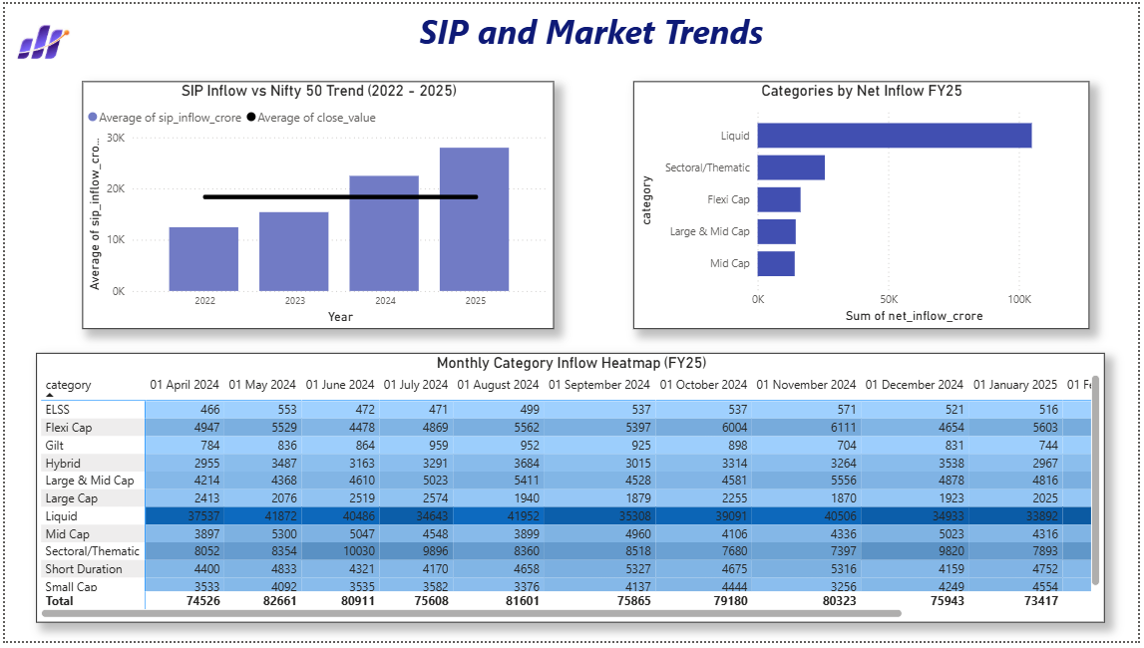
Dashboard - Investor Analysis & SIP Trends

Slide 11
Advanced Analytics & Key Findings
Advanced Analytics
✔ Value at Risk (VaR)
✔ Conditional VaR (CVaR)
✔ Investor Cohort Analysis
✔ SIP Continuity Analysis
✔ Fund Recommendation System
✔ HHI Concentration Analysis
Key Findings
Equity funds delivered superior returns.
SIP participation remains strong.
Certain funds exhibited concentration risk.
Cohort analysis revealed investor retention patterns.

Slide 12
Conclusion
The project successfully developed an end-to-end Mutual Fund Analytics Platform integrating ETL, database management, performance analytics, advanced analytics, and interactive dashboards.

