Slide 1
Audio Streaming and Chatting Application for Mobile Devices using Wi-Fi Direct and Performance Evaluation
Hema Bhatia, naveen ds
Wireless and mobile networks – Spring ‘13

Slide 2
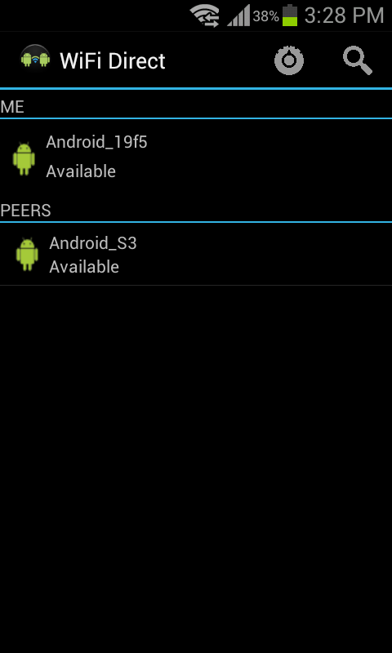
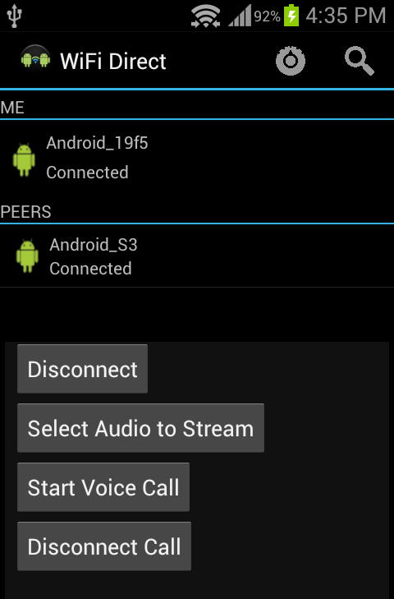
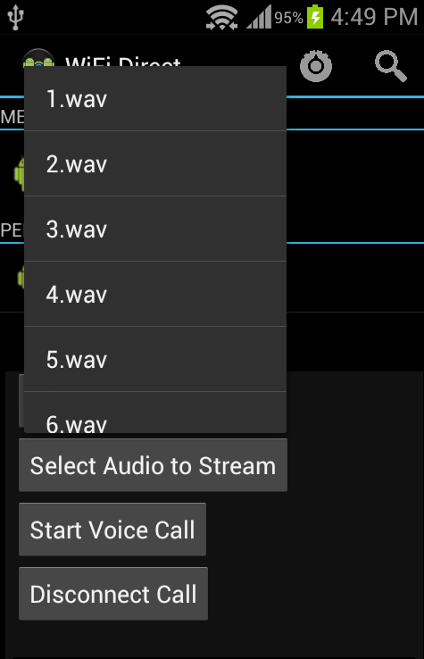
Application Screenshots

Slide 3
What is Wi-Fi Direct?
Wi-Fi Direct is a standard that allows devices with Wi-Fi capability to connect to each other without the need of a wireless access point.
Advantage: Allows devices to transfer files, stream music among themselves, without being connected to the Internet.
During connection, one peer becomes a soft access point, others connects to it.
This device is called as Group Owner who is pre-decided or selected based on capabilities of the phone.

Slide 4
Applications of Wi-Fi Direct
File Sharing and Transfer
Connecting Cameras/Mobile/Laptops to printers
Free communication in public locations without Internet connection
Collaboration in field-operations (usually with no network coverage or access point).
Anonymous voting applications useful in a theatre/match.
Multi-person audio streaming and conferencing

Slide 5
Project Features
Audio Streaming
Audio Calling
Performance evaluation of Streaming application.

Slide 6
Audio Streaming
Stream music from one peer to another.
Sends the audio file as multiple UDP packets.
Control packets are sent over TCP connection.
UDP datagram size : depends on the sample rate of the song, number of channels (mono or stereo) and the encoding (PCM 8 or 16 bit)
Playback operation : Receiver peer uses AudioTrack Class provided by Android which plays back received buffers.

Slide 7
Audio Calling
Direct Audio Chatting with connected mobiles.
Similar to streaming, we use TCP for control packets and UDP for data packets transfer.
The difference : two way data communication.
Voice recording: via microphone, using AudioRecord class of Android.
The recorded audio is read on the fly and sent to the other side as UDP packets.
Configurations remain the same as for streaming.
Ability to connect and disconnect calls anytime on a single WiFi Direct connection.

Slide 8
Performance Evaluation
Motive :
Evaluate performance of our application under various scenarios
Wi-Fi Direct works on the concept of Soft AP (Software enabled Access Point).
No evaluations of Soft AP performance in Android

Slide 9
Performance Evaluation
Application : Audio Streaming, because it is controlled and can be repeated unlike audio chatting.
Environments:
  Indoor
  Outdoor
  No Line of Sight
Experimental analysis:
  Packet Loss vs Distance : Indoor and Outdoor
  Indoor vs Outdoor
  Burst Pattern Analysis

Slide 10
Performance Indoors – MEB Corridor
Unusual behavior!

Slide 11
Performance Indoors – WEB Corridor

Slide 12
Performance Outdoors : MEB Parking Lot

Slide 13
Performance Indoors vs Outdoor

Slide 14
Performance – Non Line-Of-Sight
4 experiments
WEB : opposite side of a concrete wall.
Observation : clear communication until peers move away -15m
MEB : either side of the TA room - wooden wall
Observation : Clear communication similar to line-of-sight
MEB: 2 rooms with a room in between - wooden walls (total distance ~ 40m).
Observation : Streaming performance poorer than previous expt. but clear voice call.
MEB-WEB Tunnel: Peers at opposite ends of tunnel and streaming was very poor. May be due to concrete walls ?

Slide 15
Packet Burst Analysis

Slide 16
Other observations from the Experiments
If the atmosphere was Windy (moist), performance was poor. This may be due to the moisture.
Connection Establishment : till 60 m indoor, 50m outdoor
Streaming quality :
  Indoors till 60m : very good
  Outdoor experiments : good till 60m, frequent disconnections at and after 80m
Concrete Walls are major hindrance to communication.

Slide 17
Challenges Faced
Supporting different file formats and configurations
Different phones had different modules’ settings.
Performing measurements in the Cold Breeze in the MEB parking lot :)

Slide 18
Questions

