Slide 1
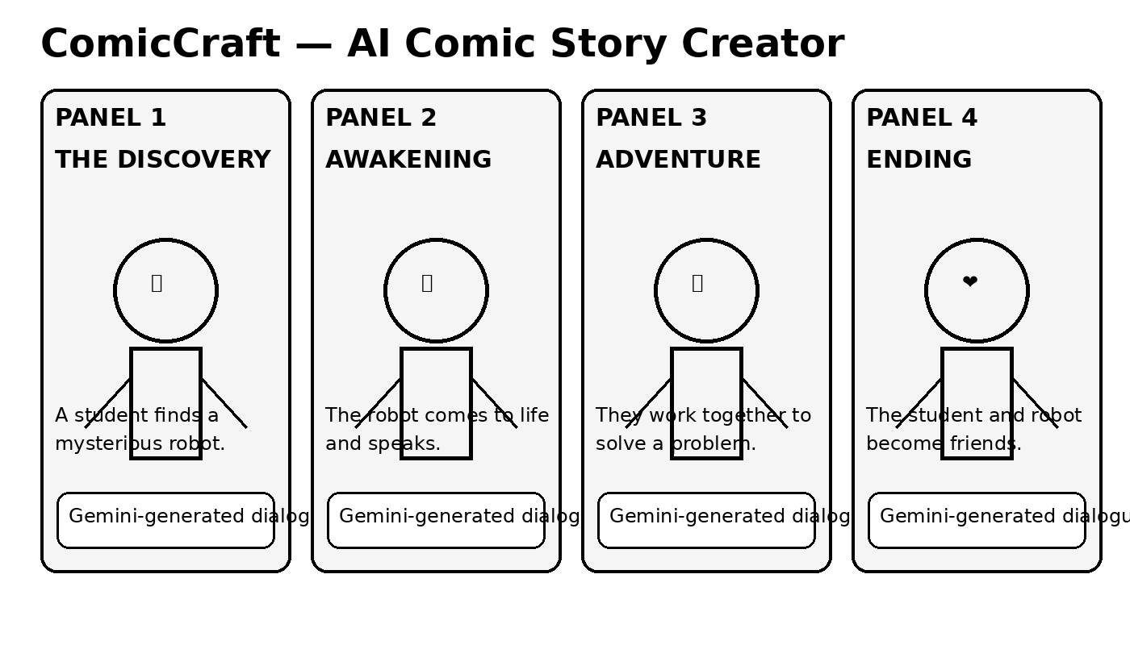
ComicCraft
AI-Powered Comic Story Creator using Google Gemini
Project Presentation

Slide 2
1. Problem Statement
Creating a complete comic manually requires time, writing skill and visual planning.
Beginners may struggle to develop characters, scenes, dialogues and a consistent storyline.
There is a need for a simple tool that turns an idea into a structured comic quickly.

Slide 3
2. Proposed Solution
ComicCraft converts a user's story idea into a comic-style story.
Google Gemini generates the story structure, characters, scenes, narration and dialogues.
The application organizes the generated content into sequential comic panels.
Users can review, edit and export the final comic.

Slide 4
3. System Workflow
User Prompt
Gemini AI
Story Planning
Panel Generation
Comic Output

Slide 5
4. Key Features
✨ AI story generation from a simple prompt
👤 Character creation and role descriptions
🎬 Scene-by-scene comic panel planning
💬 Automatic dialogue and narration
📝 Editable generated content
📤 Final comic preview/export

Slide 6
5. Technology / Architecture
Frontend: Web interface for prompt input, editing and comic preview
Backend: Application logic for requests, panel organization and output
AI Layer: Google Gemini API for story and dialogue generation
Data Layer: Optional storage for projects, characters and generated stories

Slide 7
6. Example Output
Sample comic generated from a single story idea

Slide 8
7. Benefits & Future Scope
Makes comic creation easier for students, writers and beginners.
Reduces the time needed for story planning and dialogue writing.
Future scope: image generation for each panel, voice narration, multilingual comics and PDF/social-media export.

Slide 9
8. Conclusion
ComicCraft combines creative storytelling with generative AI.
A user can start with a simple idea and receive a structured comic story.
The project demonstrates a practical use of Gemini models for creative content generation.

