Slide 1
Foundations of Machine Learning — Final Project
Interactions Between Pruning,
Quantization, and Batch Size in MLPs
Hema
Roll Number: zda24b025
Instructor: Dr. Tushar Shinde
IIT Madras Zanzibar

Slide 2
Problem Statement
Compression methods (pruning, quantization) are usually studied in isolation, but in practice they are combined. How they interact is not well understood, especially on simple models.
Three research questions:
Does the ORDER of pruning and quantization change the final accuracy?
Q1
Does the best BATCH SIZE shift once a model is compressed?
Q2
Can a COMBINED strategy work where naive compression fails?
Q3

Slide 3
Experimental Setup
Datasets (MedMNIST)
Models
 | Pneumonia | Blood
Type | Grayscale | RGB
Classes | 2 | 8
Input | 784 | 2352
Tr/Va/Te | 4708/524/624 | 11959/1712/3421
Classical: Logistic Regression, Random Forest, RBF SVM
Neural: 3-layer MLP (784/2352 → 512 → 256 → out), ReLU, dropout, Adam
Compression & settings
Pruning, quantization, coreset, PCA, and QAT (improvement)
Seed 42 (baseline & QAT over 3 seeds); early stopping on val
Metrics: test accuracy and macro-F1 (Pneumonia imbalanced)
Baseline: MLP vs classical (test acc)
RBF SVM: Pneu 0.857 | Blood 0.853
MLP: Pneu 0.858 ± 0.002 | Blood 0.867 ± 0.002
MLP wins on the harder Blood task; ties on Pneumonia (ceiling).

Slide 4
Proposed Method: Quantization-Aware Training
Problem: prune + low-bit post-training quantization (PTQ) collapses on hard tasks. Fix: let the model simulate quantization during training so it learns robust weights.
Pre-trained
MLP
→
Prune
(remove weights)
→
Train quant-
aware (STE)
→
Compact
robust model
Forward pass — fake-quantize each weight:
w_q = round( (w − min) / s ) · s + min, where s = (max − min) / (2^b − 1)
Backward pass — straight-through estimator (gradient passes through the rounding):
∂L/∂w = ∂L/∂w_q (round() treated as identity for gradients)

Slide 5
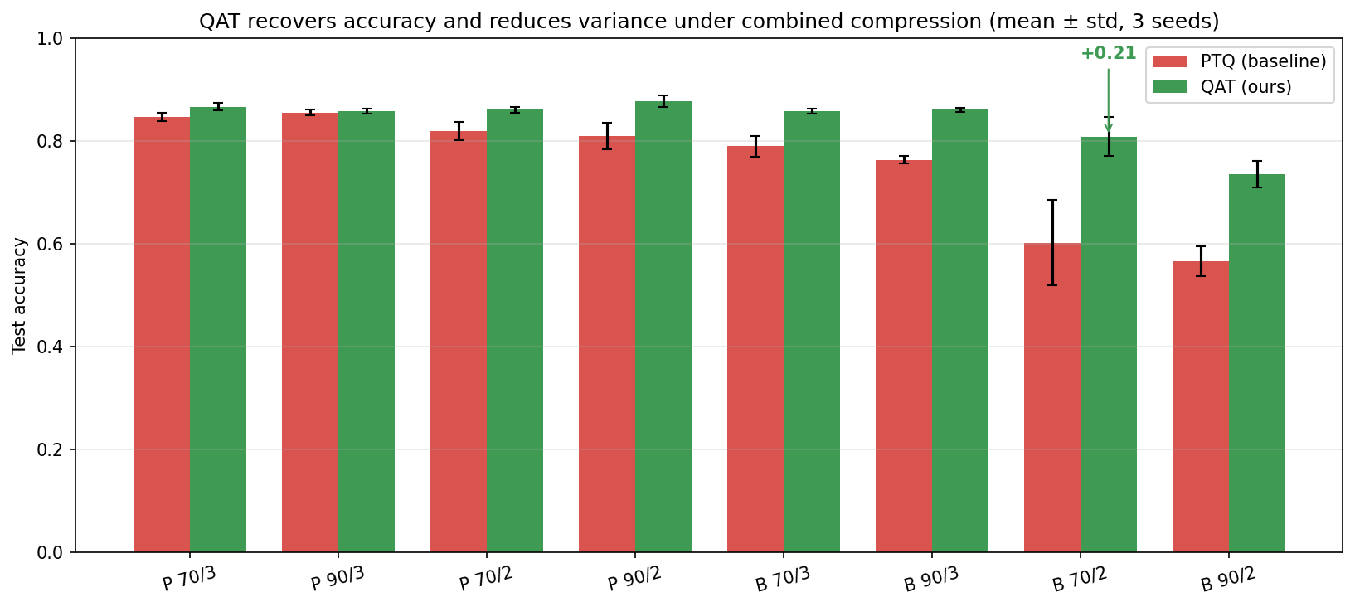
Results & Comparison
Key findings
Order: prune→quantize better on simpler task (+0.19); neutral on harder task
Batch size: dataset-dependent, not compression-dependent (matches Keskar 2017)
QAT recovers up to +0.21 and cuts variance (PTQ std 0.083 → ≤0.038)
QAT (green) vs PTQ (red) under combined compression, 3 seeds. QAT wins everywhere; biggest gain +0.21 where PTQ collapses.
Comparison: confirms Deep Compression (Han 2016) and extends it with the order finding; confirms Keskar (2017) on batch size.
[3] Han et al., Deep Compression, ICLR 2016. [5] Keskar et al., On Large-Batch Training, ICLR 2017. [7] Yang et al., MedMNIST v2, Scientific Data 2023.

Slide 6
Conclusions & Key Learnings
1
Each method works alone Pruning to 90%, quantizing to 3 bits, and PCA all shrink the model with little loss.
2
Interactions are subtle Order matters on simple tasks; best batch size is set by the dataset, not compression.
3
QAT is necessary, not optional It rescues combined compression where PTQ collapses, recovering up to +0.21 accuracy and reducing variance.
4
Key learning Many fast, well-controlled experiments and a clean finding beat one slow model — good science is about the right comparisons.

