Slide 1
Machine Learning Project
Hema, Madhu, Mason & Sam

Slide 2
Agenda
Data Exploration
Data Cleaning
Machine Learning Research
Machine Learning Implementation
SQL & Flask
Web Page with a Summary of Our Research Findings

Slide 3
Data Exploration
The first data we searched for was Wildfire & Storm data, we found the data that we wanted however it was scattered across the internet in pieces.
Ultimately decided against it; would require more data cleaning & we wanted to spend more time developing/training our ML models.
The dataset we decided to use was a breast cancer & heart failure dataset.
Only one dataset needed minimal cleaning!

Slide 4
Data Cleaning
Once we decided on our disease datasets, the only cleaning we needed to do was to perform a simple “Drop NaN” line of code to rid of any rows that contained any NaNs.
Note: Only data cleaning we needed was for the heart failure dataset.

Slide 5
Machine Learning Research
The following are the main models we decided to focus on when summarizing the results of our study.
Logistic Regression, XGB Classifier & Random Forest Classifier. [need group input here]
We were particularly interested in these models because of the cancer/ heart failure data; gave clear results of what features the model “learned” had the most/least impact on a diagnosis.

Slide 6
Machine Learning Implementation
The following slides are code examples of our main models with their respective graph.

Slide 7
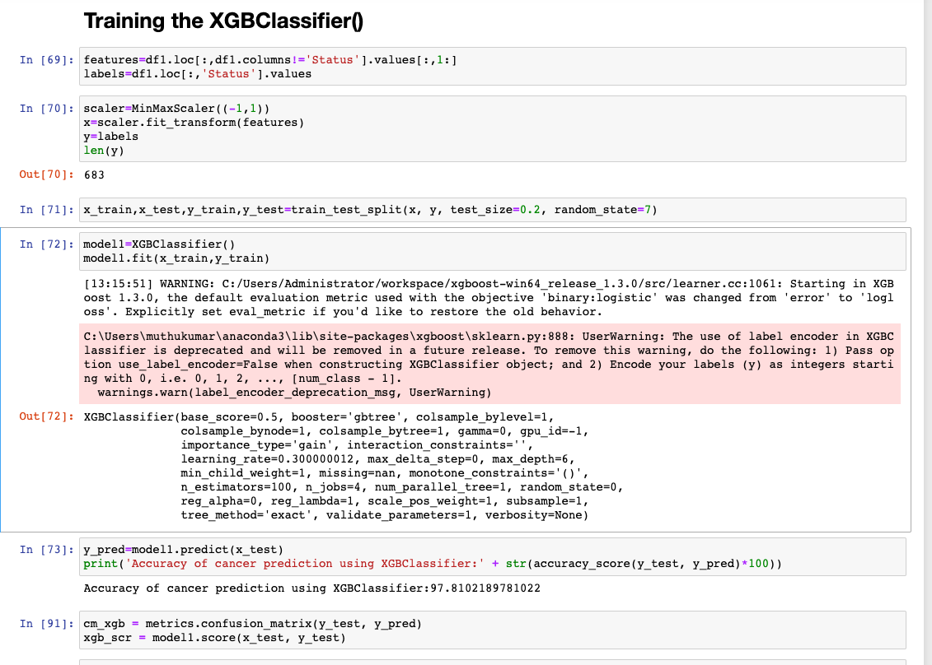
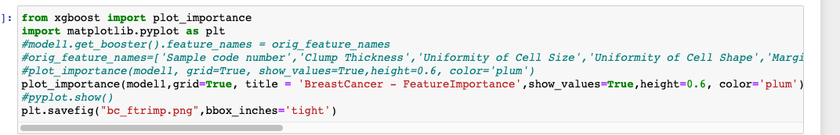
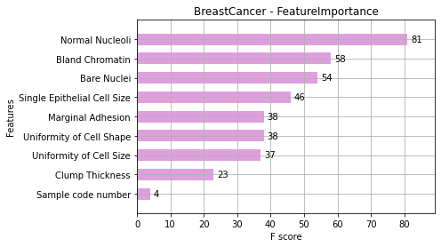
Machine Learning Implementation (cont.)

Slide 8
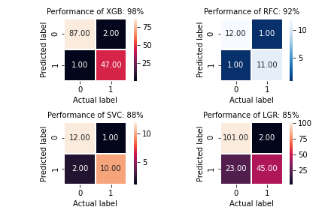
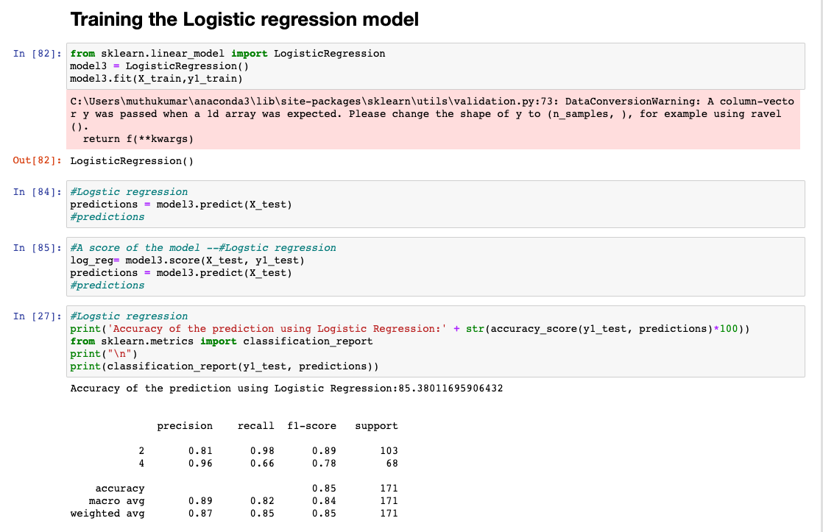
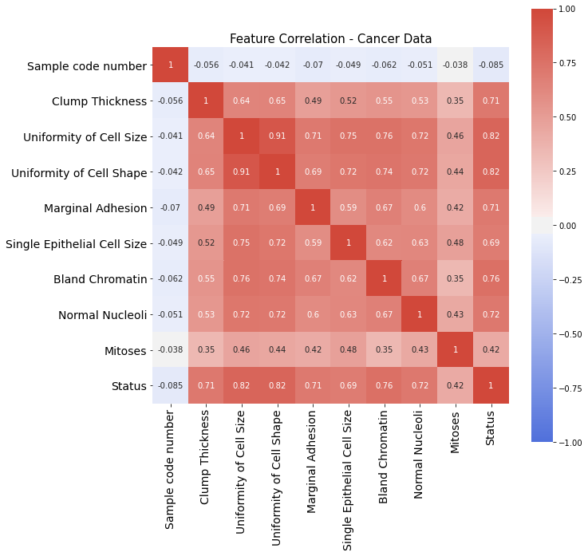
Machine Learning Implementation (cont.)

Slide 9
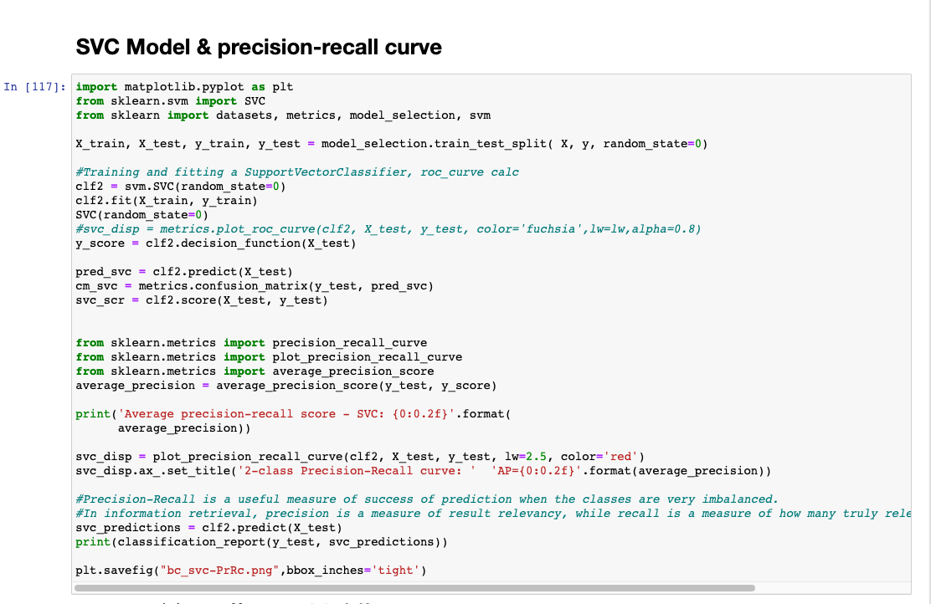
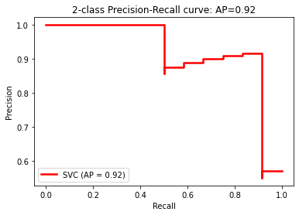
Machine Learning Implementation (cont.)

Slide 10
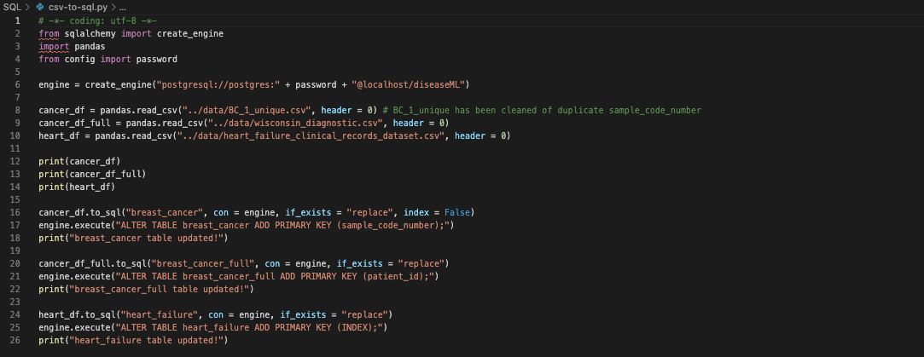
SQL & Flask
Our data is currently being stored on an SQL server. The data interacts with our webpage via Flask. Code snippet below is how we put the datasets into the SQL server.

Slide 11
SQL & Flask (cont.)
Code snippets in next couple slides are how the SQL communicates with the HTML page.

Slide 12
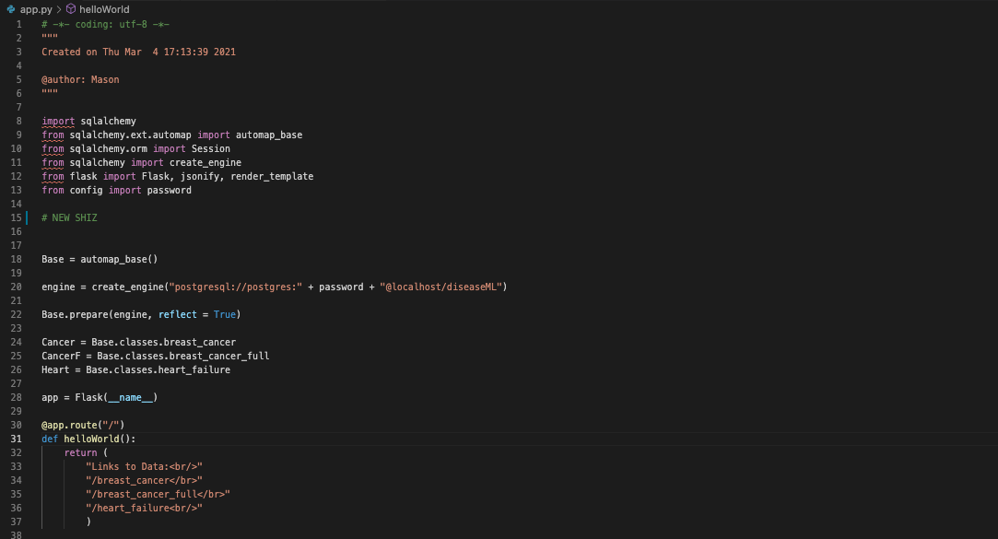
SQL & Flask (cont.)

Slide 13
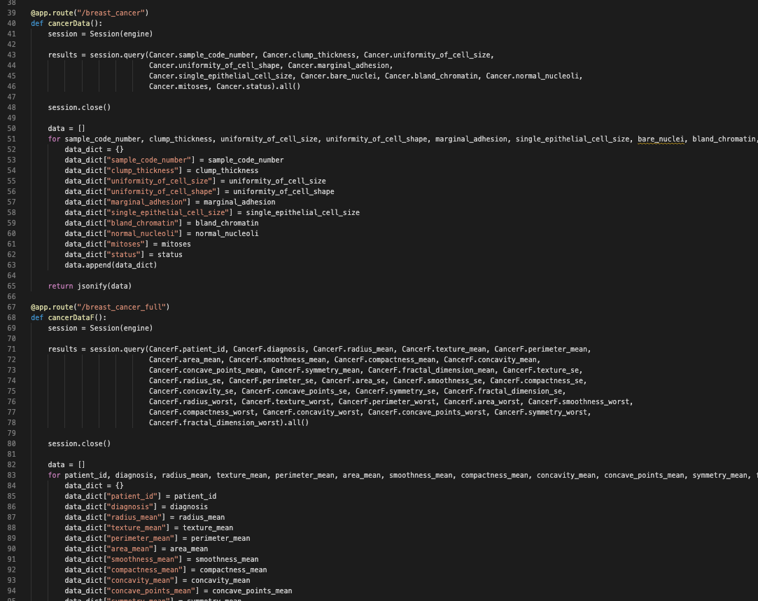
SQL & Flask (cont.)

Slide 14
Web Page with a Summary of Our Research Findings
Click this Link! : https://sambarton10.github.io/Machine-Learning-Project/

