Slide 1
DIGITAL PORTFOLIO
STUDENT NAME: L.HEMADHARSHINI
REGISTER NO AND NMID: 212405514 & 9A1E2396B7DAAEBAF3242816ED10416F
DEPARTMENT: BCA
COLLEGE: LAKSHMI BANGARU ARTS AND SCIENCE COLLEGE/ MADRAS UNIVERSITY

Slide 2
PROJECT TITLE
INTERACTIVE DIGITAL ACADEMIC PORTFOLIO USING FRONT-END DEVELOPMENT

Slide 3
AGENDA
Project statement
Project Overview
End Users
Tools and Technologies
Portfolio design and Layout
Features and Functionality
Results and Screenshots
Conclusion
Github Link

Slide 4
PROBLEM STATEMENT
A digital academic portfolio is an online collection of a student's work, showcasing skills, creativity,. It functions as a dynamic, self-directed tool for students to reflect on their achievements.

Slide 5
PROJECT OVERVIEW
This portfolio encompasses about me and education details.
My portfolio contains Home, education, services, contact section.
My main idea is to showcase my achievements, education.
Home section = classes – home, home-content, social-icons, btn-group.
Education section= classes – timeline-items, dot, date content.
Services section= classes –services-container, box, info.
Contact section, footer class.

Slide 6
WHO ARE THE END USERS?
The primary end users of a digital academic portfolio include the students who create them to document their learning and growth, teachers who use them for instruction and assessment, and families who view them to understand student progress and foster home-based learning conversations.

Slide 7
TOOLS AND TECHNIQUES
HTML ->structure of the web page(classes, section, pages).
CSS -> styling the web pages(colors, layouts, responsiveness, alignments, font size, color).
JAVASCRIPT ->interactivity( navigation menu, form validation).
VISUAL STUDIO CODE Editor and hosting platform –Github.

Slide 8
POTFOLIO DESIGN AND LAYOUT
Sections included:
Home- @keyframes is used.
Education –grid layout, webkit scroll bar,
Services – grid layout
Contact- @media is used here.
Responsive layout (desktop and mobile view).

Slide 9
FEATURES AND FUNCTIONALITY
Navigation bar for smooth scrolling.
Images used.
Interactive elements(hover effects) button group used for attractive and responsive purpose.
Contact form (with validation).
Responsive for both desktops and mobile phones.

Slide 10
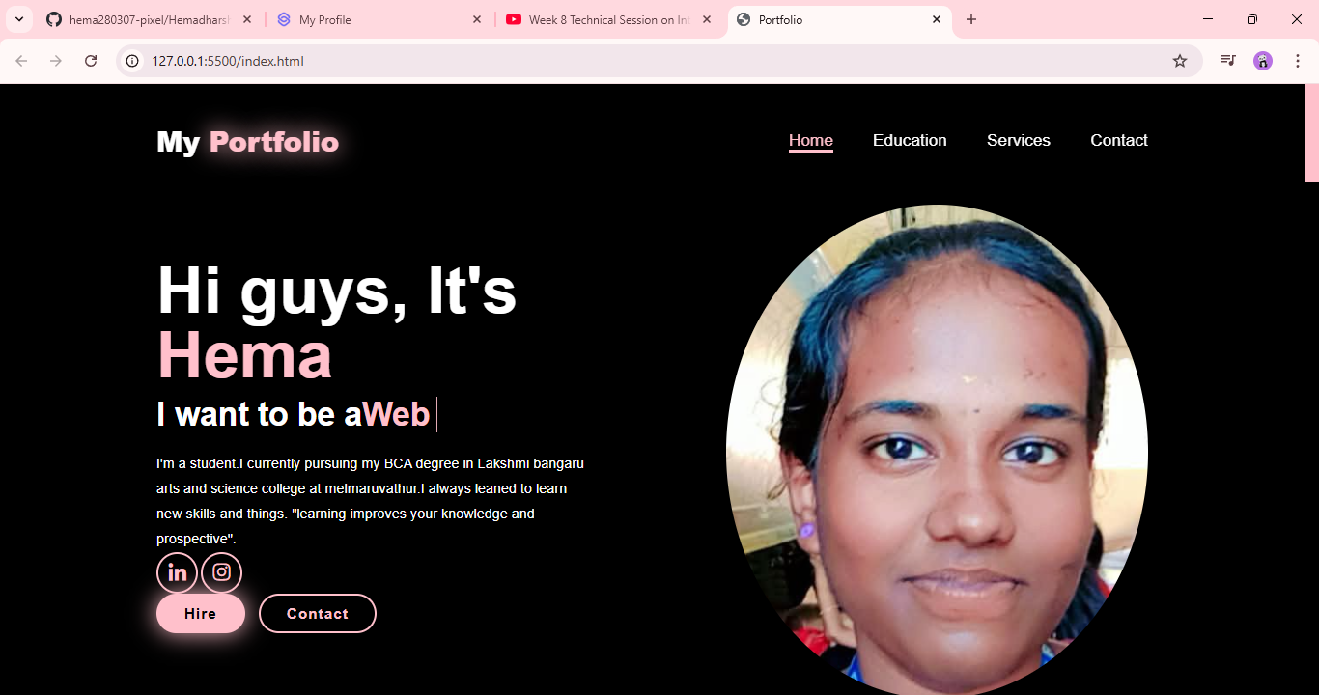
RESULTS AND SCREENSHOTS

Slide 11
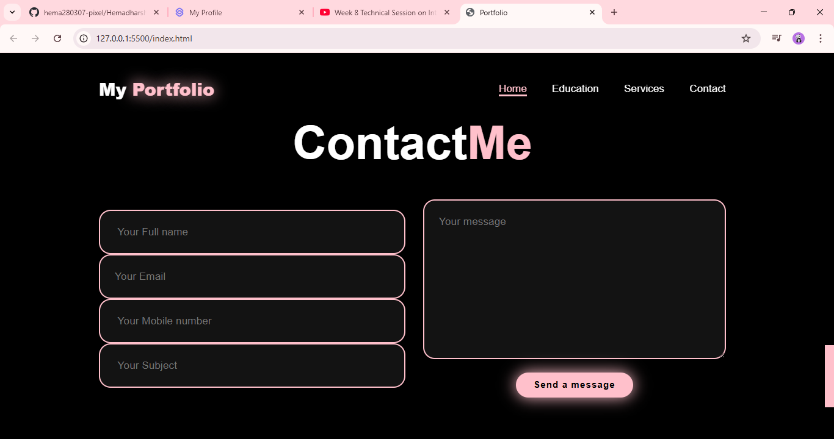

Slide 12
CONCLUSION
Benefits to the Society: Student portfolios benefit society by providing a richer, more authentic assessment of a student's growth, which helps in identifying educators, and equipping future workers with a comprehensive body of work for college and employment applications.

