Slide 1

supply chain
Hema

Slide 2
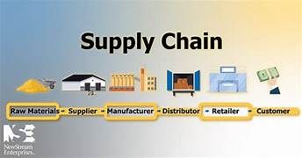
Introduction:
In modern supply chains, digital technology, data analytics, and automation are becoming crucial for optimizing performance, tracking, and enhancing communication.

Slide 3
AI and supply chain management are closely linked, with AI offering a wide range of benefits, such as improving efficiency, reducing costs, and optimizing decision-making. However, while the advantages are clear, there are also several drawbacks to integrating AI into supply chains. Here’s how you can balance the benefits with the potential challenges:
Benefits of AI in Supply Chains:
Route Optimization
Automation
Supply Chain Visibility
Predictive Maintenance
Demand Forecasting
Supplier Relationship Management

Slide 4
Drawbacks and How to Overcome Them:
High Initial Investment
Data Dependency
Job Displacement
Complex Integration
Cybersecurity Risks
Over-reliance on Technology
Ethical Concerns
Scalability Challenges

Slide 5
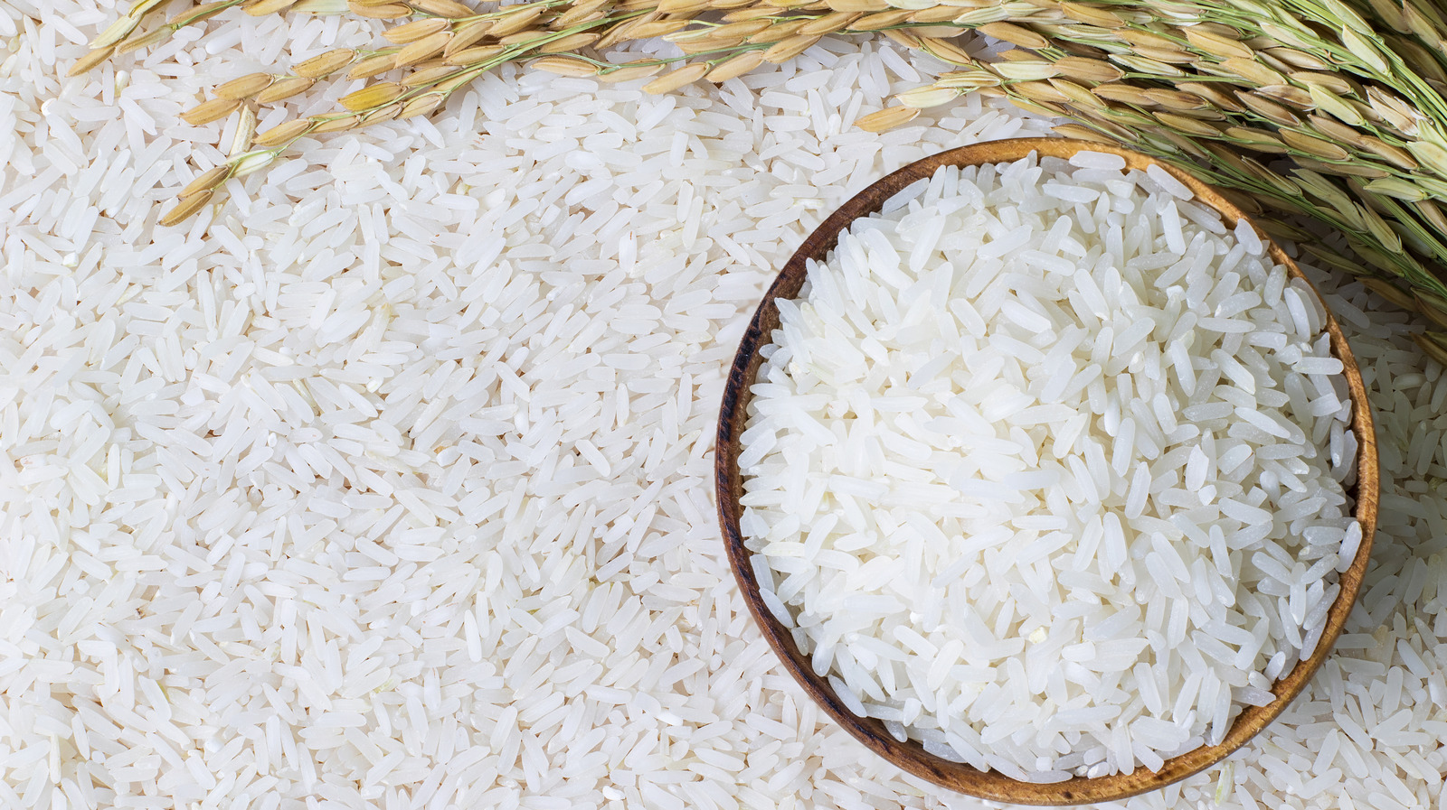
Selecting the producte and knowing about it’s risk factors

Slide 6
Rice fields face several risks, including flooding, which can damage crops during heavy rains or storms. Pests and diseases are constant threats, reducing yield and quality. Climate change is causing temperature shifts and erratic rainfall, impacting growth cycles. Soil degradation from overuse or improper irrigation can lower productivity. Lastly, water scarcity is an increasing concern in many regions, affecting irrigation systems crucial for rice cultivation.

Slide 7
NOTIFICATION:
Email notifications are automated messages sent to alert users about important events or updates, such as new messages, account activity, or reminders. They help keep users informed in real-time, ensuring they don't miss key information. These notifications are commonly used in apps, social media platforms, and online services to improve user engagement and response times. However, excessive notifications can lead to email overload, so it's important to customize preferences for relevance.

Slide 8


