Slide 1
AES
Block to state
Ad round key
Sub Byte
Shift rows
Mix columns

Slide 2
Block to state
Text F R E E G A Z A
Hex 46 52 45 45 47 41 5A 41
W 0 | W1
46 | 47
52 | 41
45 | 5A
45 | 41

Slide 3
Ad round key
Convert state hex to binary
Convert key to binary
X or key with state element with element
STATE: FREE GAZA
KEY: HEMA
W0 | W1
1000110 | 01000111
1010010 | 01000001
1000101 | 01011010
1000101 | 01000001
W0 | W1
01001000 | 01001000
01000101 | 01000101
01001101 | 01001101
01000001 | 01000001

Slide 4
XOR element with element
W0 | W1
01000110 | 01000111
01010010 | 01000001
01000101 | 01011010
01000101 | 01000001
W0 | W1
01001000 | 01001000
01000101 | 01000101
01001101 | 01001101
01000001 | 01000001
XOR
01000110
01001000
-------------
00001110
W0 | W1
00001110 | 00001111
00010111 | 00000100
00001000 | 00010111
00000100 | 00000000

Slide 5
Sub Byte
W0 | W1
00001110 | 00001111
00010111 | 00000100
00001000 | 00010111
00000100 | 00000000
Convert state binary to hex
W0 | W1
0E | 0F
17 | 04
08 | 17
04 | 00

Slide 6
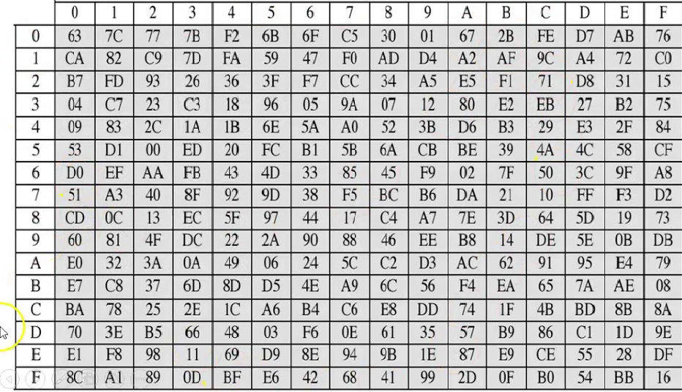
W0 | W1
0E | 0F
17 | 04
08 | 17
04 | 00
W0 | W1
AB | 76
F0 | F2
30 | F0
F2 | 63

Slide 7
Shift rows
W0 | W1
AB | 76
F0 | F2
08 | F0
30 | 63
W0 | W1
76 | AB
F0 | F2
08 | F0
30 | 63

Slide 8
Mix columns
02 03 01 01
01 02 03 01
01 01 02 03
03 01 01 02
W0 | W1
76 | AB
F0 | F2
08 | F0
30 | 63
E1=(B1*2) XOR (B2*3) XOR (B3*1) XOR (B4*1)
E2=(B1*1) XOR (B2*2) XOR (B3*3) XOR (B4*1)
E3=(B1*1) XOR (B2*1) XOR (B3*2) XOR (B4*3)
E4=(B1*3) XOR (B2*1) XOR (B3*1) XOR (B4*2)

Slide 9
Convert all to binary
W0
E1 76
E2 F0
E3 08
E4 30
02 03 01 01
76*02 | F0*02 | F0*01 | 08*01 | 30*01
01110110 | 11110000 | 11110000 | 00001000 | 01100000
 | 11100000 | 11111011
 | 00011011>1B
11101100 | 11111011 | 00001011 | 00001000 | 01100000
W0 | W1
10001111

