Slide 1
DES encryption
Convert data to binary
Initial Permutation
Divide the msg into L,R 64ibt ➔ L=32bit + R=32bit
Expansion Permutation (R) 32bit ➔ 48bit
(R) XOR Key Round X
Substitution
Straight permutation
R XOR L
Final Permutation

Slide 2
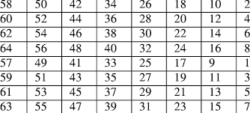
Convert data to binary
Freegaza:
01100110 01110010 01100101 01100101 01100111 01100001 01111010 01100001
Initial Permutation
1011101000110100001001011111010101100100101110001101100011010001

Slide 3
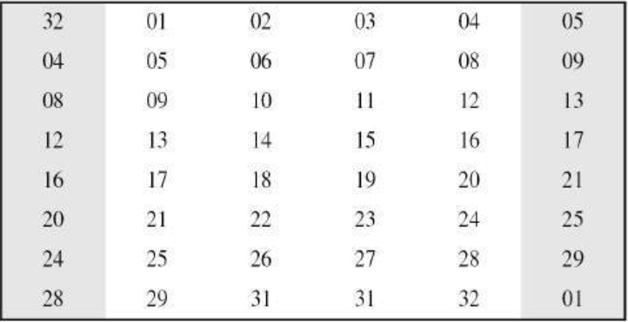
Divide the msg into L,R
L=10111010001101000010010111110101
R=01100100101110001101100011010001
Expansion Permutation
10110101011011110001001101011001000110010100110

Slide 4
(R) XOR Key Round X
010110101011011110001001101011001000110010100110
101101110111100100110101001010111100110111110010
-----------------------------------------------------------------------------
111011 011100 111010 111100 100001 110100 100101 010100

Slide 5
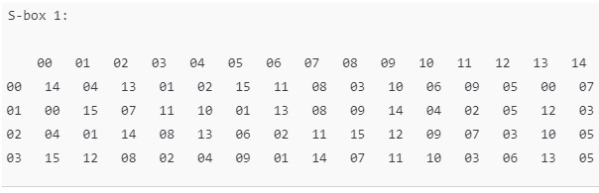
Substitution
111011 011100 111010 111100 100001 110100 100101 010100
111011
00 -> Row 0 (First row)
01 -> Row 1 (Second row)
10 -> Row 2 (Third row)
11 -> Row 3 (Fourth row)
1101➔13
13➔1101
1101 0011 0101 1100 1111 1001 1000 1111

Slide 6
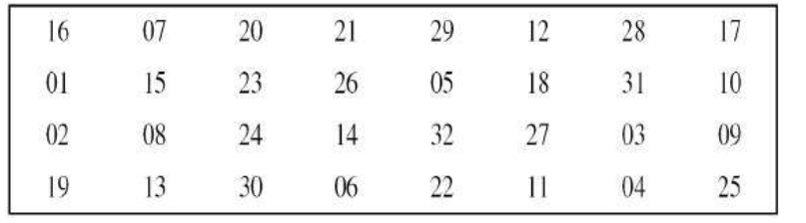
Straight permutation
01100011010111001111100110001111
11010101101010101011001010100011

Slide 7
R XOR L
11010101101010101011001010100011
10111010001101000010010111110101
-----------------------------------------------------
01101111100111101001011111010110

Slide 8
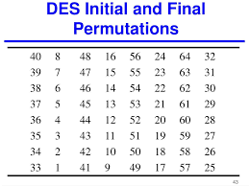
Final Permutation
The Final Permutation is applied only after all the rounds have been completed, not on the output after just one round.

