Slide 1


Electro Spark
Venture Viability Analysis
Sri Ramakrishna institute of Technology, Coimbatore, Tamil Nadu

Slide 2
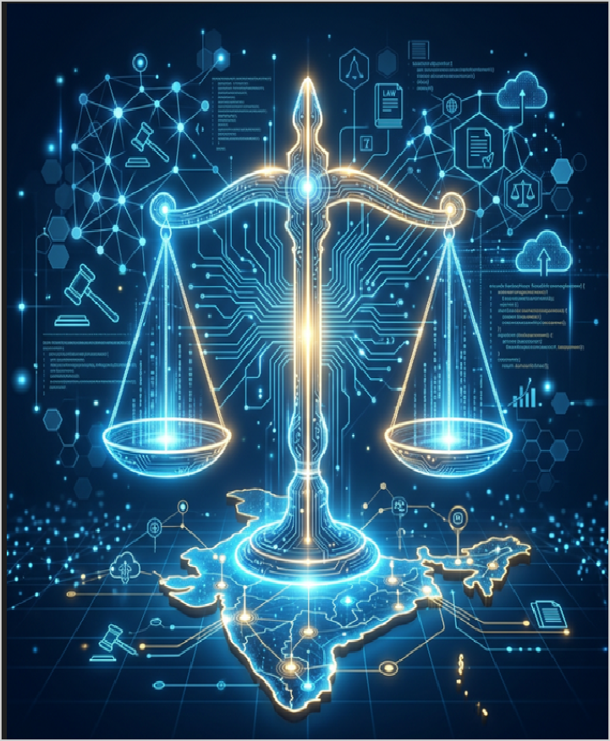
Electro Spark
We build an AI legal chatbot that deliver basic legal help in regional Indian languages via WhatsApp
Sri Ramakrishna institute of Technology, Coimbatore, Tamil Nadu

Slide 3
Context
70% of Indians lack legal aid access. India has only 1 lawyer per 1,000 people
3

Slide 4
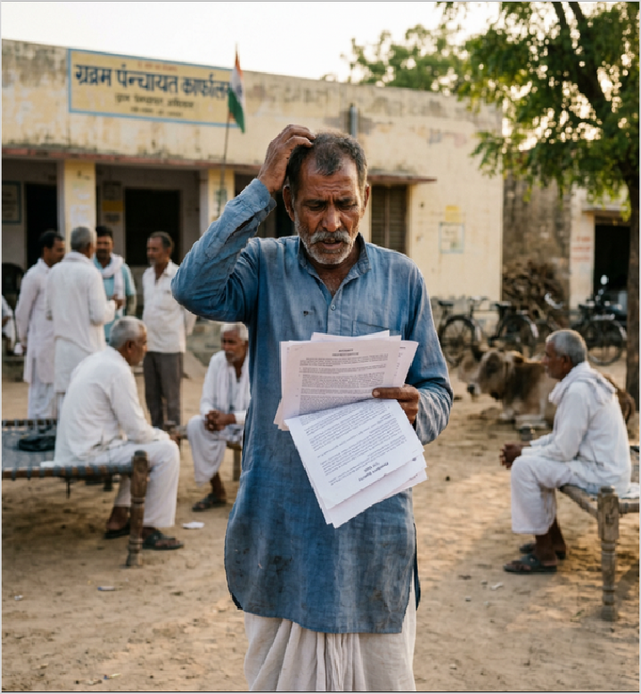
Problem Statement
Problem
Many industries experience unexpected failures in electrical equipment because there is no real-time monitoring or early fault detection system.
Impact
These failures cause power loss, production delays, high maintenance costs, and financial losses for industries, while engineers and operators struggl
4

Slide 5

Problem Statement/Industry
Problem Being Solved
People in rural India struggle to access and understand basic legal information due to language barriers and complex legal procedures."
Supporting Data
70% of Indians lack legal aid access. India has only 1 lawyer per 1,000 people
Source: NALSA Report 2023, Bar Council of India 2022
Area
Business Services
Industry
Social & Community Services
Domain
Social Services

Slide 6



Problem Analysis
Affected Stakeholders
Small and medium industries, power distribution companies, transformer operators, and maintenance engineers are affected by unexpected electrical equipment failures.
These failures also impact factory workers and businesses that depend on continuous power supply.
Impact on Stakeholders
Unexpected failures cause power interruptions, production delays, and financial losses.
Industries must spend more money on repairs and maintenance. It also increases downtime and reduces the
efficiency and reliability of electrical systems.
Root Causes
The problem exists because many electrical systems do not have real-time monitoring for current, voltage, and temperature. Maintenance is usually done only after a failure occurs. Lack of predictive maintenance technology and monitoring systems leads to undetected faults and equipment damage.
Personal/Team Connect
As engineering students interested in electrical systems and technology, we want to develop a smart monitoring system that can detect faults early and prevent equipment damage. Solving this problem will help industries reduce losses and improve efficiency using modern technologies like AI and IoT.

Slide 7
Target Customer Segments
Primary
Low-income rural individuals aged 25-55 seeking basic legal assistance in regional languages
Secondary
NGOs and Legal Aid Organizations providing free legal services to underprivileged communities (B2B)
5

Slide 8

Customer Segment & Persona
Primary Segment
Low-income rural individuals aged 25-55 seeking basic legal assistance in
regional languages
Persona
Secondary Segment
NGOs and Legal Aid Organizations providing free legal services to underprivileged communities (B2B)
Arun Kumar
Age in years: 28 Location: Small Town
Organizational Role: {Persona's
primary role}
(if applicable)

Slide 9
Customer Profile
Education: College pass out
Gender: Male
Occupation: Works for a private company Interests/Hobbies: Gaming and Entertainment Primary Source of Information: Social Media
Shopping Preference: Hybrid Comfort with Technology: Medium Favourite Social Media: Youtube
Favourite Offline Gathering Spots: Malls

Slide 10

Jobs-to-be-Done
Functional JTBD
Understand legal rights, file complaints, access government schemes, resolve land/labor disputes without expensive lawyers
Emotional JTBD
Feel confident about legal rights, reduce fear of legal situations, feel empowered and not helpless
Social JTBD
Gain respect in community, help family with legal issues, stand up against injustice confidently

Slide 11


Current Alternatives
Current Alternatives
Asks village elders, consults paid lawyers, visits government offices, seeks help from NGOs or local politicians
Gaps in Current Alternatives
Village elders give wrong advice, lawyers are expensive and far away, government offices require multiple visits, NGOs have limited reach, all information is in English only

Slide 12
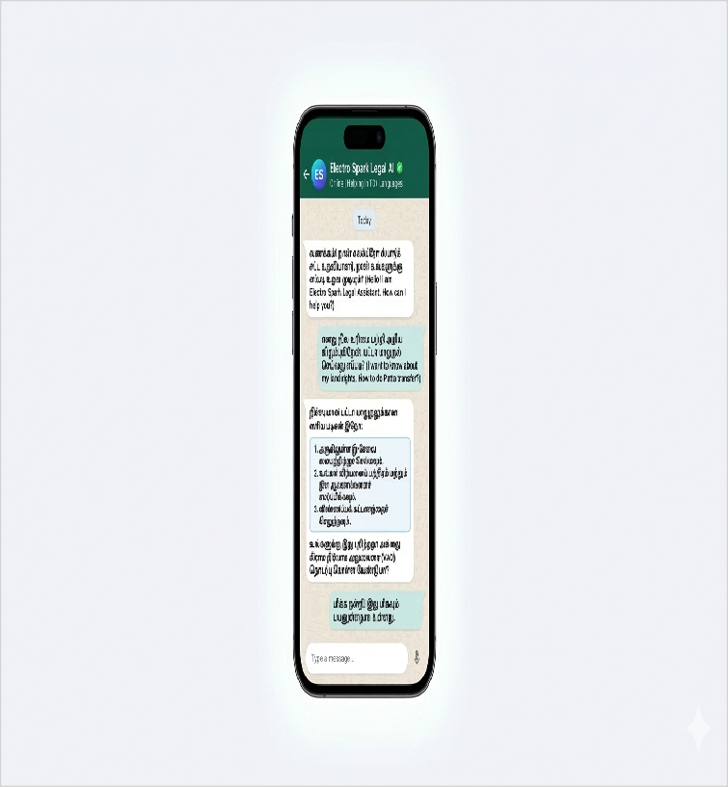
Our Solution
Solution
AI-powered multilingual legal chatbot accessible via mobile app and WhatsApp that answers basic legal queries in regional Indian languages through text and voice input
Core Technologies/ Methodologies
Python, NLP, Dialogflow, Google Translate API, WhatsApp Business API, MongoDB, AWS
6

Slide 13

Solution Design
Our Solution
AI-powered multilingual legal chatbot accessible via mobile app and WhatsApp that answers basic legal queries in regional Indian languages through text and voice input
Key Features
Multilingual support, voice & text input, legal guidance, WhatsApp integration, offline FAQ
Uniqueness
First AI legal assistant trained on Indian laws supporting 10+ regional languages, accessible via WhatsApp without downloading any app, with voice input for illiterate users
Solution Format:
AI-powered chatbot accessible via mobile app
Core Technologies/ Methodologies:
Python, NLP, Dialogflow, Google Translate API, WhatsApp Business API, MongoDB, AWS

Slide 14

Solution Benefits
Functional Benefits
Get instant legal answers for free, understand rights in local language, access government scheme information, avoid expensive lawyer fees
Emotional Benefits
Feel confident and empowered knowing their legal rights, reduce anxiety and fear about legal situations, feel equal to educated citizens
Social Benefits
Gain respect in community as legally aware person, help family and neighbors with legal queries, stand up against injustice confidently
Macro Benefits
Reduces legal inequality, saves lawyer fees for poor families, empowers marginalized communities, reduces court backlog

Slide 15


Competitors
Direct
NyaySetu, Vakeel.ai, LawRato, Nyaaya.org
DoNotPay (USA), Rocket Lawyer (USA), LawDroid (USA), Joshua AI (UK)
Indirect
Legal aid NGOs, NALSA helpline, paid lawyers, law firm websites
Google Search, ChatGPT, Wikipedia legal pages, LegalZoom
(USA)
Our Uniqueness
First AI legal assistant trained on Indian laws supporting 10+ regional languages, accessible via WhatsApp without downloading
7

Slide 16

Competitors
Direct Competitors
NyaySetu, Vakeel.ai, LawRato, Nyaaya.org
Indirect Competitors
Legal aid NGOs, NALSA helpline, paid lawyers, law firm websites
Direct Competitors Globally
DoNotPay (USA), Rocket Lawyer (USA), LawDroid (USA), Joshua AI (UK)
Indirect Competitors Globally
Google Search, ChatGPT, Wikipedia legal pages, LegalZoom (USA)

Slide 17
Macro Analysis
Favourable Trends
AREA | DESCRIPTION
Technology | AI and NLP advancements enable cheaper, accurate multilingual voice processing for regional language
Social | Rising smartphone adoption in rural India is increasing demand for affordable digital legal services
Unfavourable Trends
AREA | DESCRIPTION
Legal | Data privacy laws may restrict AI legal advisory services in India
Technology | Low internet connectivity in deep rural areas limits AI solution adoption
Data Sources:
TRAI Report 2023, NALSA Report 2022, World Justice Project 2023

Slide 18
Back-of-the-Envelope Financial Projections
Currency: Indian Rupee (INR)
Chosen Business Model: Subscriptions
AREA | YEAR 1 | YEAR 2 | YEAR 3
Revenues | 500000 | 1500000 | 3500000
Total Expenses | 1200000 | 1800000 | 2500000
Profit | -700000 | -300000 | 1000000

Slide 19
Thank You!

