Slide 1
“Innovative Solutions for Robust Safety Survrillance: Deep Learning for Automated Detection of Unanticipated Incidents in Poor CCTV Environments"

Slide 2
OUTLINE
Abstract
Introduction
Existing System
Limitations of Existing System
Proposed System
Block Diagram
Modules
Advantages
Results
Conclusion
Future Enhancement
Reference
Innovative Solutions for Robust Safety Survrillance: Deep Learning for Automated Detection of Unanticipated Incidents in Poor CCTV Environments

Slide 3
ABSTRACT
Abstract introduces a novel approach to address the challenge of detecting unanticipated incidents in challenging surveillance conditions, such as low-light environments and degraded image quality. By leveraging deep learning, specifically the YOLO algorithm, the system effectively analyzes CCTV footage. Through preprocessing and training on annotated datasets, the YOLO model learns to detect incidents like accidents and suspicious activities in real-time. The system generates alerts upon detection, enabling swift responses. Transfer learning ensures adaptability across diverse environments. This solution enhances safety surveillance by automating incident detection in difficult conditions, bolstering security measures.
Innovative Solutions for Robust Safety Survrillance: Deep Learning for Automated Detection of Unanticipated Incidents in Poor CCTV Environments

Slide 4
INTRODUCTION
Object discovery technology is crucial for identifying objects in images or videos, with wide-ranging applications from security systems to cancer detection and autonomous vehicles. Sensitivity in object detection, especially in scenarios with occlusion, is vital. It use of automatic object discovery in analyzing business conditions, tracking vehicles, and enhancing security measures. It highlights its significance in autonomous vehicles, where algorithms detect vehicle objects and determine their centroid. A system using deep learning combined with Support Vector Machine (SVM) for vehicle tracking using satellite images, showing superior performance compared to traditional approaches. It proposes an Object Discovery and Tracking System (ODTS) incorporating the YOLO algorithm to enhance performance and sensitivity in object tracking across various applications, including business analytics and public safety.
Innovative Solutions for Robust Safety Survrillance: Deep Learning for Automated Detection of Unanticipated Incidents in Poor CCTV Environments

Slide 5
EXISTING SYSTEM
Improving safety surveillance in challenging conditions, such as poor CCTV environments, requires a multi-faceted approach. While traditional techniques like background subtraction and object tracking have been foundational, they struggle in adverse conditions. Deep learning, particularly CNNs, offers robust solutions for object detection and classification. Transfer learning adapts pre-trained models to limited labeled data, augmented by ensemble methods for enhanced accuracy. Anomaly detection supplements object detection, focusing on irregular behavior. Real-time processing ensures timely threat responses, emphasizing efficient algorithms and hardware acceleration. Integration of these methodologies strengthens safety surveillance, enhancing public safety and security.
Innovative Solutions for Robust Safety Survrillance: Deep Learning for Automated Detection of Unanticipated Incidents in Poor CCTV Environments

Slide 6
LIMITATIONS OF EXISTING SYSTEM :
Sensitivity to Environmental Factors
Limited Generalization
High False Alarm Rates
Innovative Solutions for Robust Safety Survrillance: Deep Learning for Automated Detection of Unanticipated Incidents in Poor CCTV Environments

Slide 7
PROPOSED SYSTEM
The proposed system integrates advanced technologies like multi-sensor fusion, deep learning models tailored for surveillance, real-time anomaly detection, privacy-preserving techniques, adversarial robustness measures, edge computing, and human-in-the-loop integration. This comprehensive approach enhances safety surveillance effectiveness in challenging conditions, addressing limitations of poor CCTV environments while upholding individual privacy rights and adaptability to evolving threats.
Innovative Solutions for Robust Safety Survrillance: Deep Learning for Automated Detection of Unanticipated Incidents in Poor CCTV Environments

Slide 8
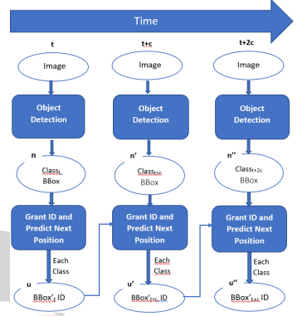
BLOCK DIAGRAM
Innovative Solutions for Robust Safety Survrillance: Deep Learning for Automated Detection of Unanticipated Incidents in Poor CCTV Environments

Slide 9
MODULES
Data Acquisition Module
Multi-Sensor Fusion Module
Deep Learning Model Module
Real-Time Anomaly Detection Module
Innovative Solutions for Robust Safety Survrillance: Deep Learning for Automated Detection of Unanticipated Incidents in Poor CCTV Environments

Slide 10
ADVANTAGES
Improved Detection Accuracy
Enhanced Robustness
Real-Time Response
Innovative Solutions for Robust Safety Survrillance: Deep Learning for Automated Detection of Unanticipated Incidents in Poor CCTV Environments

Slide 11
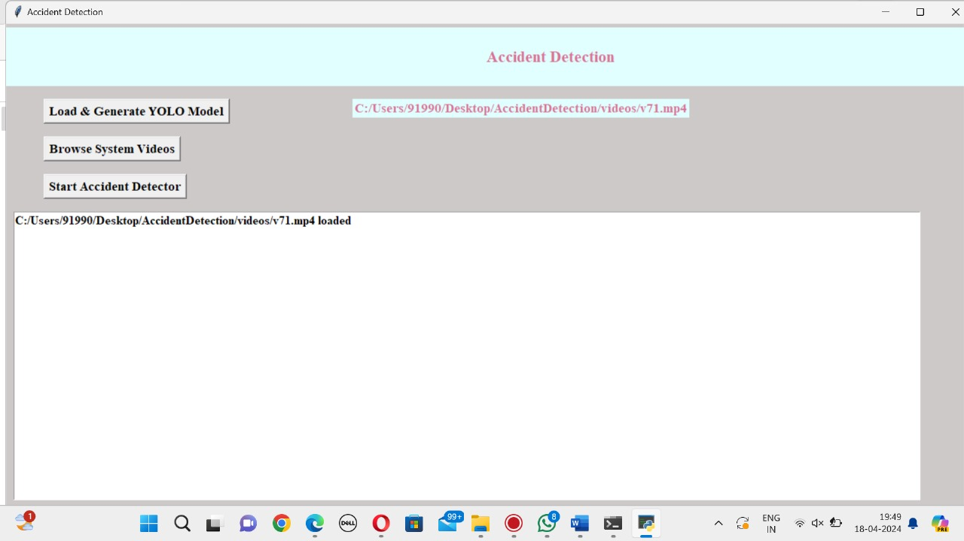
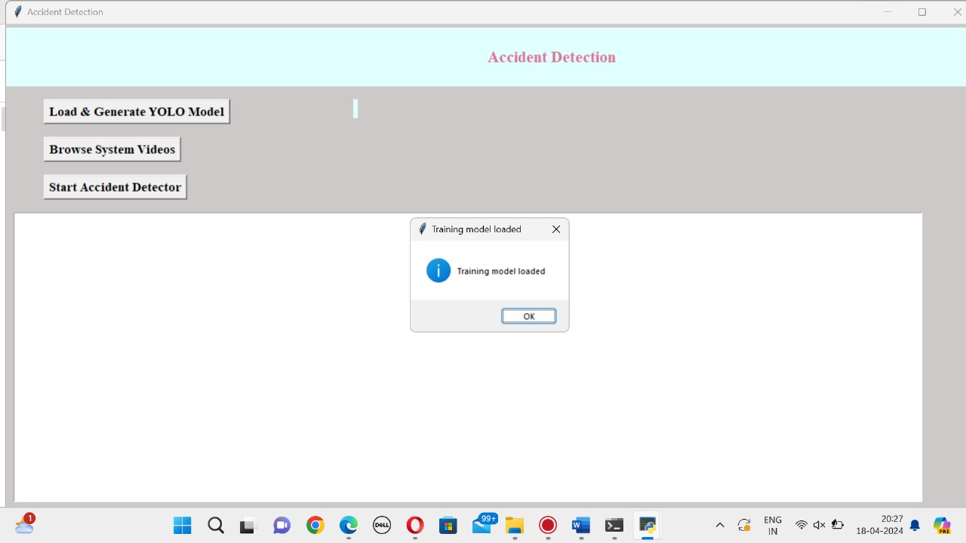
RESULT
Innovative Solutions for Robust Safety Survrillance: Deep Learning for Automated Detection of Unanticipated Incidents in Poor CCTV Environments

Slide 12
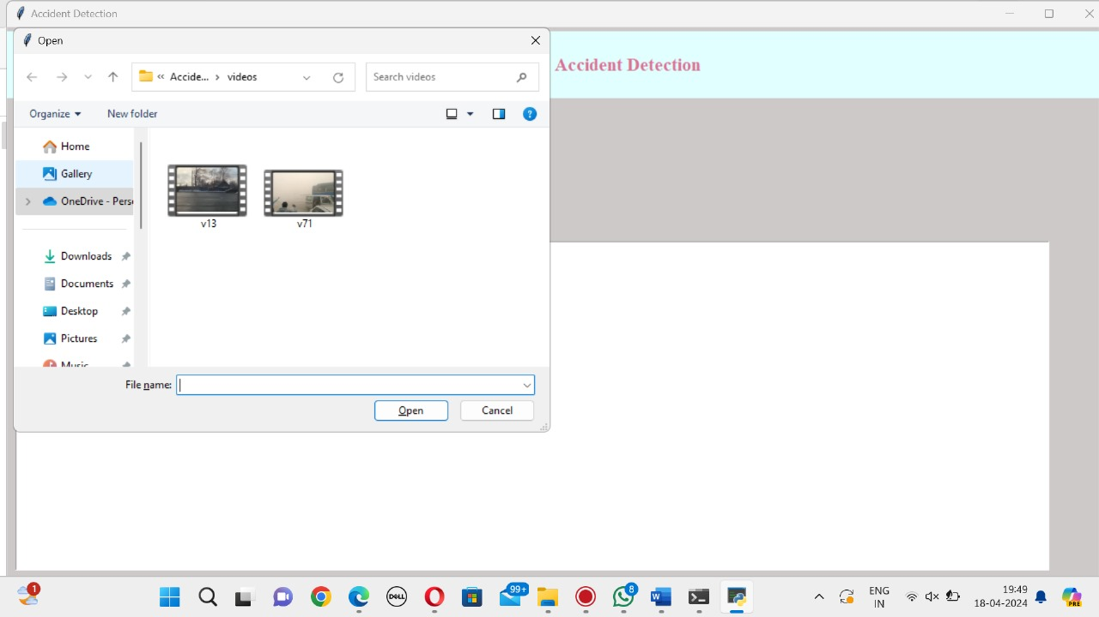
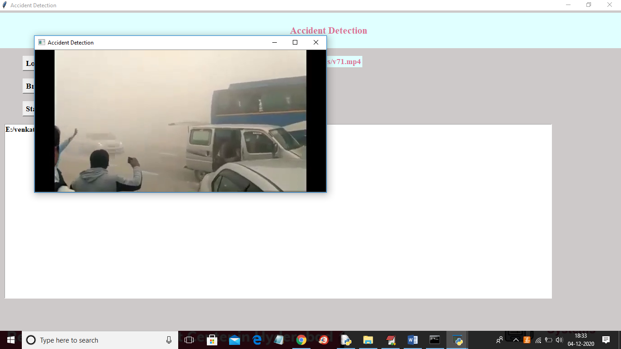
RESULT
Innovative Solutions for Robust Safety Survrillance: Deep Learning for Automated Detection of Unanticipated Incidents in Poor CCTV Environments

Slide 13
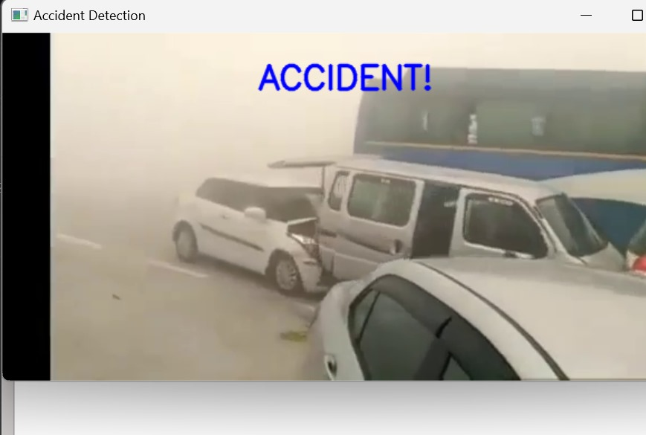

RESULT
Innovative Solutions for Robust Safety Survrillance: Deep Learning for Automated Detection of Unanticipated Incidents in Poor CCTV Environments

Slide 14
CONCLUSION
In conclusion, the proposed system for automatic detection of unexpected accidents under poor CCTV monitoring conditions in tunnels presents a comprehensive and robust solution to enhance safety and security in transportation infrastructure. By leveraging advanced deep learning algorithms and sophisticated data processing techniques, the system addresses the challenges posed by adverse monitoring conditions, such as low lighting and adverse weather, to effectively identify potential accidents or hazardous situations in real time.
Through the integration of modules for data acquisition, preprocessing, feature extraction, anomaly detection, real-time processing, alerting/notification, integration, user interface, logging/reporting, and maintenance/update, the system offers a seamless and holistic approach to tunnel monitoring. It ensures timely detection of anomalies, automated alerting of relevant stakeholders, and efficient integration with existing tunnel surveillance infrastructure.
Innovative Solutions for Robust Safety Survrillance: Deep Learning for Automated Detection of Unanticipated Incidents in Poor CCTV Environments

Slide 15
FUTURE ENHANCEMENT
Integration of AI Explainability
Advanced Sensor Technologies
Autonomous Response Mechanisms
Innovative Solutions for Robust Safety Survrillance: Deep Learning for Automated Detection of Unanticipated Incidents in Poor CCTV Environments

Slide 16

Innovative Solutions for Robust Safety Survrillance: Deep Learning for Automated Detection of Unanticipated Incidents in Poor CCTV Environments

