Slide 1

Breast Cancer Prediction and Detection Using CNN
A Deep Learning-Based Approach
Prepared By : Team 5
21BD1A6708 – B.Hema Durga
21BD1A6711 – B.Harshini
21BD1A6749 – P.Paul
21BD1A6753 – C.Sai Kanishka

Slide 2

Abstract
Breast cancer is one of the leading causes of death among women worldwide, and early detection is crucial for improving survival rates. This project presents a deep learning-based approach for breast cancer detection using Convolutional Neural Networks (CNNs). The model is designed to classify mammogram images as either cancerous or non-cancerous, aiding in early diagnosis.
Addressing class imbalance, we applied oversampling, data augmentation, and class weighting to enhance model performance. The trained CNN, comprising three convolutional layers with dropout regularization, achieved 75% accuracy using binary cross-entropy loss and the Adam optimizer.
For real-world application, we developed a web-based interface using Flask as the backend and HTML, CSS, and JavaScript for the frontend. Users can upload mammogram images, and the model predicts whether the image contains signs of cancer. The backend processes images using PIL (Python Imaging Library), and CORS (Cross-Origin Resource Sharing) is enabled for smooth communication between frontend and backend.

Slide 3
Introduction
Breast cancer is one of the leading causes of death among women, and early detection is crucial for improving survival rates. Traditional mammogram analysis relies on radiologists, making the process time-consuming and sometimes subjective.
To tackle this, we developed a Convolutional Neural Network (CNN) that classifies mammogram images as cancerous or non-cancerous. One of the biggest challenges we faced was class imbalance, as cancerous images were fewer in number. To improve model performance, we applied oversampling, data augmentation, and class weighting, for better accuracy.
To make this technology accessible, we built a web-based application using Flask, where users can upload mammogram images and receive real-time predictions. This system aims to assist doctors in early diagnosis, reducing human error and enhancing the efficiency of breast cancer detection.

Slide 4
Methodology
Dataset: Source (RSNA Breast Cancer Dataset)
Preprocessing steps : 1) loading the data set
2) validation of existing images
3) handling data imbalance by over sampling cancerous images
Algorithms/Models used : 1) sequential model
2) CNN
3) conv 2D
4) max pooling

Slide 5
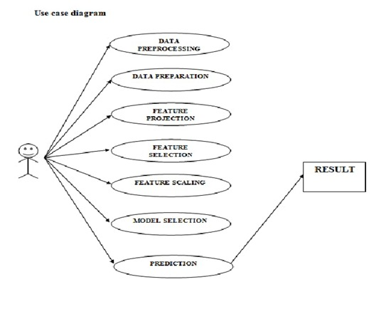
UML Diagrams

Slide 6
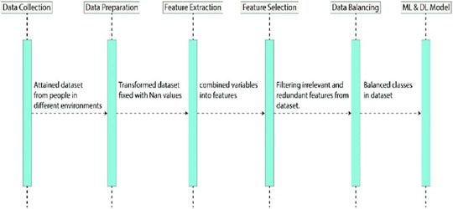
Sequence diagram

Slide 7
Breast Cancer Detection
State Chart Diagram
Data Pre-Processing
Data Validation
Data Balancing
Splitting data sets into subsets
i=1
i-th iteration
Sequential Model Training
Test set
Train set
Plotting Performance History
No
i=i+1
i=10
Yes
Averaging the output metrics

Slide 8
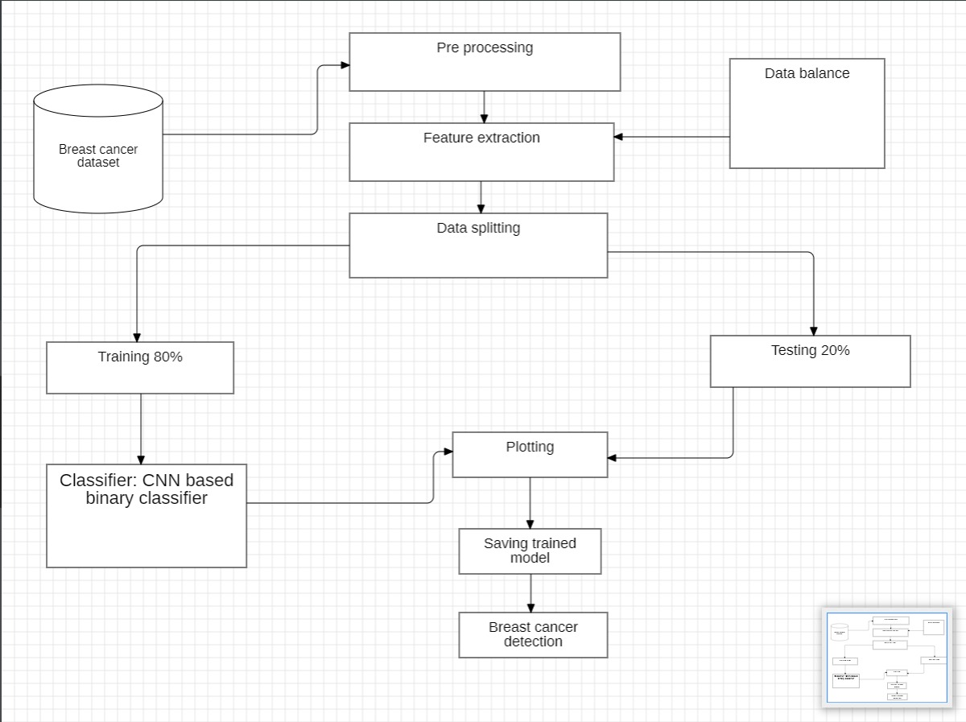
Deployment Diagram

Slide 9
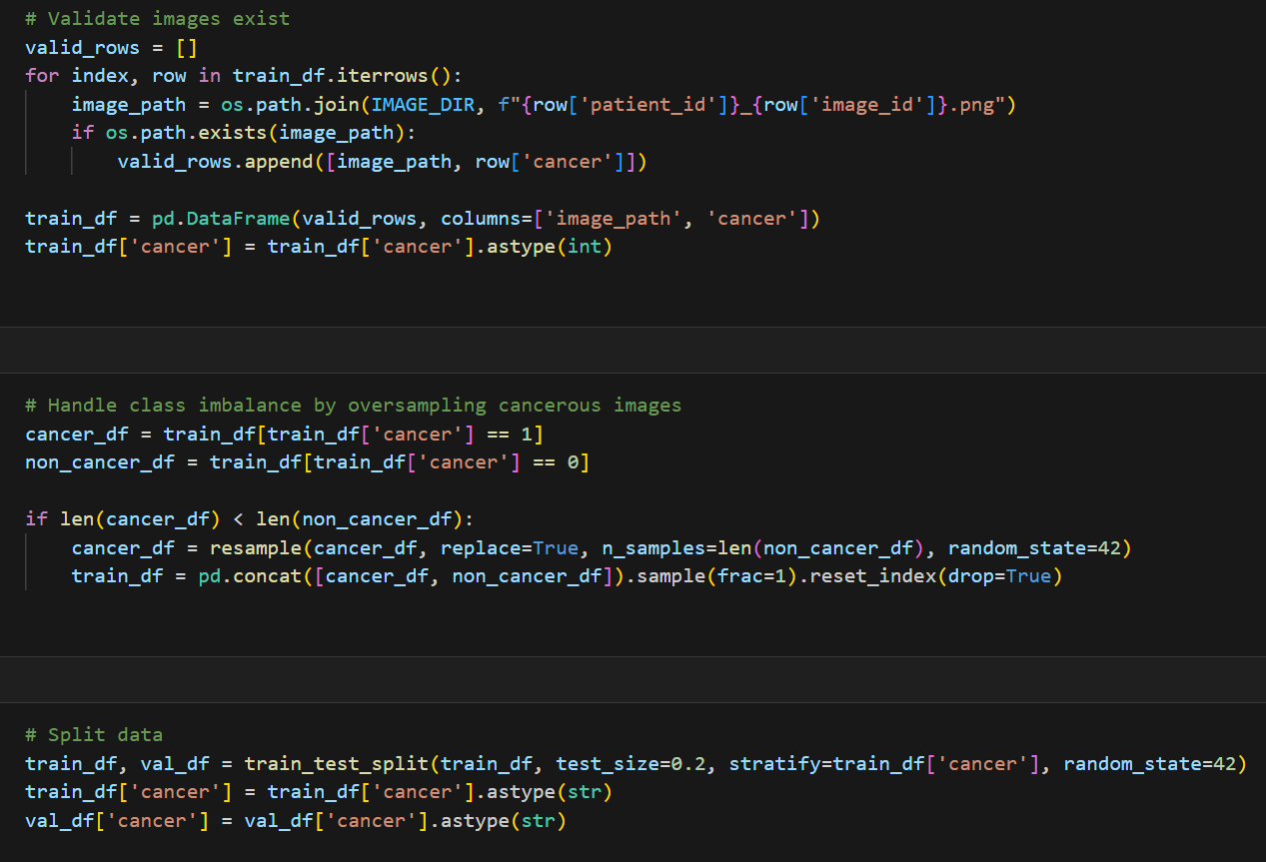
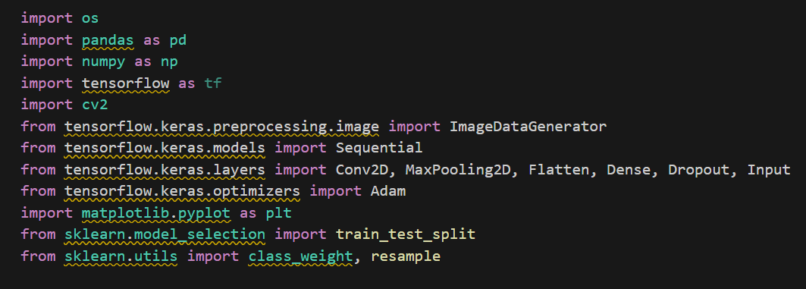
Implementation
Model development Libraries/Tools used

Slide 10
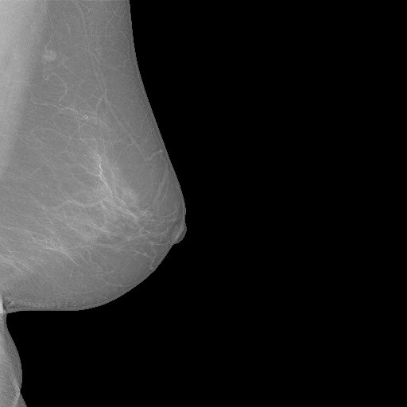
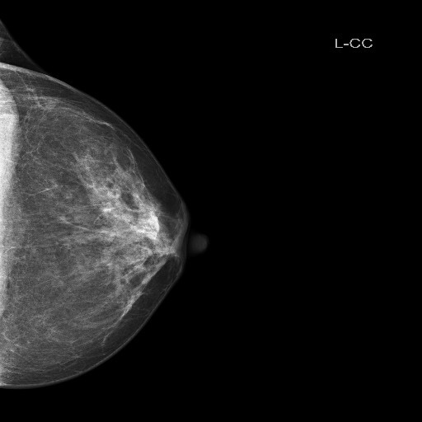
Mammogram images

Slide 11
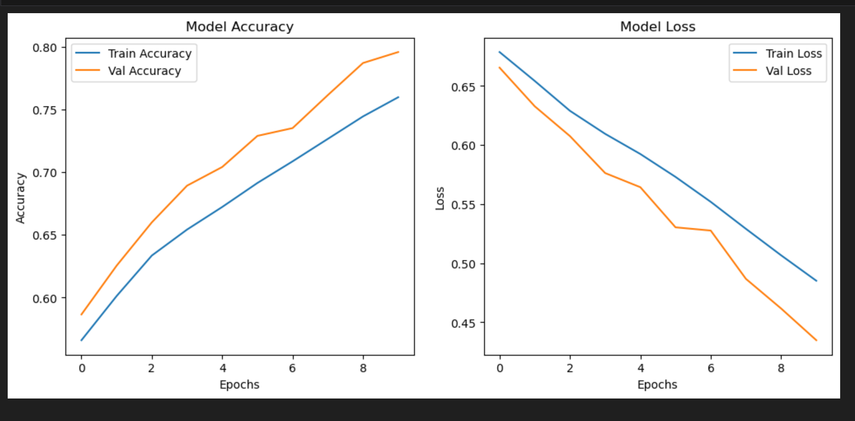

Slide 12
Model Architecture
Input: 224×224 RGB images.
3 Convolutional Layers (32, 64, 128 filters).
Max Pooling layers to reduce dimensions.
Fully connected layer with 128 neurons.
Dropout (50%) for regularization.
Sigmoid activation for binary classification.

Slide 13
Dataset Challenges
• Oversampling: Created duplicates of cancerous images.
• Data Augmentation: Applied transformations like flipping, rotation, zooming.
• Class Weights: Assigned higher weight to cancerous images.
Data Pre-processing & Augmentation:
Resized images to 224×224.
Applied augmentation techniques:
- Rotation, Flipping, Zooming
Balanced the dataset using oversampling.
Model Training & Performance:
Used binary cross-entropy loss & Adam optimizer.
Achieved 75% accuracy after balancing classes.
Reduced false positives using class weighting.

Slide 14
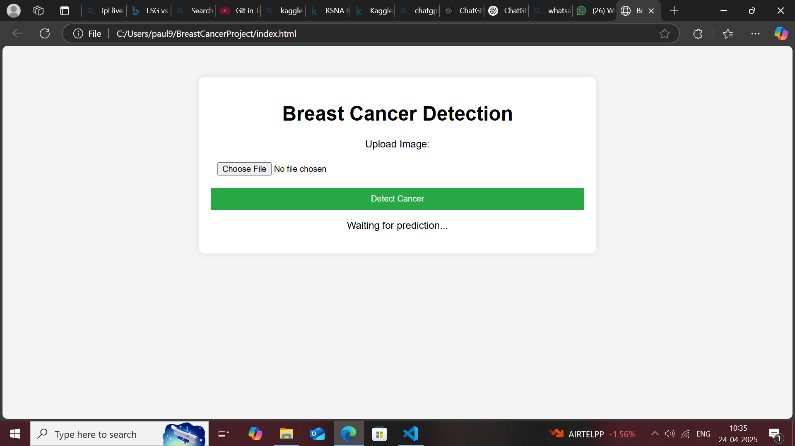
Web Application Overview
Built using Flask for backend.
HTML, CSS, JS for frontend.
Users upload images for real-time predictions.
PIL used for image preprocessing.
CORS enabled for seamless interactions.

Slide 15
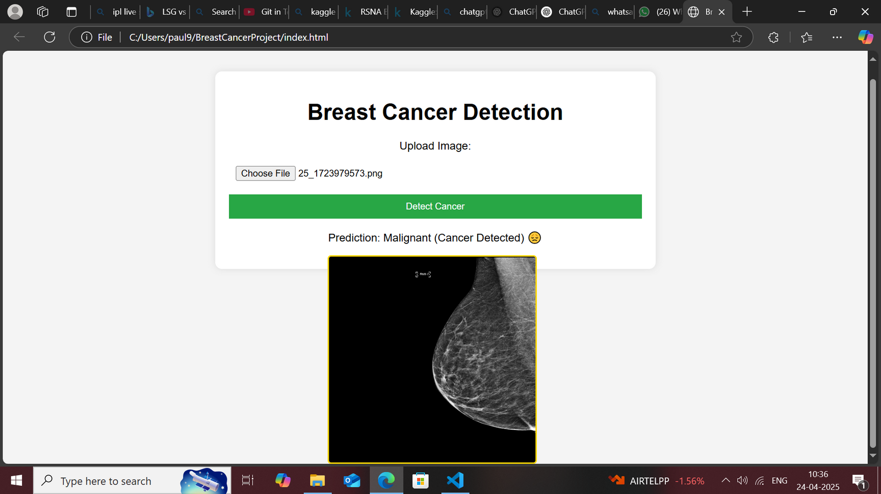
Output:

Slide 16


