Slide 1
WELCOME

Slide 2
PROJECT REPORT TEMPLATE
The tragedy of flight: A Comprehensive Crash Analysis
Servite arts and Science College For Women,
T.Idaiyapatti, Thogaimalai, Karur.
FACULTY MENTOR: Dr.M. PONNAR, M.Sc.,M.Phil.,Ph.D.
Project Done By:
C. HEMA EPSIPA – Team Leader
K.DHARANI –Team Member
S.LIBITHA – Team Member
A.MAHALAKSHMI –Team member

Slide 3
INTRODUCTION
An airplane crash analysis is a detailed investigation into the causes of an aviation
Accident . The goal of an airplane crash analysis is to identify any factors that contributed
to the accidents, with the ultimate goal of improving safety and preventing future
accidents. The process of conducting an airplane crash analysis wide range of data,
including information about the aircraft and its systems, the operators, and any other
relevant factors .
This data is typically collected from Kaggle. Once the data has been collected , it is analysed
through tableau, to identify any potential causes of the accident . The results of an airplane
crash analysis are typically published in a report, Which may include recommendations for
improving safety and preventing similar accidents in the future .These recommendations may
be implemented by the relevant authorities or industry organizations.

Slide 4
PURPOSE
The goal of a airplane crash analysis is to identify any factors that contributed to the accident ,with the ultimate goal of improving safety and preventing from accident

Slide 5
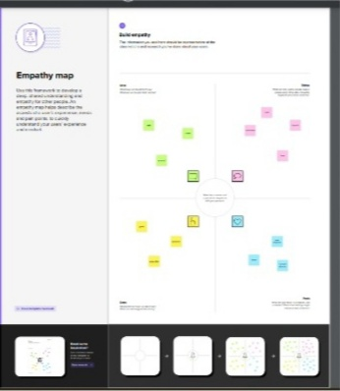

Slide 6
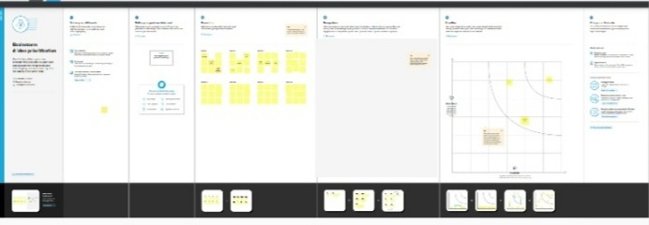

Slide 7


Slide 8
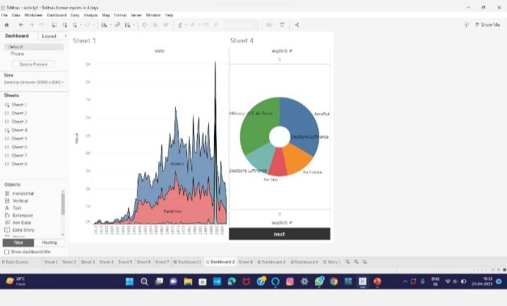

Slide 9
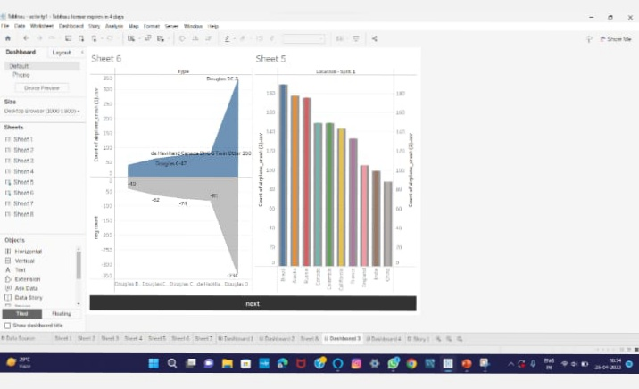

Slide 10
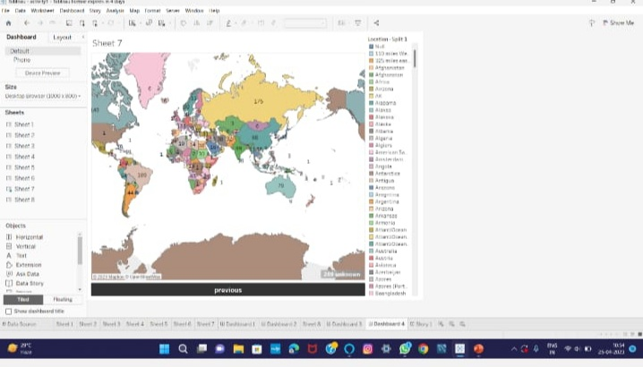

Slide 11
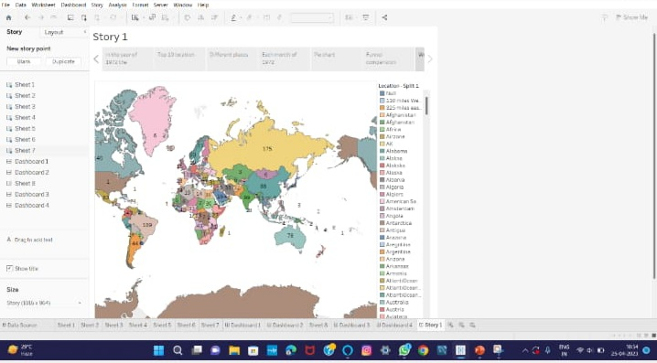

Slide 12
ADVANTAGES
Fastest type of travel .
Good facilities at most airports, refreshments/ meals in route.
Minimal check – in time for most domestic flights.
Most popular method for transport.
DISADVANTAGES
Expensive .
Airports can often be serval miles from city centre .
Long check – in time required for some flights abroad.
Bad weather can mean delays rerouting or cancellation.

Slide 13
Some causes for flight tragedy:
Aviation accidents can be traced to a variety of causes , including pilot error , air traffic controller error, design and manufacturer defects , maintenance failures , sabotage, or inclement weather.

Slide 14
conclusion
The constant maintenance and repair of aircraft may seem like a trivial job
but they can prove to fatal if not done properly.
A missing screw can jeopardize the whole aircraft.
lack of lubrication costed 88 lives there are lessons the avaitation industry
learnt the hard way.

Slide 15
Future scope
In the modern aviation industry, it is also used to analyse a database of past accidents in order to prevent an accident from happening. Many models have been used not only for the accident investigation but also for educational purpose.

Slide 16
THANK YOU

