Slide 1

PLANT DISEASE DETECTION USING ADVANCED DEEP LEARNING MODEL BCSE498J
Under the Guidance of Dr. Mukku NisanthKartheek
21BCB0133 G HEMA
21BCE2544 SRISTI AGARWAL

Slide 2
Outline
Objective: Develop a deep learning-based plant disease classification system targeting potato, bell pepper, and apple crops using leaf images.
Challenges Faced:
Class imbalance (e.g., fewer healthy leaf samples)
Limited dataset size
Generalization across plant species
Datasets Used:
Potato: 2,152 images (Early Blight, Late Blight, Healthy)
Bell Pepper: 2,475 images (Bacterial Leaf Disease & Healthy)
Apple: ~300 images (Scab, Rust & Healthy)
Approach:
Image augmentation to enhance dataset variability
Transfer learning with pre-trained CNNs
Class weights to handle data imbalance
Cross-validation across crops to test model robustness
Outcome: A robust, generalizable model for plant disease detection, aiding precision agriculture.

Slide 3
I n t r o d u c t i o n
Background
Plant diseases are a major threat to agriculture, causing significant losses in crop yield, food security, and economic stability. Traditional methods for disease diagnosis rely heavily on manual inspection, which is time-consuming, subjective, and requires expert knowledge.
Motivation
With the advancement of Artificial Intelligence and Deep Learning, there’s a growing opportunity to automate plant disease detection using image classification techniques. This project is driven by the need for a fast, accurate, and scalable solution to support farmers in identifying diseases at an early stage.
Scope of the Project
This project focuses on building a robust deep learning-based system for plant disease classification using leaf images of potato, bell pepper, and apple crops. It addresses key challenges like limited data, class imbalance, and model generalization across species, with the goal of developing a tool suitable for real-world agricultural applications.

Slide 4
Literature Review
Key Findings from Research
Deep learning models such as CNN, ResNet50, EfficientNet, YOLOv5, YOLOv7-X, and DenseNet have demonstrated high accuracy (up to 99.53%) in plant disease detection.
Transfer learning and feature extraction techniques (e.g., INC-VGG, AlexNet fine-tuning) significantly enhance classification performance.
Real-time detection systems (YOLO, CNN-LSTM) integrated into mobile and web-based applications provide instant disease identification and treatment suggestions for farmers.
Datasets like PlantVillage, Kaggle's New Plant Disease dataset, and custom field datasets from regions like Tamil Nadu are essential in improving model generalization and detection across diverse conditions.
Hybrid models combining CNN and LSTM are effective in capturing both spatial and temporal features for more accurate disease severity classification.

Slide 5
Advancements in Plant Disease Detection
YOLO-based models (YOLOv5, YOLOv7-X) provide faster inference speeds (up to 130 FPS) and high detection accuracy, making them highly suitable for real-time agricultural applications.
IoT integration with AI enables continuous crop monitoring using temperature, humidity, and soil sensors, improving predictive analytics.
Automated pesticide recommendation systems powered by AI enhance decision-making, reduce pesticide overuse, and promote sustainable farming.
Image preprocessing and augmentation techniques (e.g., resizing, normalization, rotation) boost model robustness, enabling better performance in real-world conditions.
Superpixel segmentation techniques like SLIC and traditional preprocessing (color thresholding) allow for lightweight, fast, and effective detection, especially in constrained environments.
Hybrid CNN-RNN models that use RGB and hyperspectral images improve accuracy in complex disease detection scenarios by leveraging multi-modal data.

Slide 6
Relevance to Sustainable Development Goals (SDGs)
SDG 2 – Zero Hunger Our project supports the goal of ending hunger by helping farmers detect plant diseases early, thus reducing crop loss and increasing yield reliability. This contributes to food security, especially in regions dependent on agriculture for livelihood and sustenance.
SDG 12 – Responsible Consumption and Production By accurately identifying plant diseases, your system reduces the need for broad-spectrum pesticide use. This promotes targeted treatment, leading to lower chemical input, reduced environmental impact, and more sustainable farming practices.
SDG 9 – Industry, Innovation, and Infrastructure The use of AI, deep learning, and transfer learning in plant disease detection showcases innovation in agricultural technology. Your model contributes to modern, data-driven farming infrastructure and encourages scalable, low-cost solutions for smart agriculture.

Slide 7
Proposed System/Architecture/Design
Data Augmentation:
Used TensorFlow's ImageDataGenerator to expand the small and imbalanced dataset.
Applied operations: horizontal flip, zoom, shear, random rotation (up to 40°), width/height shift, and pixel value scaling.
Helped prevent overfitting and simulated real-world leaf image variations.
Class Imbalance Handling:
Used Scikit-learn to calculate class weights.
Gave higher importance to underrepresented disease classes during model training.

Slide 8
Model Training Approach:
Used transfer learning from ImageNet-pretrained CNN models (EfficientNetB3, VGG16, MobileNetV2, ResNet50).
Combined CNN feature extraction with LSTM to capture both spatial and sequential patterns.
Fine-tuned the models on the potato disease dataset for better specialization.
Optimization:
Optimizer: Adam (fast and efficient convergence).
Loss Function: Categorical Cross-Entropy for multi-class classification.
Training Stability:
Employed callbacks:
EarlyStopping: Stop training when no improvement.
ModelCheckpoint: Save best model.
ReduceLROnPlateau: Adjust learning rate during plateaus.

Slide 9
P r o j e c t G o a l s
• Develop an accurate leaf disease detection system using deep learning techniques. • Overcome small and imbalanced datasets through advanced data augmentation and class balancing. • Leverage transfer learning with pre-trained CNN models to improve feature extraction. • Integrate LSTM layers to capture sequential feature relationships from image data. • Achieve high model generalization across different crop types through cross-validation. • Deploy an efficient and lightweight model for potential real-world agricultural use.

Slide 10
Analytical and Theoretical Description
Theoretical Foundation
CNNs extract spatial features (texture, color, shape) from images for disease classification.
Transfer Learning with pre-trained models (e.g., ResNet, VGG) enhances accuracy and speeds up training on small datasets.
Image Augmentation (rotation, flip, zoom) simulates real-world variation to improve generalization and reduce overfitting.
Analytical Methods
Class Weights balance the training process for underrepresented classes (e.g., healthy potato leaves).
Cross-validation with apple & bell pepper images ensures model adaptability across crops.
Training Optimization using Adam optimizer, categorical cross-entropy loss, and callbacks (EarlyStopping, ReduceLROnPlateau, ModelCheckpoint).
Evaluation
Performance measured with accuracy, precision, recall, and F1-score to ensure reliable real-world applicability.

Slide 11
Hardware/Software Tools and Simulation/Design Parameters
Software Tools
Python 3.8+ – Programming language
TensorFlow / Keras – Deep learning framework for model building & training
OpenCV & PIL – Image preprocessing and augmentation
Scikit-learn – Class balancing, evaluation metrics, train-test splitting
Jupyter Notebook / Google Colab – Code development and experimentation platform
Hardware Setup
GPU Support – NVIDIA Tesla T4 (Google Colab) for accelerated training
RAM – 12–16 GB (Google Colab environment)
Storage – ~5 GB dataset storage for image data and models
Simulation/Design Parameters
Input Image Size: 224 × 224 pixels (resized for pre-trained CNN compatibility)
Batch Size: 32
Epochs: 20–30 with EarlyStopping
Optimizer: Adam (learning rate = 0.0001)
Loss Function: Categorical Cross-Entropy (for multi-class classification)
Callbacks:
EarlyStopping (to prevent overfitting)
ReduceLROnPlateau (for learning rate tuning)
ModelCheckpoint (to save best model weights)

Slide 12
Discussion
• CNN-LSTM hybrid models successfully captured both spatial and sequential features from leaf images. • Data augmentation techniques (flip, rotate, zoom, shear) improved the model's ability to generalize and reduced overfitting. • Class weighting strategy balanced the learning across majority and minority classes, enhancing minority class detection. • Transfer learning allowed faster convergence and better feature transfer from large datasets to specific crop disease tasks. • Cross-validation results confirmed strong adaptability of the model across different types of crops (apple and bell pepper). • Minor performance drop on apple leaves was observed due to higher intra-class variance, indicating the need for larger and more diverse datasets.

Slide 13
A n a l y s i s
Dataset and Preprocessing:
Dataset: PlantVillage – Potato Disease Dataset.
Data augmentation using ImageDataGenerator with operations:
horizontal_flip, rotation_range, zoom_range, shear_range, width_shift, height_shift, and fill_mode='nearest'.
Preprocessing Function:
Applied normalization to make pixel values scaled between 0 and 1 and extracting features like texture, shapes and edges
Feature Extraction Backbone:
We remove its last classification layers (include_top=False) so we only get useful feature maps
Extracted high-dimensional spatial feature maps (300x300x3 input).

Slide 14
Temporal Feature Learning:
Used GlobalAveragePooling2D to aggregate spatial features.
Applied Reshape to convert pooled features into a sequence format.
Integrated LSTM layer (256 units) to capture sequential dependencies and temporal correlations within extracted feature embedding.
Final Classification
The LSTM output is passed through Dense layers to make predictions.
The final layer uses softmax to classify the image into one of three categories (e.g., healthy or disease types).
Cross Validation
The final model is cross validated with Apple and bell pepper dataset, to ensure the model is accurate and reliable.

Slide 15
Training Strategy and Analytical Outcomes
Handling Class Imbalance:
Computed class weights dynamically using compute_class_weight() from Scikit-learn.
Adjusted loss contribution during backpropagation for minority classes.
Training Configuration:
Optimizer: Used Adam optimizer for adaptive and efficient weight updates.
EarlyStopping: Monitor val_loss, patience=5.
ModelCheckpoint: Save best-performing model (val_loss basis).
ReduceLROnPlateau: Adaptive learning rate reduction (factor=0.2, patience=15).
Evaluation Metrics:
Reported Training Accuracy and Validation Accuracy after convergence.
Model evaluated on unseen validation set using model.evaluate().

Slide 16
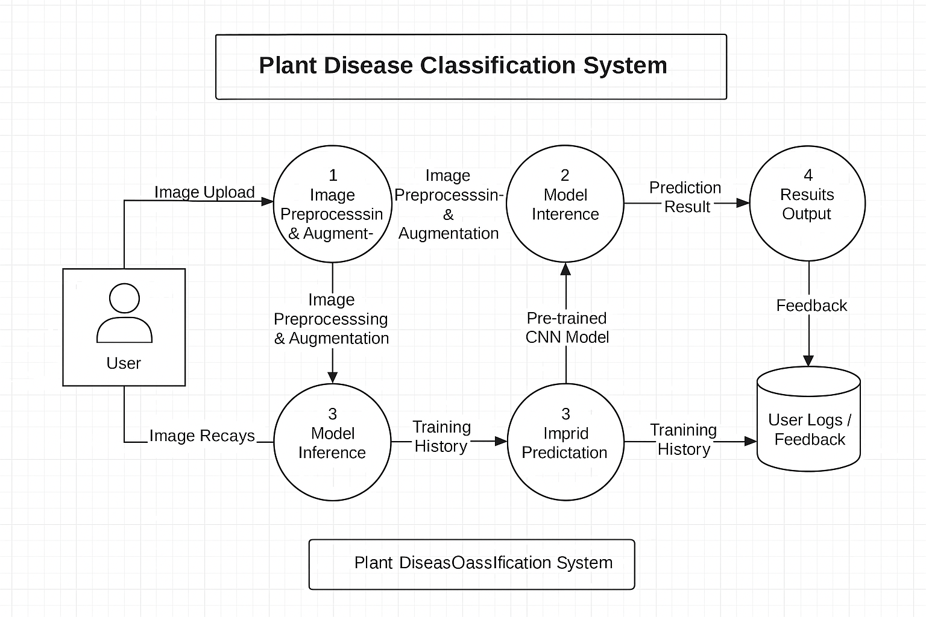
System Architecture

Slide 17
Advantages of Using LSTM in a Hybrid Model
Captures temporal dependencies in the spatial feature maps, learning sequential patterns and complex relationships between features.
Improved Accuracy: LSTM helps the model learn more complex patterns by looking at both the features from images (like shapes and textures) and the relationships between them over time.
Reduced Overfitting: Using both CNN and LSTM makes the model less likely to memorize the training data and more likely to generalize well to new, unseen data. This is especially useful when we have limited data.
Enhanced Decision Making: Facilitates better classification by considering both current and historical context of extracted features.

Slide 18
POTATO LEAF
Result
efficientnetb3 | LSTM | efficientnetb3+LSTM | resnet | Resnet+LSTM | VGG | LSTM+VGG | Mobile-net | Mobilenet+LSTM
93.25 | 85.71 | 96.51 | 71.43 | 87 | 86.78 | 90.12 | 95.11 | 95.91
CROSS VALIDATION
Apple Dataset Bell Pepper Dataset
efficientnetb3+LSTM | Resnet+LSTM | LSTM+VGG | Mobilenet+LSTM
84.78 | 76.09 | 78.26 | 83
efficientnetb3+LSTM | Resnet+LSTM | LSTM+VGG | Mobilenet+LSTM
98 | 89 | 95.83 | 95.46

Slide 19
Result Analysis
Potato Leaf Dataset Results:
EfficientNetB3 + LSTM achieved the highest accuracy: 96.51% with a low loss of 0.056.
Other models like MobileNetV2 + LSTM and VGG16 + LSTM also showed strong performance but slightly lower accuracy.
Cross-Validation Results:
On Apple Leaf Dataset, achieved 84.78% accuracy — showing decent generalization to new crops.
On Bell Pepper Leaf Dataset, achieved 98.00% accuracy — demonstrating excellent transferability.
Key Observations:
Efficient net was the best performing model.
Data augmentation and class weighting helped reduce overfitting and handle class imbalance.
Transfer learning boosted early convergence and improved feature learning.

Slide 20
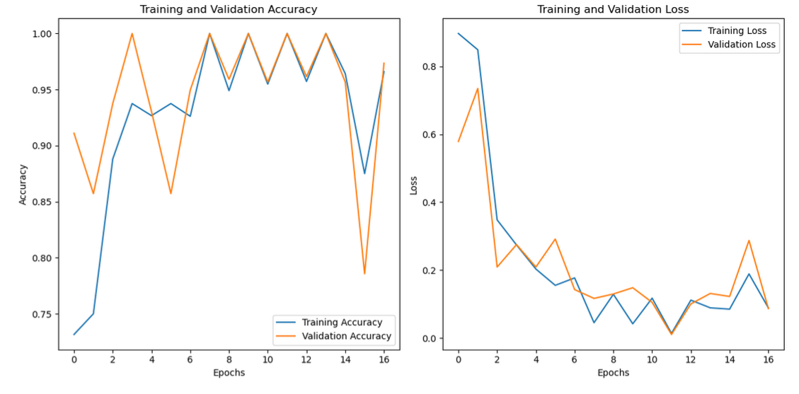
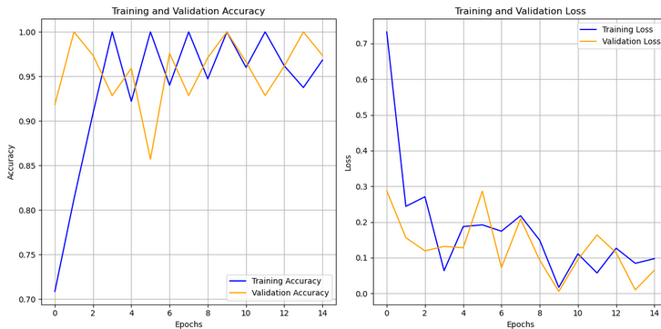
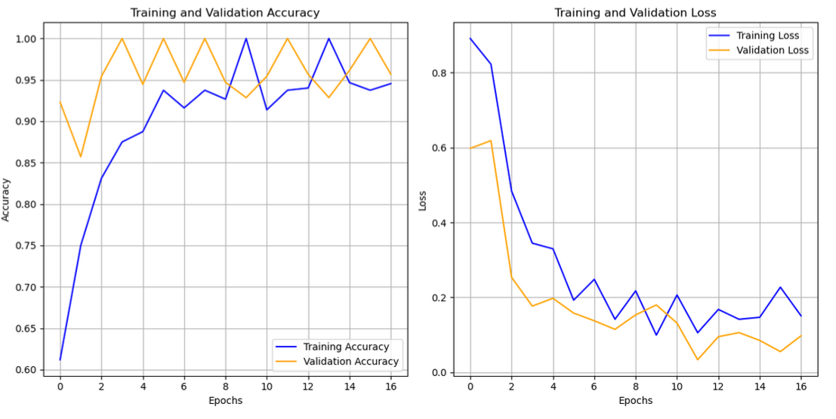
Validation Graph

Slide 21
Conclusion
• Successfully developed a potato leaf disease detection system using CNN-LSTM hybrid models. • Data augmentation and class balancing techniques helped improve model robustness and performance. • Transfer learning from ImageNet significantly boosted feature extraction and classification accuracy.
Employed Adam optimizer for efficient training and faster convergence.
Achieved 96.51% accuracy on the potato leaf dataset and strong generalization to apple and bell pepper datasets.
The model shows great potential for real-world agricultural applications, supporting early disease detection and crop protection.
This work lays a solid foundation for future improvements like mobile deployment and expansion to other crop diseases.

Slide 22
Contribution of individual Team members
Sristi:
Developed and implemented efficient LSTM models (EfficientNet+LSTM and VGG+LSTM).
Led the cross-validation process for the Apple dataset, ensuring model robustness and performance evaluation.
Contributed to the data collection process, working collaboratively with the team to compile and preprocess relevant datasets.
Hema:
Designed and built ResNet+LSTM and MobileNet+LSTM models for enhanced feature extraction and time series forecasting.
Managed cross-validation and model performance analysis for the Bell Pepper dataset, contributing to model evaluation and fine-tuning.
Actively participated in dataset collection and preprocessing to ensure data quality and consistency.

Slide 23
Impact of the project on society and environment
Enhances crop yield and quality through early and accurate disease detection, reducing losses and increasing food production.
Supports sustainable agriculture by limiting excessive pesticide use, which helps preserve soil health and biodiversity.
Improves farmers' decision-making with accessible AI tools, especially benefiting smallholder and resource-limited communities.
Contributes to food security by ensuring healthier crops and more reliable harvests, crucial for growing populations.

Slide 24
References
[1] Nagababu, P., Nageena, S., Dharani, V., & Naveen, D. (2024). Plant disease
detection and diagnosis. Plant Disease Detection and Diagnosis, 1–6.
https://doi.org/10.1109/incet61516.2024.10593371
[2] Nagababu, P., Nageena, S., Dharani, V., & Naveen, D. (2024a). An automated and
fine- tuned image detection and classification system for plant leaf diseases.
An Automated and Fine- Tuned Image Detection and Classification System for
Plant Leaf Diseases, 1–6. https://doi.org/10.1109/incet61516.2024.10593371
[3] Pandey, P., Patyane, K., Padekar, M., Mohite, R., Mane, P., & Avhad, A. (2023).
Plant Disease Detection Using Deep Learning Model - Application FarmEasy.
Plant Disease Detection Using Deep Learning Model - Application
FarmEasy, 15, 1–6. https://doi.org/10.1109/icacta58201.2023.10393095
[4]Yaswanth, D., Manoj, S. S., Yadav, M. S., & Chowdary, E. D. (2024). Plant leaf
disease detection using transfer learning approach. 2020 IEEE International
Students’ Conference on Electrical,Electronics and Computer Science
(SCEECS), 1–6. https://doi.org/10.1109/sceecs61402.2024.10482053

Slide 25
[5] Singh, V. K. (2023). SUBCOPLED: Superpixel based color distribution driven
plant leaf disease detection. 2022 International Conference on Computing,
Communication, and Intelligent Systems (ICCCIS), 864–868.
https://doi.org/10.1109/icccis60361.2023.10425303
[6] Biswas, B., & Yadav, R. K. (2023). A Review of Convolutional Neural Network-
based Approaches for Disease Detection in Plants. A Review of Convolutional
Neural Network-based Approaches for Disease Detection in Plants.
https://doi.org/10.1109/idciot56793.2023.10053428
[7] Sangeetha, T., Rajarajan, R., Krishna, S. R., & Siddharth, N. S. (2024). A novel
smart approach to plant health - Automated detection and diagnosis of leaf
diseases. 2022 International Conference on Inventive Computation
Technologies (ICICT). https://doi.org/10.1109/icict60155.2024.10544660
[8] Balwani, S., & Bawane, N. (2024). Analytical Review on Smart Plant Disease
Detection and Prevention System. 1–5.
https://doi.org/10.1109/icicet59348.2024.10616362

Slide 26
[9] Deepa, A. R., Chaurasia, M. A., Vamsi, S. B. N., Kumar, B. M., Reddy, V. S., &
Anand, K. T. (2023). Plant Diseases and Pests Detection Using Machine
Learning. Plant Diseases and Pests Detection Using Machine Learning, 1–4.
https://doi.org/10.1109/asiancon58793.2023.10270264
[10] Reddy, V. C. G., Xavier, V. M. A., & Shyni, S. S. (2024). Plant disease
detection and pesticide recommendation using deep learning. 2022 8th
International Conference on Advanced Computing and Communication
Systems (ICACCS), 2543–2547.
https://doi.org/10.1109/icaccs60874.2024.10717268
[11] Tandekar, D., & Dongre, S. (2023b). Identification of various diseases in plant
leaves using image processing and CNN approach. 2022 13th International
Conference on Computing Communication and Networking Technologies
(ICCCNT). https://doi.org/10.1109/icccnt56998.2023.10306979
[12] Amritraj, S., Hans, N., & Cyril, C. P. D. (2023). An Automated and Fine- Tuned
Image Detection and Classification System for Plant Leaf Diseases. An
Automated and Fine- Tuned Image Detection and Classification System for
Plant Leaf Diseases, 1–5.
https://doi.org/10.1109/raeeucci57140.2023.10134461

Slide 27
THANK YOU

