Slide 1

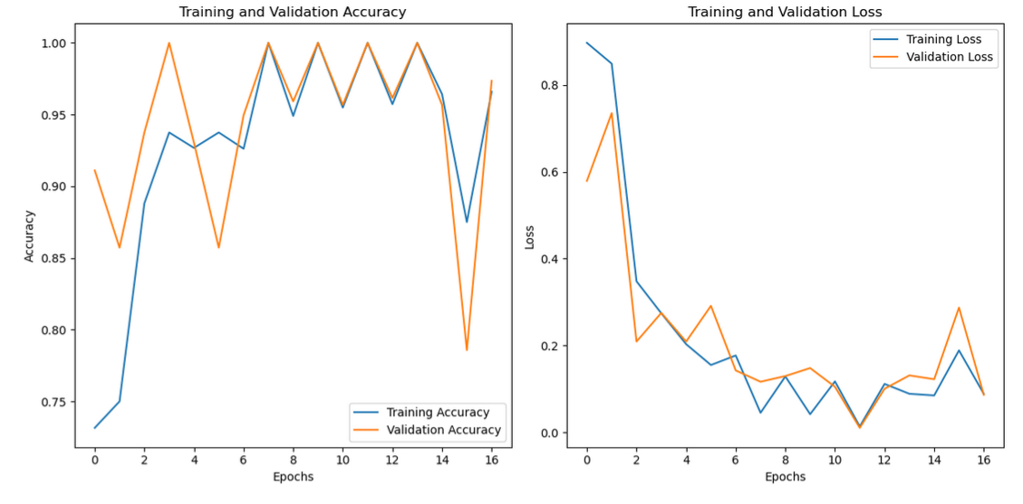
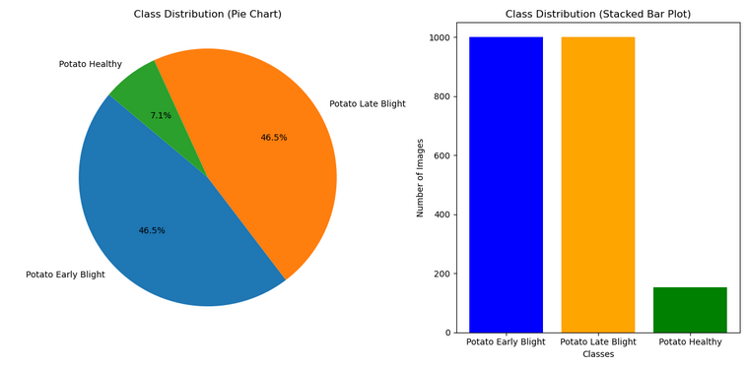
.
PLANT DISEASE DETECTION USING ADVANCED DEEP LEARNING MODEL
Sristi Agarwal and G Hema|Dr. Mukku Nisanth Kartheek|School Of Computer Science and Engineering
Introduction
Results
Our project leverages deep learning for plant disease detection, utilizing CNN architectures like MobileNet, ResNet, EfficientNet, and VGG. We also incorporate hybrid models combining CNN and LSTM to enhance feature extraction and temporal learning. These approaches enable fast, accurate classification, reducing manual intervention and promoting smarter, tech-driven agricultural practices.
Potato Leaf Dataset: • EfficientNetB3 + LSTM achieved the highest accuracy of 96.51% with a low loss of 0.056. • MobileNetV2 + LSTM also showed strong performance, slightly lower than EfficientNetB3 + LSTM.
Cross-Dataset Validation: • Apple Leaf Dataset: 84.78% accuracy (EfficientNetB3 + LSTM). • Bell Pepper Leaf Dataset: 98.00% accuracy (EfficientNetB3 + LSTM).
Key Observations: • EfficientNetB3 + LSTM and MobileNetV2 + LSTM outperformed other models. • Data augmentation and class weighting helped improve results. • Transfer learning accelerated model convergence and feature learning.
Motivation
Empowering agriculture with AI: Accurate plant disease detection using deep learning to enhance crop health, yield, and food security.
Scope of the Project
Develop a robust image classification model to accurately detect plant diseases in potato, bell pepper, and apple leaves.
Address challenges of limited and imbalanced data using augmentation techniques, class weighting, and transfer learning strategies.
Ensure cross-species generalization to improve model adaptability for real-world agricultural applications across various crops.
Methodology
Dataset Acquisition: ➔ Collected Potato Disease Dataset from PlantVillage (via Kaggle).
Data Preprocessing: ➔ Used ImageDataGenerator for augmentation (flip, zoom, shear, rotation, shifts). ➔ Applied EfficientNetB3 preprocessing on images.
Model Architecture: ➔ EfficientNetB3 as feature extractor (pre-trained on ImageNet). ➔ Added Global Average Pooling → Reshape Layer → LSTM Layer → Dense Layers for classification.
Training Strategy: ➔ Froze EfficientNetB3 layers initially. ➔ Trained with Adam optimizer (lr = 0.0001) and categorical crossentropy loss. ➔ Handled class imbalance using class weighting.
Callbacks Used: ➔ EarlyStopping (patience = 5). ➔ ModelCheckpoint (save best model). ➔ ReduceLROnPlateau (dynamic learning rate adjustment).
Evaluation Metrics: ➔ Tracked training and validation accuracy and loss. ➔ Performed performance evaluation after training.
Dataset | Model | Accuracy (%)
Potato Leaf | EfficientNetB3 + LSTM | 96.51
 | MobileNet+ LSTM | 95.91
Apple Leaf | EfficientNetB3 + LSTM | 84.78
 | MobileNetV2 + LSTM | 83.00
Bell Pepper Leaf | EfficientNetB3 + LSTM | 98.00
 | MobileNetV2 + LSTM | 95.46
Conclusion
Developed a CNN-LSTM model achieving 96.51% accuracy in potato leaf disease detection using EfficientNet B3.
Used data augmentation, class balancing, and transfer learning to enhance performance and generalization.
Demonstrated cross validation with apple and bell-pepper dataset , to determine reliability of our model and classify the best performing model .
References
[1]Haruna, A. A., Badi, I. A., Muhammad, L. J., Abuobieda, A., & Altamimi, A.
(2023). CNN-LSTM Learning Approach for Classification of Foliar Disease
of Apple. CNN-LSTM Learning Approach for Classification of Foliar Disease
of Apple, 1–6. https://doi.org/10.1109/icaisc56366.2023.10085039
[2] Devi, E., Gopi, S., Padmavathi, U., Arumugam, S. R., Premnath, S., &
Muralitharan, D. (2023). Plant Disease Classification using CNN-LSTM
Techniques. 2022 4th International Conference on Smart Systems and
Inventive Technology (ICSSIT), 1225–1229.
https://doi.org/10.1109/icssit55814.2023.10061003

