Slide 1

Vaccination for Kids
Hemalatha Subbiah
Bellevue University
DSC500-T301: Introduction to Data Science
Professor (or Dr.) Shankar

Slide 2
Why Vaccination Needed for Kids
This is trendy discussion going around the world for many decades and research are going on to prove its pros and cons. Literally I need to bet on the cons as on-time vaccination throughout childhood is essential because it helps provide immunity before children are exposed to potentially life-threatening diseases. Vaccines are tested to ensure that they are safe and effective for children to receive at the recommended ages.
Children are exposed to thousands of germs every day. This happens through the food they eat, air they breathe, and things they put in their mouth. Babies are born with immune systems that can fight most germs, but there are some serious and even deadly diseases they can’t handle. That’s why they need vaccines to strengthen their immune system. Vaccines use very small amounts of antigens to help your child’s immune system recognize and learn to fight serious diseases. Antigens are parts of germs that cause the body’s immune system to go to work.
Combination Vaccines are introduced to kids Combining vaccines into fewer shots may mean that more children
will get recommended vaccinations on time

Slide 3
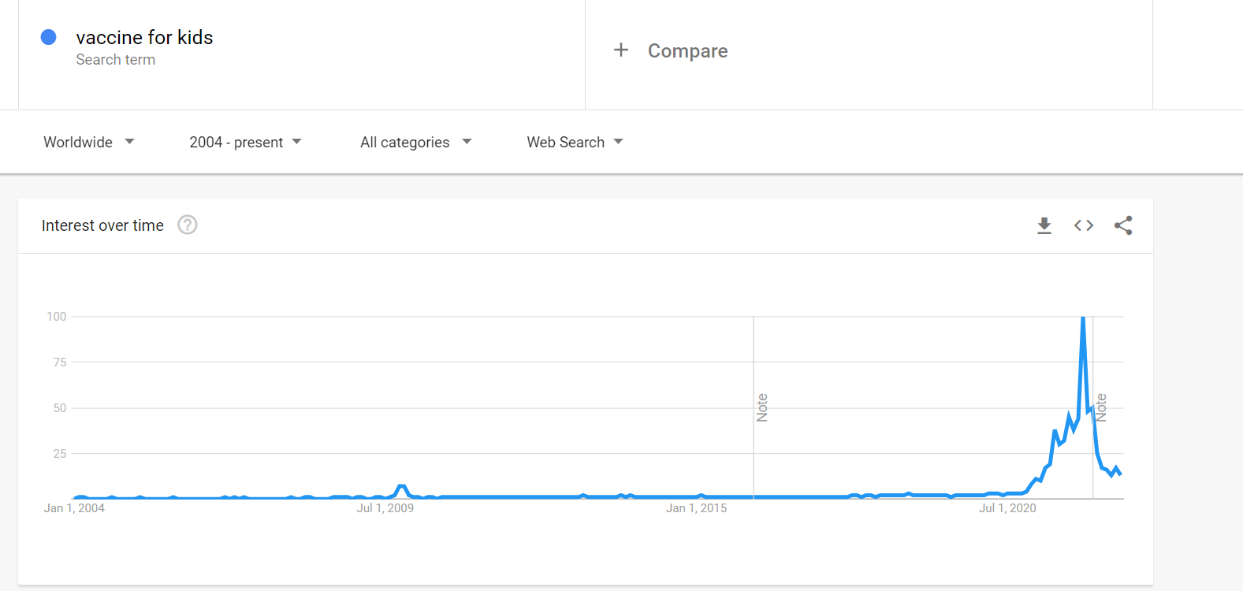
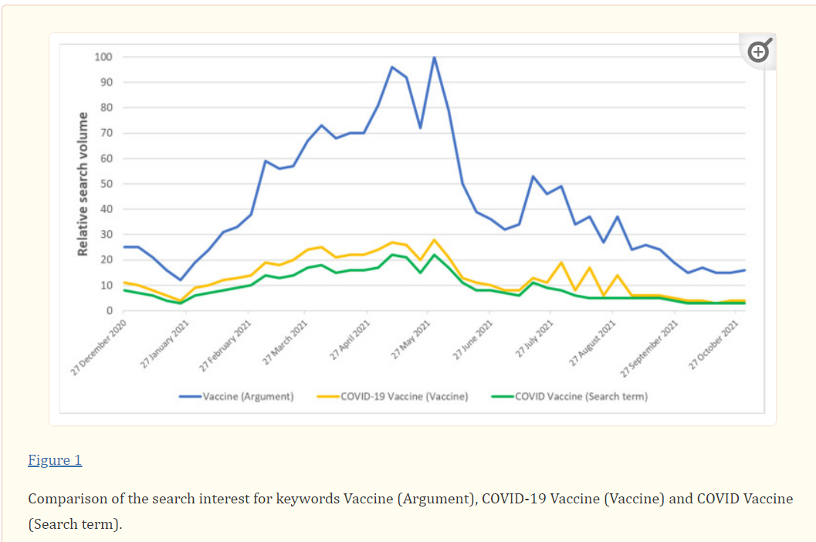
people interest on vaccine for kids
Global vaccination interest spiked up around 2020 ,when the COVID-19 pandemic entered the world. People were looking for vaccine to escape from deadlier disease.
Global vaccination interest spiked up around 2020 ,when the COVID-19 pandemic entered the world. People were looking for vaccine to escape from deadlier disease.

Slide 4
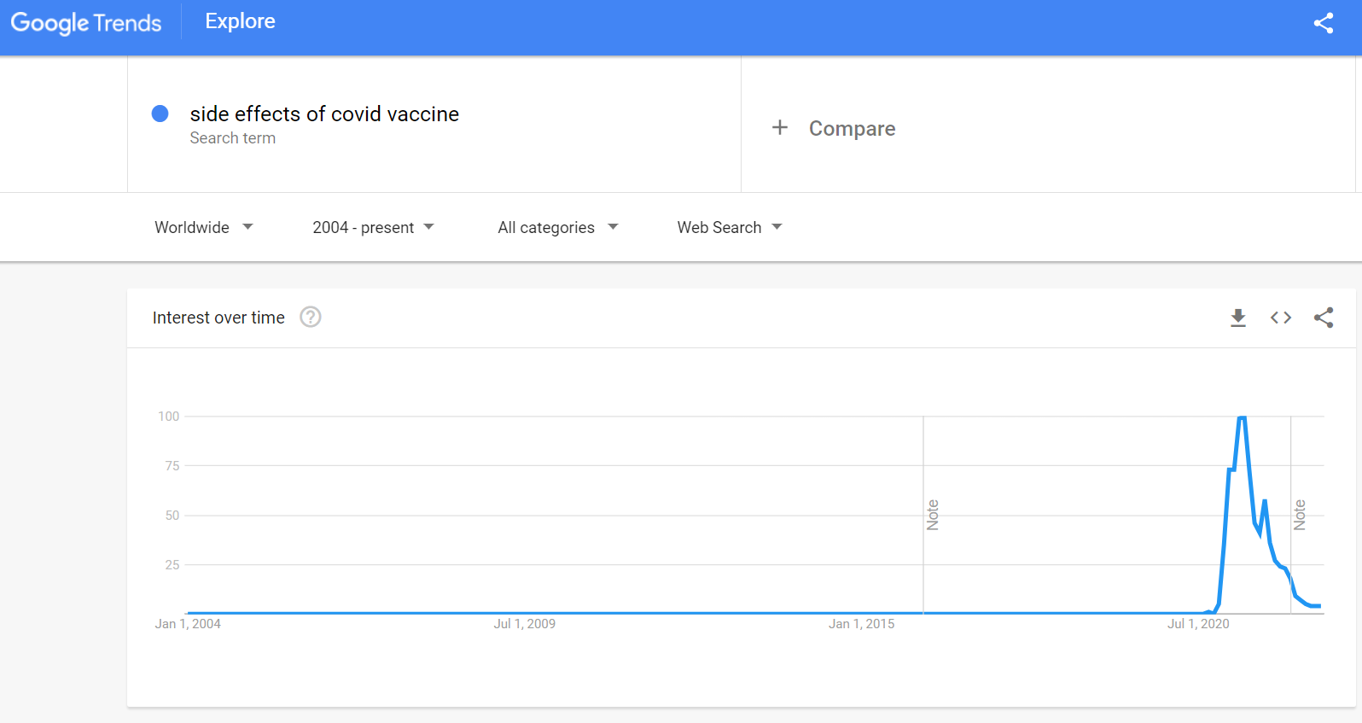
side-effects of Vaccine from GOOGLE TRENDS
The search volume of the side effects of vaccine particularly for Kids have gone up after 2020. Any vaccine can cause side effects mostly, a sore arm or low-grade fever. Remember, vaccines are continually monitored for safety, and like any medication, vaccines can cause side effects. However, a decision not to immunize a child also involves risk and could put the child and others who meet him or her at risk of contracting a potentially deadly disease.

Slide 5
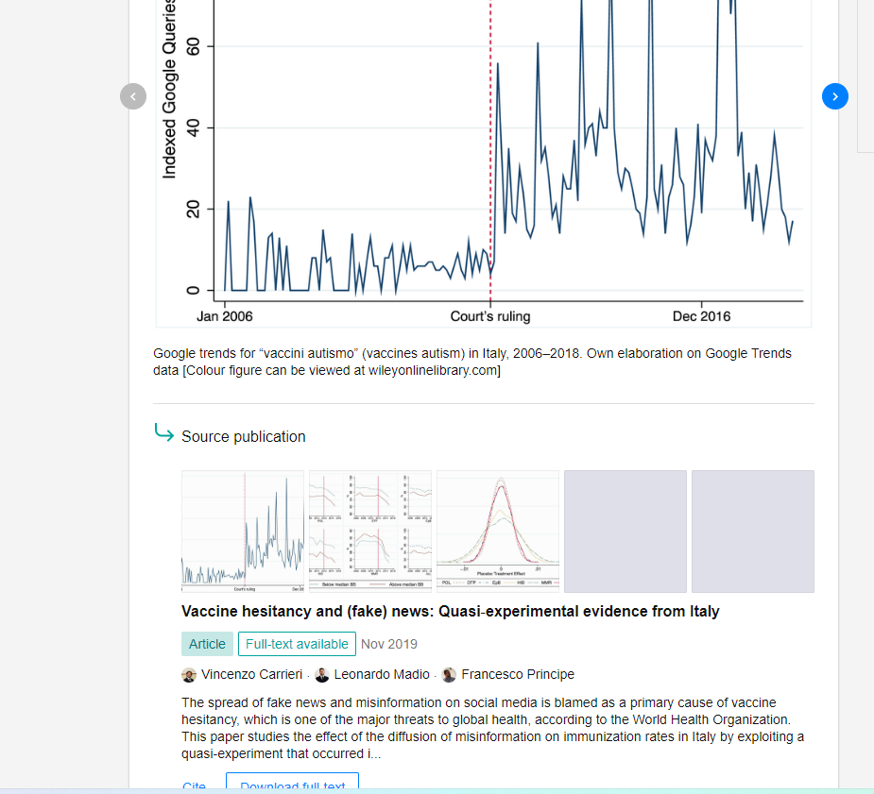
Vaccination to kids can cause Autism – A Myth
– I strongly deny it from the google search I did-it comes out as myth. Autism is a neurodevelopmental difference
usually present at birth, before vaccination begins. But the signs may not be noticeable right away. Many children
aren’t diagnosed with autism until they’re about 2 years old. Some people are older — even adult — when they receive
their diagnosis.

Slide 6
vaccination for underdeveloped countries
Vaccine preventable diseases are still the most common cause of childhood mortality, with an estimated 3 million deaths every year, mainly in Africa and Asia. Different factors were found to influence under-five childhood immunization uptake among parents in Africa. Immunization health education intervention among pregnant women, focusing on the significant findings from this systematic review, would hopefully improve childhood immunization uptake in African countries with poor coverage rates

Slide 7
Ethical Concerns
The root of the ethical dilemma behind a vaccine mandate is the conflict between public health ethics and the right to individual liberty and autonomy. Utilitarian arguments for vaccine mandates claim that higher immunization rates result in greater good for all. According to this view, mandating universal vaccination is morally justified because of the consequences: community protection and reduction in virus transmission, resulting in lower rates of infections, hospitalizations, and deaths.
Beneficence, nonmaleficence : Healthcare institutions have a legal and ethical obligation to ensure
a safe environment for patients, HCW, and visitors.
Justice: Vaccines prevent hospitalizations and may reduce HCW shortages and protect health system capacity.

Slide 8
Challenges/opportunities
Parents believe that too many immunizations will weaken their child’s immune system or may cause chronic illnesses such as asthma, rents believe that too many immunizations will weaken their child’s immune system or may cause.Parents who are non-vaccinators may believe they can control their child’s susceptibility to infection chronic illnesses such as asthma and refuse vaccination for personal, cultural and/or religious reasons, or because of a previous perceived bad experience with immunization.
Physicians need to acknowledge parents’ concerns and respectfully address them and attempt to correct any misconceptions.
It is important that all financial barriers to vaccines be removed, to enable equal access and improved immunization rates

Slide 9
conclusion
Vaccination is a highly effective, safe, and easy way to help keep your family healthy. The timing of vaccination is based on how your child’s immune system responds to vaccines at various ages and how likely your child may be exposed to disease. Vaccines are tested to ensure they are safe and effective for children to receive at the recommended ages .
In addition, state legal immunization requirements for daycares and schools should be encouraged and strengthened, and nonmedical exemptions discouraged. Vaccines need to be accessible, and available at multiple sites, including the medical home as well as alternate providers such as pharmacies, WIC settings, and schools.

Slide 10
Reference
Using Google Trends to Predict COVID-19 Vaccinations and Monitor Search Behaviours about Vaccines: A Retrospective Analysis of Italian Data - PMC (nih.gov)
Deciding to Vaccinate Your Child: Common Concerns | CDC

