Slide 1
Problem Statement
The Air Quality Index (AQI) is a crucial metric that quantifies the level of air pollution in a specific area. It provides valuable information about the quality of the air we breathe and its potential impact on human health. Predicting AQI accurately is essential for environmental monitoring, public health management, and policymaking.
The aim of the project is to develop a robust machine-learning model capable of predicting the Air Quality Index (AQI) based on various environmental parameters and pollutant concentrations. The model should be capable of providing accurate AQI predictions for future time points, allowing for early detection of potential air quality issues.

Slide 2
Why it’s important to solve
Public Health Impact
Environmental Awareness
Policy Formulation
Resource Allocation
Economic Implications
Global Concern
Quality of Life

Slide 3
Source of Data
The data is extracted from the Environmental Protection Agency website. https://aqs.epa.gov/aqsweb/airdata/download_files.html
Total of 13 datasets will be used to predict the air quality in this project, such as Ozone concentration datasets, SO2, NO2, and Carbon Monoxide concentration datasets; datasets of pollutants such as PM2.5 and PM10; datasets containing meteorological data such as Temperature, Pressure, Humidity, etc. All these datasets are for the year 2022.
Columns to identify the site location where the readings were measured:
State code, County Code, Site Number, Latitude, Longitude, Local Site name, Address, State Name, County Name, City Name.
Columns to identify the Pollutant/ Gases/ the Metrological quantity:
Parameter Name: Represents the Parameter of the Pollutant /Particulate/Toxin/Meteorological measure.
Parameter Code: Unique code assigned to the parameter describing the Pollutant /Particulate / Toxin /Meteorological measure
Units of Measure: The unit in which the parameter is measured
Observation Count: Number of observations captured on the specified date in the site location
Arithmetic Mean: The Mean value of the quantity of the parameter captured on the given date at the given site
Column to identify the Air Quality:
AQI: Represents Air Quality Index value measured on the specified date at the specified site location.
Date fields:
Date Local: Date when the parameter was measured and recorded
Columns for Pollutants:
Ozone (O3): Concentration of ozone in the air
Carbon Monoxide (CO): The Concentration of carbon monoxide in the air.
Nitrogen Dioxide (NO2): Concentration of nitrogen dioxide in the air.
Sulfur Dioxide (SO2): Concentration of sulfur dioxide in the air.

Slide 4
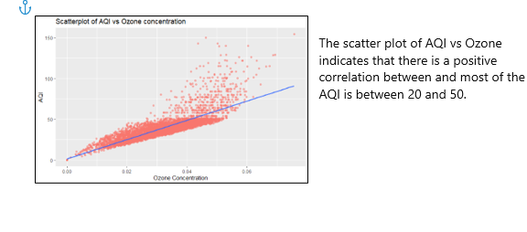
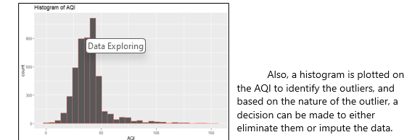
Data Visualization – Story Telling

Slide 5
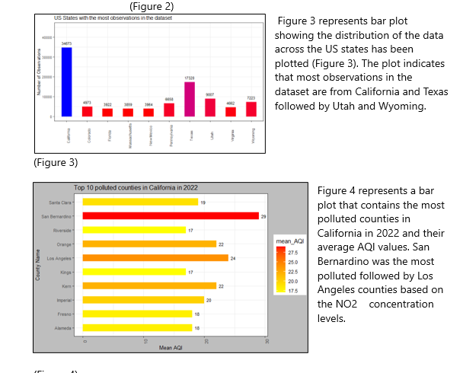
Data Visualization – Story Telling

Slide 6
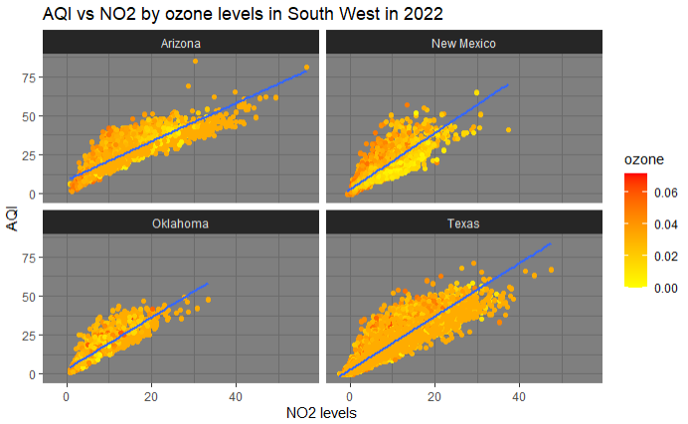
Data Visualization – Story Telling
Figure 5 represents multiple scatter plots of NO2 concentration versus AQI colored based on ozone values. Each subplot represents a state in the Southwest region. All 4 states represent a similar trend with ozone concentration uniform, though Oklahoma and Texas had higher Ozone.

Slide 7
Data Preparation
The data for this project was collected by combining multiple CSV files each containing information about the pollutant concentration, meteorological data, etc. Each row represents information about the pollutant concentration and the Air Quality Index for a location in the US on a given day and has additional details such as state, county, pollutant description, etc.
Data format conversion :After creating data frames for each dataset, data conversion was performed by converting some character columns to Factors and Dates.
Renaming the features and merging the datasets : The field names were renamed for easier computations by removing spaces in the column names and replacing them with underscores. To prepare the final data, the Dataset containing NO2 data was joined with all other datasets based on common columns such as State ID, County ID, Site ID, and the Date of Observation.
Null handling and Duplicate checks :The nulls were then handled by replacing them with Median values for the column. The dataset was then checked for duplicates in the key columns and only the distinct values were retained.

Slide 8
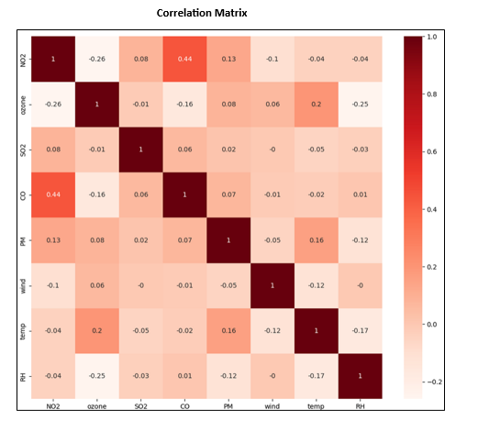
Feature Engineering
Feature Reduction based on the Correlation matrix:
The correlation matrix was leveraged for analyzing and identifying pairs of features with high correlation coefficients (close to 1 or -1) and the features with high correlation were removed to reduce redundancy. Only the features that had a high correlation with the target variable were retained for model building.
Feature Reduction using the PCA method :
The PCA- the dimensionality reduction technique was implemented to preserve most of the variability in the data and reduce the number of features in the dataset. Figure 7 is the snippet of code.

Slide 9
Model Development
The final dataset derived by combining multiple datasets was split into Training and Test sets in approximately 75:25 ratio. Also, feature extraction or selection was deployed to reduce the number of features in the dataset
In R:
Predicting the Air quality index, which is a continuous Numeric variable, the Regression algorithm is used for building the models.
In Python:
The below regression algorithms were explored as a part of model development:
Linear Regression
Decision Tree Regression
Random Forest Regression
K Neighbors Regression
Gradient Boosting Regressor

Slide 10
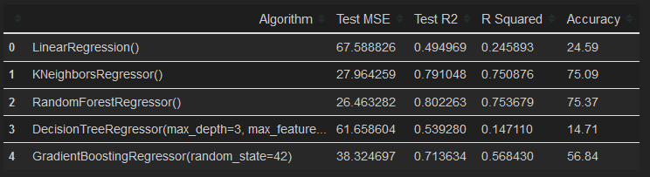
Model Performance
For evaluation of regression models the metrics Mean Squared Error (MSE),
R-squared and accuracy sed to assess their performance. These metrics quantify the errors between predicted and actual values, providing a measure of accuracy in terms of the model's ability to make predictions.
Model Results with No Feature Reduction:

Slide 11
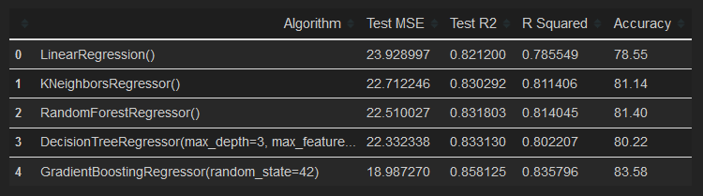
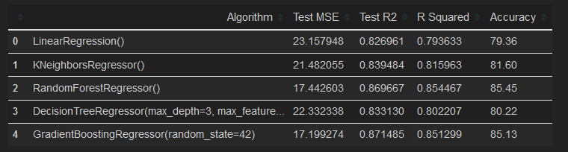
Model Performance
Model Results with Pearson’s Method Feature reduction:
Model Results with PCA Feature Reduction:

Slide 12
Model Deployment
Deployment is the method by which you integrate a machine learning model into an existing production environment to make practical business decisions based on data. FastAPI allows us to take a trained model and create an API for it, in less than 10 lines of code. Tools like TFX, Mlflow, Kubeflow ,Sagemaker can simplify the whole process of model deployment, and data scientists can leverage for Model deployment.
Some effort left out for deploying this model in Production either in on prem on cloud based what method the model is to inferenced.

Slide 13
Ethical Implications
Though gas-powered vehicle emissions and industrial smoke have played a significant role in air pollution, they cannot be entirely replaced by sustainable solutions, as they can lead to many job losses affecting many families employed by the manufacturing industries. Care must be taken while publishing the results, keeping in mind the impact it can have on families.
While determining the acceptable levels of greenhouse gases and pollutants for humans, careful assessment should be made while determining the values, as the acceptable levels for humans may cause significant damage to other ecosystems and species. (Brown, 2001)
The acceptable levels should also be carefully assessed with international considerations in mind, as the gas emissions and pollutants from the developed countries are no longer a local issue. These impacts are already seen on the other side of the world, with extreme floods and drought conditions that were not seen in the past.

Slide 14
Conclusion And Recommendations
The model results suggest that NO2 and CO are better predictors for AQI compared to other pollutants. Though ozone was not a strong predictor for AQI as per the model, the effects of ozone cannot be undermined as it can have detrimental effects on Air quality, so it was included during the model building.
Among all the states in the US, California had the greatest number of observations in the dataset, of which San Bernardino County was found the most polluted. A similar analysis can be extended to other states and regions to find the most polluted counties and measures can be taken to reduce the impacts on the Air quality in those regions. Furthermore, clustering can be done on the dataset to identify the clusters with the higher AQI.

Slide 15
Reference:

