Slide 1
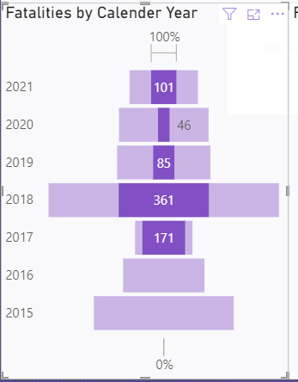
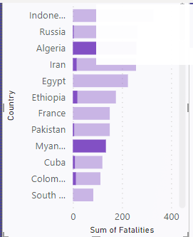
Fatalities by Calendar Year and by Country

Slide 2
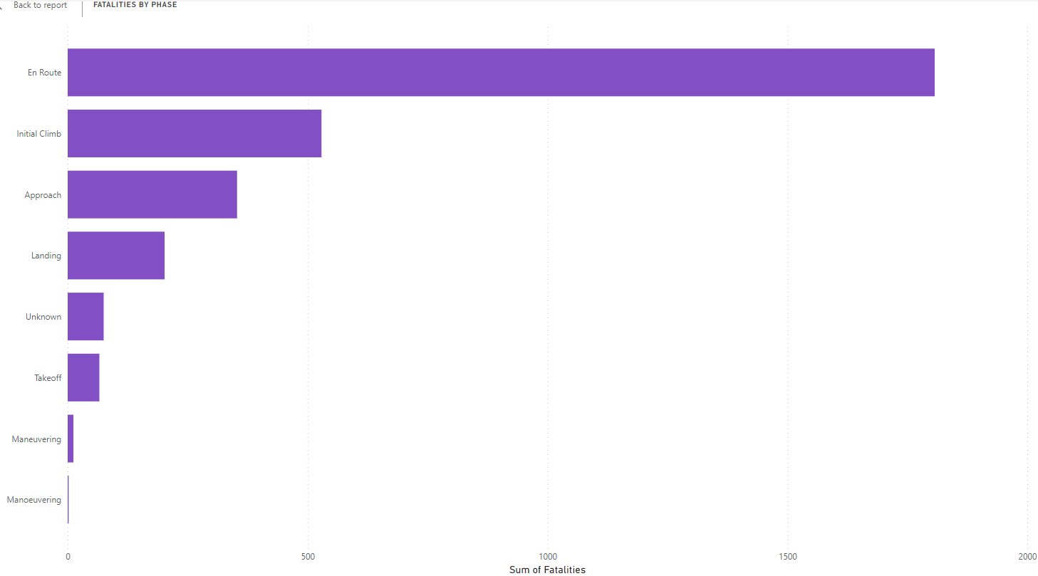
Fatalities by Phase

Slide 3
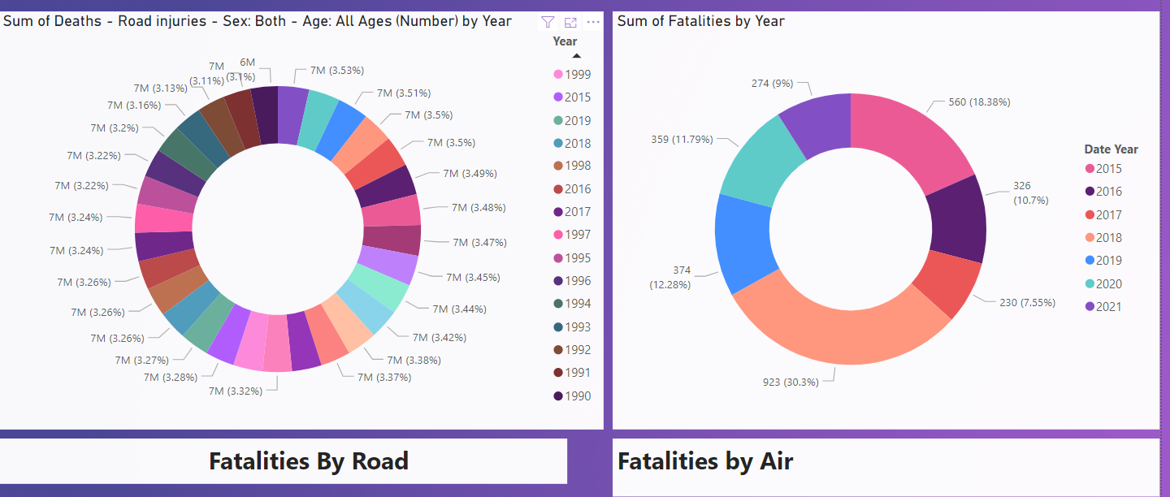
Airline accidents, while highly publicized when they occur, are statistically rare compared to the vast number of flights conducted daily worldwide.

Slide 4
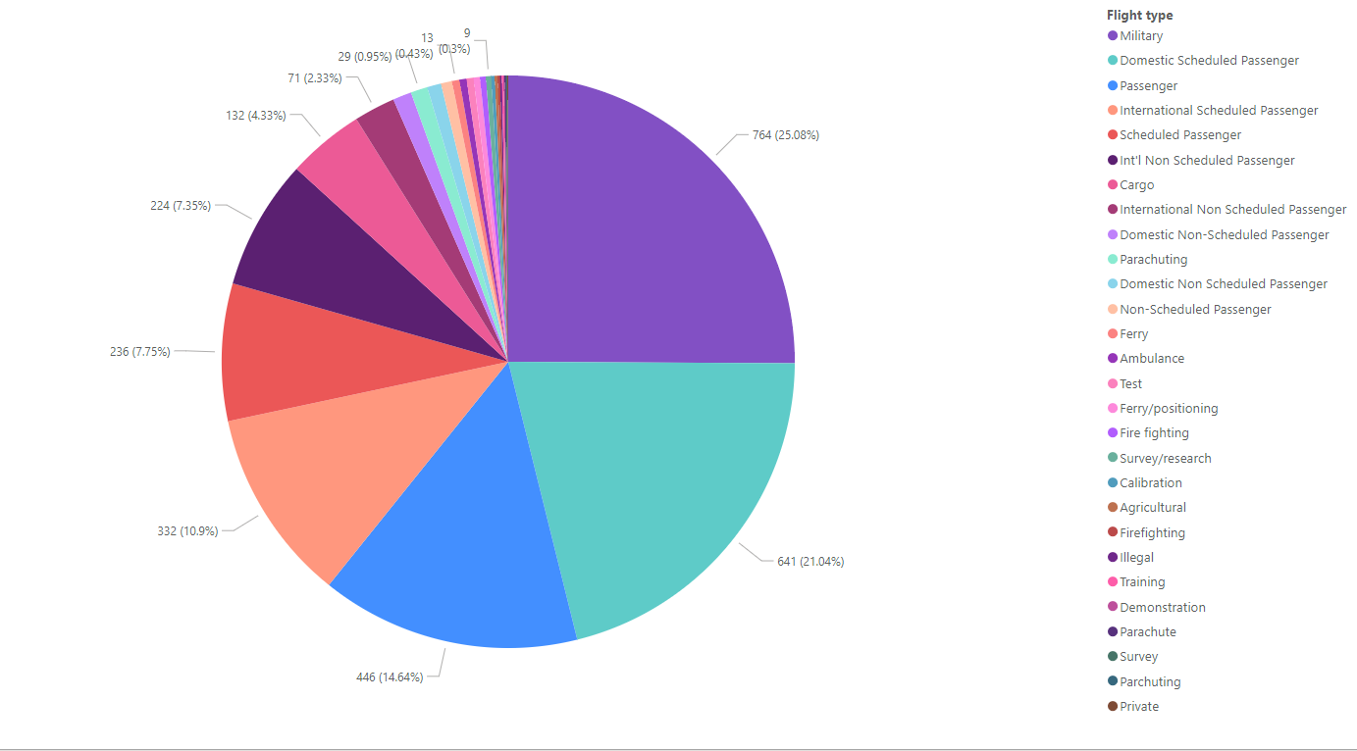
Fatalities by Flight Type

Slide 5
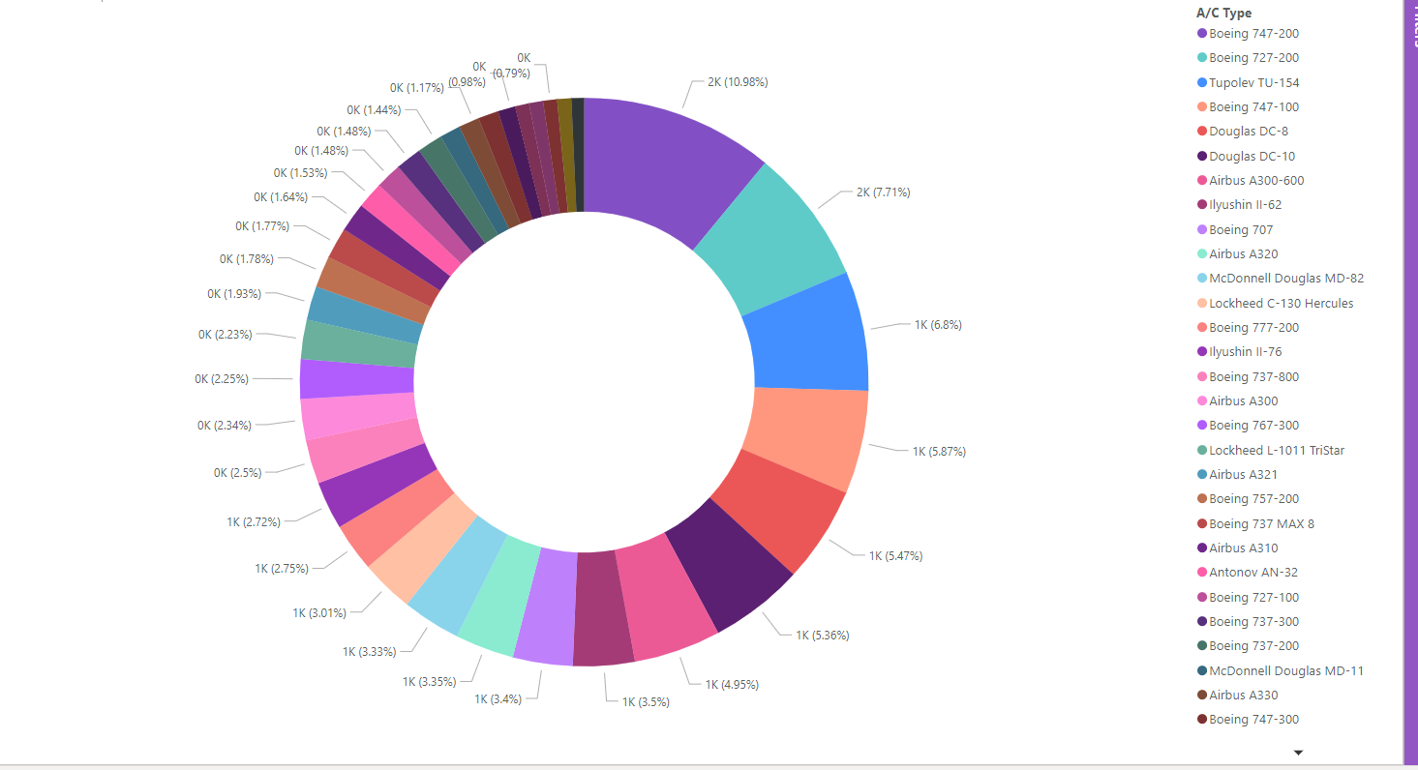
Fatalities by A/C Type
The donut shows the top aircraft models that have caused the highest number of casualties.

