Slide 1
Digital Portfolio
STUDENT NAME: HEMALATHA.K
REGISTER NO AND NMID: 2426JO685&5769A913E9333E993DA4BF3956A9967A
DEPARTMENT: II B.SC(IT)
COLLEGE: MICHAEL JOB COLLEGE OF ARTS & SCIENCE FOR WOMEN

Slide 2
PROJECT TITLE
Web Development Fundamentals – HTML & CSS
Practical Implementation

Slide 3


AGENDA
Problem Statement
Project Overview
End Users
Tools and Technologies
Portfolio design and Layout
Features and Functionality
Results and Screenshots
Conclusion
Github Link
3/21/2024 Annual Review

Slide 4

PROBLEM STATEMENT
When starting web development, beginners often feel a bit lost.
Learning how to use HTML and CSS to build real websites can
be confusing at first.
Making pages that look good and are easy to use feels like a
big challenge.
The flood of technical terms can make the learning process stressful.
Without a clear step-by-step path, it’s hard to practice and steadily
improve.

Slide 5

PROJECT OVERVIEW
This project is designed to help you learn web development step by step. We’ll focus on building a strong foundation with HTML and CSS, starting small and gradually adding more style and creativity each week.
Weekly Plan
Week 2: Build your very first HTML webpage.
Week 3: Create a simple class timetable and add media elements like
images or videos.
Week 4: Design a registration form and style it using CSS.
Week 5: Make an interactive card using CSS transitions to add cool effects.

Slide 6

WHO ARE THE END USERS?
Students who are just beginning their web development journey
Beginners who want to learn HTML & CSS step by step
Colleges and training centers that can use this as a teaching resource
Developers who want to brush up on their basic skills

Slide 7

TOOLS AND TECHNIQUES
Languages: HTML & CSS – to build and style your webpages
Editors: Beginner-friendly editors like VS Code or Notepad++
Browsers: Test and preview your work in Chrome or Edge
Version Control: Use GitHub to save your code and showcase your portfolio online

Slide 8
POTFOLIO DESIGN AND LAYOUT
Clean and simple layout that’s easy to navigate
Clear use of headings, tables, lists, and forms to organize content
Modern look with CSS styling and smooth transitions
Responsive design so it works well on any device
Focused on simplicity, making it easy to learn and practice
‹#›

Slide 9
FEATURES AND FUNCTIONALITY
Clean and simple webpages that are easy to understand
A class timetable that includes images or media elements
A registration form with neatly styled input fields
Interactive cards with smooth hover effects and transitions

Slide 10
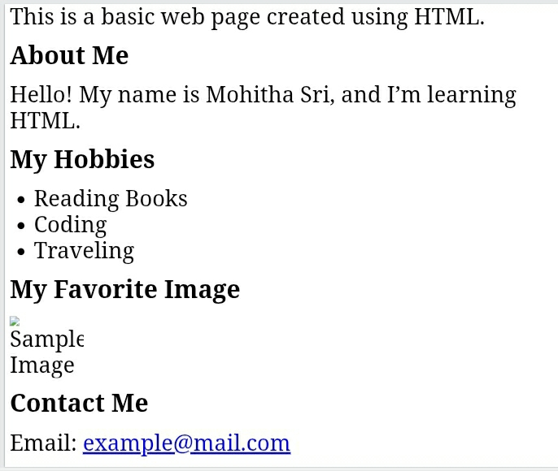
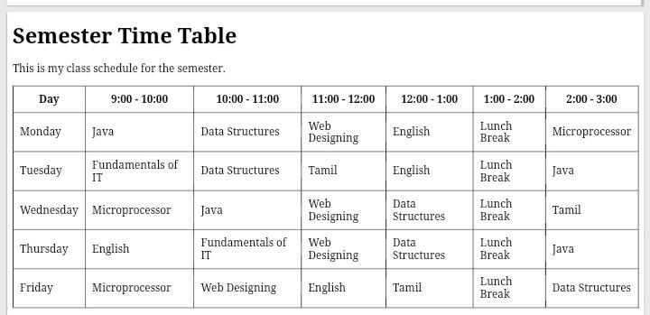

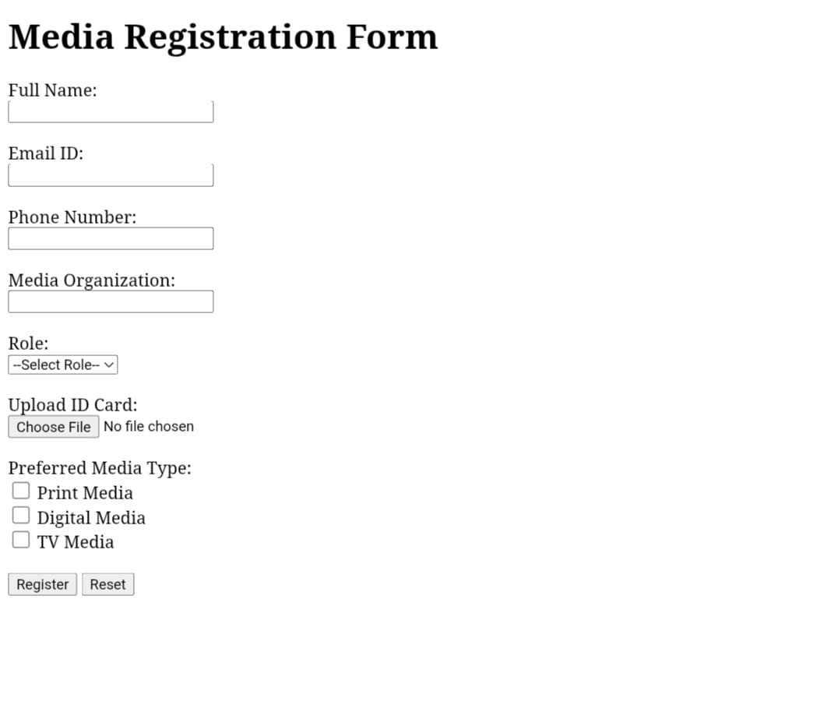
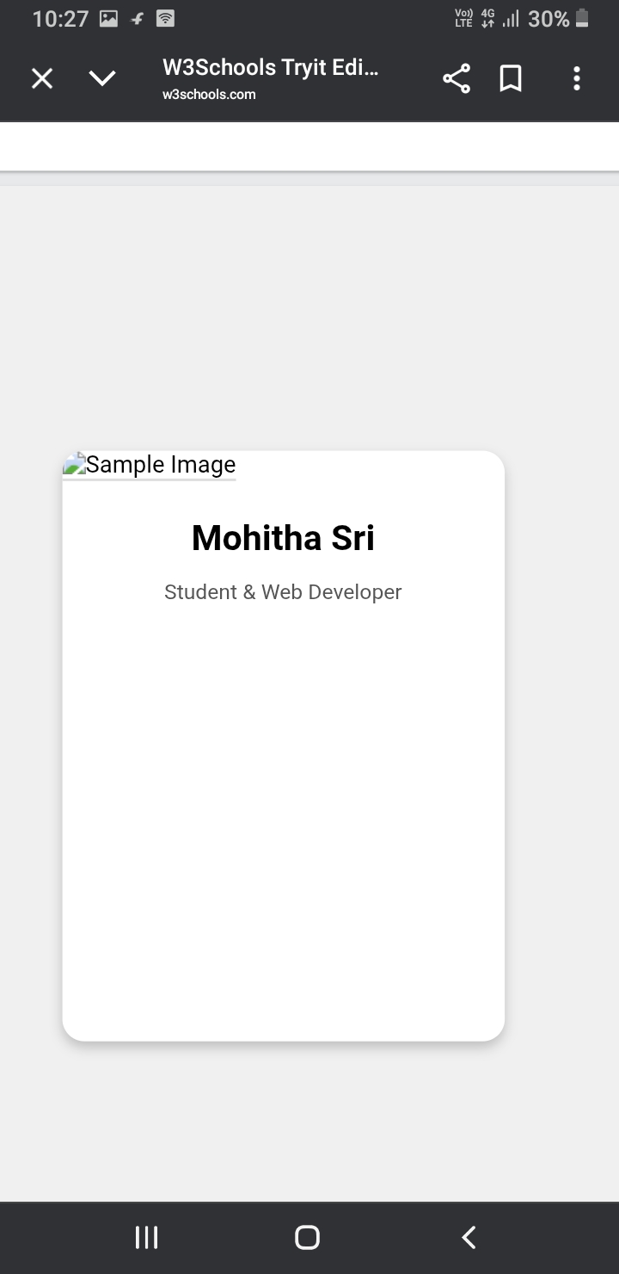
RESULTS AND SCREENSHOTS
3/21/2024 Annual Review
‹#›

Slide 11
CONCLUSION
This project gave practical experience in creating simple websites using
HTML and CSS.It shows how to use the core building blocks of web development
and builds a strong base for learning more advanced web design and development skills
in the future.
‹#›

