Slide 1
pointers

Slide 2
Introduction
Pointers (pointer variables) are special variables that are used to store addresses rather than values.
It stores address of another variable.
Pointer decaration Syntax
Here is how we can declare pointers.
datatype *pointervariable_name;
int* p;
int *p1, *p2; //declaraing two pointer variables.
Let's take another example of declaring pointers.
int* p1, p2;Here, we have declared a pointer p1 and a normal variable p2.
How to declare a pointer?
int *p1 /*Pointer to an integer variable*/
double *p2 /*Pointer to a variable of data type double*/
char *p3 /*Pointer to a character variable*/
float *p4 /*pointer to a float variable*/

Slide 3
Assigning addresses to Pointers
Datatype *pointervariablename= & already_existing_varaiblename;
int a=10;
int *ptr=&a;
Or
Datatype *pointer_varaiblename;
Pointervariablename=& already_existing_varaiblename;
int a=10;
int *ptr;
ptr=&a;
Note:
%p is a format specifier which is used for displaying the address in hex format.
The Pointer Operators:
There are two pointer operators: * and &.
The & is a unary operator that returns the memory address of its operand.
The second pointer operator, *, it is a unary operator that returns the value located at the address that follows. can think of * as "at address.

Slide 4
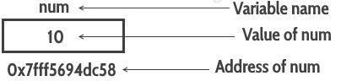
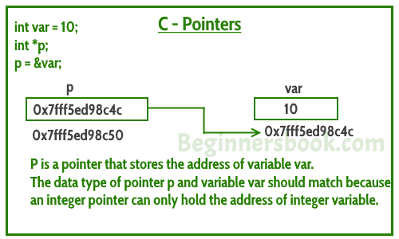
int num=10;

Slide 5
int a=10;
int *ptr;
ptr=&a;
printf(“%d”,a);
printf(“%d”,&a);
printf(“%d”,ptr);
printf(“%d”,*ptr);
printf(“%d”,&ptr);
*ptr=20;
printf(“%d”,*ptr);
printf(“%d”,a);
int *ptr2;
ptr2=ptr;
printf(“%d”,*ptr);
printf(“%d”,*ptr2);

Slide 6
Can you guess the output of following C program?
#include <stdio.h>
int main()
{
int var =10;
int *p;
p= &var;
printf ( "Address of var is: %p", &var);
printf ( "\nAddress of var is: %p", p);
printf ( "\nValue of var is: %d", var);
printf ( "\nValue of var is: %d", *p);
printf ( "\nValue of var is: %d", *( &var)); /* Note I have used %p for p's value as it represents an address*/
printf( "\nValue of pointer p is: %p", p);
printf ( "\nAddress of pointer p is: %p", &p);
return 0;
}
Output:
Address of var is: 0x7fff5d027c58
Address of var is: 0x7fff5d027c58
Value of var is: 10
Value of var is: 10
Value of var is: 10
Value of pointer p is: 0x7fff5d027c58
Address of pointer p is: 0x7fff5d027c50

Slide 7
Pointer Arithmetic
There are only two arithmetic operations that you can use on pointers: addition and subtraction.
There are four arithmetic operators that can be used on pointers: ++, --, +, and -.
move to the next location
ptr++;
move to the previous location
ptr--;
All pointers will increase or decrease by the length of the data type they point to.

Slide 8
#include <stdio.h>
int main()
{int a=10;
int *ptr=&a;
printf("%lu",ptr);
ptr=ptr+10;
printf("\n%lu",ptr);
return 0;
}
140729114185908
140729114185948

Slide 9
Pointer Assignments
use a pointer on the right-hand side of an assignment statement to assign its value to another pointer.
int main(void)
{
int x = 99;
int *p1, *p2;
p1 = &x;
p2 = p1;
printf(''Values at p1 and p2: %d % d\n", *p1, *p2);
printf("Addresses pointed to by p1 and p2: %p %p", p1, p2);
return 0;
}
Values at p1 and p2: 99 99
Addresses pointed to by p1 and p2: 0063FDF0 0063FDF0

Slide 10
Pointer Conversions
One type of pointer can be converted into another type of pointer.
In C, it is permissible to assign a void * pointer to any other type of pointer. It is also permissible to assign any other type of pointer to a void * pointer.
A void * pointer is called a generic pointer.
The void * pointer is used to specify a pointer whose base type is unknown.
The void * type allows a function to specify a parameter that is capable of receiving any type of pointer argument without reporting a type mismatch. No explicit cast is required to convert to or from a void * pointer.
Except for void *, all other pointer conversions must be performed by using an explicit cast.
However, the conversion of one type of pointer into another type may create undefined behavior

Slide 11
#include <stdio.h>
int main()
{
double x = 100.1, y;
int *p;
p = (int *) &x;
y = *p;
printf("The (incorrect) value of x is: %lf %lf", y,x);
return 0;
}
The (incorrect) value of x is: 1717986918.000000 100.100000
Notice that an explicit cast is used when assigning the address of x (which is implicitly a double * pointer) to p, which is an int * pointer.
While this cast is correct, it does not cause the program to act as intended (at least not in most environments).
To understand the problem, assume 4-byte ints and 8-byte doubles. Because p is declared as an integer pointer, only 4 bytes of information will be transferred to y by this assignment statement, y = *p; not the 8 bytes that make up a double.

Slide 12
You can subtract one pointer from another in order to find the number of objects of their base type that separate the two.
All other arithmetic operations are prohibited.
Specifically, you cannot
multiply or divide pointers;
add two pointers;
apply the bitwise operators to them; and
add or subtract type float or double to or from pointers
Pointer Comparisons :
You can compare two pointers in a relational expression.
For instance, given two pointers p and q, the following statement is perfectly valid:
if(p < q) printf("p points to lower memory than q\n");

Slide 13
Pointers and Arrays:
There is a close relationship between pointers and arrays.
Consider this program fragment:
char str[80], *p1;
p1 = str;
Here, p1 has been set to the address of the first array element in str.
To access the fifth element in str, you could write
str[4]
or
*(p1+4)
Recall that an array name without an index returns the starting address of the array, which is the address of the first element.

Slide 14
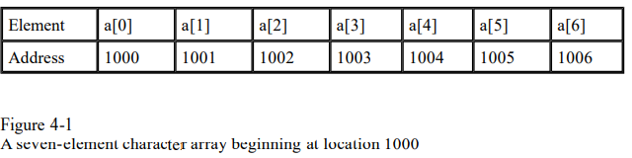
Generating a Pointer to an Array:
You can generate a pointer to the first element of an array by simply specifying the array name, without any index.
int sample[10];
you can generate a pointer to the first element by using the name sample.
Thus, the following program fragment assigns p the address of the first element of sample:
int *p;
int sample[10];
p = sample; ⬄ p=&sample[0];
You can also specify the address of the first element of an array by using the & operator.
For example, sample and &sample[0] both produce the same results.

Slide 15
Passing Single-Dimension Arrays to Functions(3 ways): or passing array as an argument)
In C, you cannot pass an entire array as an argument to a function.
You can, however, pass a pointer to an array by specifying the array's name without an index.
int main(void)
{
int i[10];
func1(i);
/* . . . */
}
void func1(int *x) //formal parameter as a pointer
{…
}
or
void func1(int x[10]) // formal parameteras a sized array
{ /* . . . */ }
Or
finally as
void func1 (int x[]) //formal parameter as an unsized array
{ /* . . . */ }

Slide 16
// Program to calculate the sum of array elements by passing to a function
#include <stdio.h>
float calculateSum(float age[]);
int main()
{
float result, age[] = {23.4, 55, 22.6, 3, 40.5, 18};
// age array is passed to calculateSum()
result = calculateSum(age);
printf("Result = %.2f", result);
return 0;
}
float calculateSum(float age[])
{
float sum = 0.0;
for (int i = 0; i < 6; ++i)
{
sum += age[i];
}
return sum;
}

Slide 17
#include<stdio.h>
int sum(int a[]);
void main()
{
int arr[]={10,20,30};
int sum=sum(arr);
printf(“%d”,sum);
}
int sum(int a[])
{ int s=0;
for(int i=0;i<3;i++)
{
s=s+a[i];
}
return s;
}
void sum(int *p)
{
for(int i-0;i<3;i++)
{
printf(“%d”,p[i]); //or *(p+i)
}
}
void main()
{
int a[]={10,20,30};
sum(a);
}

Slide 18
Passing two-dimensional arrays
#include <stdio.h>
void displayNumbers(int num[2][2]);
int main()
{
int num[2][2];
printf("Enter 4 numbers:\n");
for (int i = 0; i < 2; ++i)
for (int j = 0; j < 2; ++j)
scanf("%d", &num[i][j]);
// passing multi-dimensional array to a function
displayNumbers(num);
return 0;
}
void displayNumbers(int num[2][2])
{
printf("Displaying:\n");
for (int i = 0; i < 2; ++i) {
for (int j = 0; j < 2; ++j) {
printf("%d\n", num[i][j]);
}
}
}
Output
Enter 4 numbers:
2
3
4
5
Displaying:
2
3
4
5

