Slide 1
Array

Slide 2
Introduction
An array in C or C++ is a collection of items stored at contiguous memory locations and elements can be accessed randomly using indices of an array.
They are used to store similar type of elements as in the data type must be the same for all elements.
They can be used to store collection of primitive data types such as int, float, double, char, etc of any particular type.
To add to it, an array in C or C++ can store derived data types such as the structures, pointers etc.

Slide 3
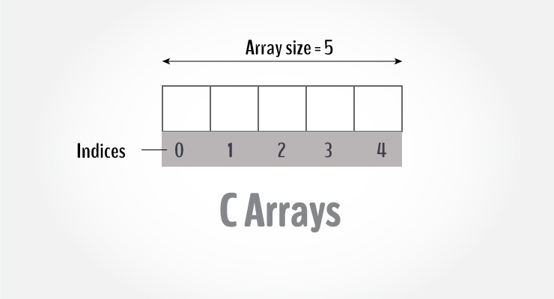
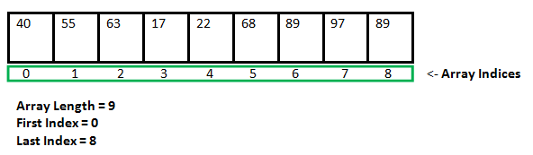
Why do we need arrays? We can use normal variables (v1, v2, v3, ..) when we have a small number of objects, but if we want to store a large number of instances, it becomes difficult to manage them with normal variables. The idea of an array is to represent many instances in one variable.

Slide 4
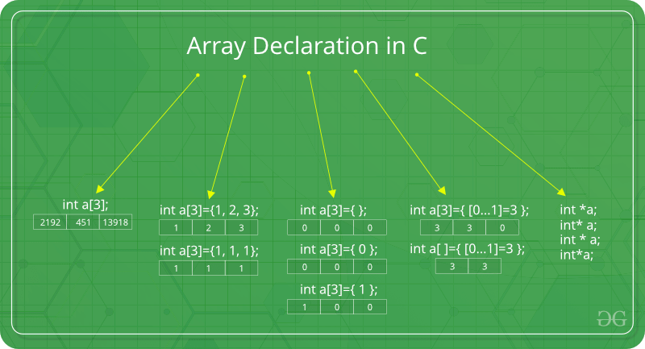
int a[4]={ [0 ... 1]=3 };
for(int i=0;i<4;i++)
printf(" %d",a[i]);
return 0;
}
Output: 3 3 0 0 Note: In above image int a[3]={[0…1]=3}; this kind of declaration has been obsolete since GCC 2.5

Slide 5
// Array declaration by specifying size
int arr1[10];
// With recent C/C++ versions, we can alsodeclare an array of user specified size
int n = 10;
int arr2[n];
// Array declaration by initializing elements
int arr[] = { 10, 20, 30, 40 }
// Array declaration by specifying size and initializing elements
int arr[6] = { 10, 20, 30, 40 }
int arr[5]={[0]=10,[2]=20,[3]=30,[4]=40,[5]=50};

Slide 6
Advantages of an Array in C/C++:
Random access of elements using array index.
Use of less line of code as it creates a single array of multiple elements.
Easy access to all the elements.
Traversal through the array becomes easy using a single loop.
Disadvantages of an Array in C/C++:
Allows a fixed number of elements to be entered which is decided at the time of declaration. Unlike a linked list, an array in C is not dynamic.
Insertion and deletion of elements can be costly since the elements are needed to be managed in accordance with the new memory allocation.

Slide 7
#include <stdio.h>
int main()
{
int arr[5];
arr[0] = 5;
arr[2] = -10;
arr[3 / 2] = 2; // this is same as arr[1] = 2
arr[3] = arr[0];
printf("%d %d %d %d", arr[0],
arr[1], arr[2], arr[3]);
return 0;
}
No Index Out of bound Checking:
// This C program compiles fine as index out of bound is not checked in C.
#include <stdio.h>
int main()
{
int arr[2];
printf("%d ", arr[3]);
printf("%d ", arr[-2]);
return 0;
}
Output
-449684907 4195777

Slide 8
int main()
{
int arr[6]={11,12,13,14,15,16};
// Way -1
for(int i=0;i<6;i++)
cout<<arr[i]<<" ";
cout<<endl;
// Way 2
cout<<"By Other Method:"<<endl;
for(int i=0;i<6;i++)
cout<<i[arr]<<" ";
cout<<endl;
return 0;
}

Slide 9
int a[5]={10,20,30,40,50}; Or int a[]={10,20,30,40,50};
int a[5]={10,20,30,40,50,60}; // syntax error:too many initializer
int a[5]={10,20}; //remaining 3 spaces filled with 0.
printf(“%d”,a[6]); //garbage value
int n=10;
int arr[n]; // this is not possible in turbo c bez it follows c89/90 std.
But works in GCC compilers bez it is following c99 std.
int a[-5]; // specifying negative size is compiler error
printf(“%d”,a[-1]);// no error: gives garbage value
a[0] ⬄ *(a+0)
a[1] ⬄ *(a+1)

Slide 10
Why array index starts at 0?
Consider int arr[100]. The answer lies in the fact how the compiler interprets arr[i] ( 0<=i<100).
arr[i] is interpreted as *(arr + i).
Now, arr is the address of the array or address of 0th index element of the array.
So, address of next element in the array is arr + 1 (because elements in the array are stored in consecutive memory locations), further address of next location is arr + 2 and so on.
Going with the above arguments, arr + i mean the address at i distance away from the starting element of the array.
Therefore, going by this definition, i will be zero for the starting element of the array because the starting element is at 0 distance away from the starting element of the array.
To fit this definition of arr[i], indexing of array starts from 0.

Slide 11
int main()
{
int arr[] = {1, 2, 3, 4};
// Below two statements mean same thing
cout << *(arr + 1) << " ";
cout << arr[1] << " ";
return 0;
}
To find the next location of the element with the help of index
starting address+size of element type(eg int:4bytes, char:1bytes)
Eg if starting address is 1000
1000+4 =>1004
1004+4=>1008
If char, size of char is 1 byte
1000+1=>1001
1002+1=>1002

Slide 12
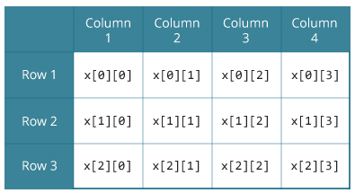
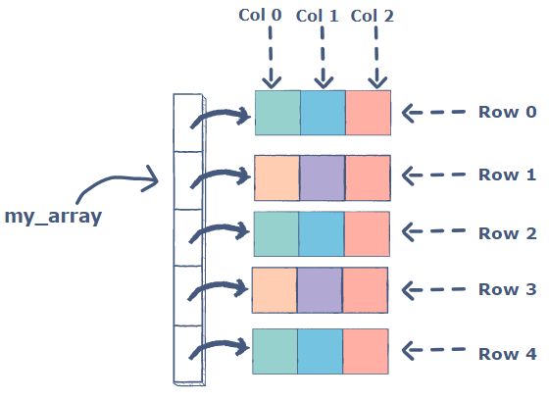
2D Array
An array of arrays is known as 2D array.
A two-dimensional array in C can be thought of as a matrix with rows and columns.
The general syntax used to declare a two-dimensional array is:
datatype array_name[rows][cols];
A two-dimensional array is an array of several one-dimensional arrays.
Following is an array with five rows, each row has three columns:
int my_array[5][3];

Slide 13
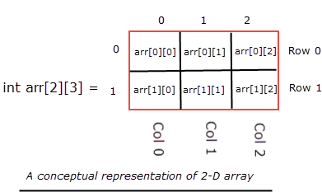
arr[0][0] - refers to the first element arr[0][1] - refers to the second element arr[0][2] - refers to the third element arr[1][0] - refers to the fourth element arr[1][1] - refers to the fifth element arr[1][2] - refers to the sixth element

Slide 14
Various Initialization of two-dimensional a​rrays
#include <stdio.h>
int main()
{
int my_array[5][3] = {
{1, 2, 3}, //row 1
{4, 5, 6}, //row 2
{7, 8, 9}, //row 3
{10, 11, 12}, //row 4
{13, 14, 15} //row 5
};
}
Or
#include <stdio.h>
int main()
{
int my_array[5][3] = {1, 2, 3, 4, 5, 6, 7, 8, 9, 10, 11, 12, 13, 14, 15};
}
Other initialization:
int a[2][2]={1,2,3,4};//valid
int a[][2]={1,2,3,4};//valid
int a[][]={1,2,3,4};//invalid
int a[2][]={1,2,3,4};//invalid : must need atleast second dimension
int a[] = {[0]=10,[1]=20,[2]=30};

Slide 15
Accessing elements in two-dimensional arrays
#include <stdio.h>
int main()
{
// array declaration and initialization
int my_array[5][3] = {
{1, 2, 3}, //row 1
{4, 5, 6}, //row 2
{7, 8, 9}, //row 3
{10, 11, 12}, //row 4
{13, 14, 15} //row 5
};
// accessing and printing the elements
for ( int i = 0; i < 5; i++ ) {
// variable i traverses the rows
for ( int j = 0; j < 3; j++ ) {
// variable j traverses the columns
printf("my_array [%d][%d] = %d\n", i,j, my_array[i][j] );
} }
return 0; }

Slide 16
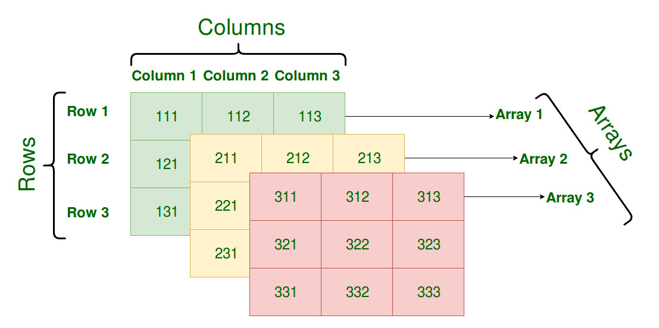
3D array

Slide 17
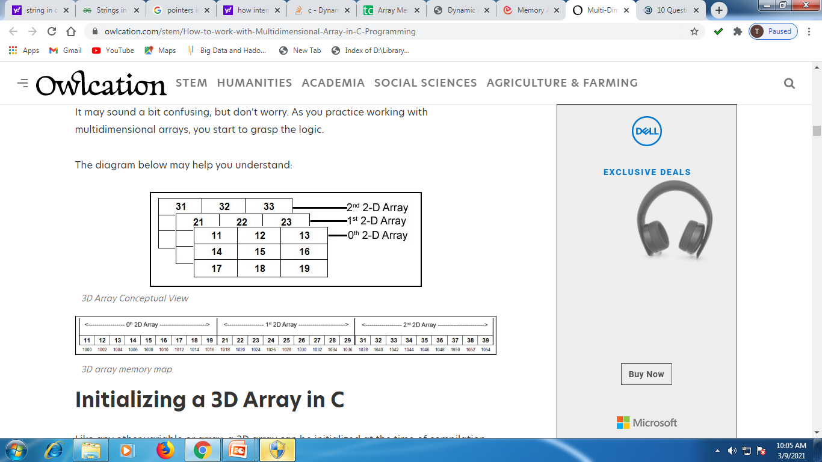
Syntax of a 3D Array in C:
data_type array_name[table][row][column];

Slide 18
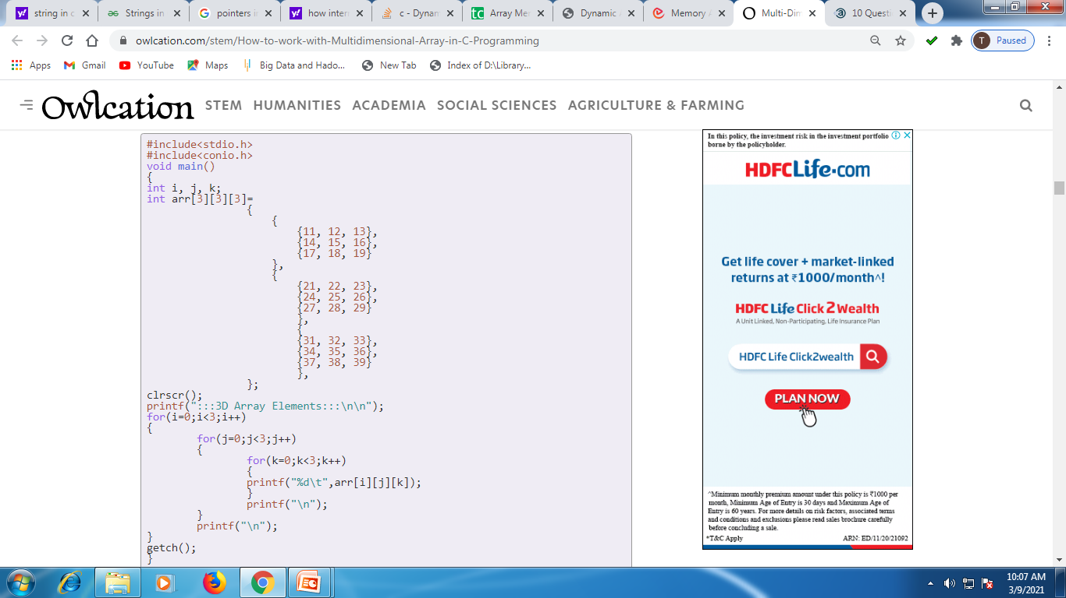

Slide 19
int main(){
int a[2][2]={10,20,30,40};
printf("%d",a[0][0]);
printf("%d",a[0][1]);
printf("%d",a[1][0]);
printf("%d",a[1][1]);
printf("\n");
printf("%u",a);
printf("\n%u",&a);
printf("\n%u",&a[0][0]);
printf("\n%u",&a[0][1]);
printf("\n%u",&a[1][0]);
printf("\n%u",&a[1][1]);
return 0;}
10203040
1351672384
1351672384
1351672384
1351672388
1351672392
1351672396

Slide 20
Sum of all elements in an array
Sum of odd numbers in an array
Count of even numbers in an array
Frequency of a number in an array
Union and intersection of two arrays
Reversing an array
Sum of all elements in a 2D array of size 2*2 matrix size.
Finding an element in an array.

