Slide 1
KNN
Finding Nearest Neighbors

Slide 2
Introduction
K-nearest neighbors (KNN) algorithm is a type of supervised ML algorithm which can be used for both classification as well as regression predictive problems.
Two properties would define KNN well −
Lazy learning algorithm − KNN is a lazy learning algorithm because it does not have a specialized training phase and uses all the data for training while classification.
Non-parametric learning algorithm − KNN is also a non-parametric learning algorithm because it doesn’t assume anything about the underlying data.
Non—parametric:
Algorithms that do not make strong assumptions about the form of the mapping function are called nonparametric machine learning algorithms. By not making assumptions, they are free to learn any functional form from the training data. since the number of parameters grows with the size of the training set.

Slide 3
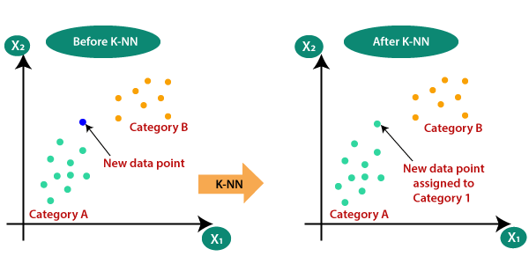
Why do we need a K-NN Algorithm?
Suppose there are two categories, i.e., Category A and Category B, and we have a new data point x1, so this data point will lie in which of these categories. To solve this type of problem, we need a K-NN algorithm. With the help of K-NN, we can easily identify the category or class of a particular dataset

Slide 4
How does K-NN work?
The K-NN working can be explained on the basis of the below algorithm:
Step-1: Select the number K of the neighbors
Step-2: Calculate the Euclidean distance of K number of neighbors
Step-3: Take the K nearest neighbors as per the calculated Euclidean distance.
Step-4: Among these k neighbors, count the number of the data points in each category.
Step-5: Assign the new data points to that category for which the number of the neighbor is maximum.
There are four ways to calculate the distance measure between the data point and its nearest neighbor: Euclidean distance, Manhattan distance, Hamming distance. Out of the three, Euclidean distance is the most commonly used distance function or metric

Slide 5
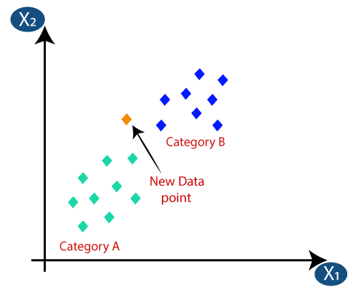
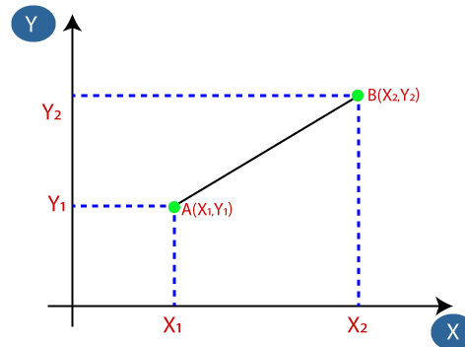
Suppose we have a new data point and we need to put it in the required category.
Firstly, we will choose the number of neighbors, so we will choose the k=5.
Next, we will calculate the Euclidean distance between the data points. The Euclidean distance is the distance between two points and it can be calculated as:

Slide 6
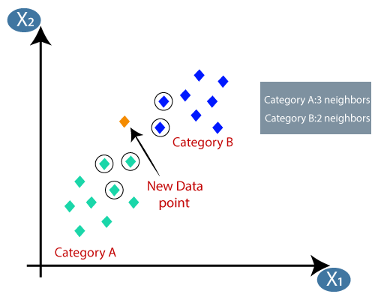
By calculating the Euclidean distance we got the nearest neighbors, as three nearest neighbors in category A and
As we can see the 3 nearest neighbors are from category A, hence this new data point must belong to category A.

Slide 7
How to select the value of K in the K-NN Algorithm?
There is no particular way to determine the best value for "K", so we need to try some values to find the best out of them. The most preferred value for K is 5.
A very low value for K such as K=1 or K=2, can be noisy and lead to the effects of outliers in the model.
Large values for K are good.
Advantages of KNN Algorithm:
It is simple to implement.
It is robust to the noisy training data
It can be more effective if the training data is large.
Disadvantages of KNN Algorithm:
Always needs to determine the value of K which may be complex some time.
The computation cost is high because of calculating the distance between the data points for all the training samples.

Slide 8
A classification report is a performance evaluation metric in machine learning.
It is used to show the precision, recall, F1 Score, and support of your trained classification model.
Support is the number of actual occurrences of the class in the dataset. It doesn’t vary between models

Slide 9
Extra points

Slide 10
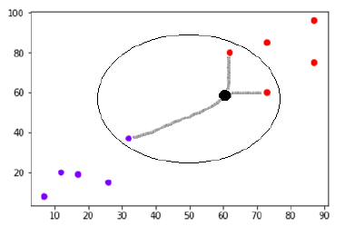
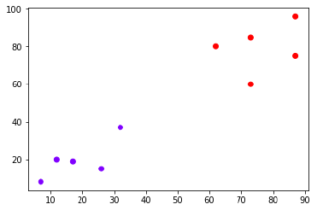
we need to classify new data point with black dot (at point 60,60) into blue or red class.
We are assuming K = 3 i.e. it would find three nearest data points.
Can able to see the three nearest neighbors of the data point with black dot.
Among those three, two of them lies in Red class hence the black dot will also be assigned in red class.

Slide 11
Minkowski Distance –
It is a metric intended for real-valued vector spaces.
We can calculate Minkowski distance only in a normed vector space, which means in a space where distances can be represented as a vector that has a length and the lengths cannot be negative.
It is basically a generalization of the Euclidean distance and the Manhattan distance

Slide 12
K-nearest neighbor algorithm pseudocode
Programming languages like Python and R are used to implement the KNN algorithm. The following is the pseudocode for KNN:
Load the data
Choose K value
For each data point in the data:
Find the Euclidean distance to all training data samples
Store the distances on an ordered list and sort it
Choose the top K entries from the sorted list
Label the test point based on the majority of classes present in the selected points
End

Slide 13
To validate the accuracy of the KNN classification, a confusion matrix is used. Other statistical methods such as the likelihood-ratio test are also used for validation.
In the case of KNN regression, the majority of steps are the same. Instead of assigning the class with the highest votes, the average of the neighbors’ values is calculated and assigned to the unknown data point.

