Slide 1
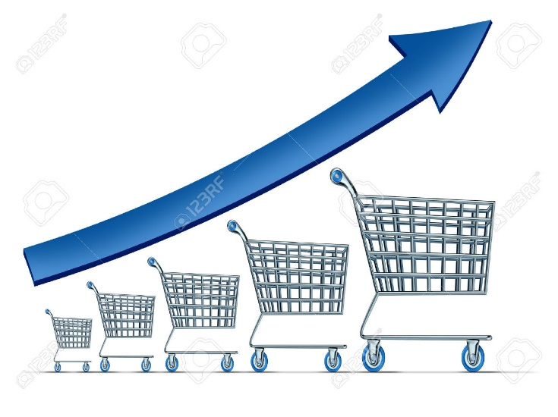
Retail Analytics - Zoe’s Chain
Using Advanced Analytics for Customer Scoring & Segmentation

Slide 2
Problem Statement
Zoe's is a retail chain organization that has several stores in various locations. The organization wants to understand the customer behavior from the information it has about their previous transactional data for the last two years.
It wants to develop an engine which actually provides the score for customer based on their behavior and analyze their purchasing pattern periodically which helps in designing various customer specific promotions.
Data description
RetailStore: Id of the retail store in which the transaction has been made
CustomerID: Id of the customer who made the transaction
TransactionID: Id of the transaction, unique for a transaction.
Transaction Time: Time when the transaction is made
ProductID: What product is being purchased
Cost: Price of the product

Slide 3
Raw data Snapshot
RetailStore | CustomerID | TransactionID | Transaction Time | ProductID | Cost
1 | 1001 | 1ID10051 | 1/1/2011 9:18 | 1 | 144.75
2 | 1002 | 2ID10052 | 1/1/2011 11:56 | 2 | 97.25
2 | 1002 | 2ID10052 | 1/1/2011 11:56 | 3 | 47.25
2 | 1002 | 2ID10052 | 1/1/2011 11:56 | 4 | 197.25
3 | 1003 | 3ID10053 | 1/1/2011 12:38 | 5 | 216
3 | 1003 | 3ID10053 | 1/1/2011 12:38 | 6 | 137.25
1 | 1004 | 1ID10054 | 1/1/2011 11:54 | 7 | 253.25
2 | 1005 | 2ID10055 | 1/1/2011 14:30 | 8 | 147.25
3 | 1006 | 3ID10056 | 1/1/2011 13:43 | 9 | 192
3 | 1006 | 3ID10056 | 1/1/2011 13:43 | 10 | 101
3 | 1006 | 3ID10056 | 1/1/2011 13:43 | 10 | 101
3 | 1006 | 3ID10056 | 1/1/2011 13:43 | 11 | 202
3 | 1006 | 3ID10056 | 1/1/2011 13:43 | 12 | 101
3 | 1006 | 3ID10056 | 1/1/2011 13:43 | 13 | 242

Slide 4
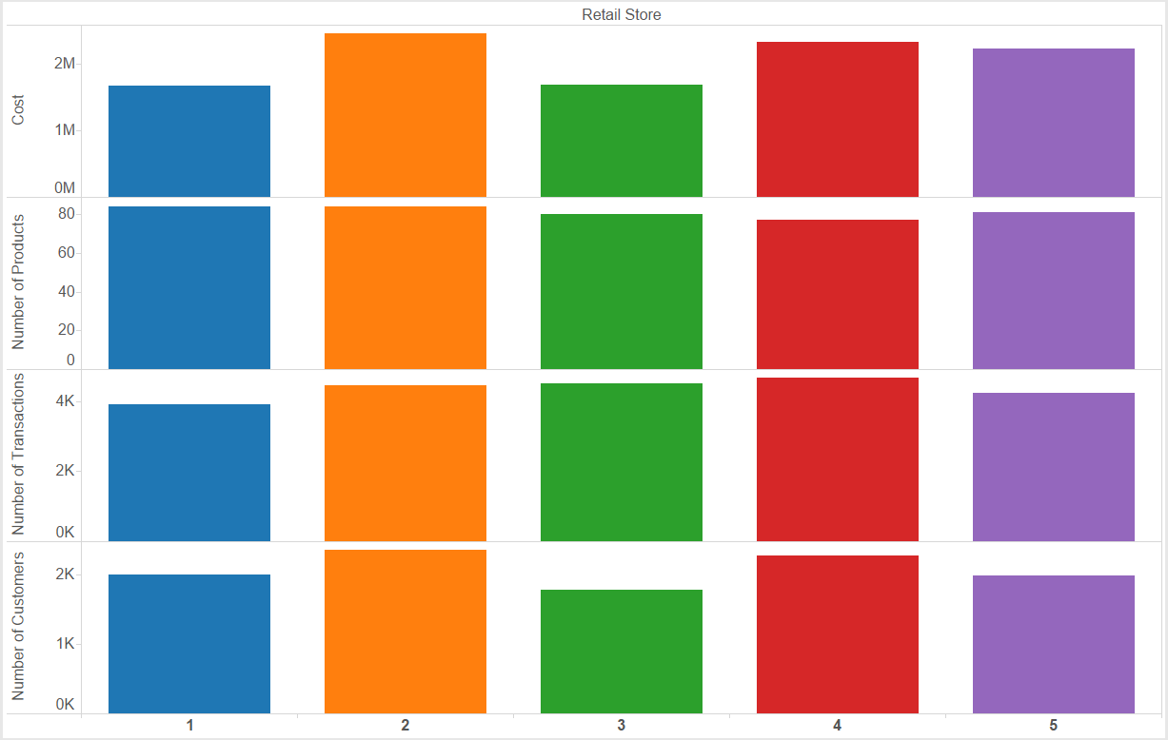
Summary of Zoe’s data provided
It has 5 stores with 89 products in its inventory.
About 10,372 customers visited the store in 2 years.
About 21767 transactions done.
Revenue of over 10M.

Slide 5
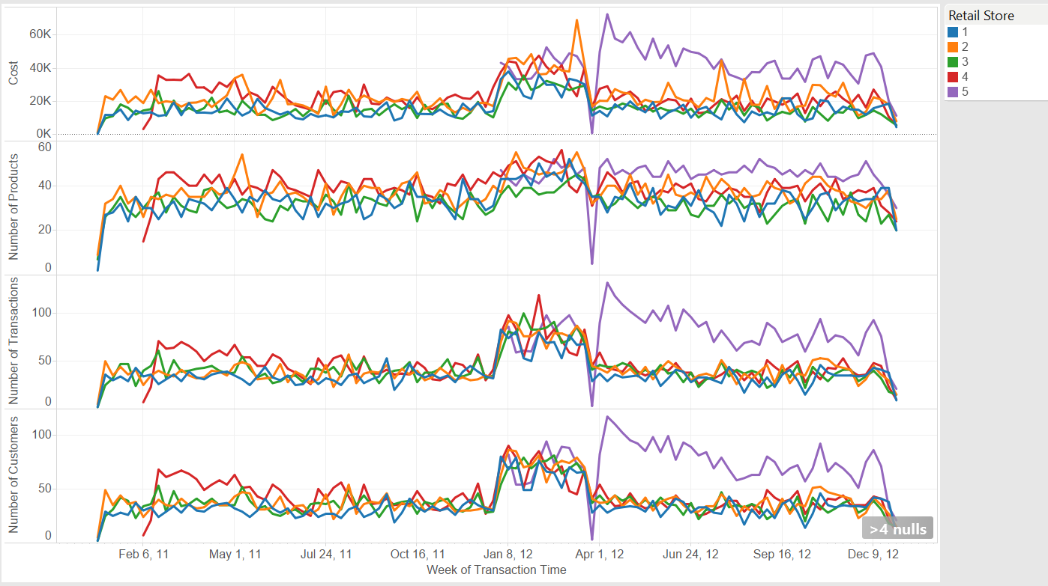
Customer Buying Trend

Slide 6
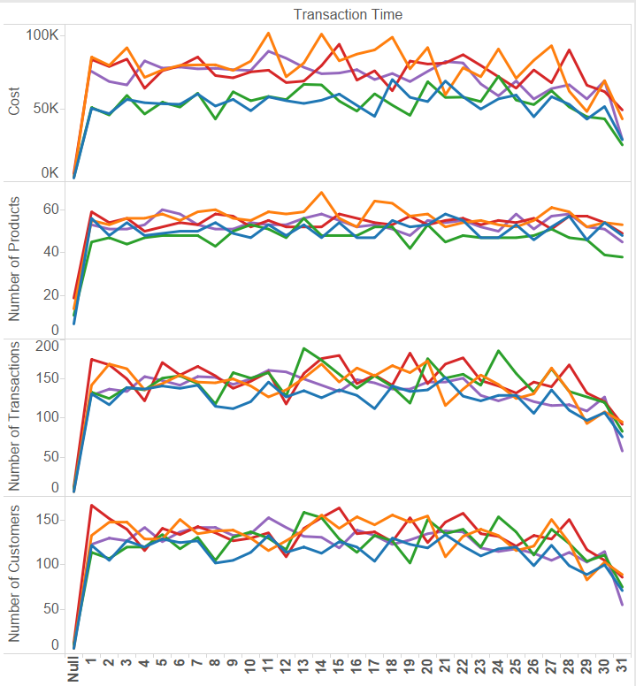
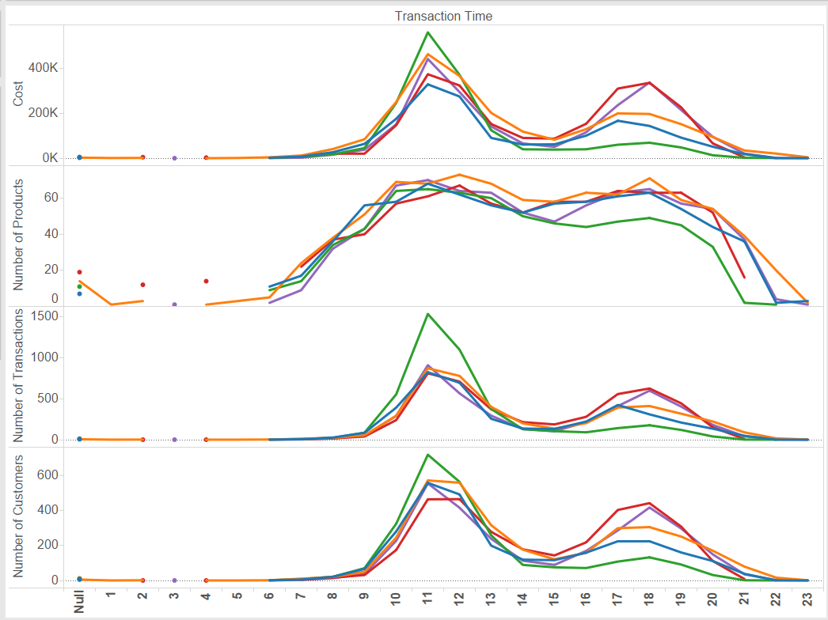
Customer Buying Trend contd.
Trend by each day of the month
Total Revenue at each Hour
On each month, we can see the average trend increases slowly falls over.
On each day, the highest buying was observed between 10AM to 12 PM and 5PM to 7PM.

Slide 7
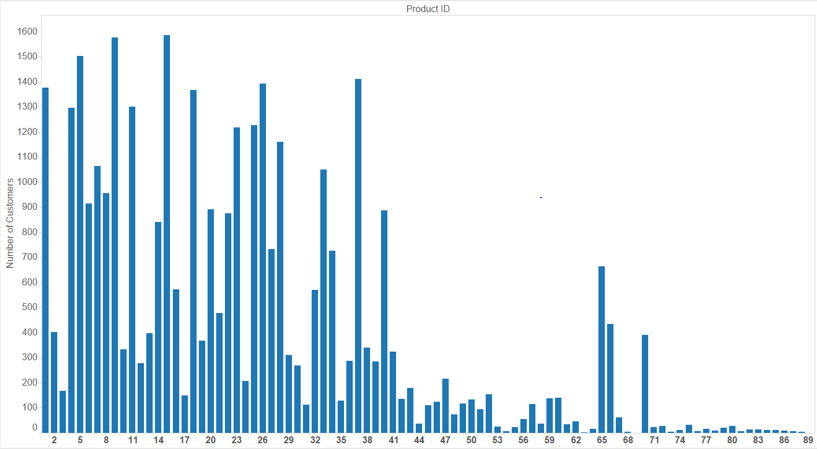
Customer v/s Product Behavior
Customers per Product
It is observed that some products have been bought repeatedly by several customers whereas some products were bought very few times
Those products that were bought repeatedly have also contributed proportionately to the total revenue
All products that were bought higher than the 3rd quadrant value (989) are considered popular products

Slide 8
Feature Engineering
Important Variables created in Feature Engineering Step
StoreFrequency:
Total number of Stores visited.
TransactionFrequency:
Total number of Transactions done.
ProductFrequency :
Total number of products purchased .
RevenueValue :
Normalized total cost contributed by each customer over two years

Slide 9
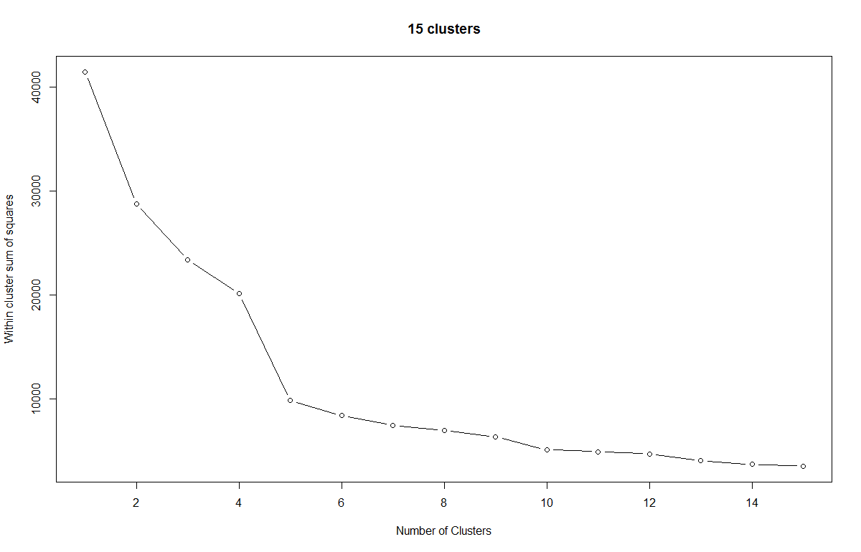
Creating Customer Clusters
Segmenting Customer into clusters based on buying behavior
Cluster analysis or clustering is the task of grouping a set of objects in such a way that objects in the same group (called a cluster) are similar (in some sense or another) to each other than to those in other groups (clusters).
For K-Means, there are always K clusters.
There is always at least one item in each cluster.
The clusters are non-hierarchical and they do not overlap.
Every member of a cluster is closer to its cluster than any other cluster because closeness does not always involve the ‘center’ of clusters.
Choosing the number of partitions, i.e. k value, plot each iteration to display the elbow graph change for how many iterations (Calculating variance and storing at the first index), tf, k = 4

Slide 10
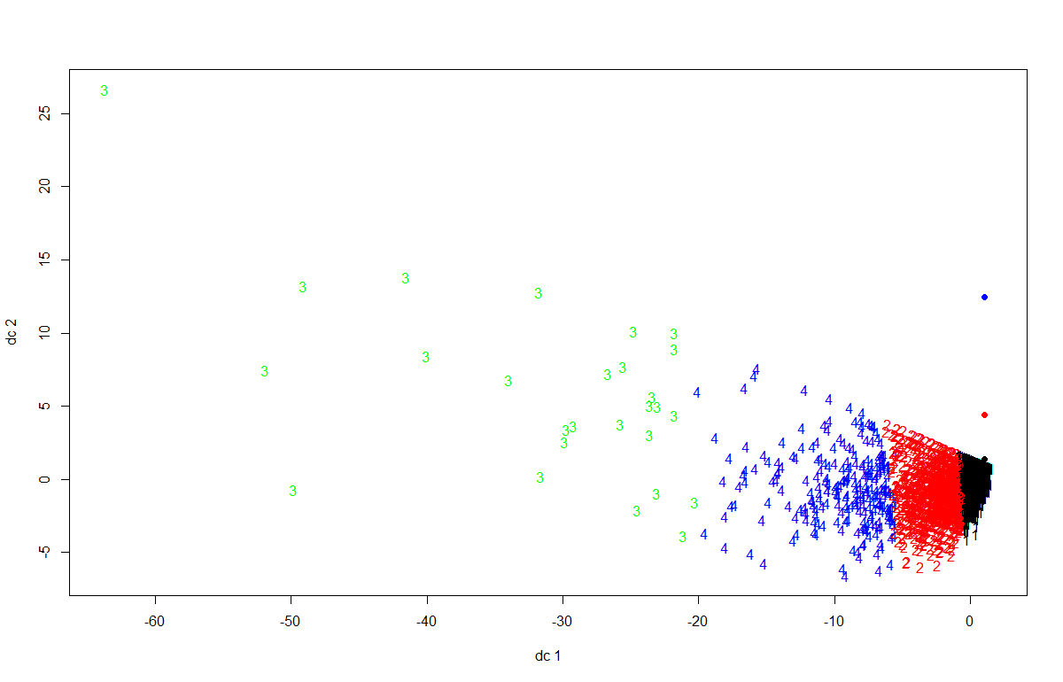
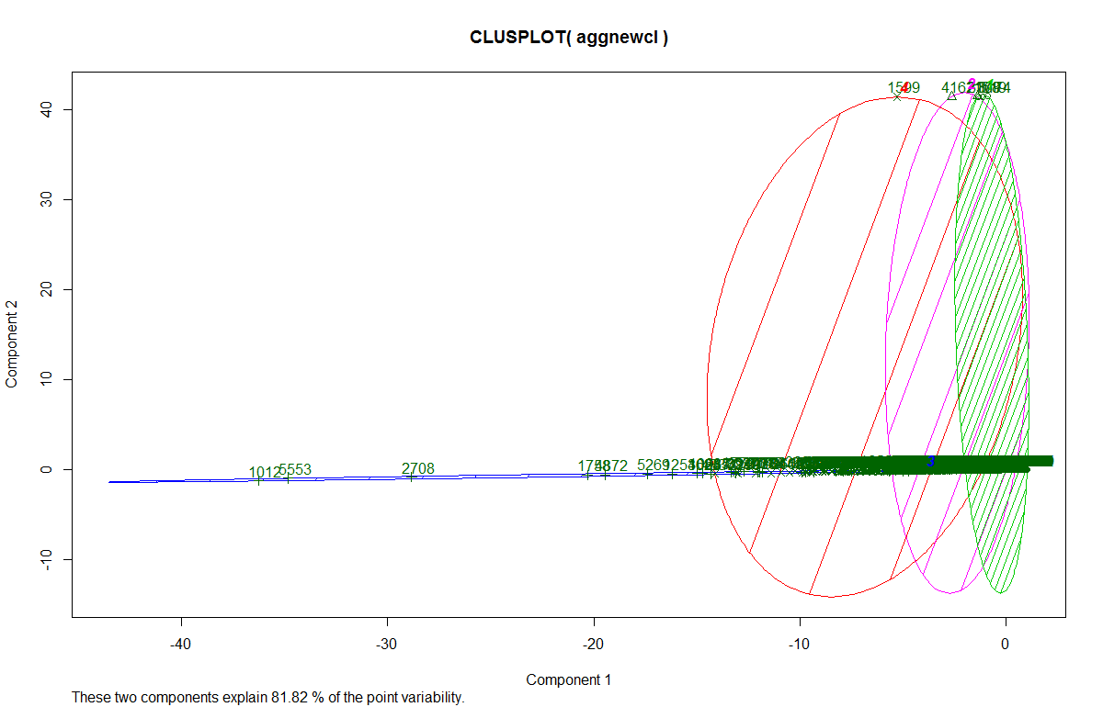
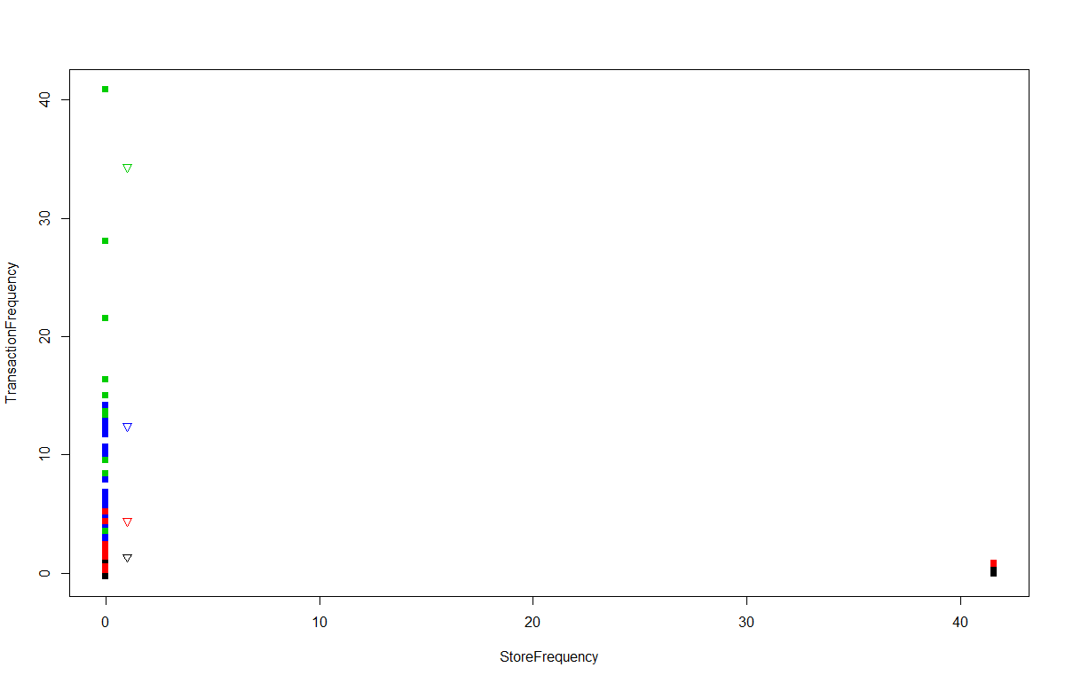
K- Means Cluster Analysis

Slide 11
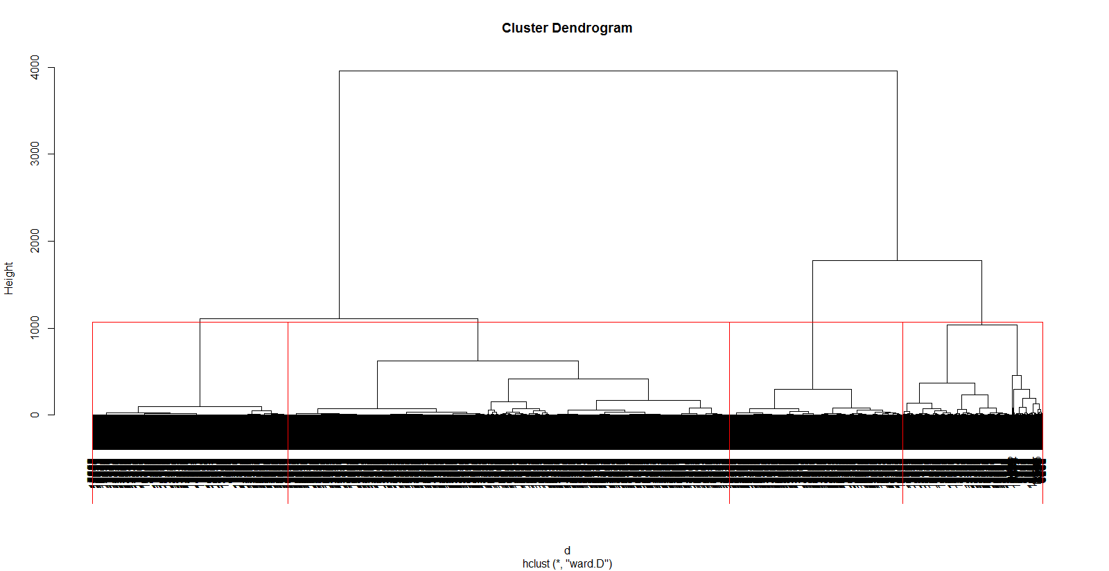
Hierarchical clustering Analysis

Slide 12
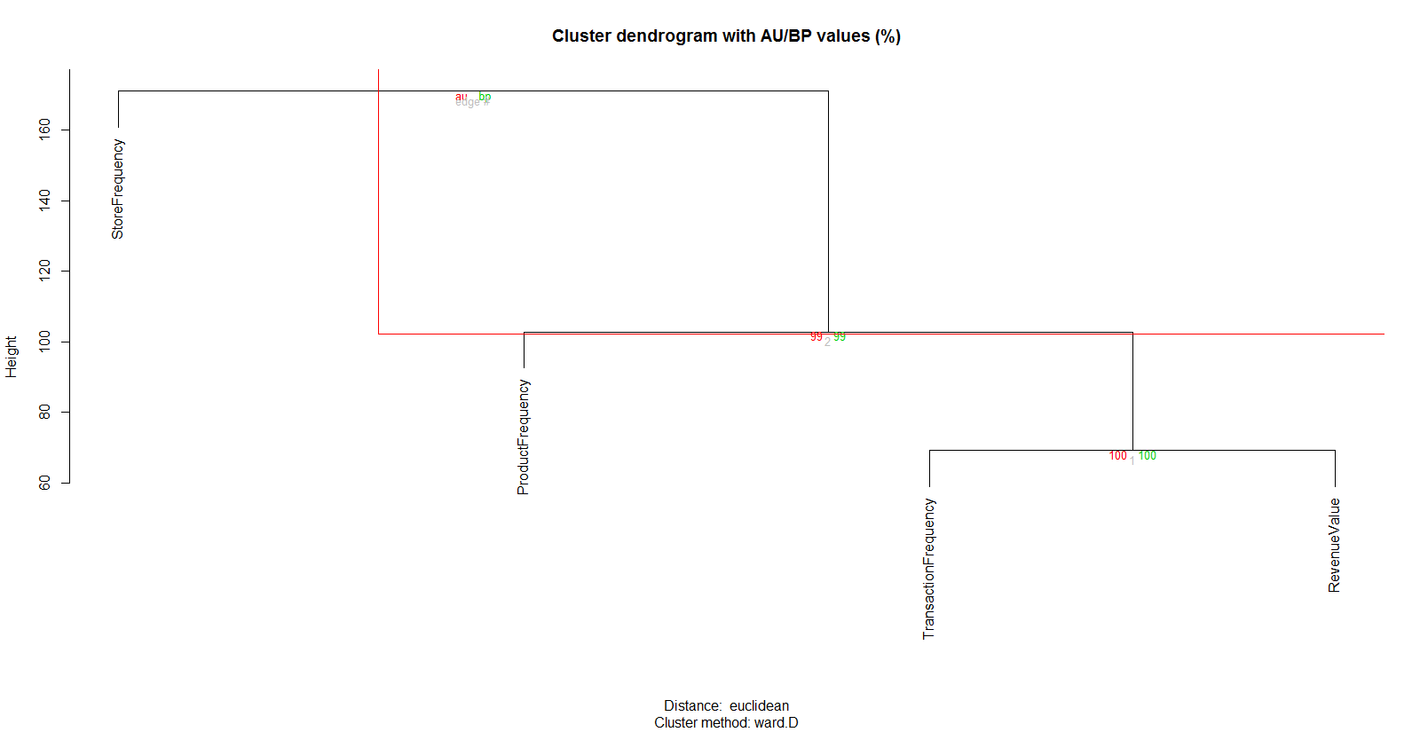
Ward Hierarchical Clustering (with Bootstrapped p values)

Slide 13
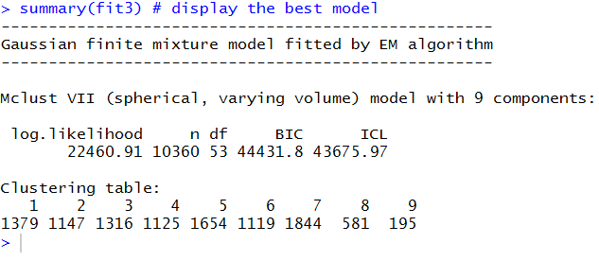
Model Based Clustering to display the best model
Comparing different cluster solutions
We used different cluster solutions using cluster.stats of the fpc library and found that k-means cluster was the best one since it has the least diameter for the clusters and average distance of each clustering was least.

Slide 14
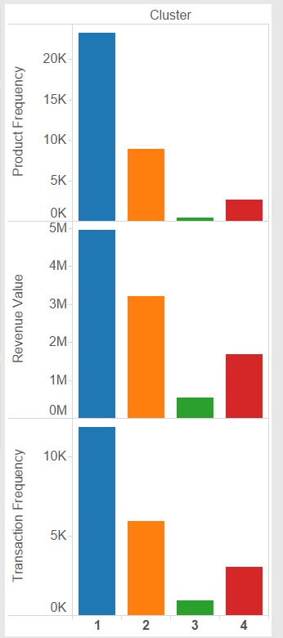
Results
Observations from Clusters
Customers are clustered based on their Transaction, Product , Store Frequency and Revenue Value contributed
Kmeans Clustering algorithm used to generate 4 clusters
Customers are divide into 4 clusters of the below sizes:
fit$size [1] 8733 1354 27 246
Each cluster exhibits an almost distinct behavior
Cluster 1 has maximum number of customers since this cluster constitutes most of the one time visitors
Cluster 1 also highlights that the average Monetary, PPF and PHF are on the lower side
Cluster 4 constitutes the least number of customers who are the most frequent and highest individual contributors
Output Data Snapshot
Customer ID | Cluster Number
10000 | 2
10001 | 1
10002 | 1
10003 | 1
10004 | 1
10005 | 2

Slide 15
Conclusion - Customer Scoring & Promotions
Can name the clusters 1 to 4 as Starter, Prospective, Advanced and Privileged.
Highest individual revenues are contributed by Privileged customers that are most frequent, buy more popular products and usually shop during peak hours
Any new customer joining the system is likely to be put in the group Starter.
Prospective group has the customers with people buying less products but more revenue.
Advanced group has very few customers with buying products of high costs.
Privileged group has customers with highest number of customer per revenue.
The promotions should be targeted to transition the customers from the lower cluster to the next higher cluster.

