Slide 1


BALLARI INSTITUTE OF TECHNOLOGY & MANAGEMENT
(Recognized by Govt. of Karnataka, approved by AICTE, New Delhi Autonomous Institute under Visvesvaraya Technological University, Belagavi)
"Jnana Gangothri" Campus, No.873/2, Ballari-Hosapete Road, Allipura, Ballari-583 104 (Karnataka) (India)
Ph: 08392 – 237100 / 237190, Fax: 08392 – 237197
Department of CSE-AI
AWS Cloud Internship
Presented by
HEMALATHA D 3BR22CA019

Slide 2
Internship Introduction
• Learned AWS cloud fundamentals
• Hands-on understanding of AWS services
• Explored real-world cloud concepts
• Prepared for Cloud Practitioner concepts

Slide 3
Introduction to Cloud Computing
Cloud computing delivers servers, storage, databases, networking and software over the internet.
Advantages:
• Scalability
• Flexibility
• Cost efficiency

Slide 4
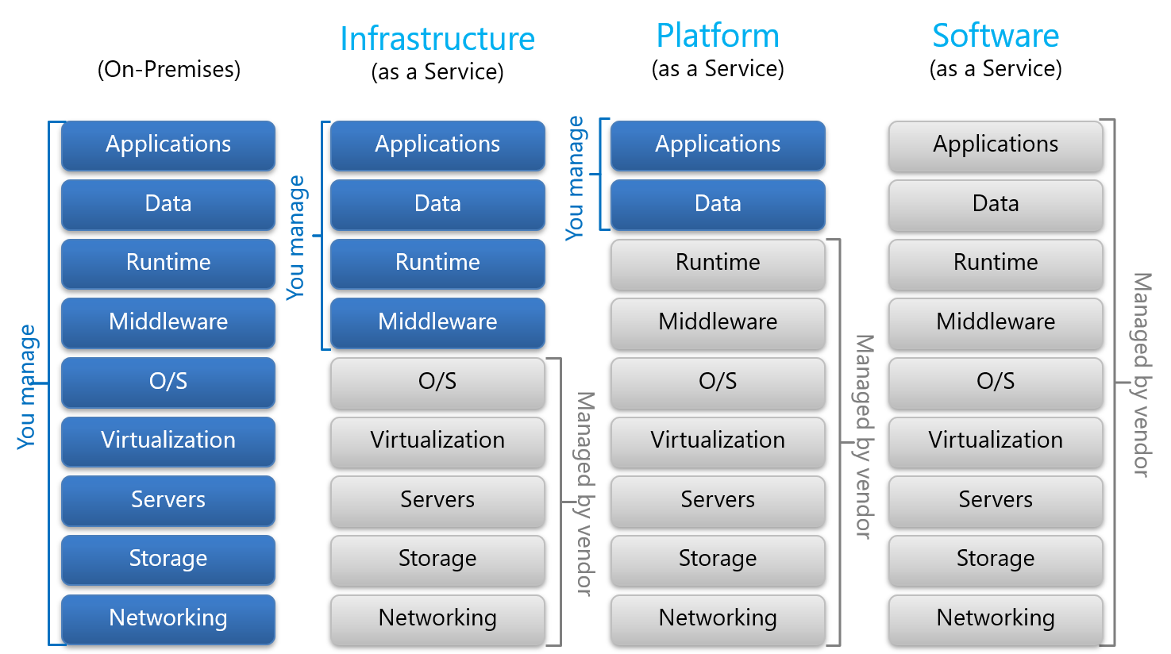
Cloud Service Models

Slide 5
AWS Global Infrastructure
• Regions – Geographic locations
• Availability Zones – Multiple isolated data centers
• Edge Locations – Fast content delivery

Slide 6
AWS Compute Services
• EC2 – Virtual machines
• Lambda – Serverless execution
• Elastic Beanstalk – Easy deployment
• Auto Scaling & ELB

Slide 7
AWS Storage Services
• S3 – Object storage
• EBS – Block storage
• EFS – Shared file storage
• Glacier – Archival and backup

Slide 8
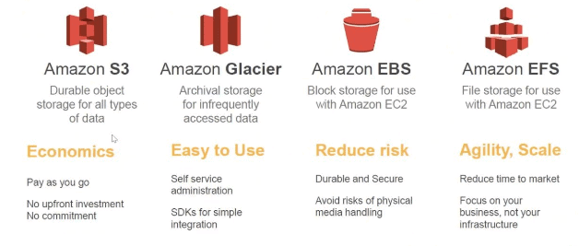

Slide 9
AWS Database Services
• RDS – Managed SQL databases
• Aurora – High performance database
• DynamoDB – NoSQL database
• Redshift – Data warehouse

Slide 10
Networking and Security
• VPC and Subnets
• Route 53
• Security Groups
• IAM and MFA

Slide 11
Monitoring and Cost Control
• CloudWatch
• AWS Config
• Cost Explorer
• AWS Budgets

Slide 12
AWS Well-Architected Framework
AWS Well-Architected Framework helps build secure and efficient applications.
Six Pillars:
• Operational Excellence • Performance Efficiency
• Security • Cost Optimization
• Reliability • Sustainability

Slide 13
High Availability & Scalability
High Availability:
• Ensures applications remain available with minimal downtime
• Achieved using multiple Availability Zones
Scalability:
• Vertical Scaling → Increase instance capacity
• Horizontal Scaling → Add more instances

Slide 14
High Availability & Scalability
AWS Services Used:
• Auto Scaling
• Elastic Load Balancer

Slide 15
AWS Shared Responsibility Model
AWS and customers share security responsibilities:
AWS Responsibilities (Security OF the Cloud):
• Physical infrastructure security
• Hardware maintenance
• Network infrastructure
• Data center security

Slide 16
Customer Responsibilities (Security IN the Cloud):
• User access management
• Data protection
• Application security
• Operating system updates

Slide 17
Skills and Learning Outcomes
• Understanding cloud architecture
• Security awareness
• Resource management skills
• Problem-solving skills

Slide 18
Conclusion
The AWS internship strengthened cloud knowledge and practical understanding of AWS services.

