Slide 1
Student Attendance Management System

Slide 2
Problem Statement
Manual attendance takes time and makes tracking difficult.

Slide 3
Objectives
• Digital attendance
• Automatic reports
• Student analysis
• Cloud deployment

Slide 4
Technologies Used
• Python Flask
• MySQL
• HTML/CSS
• AWS EC2
• Amazon RDS
• Gunicorn

Slide 5
AWS Components Used
• Amazon EC2
• Amazon RDS
• Security Groups
• Gunicorn

Slide 6
Amazon EC2
Purpose:
Hosts the Flask application.
Why EC2?
• Cloud hosting
• Accessible anywhere
• Easy deployment
• No local machine dependency

Slide 7
Amazon RDS
Purpose:
Stores attendance data.
Why RDS?
• Managed database
• Reliable
• Secure
• Automatic management

Slide 8
Security Groups
Purpose:
Acts as firewall.
Ports used:
22 → SSH
5000/8000 → App access
3306 → Database

Slide 9
Gunicorn
Purpose:
Runs Flask application in deployment.
Why Gunicorn?
• Handles multiple requests
• Better than development server

Slide 10
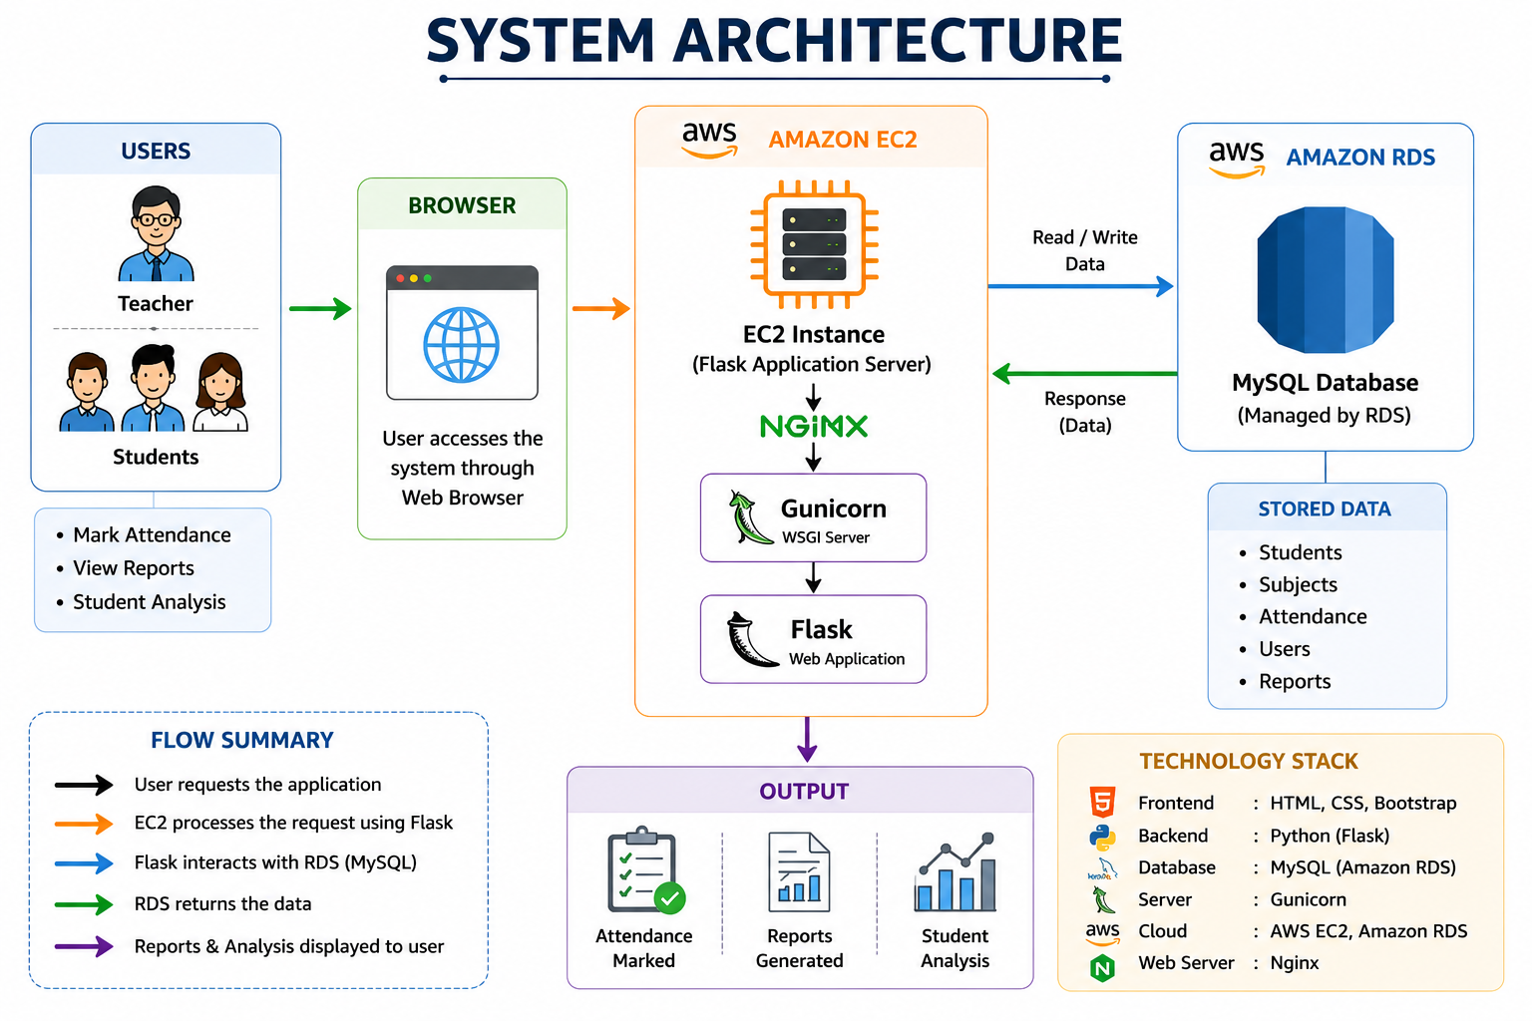

Slide 11
Database Tables
Users
Students
Attendance

Slide 12
Modules
• Teacher login
• Student signup
• Attendance
• Reports
• Analysis

Slide 13
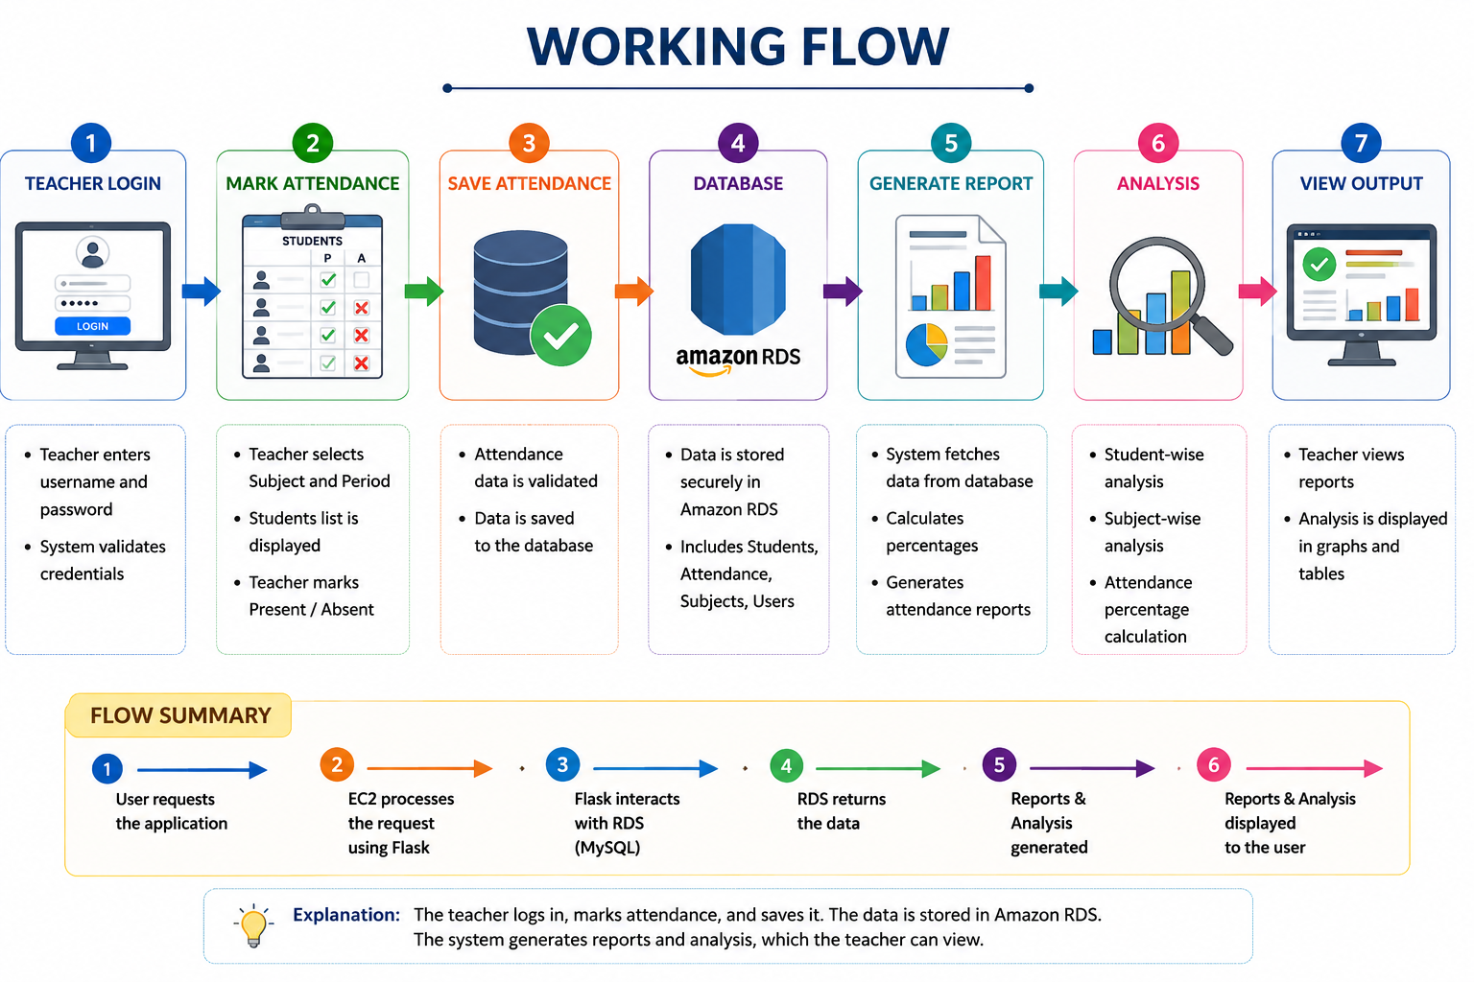

Slide 14
Features
• Present/Absent marking
• Teacher-wise reports
• Subject-wise analysis
• Percentage calculation

Slide 15
Future Enhancements
• Face recognition
• Email alerts
• Mobile app

Slide 16
Thank You

