Slide 1
Recommending best neighborhood to open Indian Restaurant in New York
Name: Hemalatha
Applied Data Science Capstone
IBM Data Science Professional Certificate

Slide 2
Introduction
This project is part of Applied Data Science capstone project. In this project I am going to provide recommendation for our client to open Indian restaurant in New York. Indian Cuisines are famous for its spicy, flavorful and having lot of species recipes. So, my client want to expand their service in New York. With that in mind finding the suitable location for my client to open restaurant is the important for my client so I am creating this project to help my client to find the best location.

Slide 3
Problem statement
The main objective of this Applied Data Science capstone project is to provide recommendation to my client to open Indian restaurant in New York. This project aims to address this business question: If my client want to open Indian restaurant in Toronto, In Which neighborhood/area/location should they open it?

Slide 4
Data
For this project I am going to use these below mentioned dataset:
List of neighborhood in New York from Wikipedia.
Latitude and longitude of the neighborhood from Geocoder package.
Location/venue data related to Indian restaurant from Foursquare.

Slide 5
Approach
1.Collect the new York city data from https://cocl.us/new_york_dataset.
2.Using Foursquare API we will find all venues for each neighborhood.
3.Filter out all venues that are Indian Restaurants.
4.Find rating , tips and like count for each Indian Restaurants using Foursquare API.
5.Using rating for each restaurant , we will sort that data.
6.Visualize the Ranking of neighborhoods using folium library(python)

Slide 6
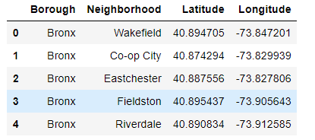
Sample Data

Slide 7
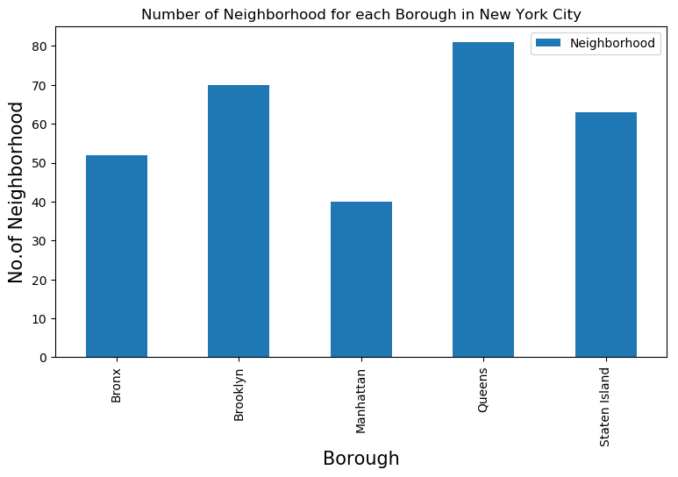
Number of Neighborhood in NY

Slide 8
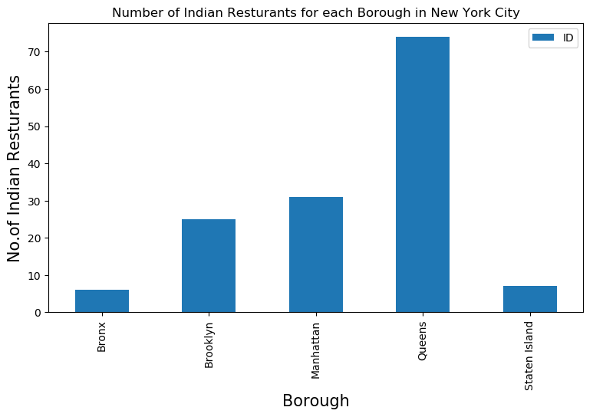
Indian restaurant for each neighborhood

Slide 9
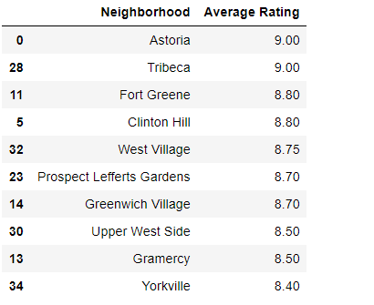
Good neighborhood for Indian restaurant

Slide 10
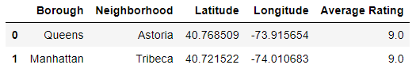
Neighborhood with average rating > 9.0

Slide 11
Decision Making and Reporting Results
Astoria(Queens) and Tribeca (Manhattan) are the best neighborhoods for Indian cuisine.
Queens having large number of Indian restaurant and Manhattan having 2nd largest number of Indian restaurant.
Bronx ranks last in average rating of Indian Restaurants.

Slide 12






Thank You!

