Slide 1

LogiSphere: Cloud-Native Logistics and Supply Chain Management Platform
CNAD Project Review-2
Date:9/23/2026
 | Under the Guidance of Dr. Patha Srilatha Associate Professor Department of CSE, KLH CSE Bowrampet Campus
Team Members B Hemalatha - 2420030698 Bhagyalaxmi - 2420030700 D Yashaswini - 2420030016

Slide 2
Outline of Project
Focus
Introduction
Literature Survey
Challenges
Research Objectives
Conclusion & Future Work
References
Publications Details

Slide 3
Project Overview
Main Process:
What is LogiSphere?
LogiSphere is an adaptive cloud-native logistics and supply chain management platform that manages the complete flow of goods from suppliers to customers.
It provides:
Product management, inventory management, customer orders, shipment tracking, and delivery management through independent microservices.
The platform is designed to automatically validate stock, deduct inventory when an order is placed, create shipments, and assign approved delivery personnel based on workload.
Supplier / Customer
Product Management
Inventory Management
Order Placement
Stock Validation & Deduction
Shipment Creation & Delivery Assignment
Shipment Tracking → Delivered

Slide 4
Problem Definition & Requirements
Problem Definition
Traditional logistics and supply chain operations often involve separate systems for suppliers, products, inventory, orders, shipments, and deliveries. This can lead to inaccurate stock information, manual order processing, shipment delays, and inefficient delivery allocation.
Proposed Solution
LogiSphere provides a cloud-native microservices-based logistics platform that integrates product, inventory, order, shipment, and delivery management. It automatically validates and updates inventory, creates shipments, tracks deliveries, and assigns approved delivery personnel based on workload.
Functional Requirements
• Insufficient-stock prevention
• Order management and history
• Shipment creation and tracking
• Delivery-person verification
• Workload-based delivery assignment
• Shipment status updates
• Monitoring and notifications

Slide 5
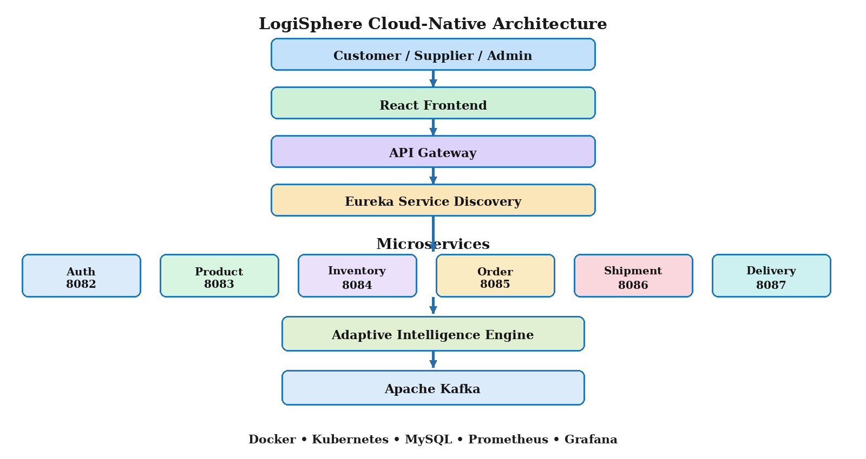
System Architecture / Blueprint

Slide 6
Module Design / Module-wise Description
Identified Modules
Module | Description
Auth Service | Handles registration, login, roles and JWT authentication
Product Service | Manages products, categories, prices and supplier information
Inventory Service | Maintains product stock and handles stock updates
Order Service | Creates and manages customer orders and order items
Shipment Service | Creates shipments and manages status and tracking
Delivery Service | Manages delivery persons, verification and assignments
Adaptive Intelligence | Analyzes logistics conditions and recommends adaptive actions
Notification Service | Sends order, shipment and delivery notifications
API Gateway & Eureka | Provides a single entry point and service discovery
Monitoring & Analytics | Tracks service health, logistics activity and operational metrics
The project documentation identifies authentication, product management, inventory management, order processing, shipment tracking, delivery management, adaptive intelligence, notifications, service discovery and monitoring as the main functional components.

Slide 7
Core Module: Product, Inventory & Order Analysis
1. Product Management
Supplier Details
↓
Product Information
↓
Product Category
↓
Price & Quantity
Example:
Product Name : HP Laptop 15
Brand : HP
Category : Laptops
Price : ₹54,999
Supplier : Sharma Electronics
Location : Bachupally, Hyderabad
2. Inventory Analysis
Product Stock
↓
Check Available Quantity
↓
Stock Validation
↓
Update Inventory
Example:
Initial Stock : 50
Customer Order : 2
Available Stock : 48
If Requested > Available:
Insufficient Stock → Order Rejected
3. Order & Shipment Analysis
Customer Order
↓
Validate Inventory
↓
Deduct Stock
↓
Create Order
↓
Create Shipment
Example:
Customer : Test Customer
Product : HP Laptop 15
Quantity : 2
Order Status : PLACED
Inventory : 50 → 48
Shipment : CREATED
The integrated product, inventory and order modules ensure accurate stock management, prevent insufficient-stock orders, and
support seamless shipment creation in LogiSphere.

Slide 8
Core Module: Adaptive Risk & Decision
Risk Calculation
The initial implementation will use a rule-based adaptive decision engine.
Inventory Condition
+
Shipment Delay
+
Delivery Workload
+
Order Priority
+
Resource Availability
↓
Adaptive Risk Score
Example:
Risk Factor | Score
Low Inventory | +20
Shipment Delay | +20
High Delivery Workload | +15
High-Priority Order | +15
Resource Shortage | +20
Operational Alert | +10
Total Risk Score | 100
Adaptive Decision
0–30 → LOW → Normal Processing
31–60 → MEDIUM → Monitor Closely
61–80 → HIGH → Take Adaptive Action
81–100 → CRITICAL → Immediate Intervention
This rule-based approach is proposed for the initial implementation of the adaptive logistics module.

Slide 9
Implementation
Technology Stack
Implementation Order
Layer | Technologies
Frontend | React.js
Backend | Java, Spring Boot
Authentication | Spring Security, JWT
Database | MySQL
Architecture | Microservices
API Communication | REST APIs
Service Discovery | Eureka
API Gateway | Spring Cloud Gateway
Event Communication | Apache Kafka
Containerization | Docker
Orchestration | Kubernetes
Monitoring | Prometheus, Grafana
Spring Boot Microservices
↓
MySQL
↓
REST Integration
↓
Eureka
↓
API Gateway
↓
Kafka
↓
Adaptive Intelligence
↓
Docker
↓
Kubernetes
↓
Monitoring
↓
React Dashboard

Slide 10
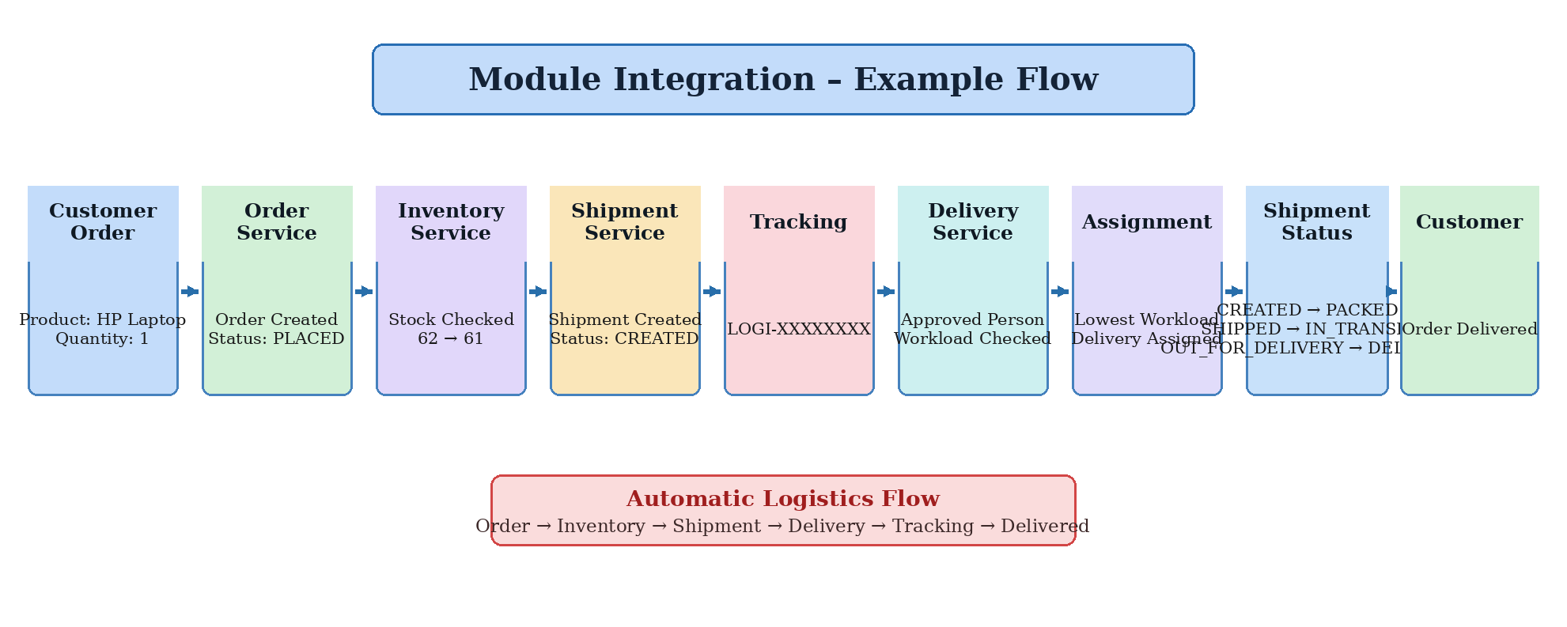
Module Integration

Slide 11
Team Contribution & Work Plan
Member 1 — Backend & Microservices
Auth Service
Product Service
Inventory Service
Order Service
REST API integration
MySQL integration
Member 2 — Logistics & Adaptive Intelligence
Shipment Service
Delivery Service
Delivery Assignment
Workload Calculation
Adaptive Intelligence
Kafka Integration
Member 3 — Frontend & Cloud
Deployment
React Dashboard
Customer/Supplier UI
Admin Dashboard
Docker
Kubernetes
Monitoring

Slide 12
Demonstration & Expected Outcome
Order created
Product: HP Laptop
Quantity: 1
1
Expected Output
Order Status : PLACED
Inventory : 62 → 61
Shipment Status : CREATED
Tracking Number : LOGI-XXXXXXXX
Delivery Assignment : APPROVED PERSON
Shipment Tracking : CREATED → DELIVERED
LogiSphere validates stock, creates the order and shipment,
and supports delivery assignment and tracking.
Order Service
2
Order delivered
Customer places order
Stock validation & deduction
3
Shipment created
Delivery assignment
4
Shipment tracking
Approved delivery person
Workload checked
5

Slide 13
Tracking number
generated
Order → Shipment
CREATED
Delivery completed
6
11
DELIVERED
Shipment status
updated
Order completed
7
DELIVERY
12
Customer sees
DELIVERED status
Shipment & Delivery Flow
8
CREATED → PACKED
→ SHIPPED
Delivery person
workload checked
9
IN_TRANSIT
OUT_FOR_DELIVERY
Shipment assigned
10
Status transitions
validated

Slide 14
THANK YOU

