Slide 1

LogiSphere: An Adaptive Cloud-Native Logistics and Supply Chain Management Platform
CNAD Project Review-2
Date: Wednesday, 23 September 2026
 | Under the Guidance of Dr. Patha Srilatha Associate Professor Department of CSE, KLH CSE Bowrampet Campus
Team Members B Hemalatha - 2420030698 Bhagyalaxmi - 2420030700 D Yashaswini - 2420030016

Slide 2
Outline of Project Work
Focus
Introduction
Literature Survey
Challenges
Research Objectives
Conclusion & Future Work
References
Publications Details

Slide 3
Project Overview
Main Process:
Change
What is CloudChange?
CloudChange is a cloud-native safety layer that analyzes a proposed application or infrastructure change before deployment.
It answers:
What changed? What can be affected? How risky is it? How should it be deployed safely?
Impact Analysis
Risk & Blast Radius
Deployment Strategy
Deploy
The project is designed to identify affected components, calculate risk, recommend a deployment strategy, and safely handle unhealthy deployments.
Monitor
Promote / Rollback

Slide 4
Problem Definition & Requirements
Problem Definition
Cloud-native applications contain multiple interconnected microservices and Kubernetes resources. A small configuration or deployment change can affect dependent services and cause failures or downtime.
Proposed Solution
CloudChange analyzes a change before deployment, identifies its impact and risk, recommends a deployment strategy, and monitors the deployment for safe promotion or rollback.
Functional Requirements
Detect configuration/deployment changes
Identify resource dependencies
Calculate affected components
Estimate blast radius
Calculate risk score
Recommend deployment strategy
Perform controlled deployment
Monitor application health
Trigger rollback on failure
Display results through dashboard

Slide 5
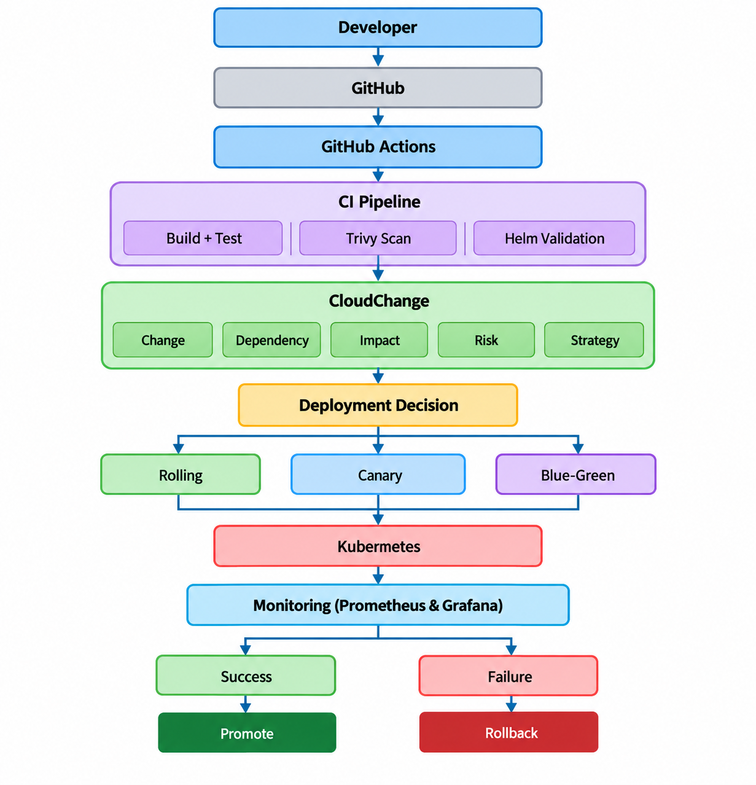
System Architecture / Blueprint

Slide 6
Module Design / Module-wise Description
Identified Modules
Module | Description
Change Detection | Compares old and new configuration/manifests
Dependency Analyzer | Builds relationships between Kubernetes resources
Impact Analyzer | Finds potentially affected services/resources
Risk Engine | Calculates risk score from identified factors
Strategy Advisor | Recommends Rolling/Canary/Blue-Green
Deployment Engine | Executes controlled Kubernetes deployment
Monitoring | Tracks runtime health and metrics
Rollback Manager | Restores previous stable version
Dashboard | Displays change, impact, risk and deployment status
AI Explanation | Converts technical results into understandable explanations
The project documentation identifies change detection, dependency analysis, impact analysis, risk scoring, deployment strategy, monitoring and rollback as the main functional components.

Slide 7
Core Module: Change, Dependency & Impact Analysis
Change Detection
Old Configuration
↓
DIFF
↓
New Configuration
↓
Changed Parameters
Example:
Replicas : 3 → 1
Memory : 512Mi → 128Mi
2. Dependency Analysis
Ingress
↓
Service
↓
Deployment
↓
Pods
3. Impact Analysis
Changed Service
↓
Dependent Services
↓
Affected Pods/APIs
↓
Blast Radius
The dependency graph is the key technical contribution of CloudChange.

Slide 8
Core Module: Risk & Deployment Decision
Risk Calculation
The initial implementation will use a rule-based risk engine.
Configuration Change
+
Dependency Impact
+
Traffic
+
Criticality
+
Security
↓
Risk Score
Example:
Risk Factor | Score
Replica Reduction | +20
Memory Reduction | +20
Missing Probe | +15
High Traffic | +15
Critical Service | +20
Security Issue | +10
Total Risk Score | 100
Deployment Decision
0–30 → LOW → Rolling
31–60 → MEDIUM → Canary
61–80 → HIGH → Canary
81–100 → CRITICAL → Canary/Blue-Green
This rule-based approach is explicitly proposed for the initial project implementation.

Slide 9
Implementation
Technology Stack
Implementation Order
Layer | Technologies
Frontend | React, Tailwind CSS
Backend | Python, FastAPI
Database | PostgreSQL
Containerization | Docker
Orchestration | Kubernetes, Minikube
Package Management | Helm
CI/CD | GitHub Actions
Security | Trivy
Monitoring | Prometheus, Grafana
GitOps | Argo CD
Cloud | AWS / EKS
AI | Gemini API / LLM
Docker/Kubernetes
↓
Helm
↓
CI/CD
↓
Change Detection
↓
Dependency + Impact
↓
Risk Engine
↓
Safe Deployment
↓
Monitoring/Rollback
↓
Dashboard

Slide 10
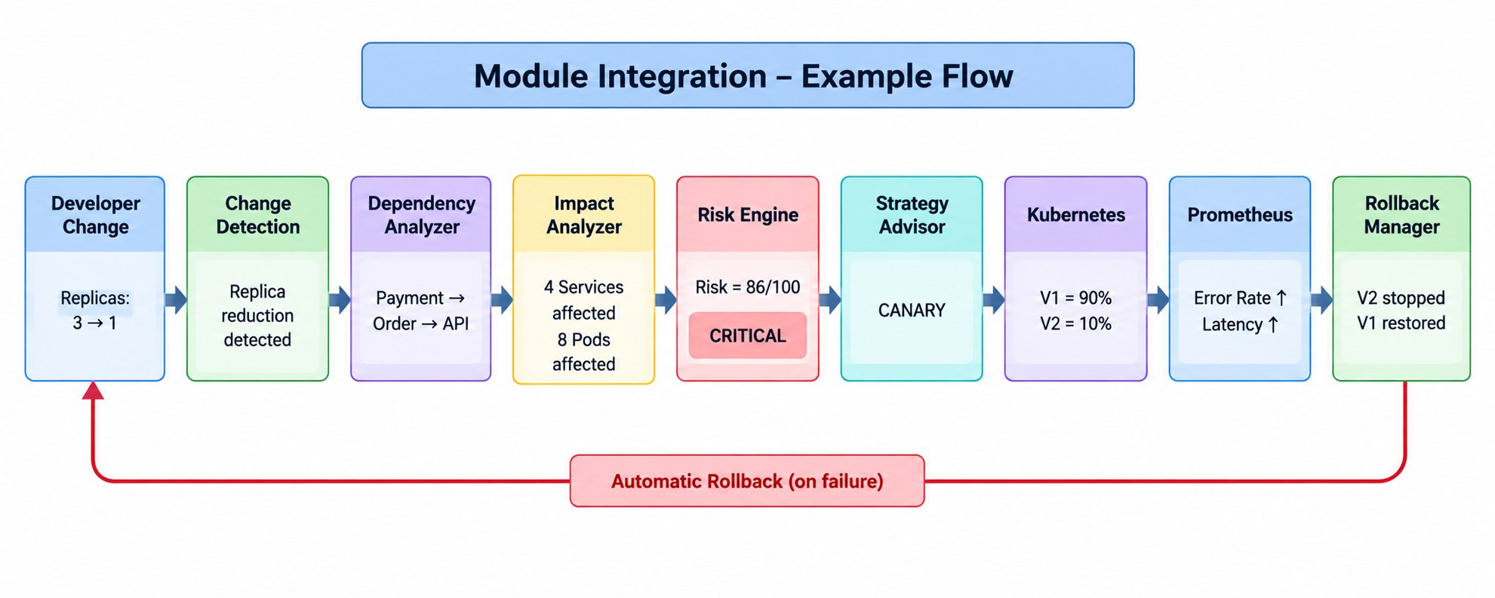
Module Integration

Slide 11
Team Contribution & Work Plan
Member 1 — DevOps & Kubernetes
Difficulty: Hard
Docker
Kubernetes
Helm
GitHub Actions
Trivy
Rolling/Canary deployment
Prometheus
Rollback
Member 2 — Core Analysis & Risk
Difficulty: Hardest
Change Detection
Dependency Graph
Impact Analysis
Blast Radius
Risk Engine
Strategy Recommendation
Member 3 — Dashboard & AI
Difficulty: Medium
FastAPI integration
React Dashboard
Graph Visualization
Risk Visualization
Deployment UI
AI Explanation

Slide 12
Demonstration & Expected Outcome
Developer makes a configuration change
Replicas: 3->1
1
Expected Output
Risk Score : 86/100
Risk Level : CRITICAL
Blast Radius : HIGH
Strategy : CANARY
Deployment : 10% → 90%
Health : UNHEALTHY
Promotion : BLOCKED
Rollback : SUCCESS
CI/CD pipeline starts
2
GitHub Actions
CloudChange detects the change
Change detected(replica reduction
3
Dependency graph is generated
Payment->order->API
4
Impact + blast radius
calculated
4 services affected
8 pods affected
5

Slide 13
Risk Score Generated
Risk = 86/100
CRITICAL
Deployment stopped
6
11
V2 stopped
Deployment Strategy
Selected
Previous version
restored
7
CANARY
12
V1 restored
System stable
Canary Deployment
Starts
8
V1 = 90%
V2 = 10%
Prometheus monitors
health
9
Error Rate
Latency
Failure Detected
10
Threshold Exceeded

Slide 14
THANK YOU

