Slide 1
Employee Data Analysis using Excel
STUDENT NAME: HEMALATHA N N
REGISTER NO: 22COR620 (NM ID: DCCB38243A4A75EB9464A707B25157A8)
DEPARTMENT: Corporate Secretaryship
COLLEGE: Valliammal College For Women, Annanagar East, Chennai – 102.

Slide 2
PROJECT TITLE
Employee Performance Analysis using Excel

Slide 3


AGENDA
Problem Statement
Project Overview
End Users
Our Solution and Proposition
Dataset Description
Modelling Approach
Results and Discussion
Conclusion
3/21/2024 Annual Review

Slide 4

PROBLEM STATEMENT
Employee performance plays main and important role in organization success. This project is carried out to identify and track employee performance to focus and improve growth of the employee and organization.

Slide 5

PROJECT OVERVIEW
.Analyze employee performance of the organization by considering various factors like Business Unit, Employee Type, Employee Status, Gender and rating.
Identify trends and patterns by categorizing employee performance as VERY HIGH, HIGH, MED and LOW based on their rating

Slide 6

WHO ARE THE END USERS?
Employee
Supervisor
Department Manager
Business Unit Head
Human Resource Head & Department

Slide 7

OUR SOLUTION AND ITS VALUE PROPOSITION
Collect the employee details information for analysis
From employee details information, select the required fields/Columns for analysis
Missing values marked using conditional formatting and removed or excluded for analysis by filter
Performance rating categorized based on employee rating as VERY HIGH, HIGH, MED and LOW using formula
Summarized performance analysis through Pivot table
Analysis result presented in the form of Chart/Graph for visualization

Slide 8
Dataset Description
Employee Details Information collected from Kaggle
It contains 26 features about the employee
Out of 26 features 9 selected for analysis
Selected Features and their data type are provided below
EmpID - Number
FirstName – String/Text
LastName – String/Text
BusinessUnit – String/Text
EmployeeStatus – String/Text
EmployeeType – String/Text
GenderCode – String/Text
Performance Score – String/Text
Current Employee Rating - Number

Slide 9

THE "WOW" IN OUR SOLUTION
To simply analysis and to find trends and patterns in performance, employee rating categorized into 4 level as “VERY HIGH”, “HIGH”, “MED” and “LOW” through formula.
Performance Level =IFS(Z2>=5,"VERY HIGH",Z2>=4,"HIGH",Z2>=3,"MED",TRUE,"LOW")
3/21/2024 Annual Review
9

Slide 10
MODELLING
Data Collection
Identify Employee details information
Collect employee data from Kaggle
Feature Selection
Go through features of employee information
Identify and Select required features.
Data Cleaning
Go thru all the features in the data
Identify, mark, and Remove or exclude missing values
10

Slide 11
MODELLING
Performance Level
Convert Performance rating into category thru formula
Add new feature/Column – Performance Level – use formula to get values
Summary
Summarize analysis using Pivot table
Place required employee features in row, column, Filter and column value of pivot table
Visualization
Plot analysis result through Chart/Graph
Use various filter to find out insights in the performance
Mark trend line and pattern, if any
11

Slide 12
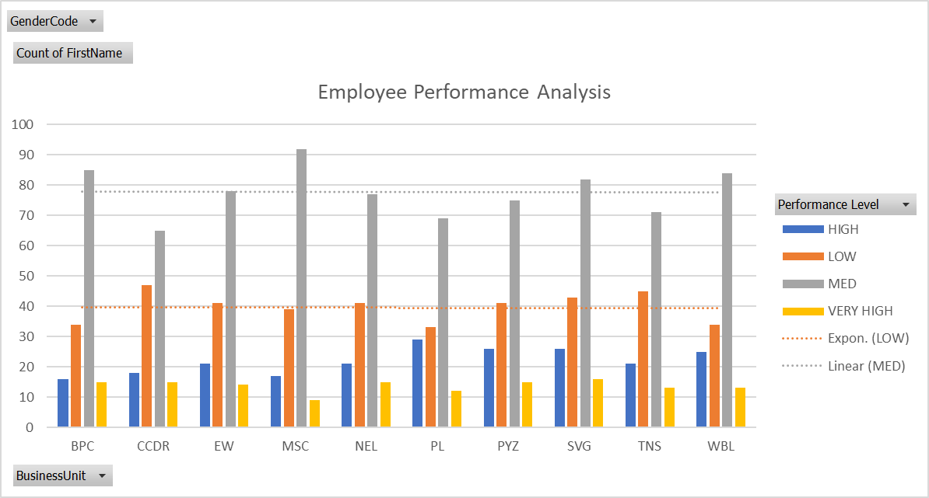
RESULTS
12

Slide 13
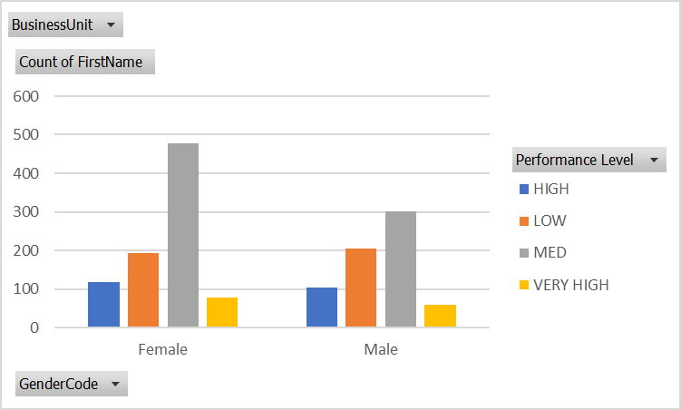
RESULTS
13

Slide 14
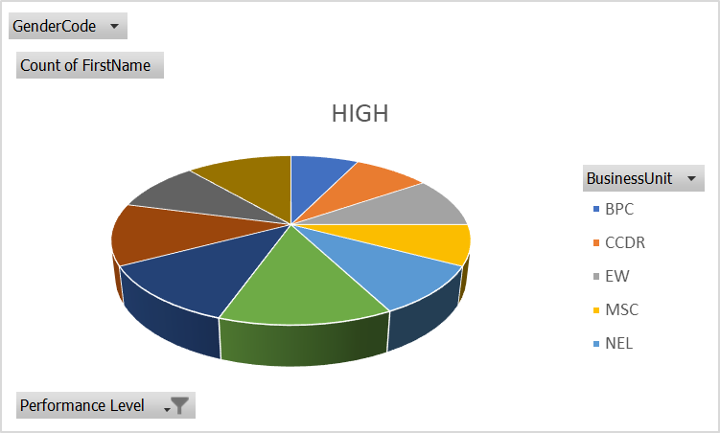
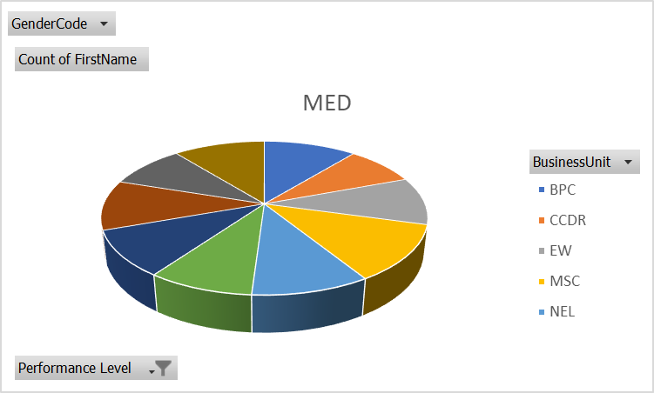

RESULTS
14

Slide 15
Conclusion
More number of employees are under medium performance level followed by Low level
Trend lines indicates that there is not much deviation or variation at MEDIUM and LOW level
More Female employees are in MEDIUM performance level compared to Male employees
No of employees in MEDIUM and LOW performance level almost equal in number across all business unit
High performers are more in BPC and NEL Business unit

