Slide 1
CAPSTONE PROJECT
EMPLOYEE SALARY PREDICTION
Presented By:
1. Mathakala Hemalatha, B.Tech , CSE department,
Sree Venkateswara College of Engineering ,North Rajupalem
2. AICTE ID: STU683347427473e1748191186

Slide 2
OUTLINE
Problem Statement (Should not include solution)
System Development Approach (Technology Used)
Algorithm & Deployment (Step by Step Procedure)
Result
Conclusion
Future Scope(OptIonal)
References

Slide 3
PROBLEM STATEMENT
PROBLEM :
Companies struggle to decide fair salaries for employees
Salaries depend on many factors like age, experience, education, and job role.
Manual estimation can be time-consuming and inaccurate.
WHY THIS PROJECT ?
To predict salaries using past employee data.
Helps in making fair and consistent salary decisions.
Useful for HR planning and budgeting.
Reduces chances of salary bias or error.

Slide 4
SYSTEM APPROACH
HARDWARE :
Processor (CPU) | Intel Core i5 or higher
RAM | Minimum 8 GB
Storage | Minimum 512 GB
Operating System | Windows 10 / Linux / macOS
Internet Access | Required – for Google Colab, package installation, and app sharing
Software/Platforms :
Python for data analysis and modeling
Google Colab for model training and evaluation
Streamlit for building the web application
Joblib to save and load the trained model
VS Code for running Streamlit app locally
Ngrok for sharing app via public link

Slide 5
LIBRARIES :
Library | Purpose
pandas | Reading CSV data, handling and manipulating tabular data
numpy | Performing numerical computations
matplotlib, seaborn | Visualizing distributions, outliers (e.g., boxplot for age)
scikit-learn (sklearn) | -- Builtin Machine Learning models accessing purpose – train_test_split: Splitting data – Pipeline, ColumnTransformer: Combining preprocessing and model – StandardScaler, OneHotEncoder, LabelEncoder: Feature scaling and encoding – accuracy_score, confusion_matrix, classification_report: Model evaluation metrics
joblib | Saving and loading the trained ML pipeline (best_model.pkl)
streamlit | Creating the web app interface for real-time and batch predictions
pyngrok (optional) | Exposing the Streamlit app online (temporary public URL)

Slide 6
ALGORITHM & DEPLOYMENT
Algorithm – Step-by-Step Procedure :
Data Loading
First, I loaded the dataset adult.csv using pandas.
Cleaning the Data
I replaced missing values (like “?”) in columns such as workclass and occupation.
Removed age outliers (below 17 and above 75).
Removed records where people never worked or had no useful workclass.
Also dropped the column fnlwgt as it was not useful.
Converting Categorical to Numbers
Converted columns like income, sex, and race into numeric form using “label encoding”.
Used “OneHotEncoding” to convert other categorical columns.
Splitting the Data
Divided the dataset into training and testing using “train_test_split” (80% training, 20% testing).
Training the Model
I tried different machine learning models like: KNN, Logistic Regression, Random Forest, SVM, Gradient Boosting
Trained them using “Pipeline” and “ColumnTransformer” for preprocessing.

Slide 7
Model Evaluation
I checked how accurate each model was using accuracy score and classification report.
Model Saving
Saved the best performing model using joblib into a file called best\_model.pkl.
Deployment :
Built a Web App
Used Streamlit to make a simple and user-friendly app.
Created a sidebar to enter employee details like age, job, education, hours per week, etc.
Prediction Using Model
Loaded the saved model (best\_model.pkl) and used it to predict whether salary is >50K or ≤50K.
Batch CSV Upload Option
Added an option to upload a CSV file for multiple predictions at once.
Download Result
Gave an option to download the prediction results as a CSV file.
App Sharing (optional)
Used pyngrok to generate a public link to share the app.

Slide 8
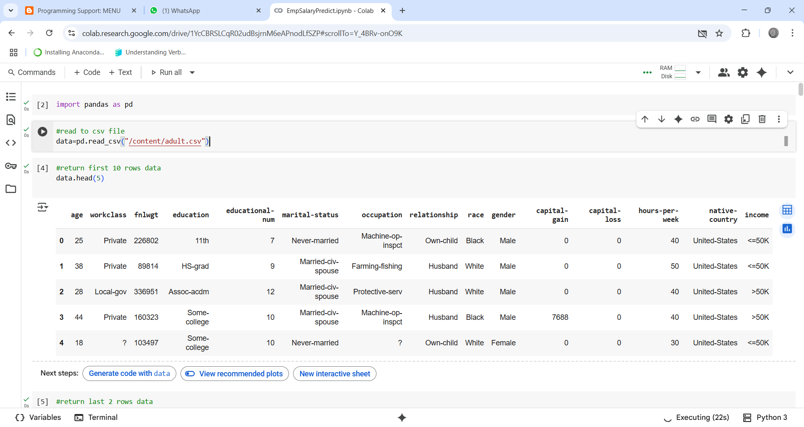
RESULT
Loaded “adult.csv ” file into google colab notebook

Slide 9
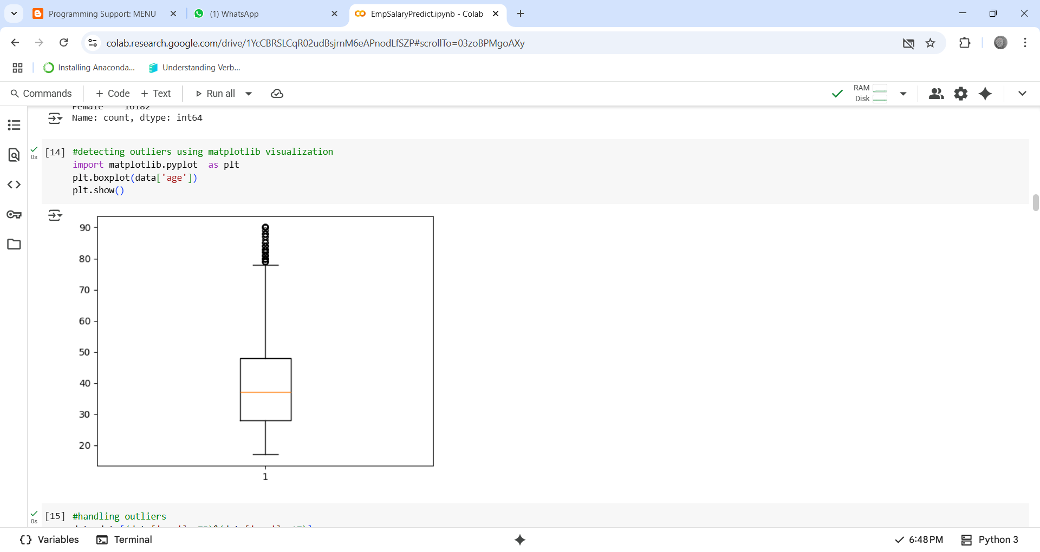
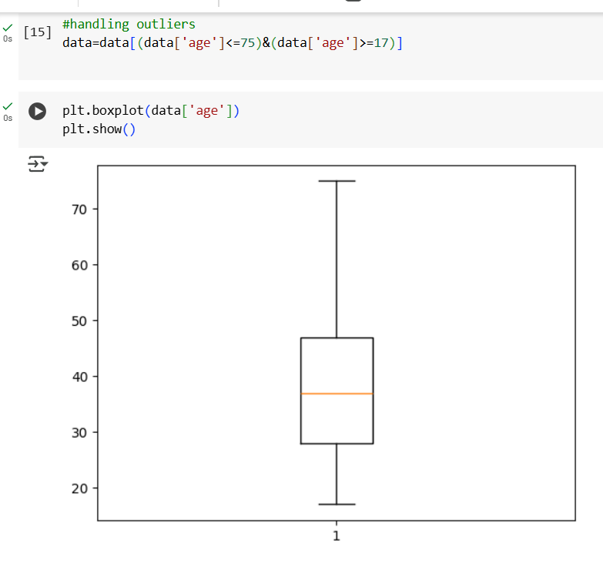
Detecting outliers and Handling them :

Slide 10
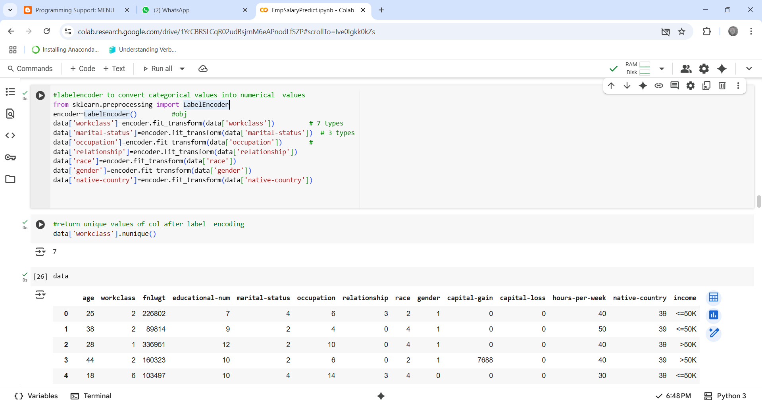
Labelencoder to convert categorical values into numerical values :

Slide 11
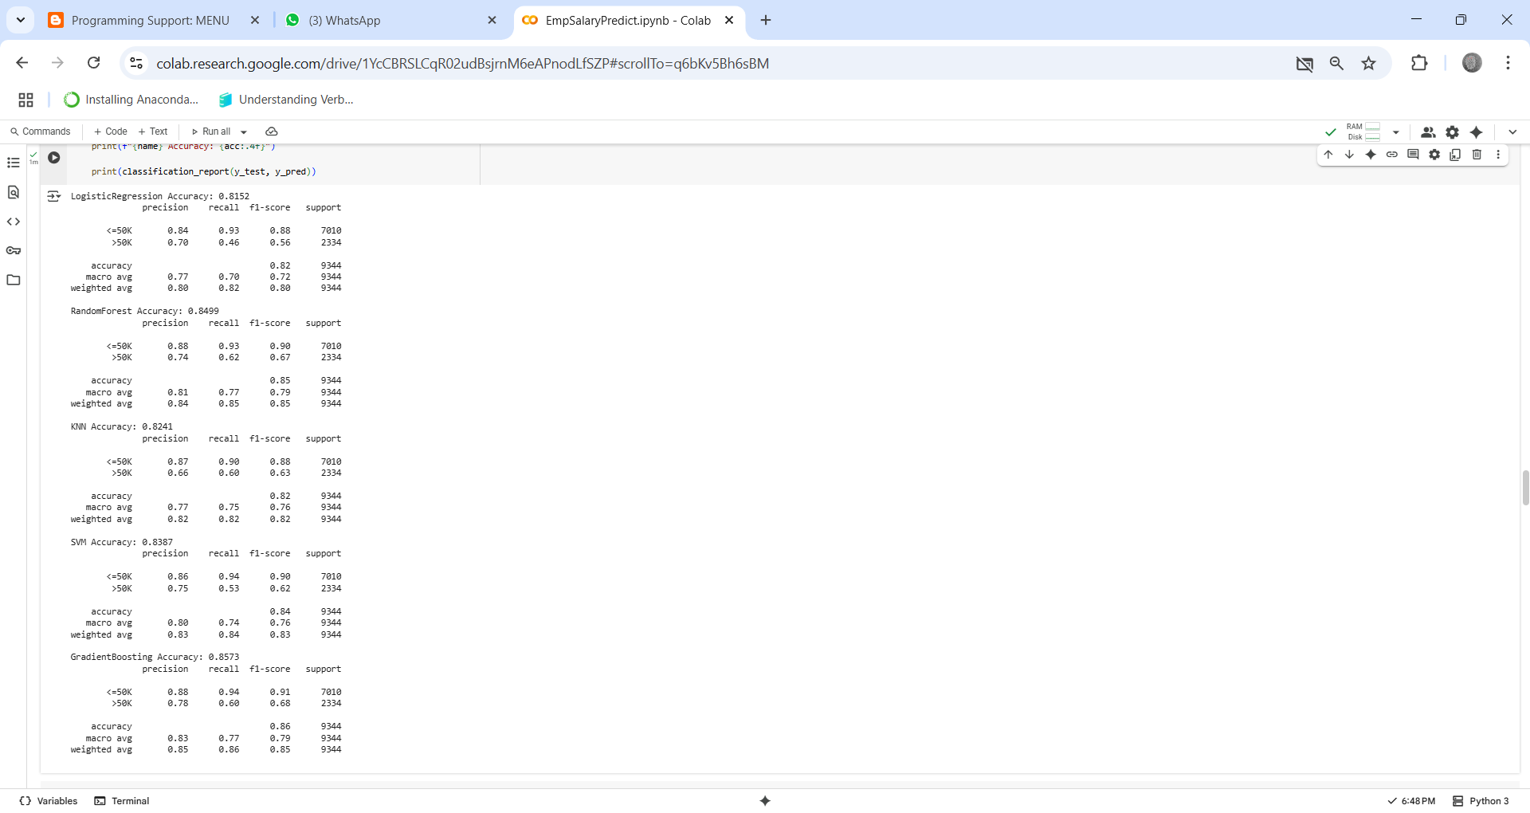
Accuracy evaluation matrix for all the models :

Slide 12
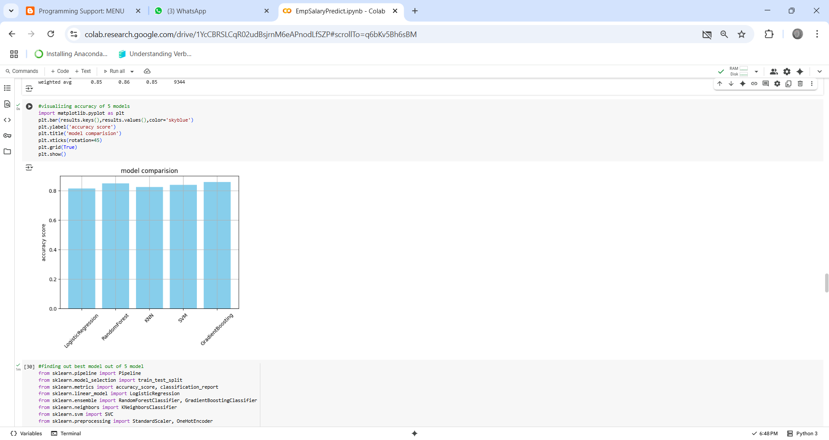
Visualizing Accuracy of 5 Models using matplotlib :

Slide 13
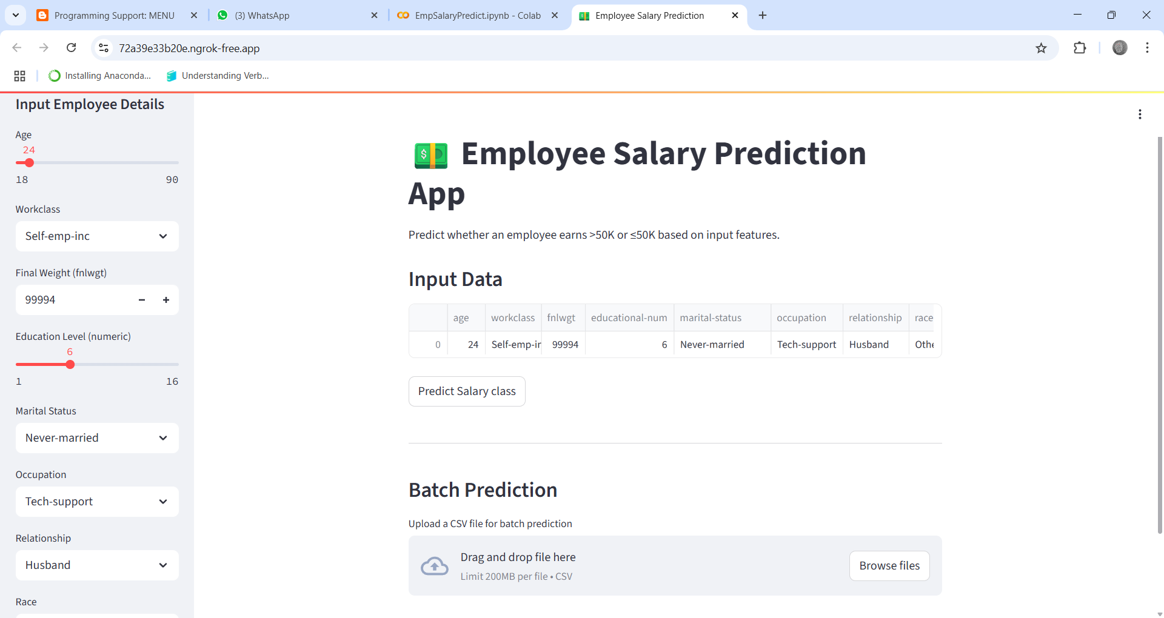
Created Employee Salary Prediction App using Streamlit :

Slide 14
Git Hub Link : https://github.com/hemalatha9177/EmployeeSalaryPrediction-IBM-edunet.git

Slide 15
CONCLUSION
Findings :
In this Employee Salary Prediction project, I worked on predicting employee salary using machine learning techniques. I tried multiple algorithms like KNN,
Logistic Regression, Random Forest, SVM, and Gradient Boosting. After comparing all models, we found that the Gradient Boosting Classifier performed the
best with high accuracy. So, we saved this model (“best_model.pkl ”) and used it for deployment.
Effectiveness of the Proposed Solution :
The final solution was effective in predicting salaries based on user input. The Streamlit app made the prediction process user-friendly and quick. The model gave good performance and handled real-world input quite well. Overall, the solution was practical, accurate, and ready for use.
Challenges Faced :
Data cleaning and preprocessing took time and effort
Deployment using Streamlit and making it accessible online was slightly tricky
Managing file imports and dependencies during deployment was a bit confusing

Slide 16
REFERENCES
ngrok – Secure Tunnel Service https://dashboard.ngrok.com/
Google Colab – Cloud-based Python Notebook https://colab.research.google.com/
scikit-learn: Machine Learning in Python
https://scikit-learn.org/
Streamlit: Web App Framework for ML
https://streamlit.io/

Slide 17
THANK YOU

