Slide 1
Digital Portfolio
STUDENT NAME: P.HEMALATHA
REGISTER NO AND NMID: E5DC0EE9FEDAA75A41E4CAB6790E8D23
DEPARTMENT: B.Sc Computer Science
COLLEGE: Krishnasamy college of Science,Arts & Management for Women

Slide 2
PROJECT TITLE
DIGITAL PORTFOLIO

Slide 3


AGENDA
Problem Statement
Project Overview
End Users
Tools and Technologies
Portfolio design and Layout
Features and Functionality
Results and Screenshots
Conclusion
Github Link
3/21/2024 Annual Review

Slide 4

PROBLEM STATEMENT
In the modern digital era, students and professionals need an effective way to showcase their skills, achievements, and projects beyond traditional resumes. Conventional paper-based resumes often fail to reflect an individual’s creativity, technical expertise, and personal branding. Moreover, they lack interactivity and do not provide easy access to multimedia evidence such as project demos, certificates, designs, or code samples.Without a centralized and easily accessible platform, individuals face difficulties in presenting their competencies to recruiters, educators, and peers. On the other hand, organizations and institutions face challenges in evaluating candidates holistically due to the absence of a dynamic and well-structured representation of their work.

Slide 5

PROJECT OVERVIEW
The Digital Portfolio Project is designed to provide students and professionals with an online platform to showcase their academic achievements, technical skills, projects, certifications, and personal interests in a well-structured and visually appealing manner. Unlike traditional resumes, a digital portfolio offers an interactive experience by integrating multimedia elements such as images, videos, documents, and links to live projects.

Slide 6

WHO ARE THE END USERS?
Employers or Recruiters– To assess your skills, projects, and experience.
Teachers or Professors– To evaluate academic progress or project work.
Clients – To review your work before hiring (common for freelancers).
Admissions Committees– For college or scholarship applications.
Peers or Collaborators – To view your work and potentially collaborate.
You (the creator)– For self-assessment and showcasing your growth.

Slide 7

TOOLS AND TECHNIQUES
Google Sites - User-friendly, integrates with Google Drive - Great for students and beginners.
Wix / WordPress - Website builders with customizable templates - Good for professional portfolios.
Adobe Portfolio - Ideal for creatives (designers, photographers) - Integrates with Adobe Creative Cloud.
GitHub - Best for programmers and developers - Showcases coding projects and repositories
Canva - Create visual resumes, one-page portfolios - Drag-and-drop interface, no coding needed

Slide 8
POTFOLIO DESIGN AND LAYOUT
Tools:
1. Website Builders - Google Sites: Free, simple, and integrates with Google tools. Wix:Drag-and-drop interface with customizable templates. WordPress: More advanced, suitable for blogs and full websites. Adobe Portfolio: Ideal for photographers, designers, and artists. Notion: Good for structured, resume-style portfolios.
2. Code Repositories (for developers) GitHub: Showcases programming projects with code, documentation, and collaboration. Gitlab / Bitbucket: Similar to GitHub, good for version control and private repositories.
Techniques: - Organize Content Clearly Sections like: About Me, Projects, Resume, Contact Info, Skills, Certifications. - Highlight Key Projects Choose your best work. Add descriptions like the tools used, your role, and the outcomes. - Use Multimedia Embed videos, images, or interactive elements to make the portfolio engaging.
8

Slide 9
FEATURES AND FUNCTIONALITY
User-Friendly Interface: Easy navigation through menus and links. Clear layout that helps users find information quickly.
Responsive Design: Portfolio adapts to different devices and screen sizes (mobile, tablet, desktop).
Multimedia Integration: Ability to include images, videos, audio clips, and animations to showcase work dynamically.
Project Showcases: Sections to display work samples, case studies, or completed projects with detailed descriptions.
Interactive Elements: Clickable buttons, links, and portfolios that allow users to interact with content (e.g., expand images, open project details).

Slide 10
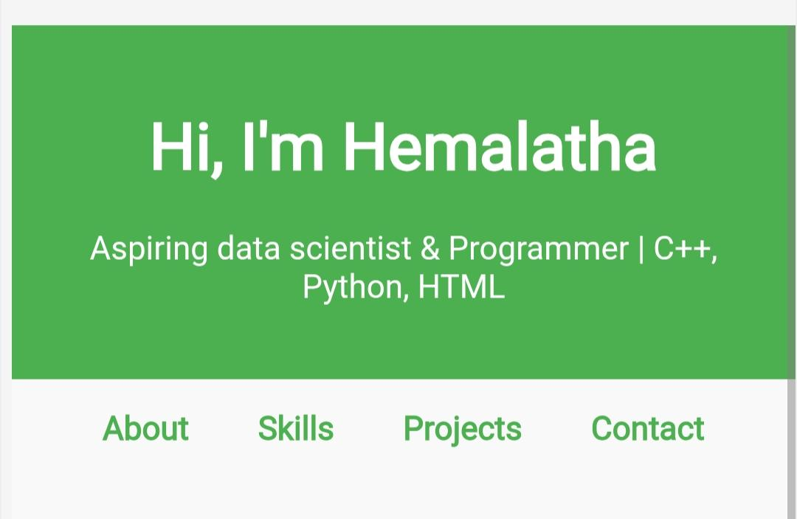

RESULTS AND SCREENSHOTS
3/21/2024 Annual Review
10

Slide 11
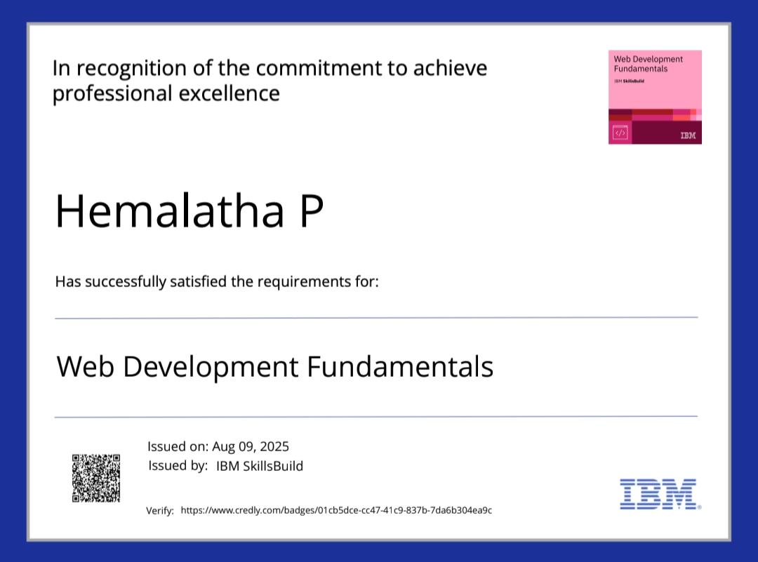
RESULTS AND SCREENSHOTS

Slide 12
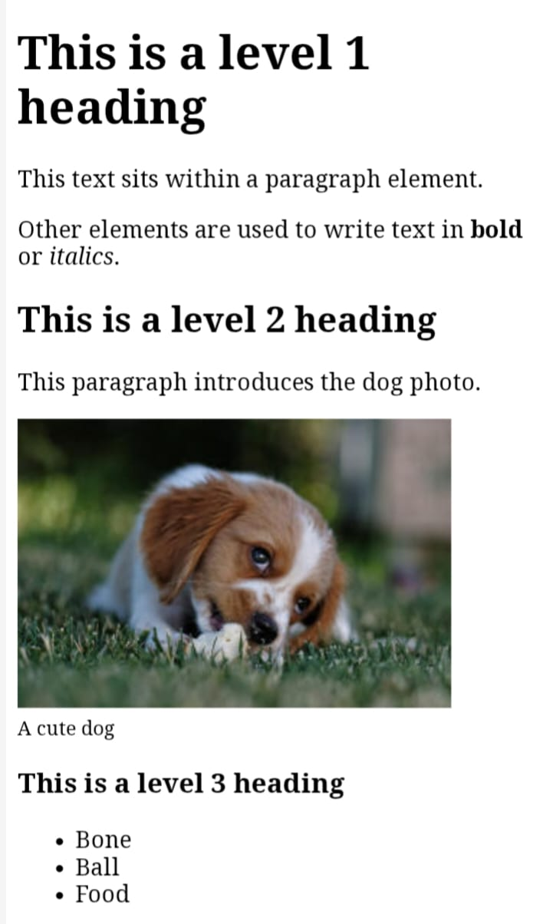
RESULTS AND SCREENSHOTS

Slide 13
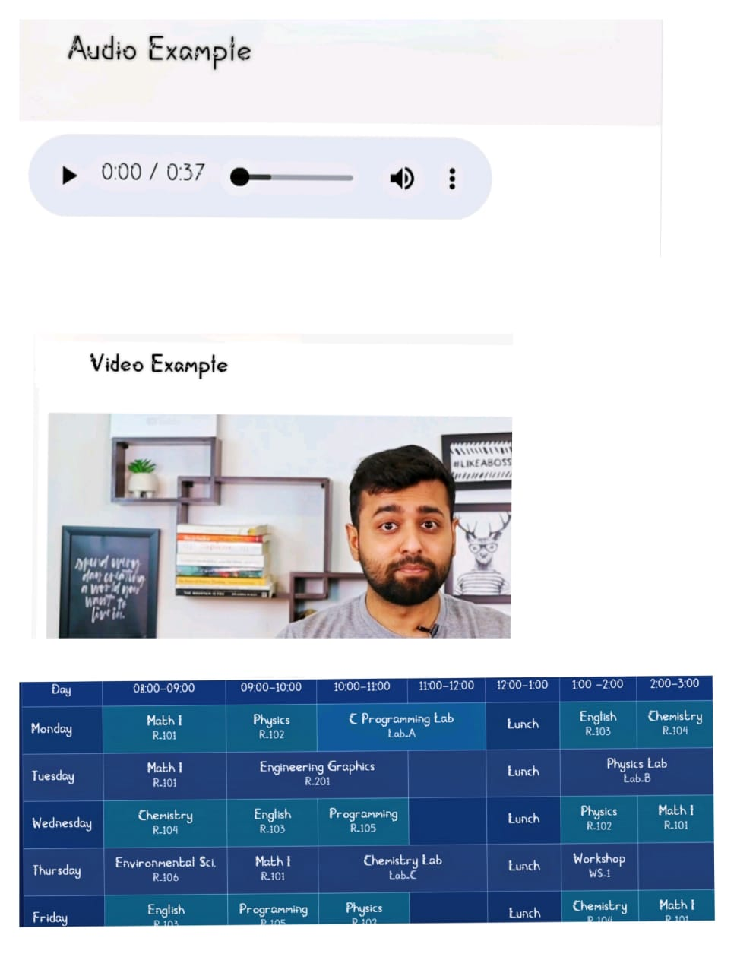
RESULTS AND SCREENSHOTS

Slide 14
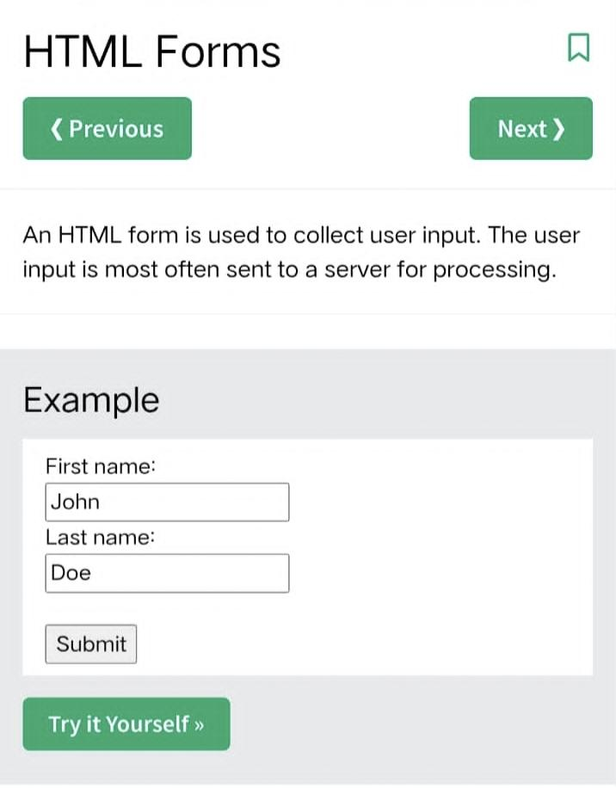
RESULTS AND SCREENSHOTS

Slide 15
CONCLUSION
A digital portfolio is a powerful tool that allows individuals—especially students, professionals, and creatives—to showcase their skills, achievements, and growth in a visually appealing and organized manner. It goes beyond traditional resumes by providing real-world examples of work and demonstrating technological proficiency.Digital portfolios improve visibility, credibility, and career opportunitiesby making it easier to share work with employers, clients, or institutions. With the right tools, thoughtful design, and well-organized content, a digital portfolio becomes an essential part of personal branding and professional development in the digital age.
15

