Slide 1
24CC3046 · P079
Azure Lighthouse Delegated
Administration
Designed on paper. Then built for real, in Azure.
Team T181 · 4 Students
Microsoft Certified: Azure Administrator Associate

Slide 2
THE PROBLEM
Managing a customer's cloud, without breaking their trust
✕
Guest (B2B) Accounts
✕
Shared Credentials
A separate identity created in every customer's tenant. Easy to forget, easy to leave active long after the work is done.
Handing over admin logins directly. Breaks least-privilege completely — if that access is misused, the customer's data is exposed.
Azure Lighthouse gives the provider exactly the access they need — nothing more. If that access is ever misused, the damage stays small, not total.

Slide 3
WHAT WE HAD TO SOLVE
Two bottlenecks, made concrete
01
Giving out too much access, by accident
A key to the whole building, when only one room was needed. A single mistake or stolen credential then risks everything, not just one part.
02
No single place to check activity
Every customer keeps a separate log system. Managing ten customers means checking ten separate screens — things get missed.

Slide 4
OUR APPROACH
The fix for each bottleneck
BOTTLENECK
OUR FIX
Too much access, by accident
Scope every delegation to one resource group — one room — never the whole subscription. A mistake stays small.
BOTTLENECK
OUR FIX
No single view across tenants
Each customer keeps their own private logs. We add one extra tool — Resource Graph + Sentinel — for a unified view, without taking anything away from them.

Slide 5
THE DESIGN
How the delegation is structured
Provider Tenant (MSP)
Admin AD groups · Azure Policy · Central monitoring (Log Analytics + Sentinel)
Customer Tenant A
Customer Tenant B
Lighthouse Delegation
Lighthouse Delegation
registrationDefinition + assignment
registrationDefinition + assignment
Delegated Role — Reader
Delegated Role — Contributor
one resource group (our real build)
resource group scope

Slide 6
WHAT ACTUALLY HAPPENED
We hit a real Azure restriction — and that became useful
New-AzDisk / New-AzVM / New-AzStorageAccount
ErrorCode: RequestDisallowedByAzure — "a set of best available regions where your subscription can deploy resources"
Tested in 3 regions. All Compute/Storage/Network providers confirmed Registered. Same error every time.
A student subscription's built-in fraud-prevention hold — blocking new billable resources, not our commands.
THE TURNING POINT
A resource lock — a management action, not a billable resource — worked perfectly. That told us the restriction only blocks new infrastructure, not authorization actions. Since Lighthouse delegation is also a management action, we tested it live.

Slide 7
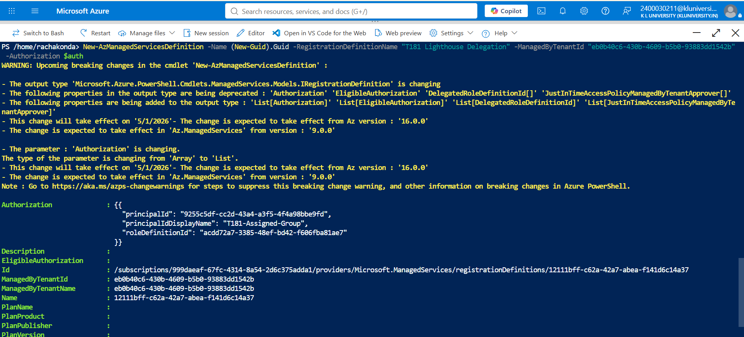
REAL EVIDENCE — NOT A MOCKUP
The delegation was actually created in Azure

Slide 8
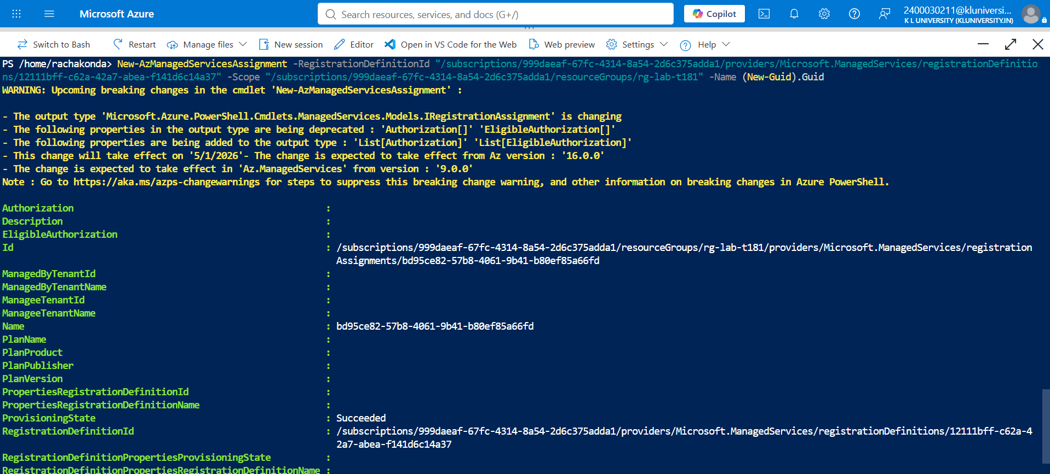
REAL EVIDENCE — NOT A MOCKUP
And then actually assigned to our resource group

Slide 9
END TO END
How it actually works, start to finish
1
Customer deploys the template
2
Lighthouse creates the assignment
Grants a scoped role to our AD group — they initiate the trust, not us.
Our group appears in their tenant with exactly that role — nothing more.
3
We sign in once, in our own tenant
4
Logs stay local, then get aggregated
Their environment appears under “My customers” — no second login.
Each tenant's logs stay private; we layer Resource Graph + Sentinel on top.

Slide 10
SEE IT LIVE
An interactive console, and what it all costs
Lighthouse Console (live demo)
Cost model
→ Tenant Delegations — real scope, real roles
Azure Lighthouse
Free — any number of customers
→ Scope Risk Checker — pick a role + scope, see the risk live
Azure RBAC / Policy
→ Unified Audit Log — filterable across tenants
Free
Log Analytics / Sentinel
Usage-based only

Slide 11
We didn't just design this.
We built the real delegation, in real Azure.
Narrow access instead of a master key. One unified view instead of ten scattered logs. Proven, not just proposed.
Team T181 · 24CC3046 - P079 · Azure Administrator Associate Track

