Slide 1

Exegesis
A Collaborative Annotation & Project Management Platform
Tanmay Sarda (202301131) Hemal Chavda (202301451)

Slide 2



Platform Overview
Exegesis is a web-based platform that allows collaborative literary analysis, main features being combining document annotation, project management, and classroom-like features.
Annotate
Highlight & label text passages in PDF or plain-text documents.
Collaborate
Shared workspaces with differing controlled acess.
Assess
Assignments, submissions, announcements in the same place.
Bridging close reading and digital collaboration — for classrooms & research groups.

Slide 3




App Sitemap
Auth & Profile
Project Workspace
Document & Annotation
Assignments
Landing Page
Project Dashboard
Text & PDF Viewer
Issue Assignments
Login / Signup
Create/Delete Projects
Custom Labels & Colors
Submission Tracking
Password Recovery
Member Roles & Perms
Highlight Annotations
Pending to Completed
Profile & Settings
Announcements & Replies
Threaded Comments
Grading & Feedback

Slide 4
General Workflow
01
Setup & Onboarding
Register an account, create a project, and share invite links or invite collaborators.
02
Content & Curation
Upload PDF or text documents and define annotation labels (e.g., Metaphor, Symbolism).
03
Collaborative Analysis
Members annotate passages, attach labels, and hold threaded discussions on annotations within the text.
04
Assessment & Tracking
Owners issue assignments; members submit work; status updates Pending --> Submitted --> Completed.

Slide 5
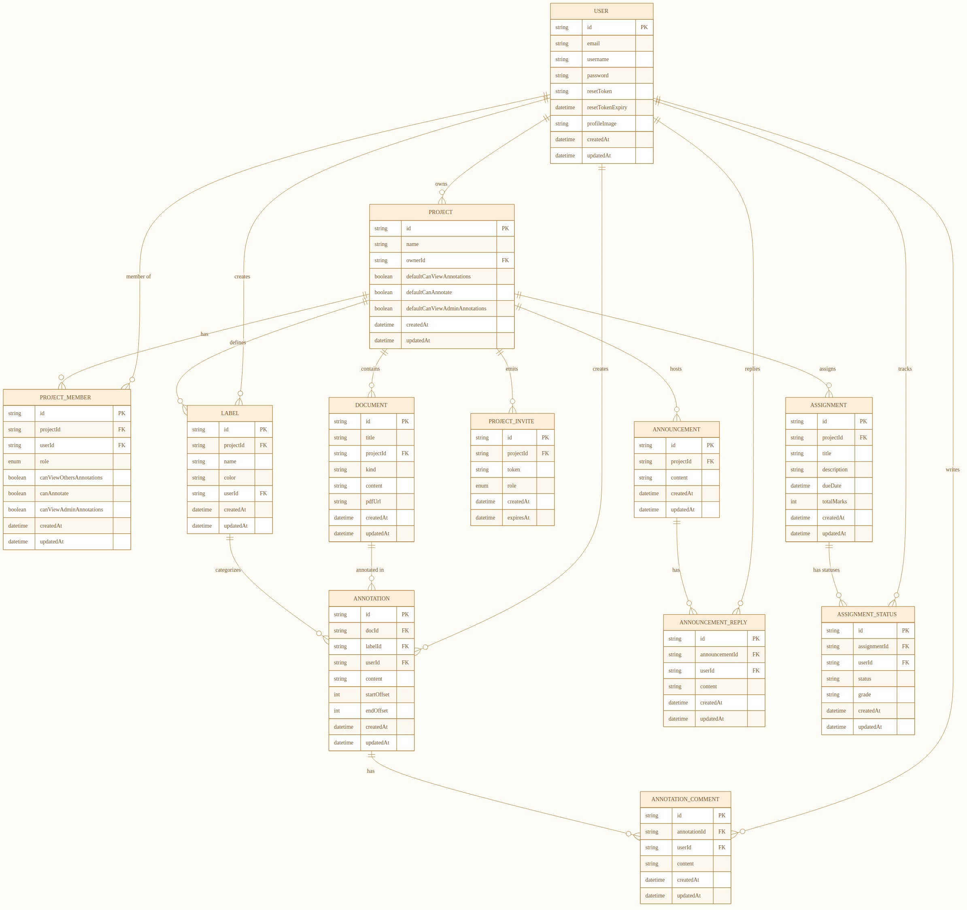
Entity–Relationship Diagram
PK = Primary Key | FK = Foreign Key (italic)

Slide 6

Thank You
Questions & Discussion
Exegesis Platform Overview

