Slide 1

ENGINEER’S PITCH
PawPal+
Pet-care planning that is
predictable, grounded, and safer.
Applied AI final project • Python • RAG • Claude
Hemaleka Mohanram
Notes:
Hi everyone. My project is PawPal Plus, an applied AI pet-care planning assistant. I started with my earlier Module 2 PawPal project, which stored pets and tasks and generated a daily schedule. For this final project, I kept that reliable scheduling foundation and added retrieval-augmented generation, Claude guidance, confidence scoring, guardrails, structured logging, and reliability tests. My goal was not just to add a chatbot. I wanted to build a complete AI system that I could explain and test.
[Sources]
- PawPal+ project repository: https://github.com/hemalekamohanram/codepath-applied-ai-system-project
- Cover illustration generated with the built-in OpenAI image-generation tool on August 4, 2026.

Slide 2
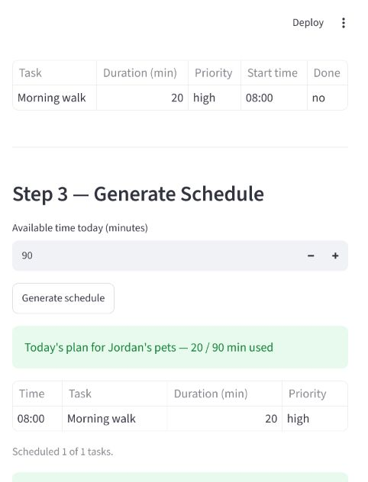
THE PROBLEM
Pet owners need a plan,
not another generic chatbot.
Walks, feeding, medication, grooming, and appointments compete for limited time. The first challenge is deciding what matters today—and what actually fits.
PawPal keeps scheduling deterministic, then uses AI only to explain the real plan with retrieved care guidance.
PAWPAL+
2
Notes:
Pet owners may need to manage walks, feeding, medication, grooming, play, and appointments, often with limited time. The first problem is deciding which tasks are most important and what actually fits into the day. A generic chatbot can give general pet-care advice, but it may ignore the user's real schedule or give unsupported medical guidance. PawPal solves this by separating the work. Predictable Python logic creates the schedule, and AI is used only to explain that specific plan with relevant pet-care information.
[Sources]
- PawPal+ project repository: https://github.com/hemalekamohanram/codepath-applied-ai-system-project
- Schedule image captured from the local PawPal Streamlit application on August 4, 2026.

Slide 3
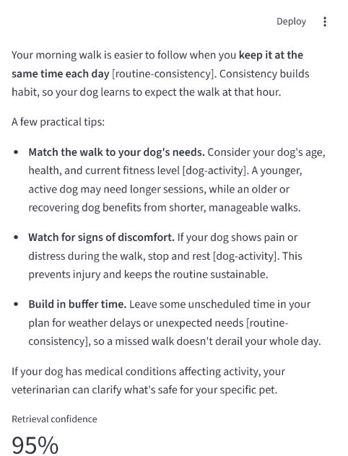
THE LOGIC
A fixed RAG pipeline keeps the AI inspectable.
01
02
03
PLAN
RETRIEVE
EXPLAIN
Python sorts by priority and fits tasks into available time.
Local passages are filtered by species and ranked by relevance.
Claude receives the plan, question, and sources, then cites them.
Emergency language is checked first. If triggered, PawPal skips Claude and recommends veterinary help.
PAWPAL+
3
Notes:
PawPal uses a fixed RAG pipeline, not an agentic loop. First, the Python scheduler sorts tasks by priority and start time and creates a plan that fits within the available minutes. Second, the retriever searches a local pet-care knowledge base. It removes common stop words, filters out passages for the wrong species, ranks keyword matches, and calculates retrieval confidence. Third, PawPal sends the schedule, the question, and the retrieved passages to Claude Haiku 4.5. Claude explains the plan and cites the passage IDs. Before any of this, emergency language is checked. If the question may describe an emergency, PawPal skips Claude and directs the user to a veterinarian.
[Sources]
- PawPal+ project repository: https://github.com/hemalekamohanram/codepath-applied-ai-system-project
- Guidance image captured from the local PawPal Streamlit application on August 4, 2026.

Slide 4
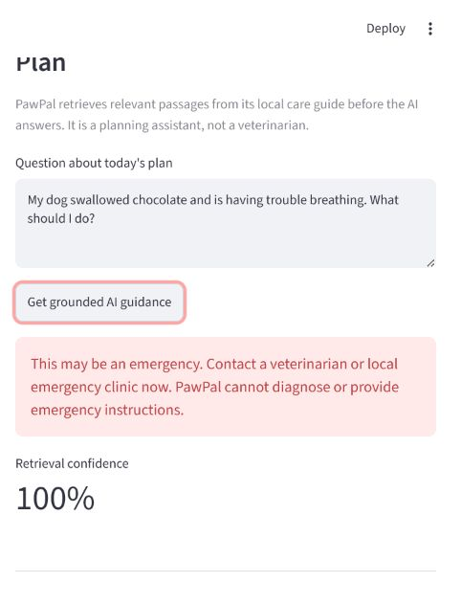
THE RELIABILITY
I measured the system instead of trusting the demo.
48
95%
Pytest cases passed
Retrieval confidence
in the live demo
7/7
Confidence measures retrieval strength—not medical certainty.
Evaluation scenarios passed
PAWPAL+
4
Notes:
I did not want the system to only look like it worked, so I added multiple forms of evidence. The project has 48 passing Pytest cases covering scheduling, persistence, retrieval, model-call behavior, missing configuration, and guardrails. A separate evaluation harness runs seven predefined AI scenarios, and all seven passed. The live demo retrieved relevant sources and displayed 95 percent retrieval confidence. That percentage measures how strongly the question matched the retrieved documents; it is not medical certainty. The AI tests use a fake Claude client, so they are reproducible and do not spend API credits. GitHub Actions reruns the tests after every push.
[Sources]
- PawPal+ project repository: https://github.com/hemalekamohanram/codepath-applied-ai-system-project
- Guardrail image captured from the local PawPal Streamlit application on August 4, 2026.

Slide 5
THE REFLECTION
The surprising bugs were in retrieval—not in Claude.
WHAT HELPED
WHAT FAILED
Keep scheduling deterministic.
Use Claude only for grounded explanation.
Test each system boundary separately.
Wrong-species passages slipped through.
The generic word “can” caused a false match.
Weak assertions still produced green tests.
My biggest lesson: inspect the output, not only the pass total.
PAWPAL+
5
Notes:
What surprised me most was that the hardest problems appeared in retrieval, not in Claude's final wording. My first retriever gave a species match a bonus but did not fully exclude the wrong species, so a cat question could retrieve dog guidance. Later, the common word can caused a medication question to match an unrelated enrichment passage. The original tests still passed because their assertions were too weak. I fixed the species filtering, expanded the stop-word list, and wrote stronger regression tests. This taught me to inspect actual outputs instead of trusting only a green test total.
[Sources]
- PawPal+ project repository: https://github.com/hemalekamohanram/codepath-applied-ai-system-project

Slide 6
PAWPAL+
Useful AI is designed
around its limits.
Predictable by design
Grounded in evidence
Honest about limitations
github.com/hemalekamohanram/codepath-applied-ai-system-project
Notes:
PawPal taught me that useful AI is designed around its limits. I kept scheduling predictable, grounded Claude with visible sources, tested unsafe and failure paths, and documented where the system should not be trusted. PawPal is still a student planning assistant, not a veterinarian, but it demonstrates the engineering mindset I want to bring to future AI projects: build something useful, make its behavior visible, test it honestly, and improve it when the evidence reveals a flaw. Thank you.
[Sources]
- PawPal+ project repository: https://github.com/hemalekamohanram/codepath-applied-ai-system-project

