Slide 1
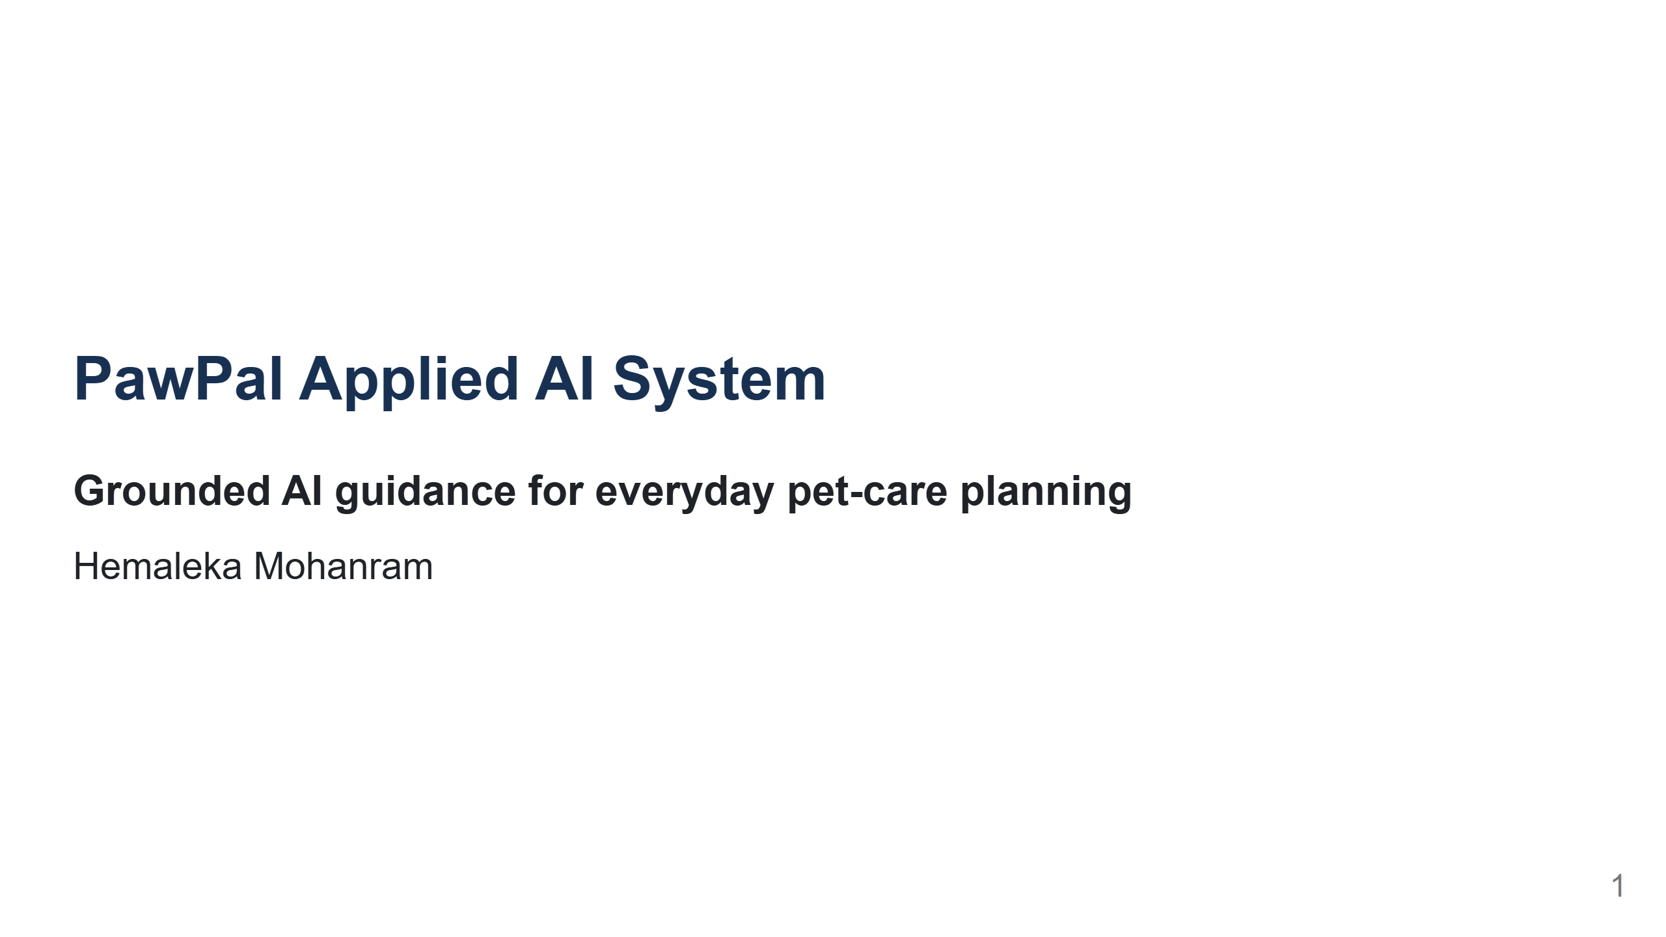
Notes:
Introduce PawPal as an upgrade of my Module 2 scheduling project. My goal was not to add AI everywhere. I wanted to add it where explanation and retrieval are useful while keeping the schedule predictable. [Sources] - https://github.com/hemalekamohanram/codepath-applied-ai-system-project

Slide 2
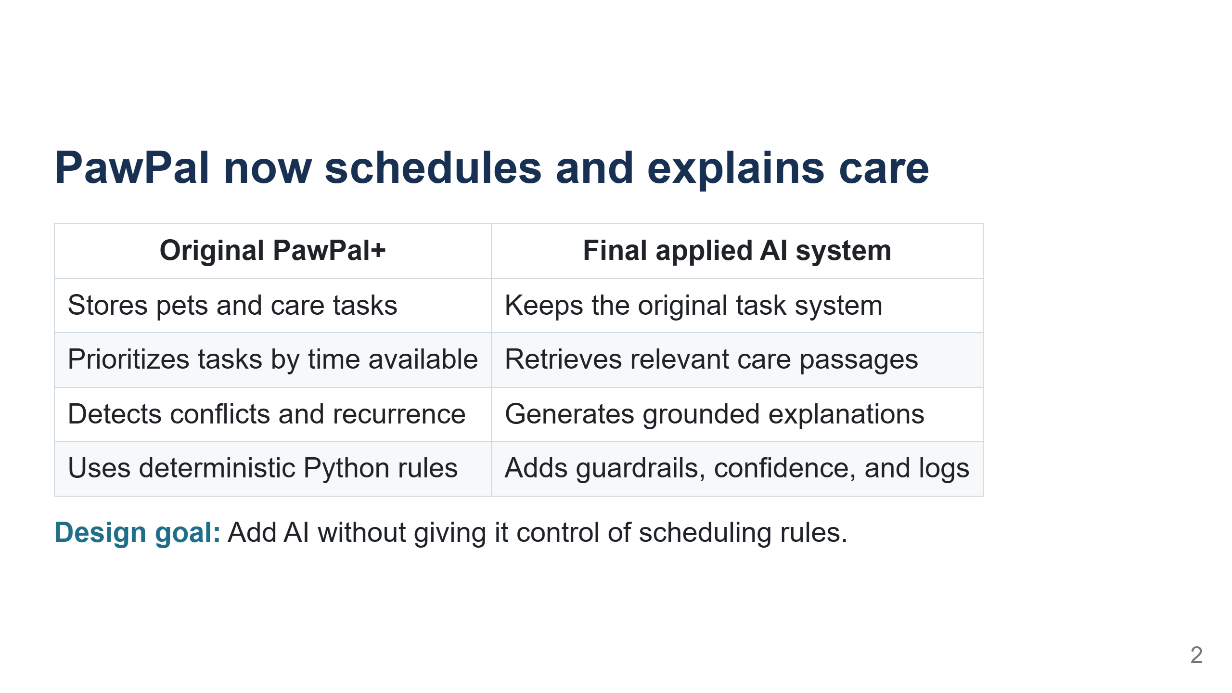
Notes:
Explain that the original Module 2 project already did useful scheduling and persistence. The upgrade keeps those strengths. The main new problem is helping an owner understand and follow the plan, while showing where the answer came from. [Sources] - https://github.com/hemalekamohanram/codepath-applied-ai-system-project/blob/main/README.md

Slide 3
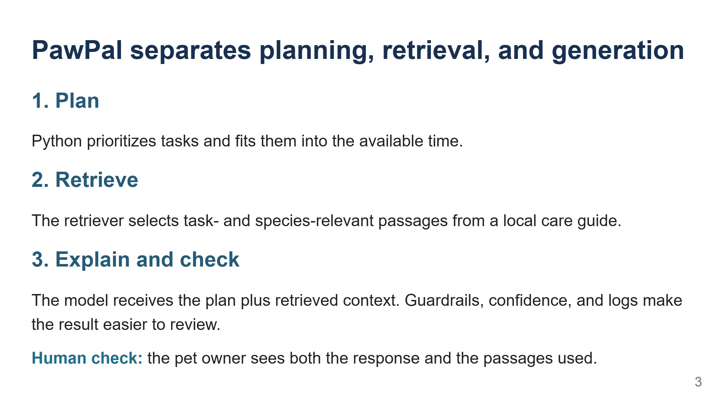
Notes:
Walk through the three components. Stress that retrieval is inside the prompt, so it changes what the model sees. Mention that emergency phrases stop before the model and that the owner remains part of the checking process. [Sources] - https://github.com/hemalekamohanram/codepath-applied-ai-system-project/blob/main/diagrams/architecture.mmd - https://github.com/hemalekamohanram/codepath-applied-ai-system-project/blob/main/pawpal_ai.py

Slide 4
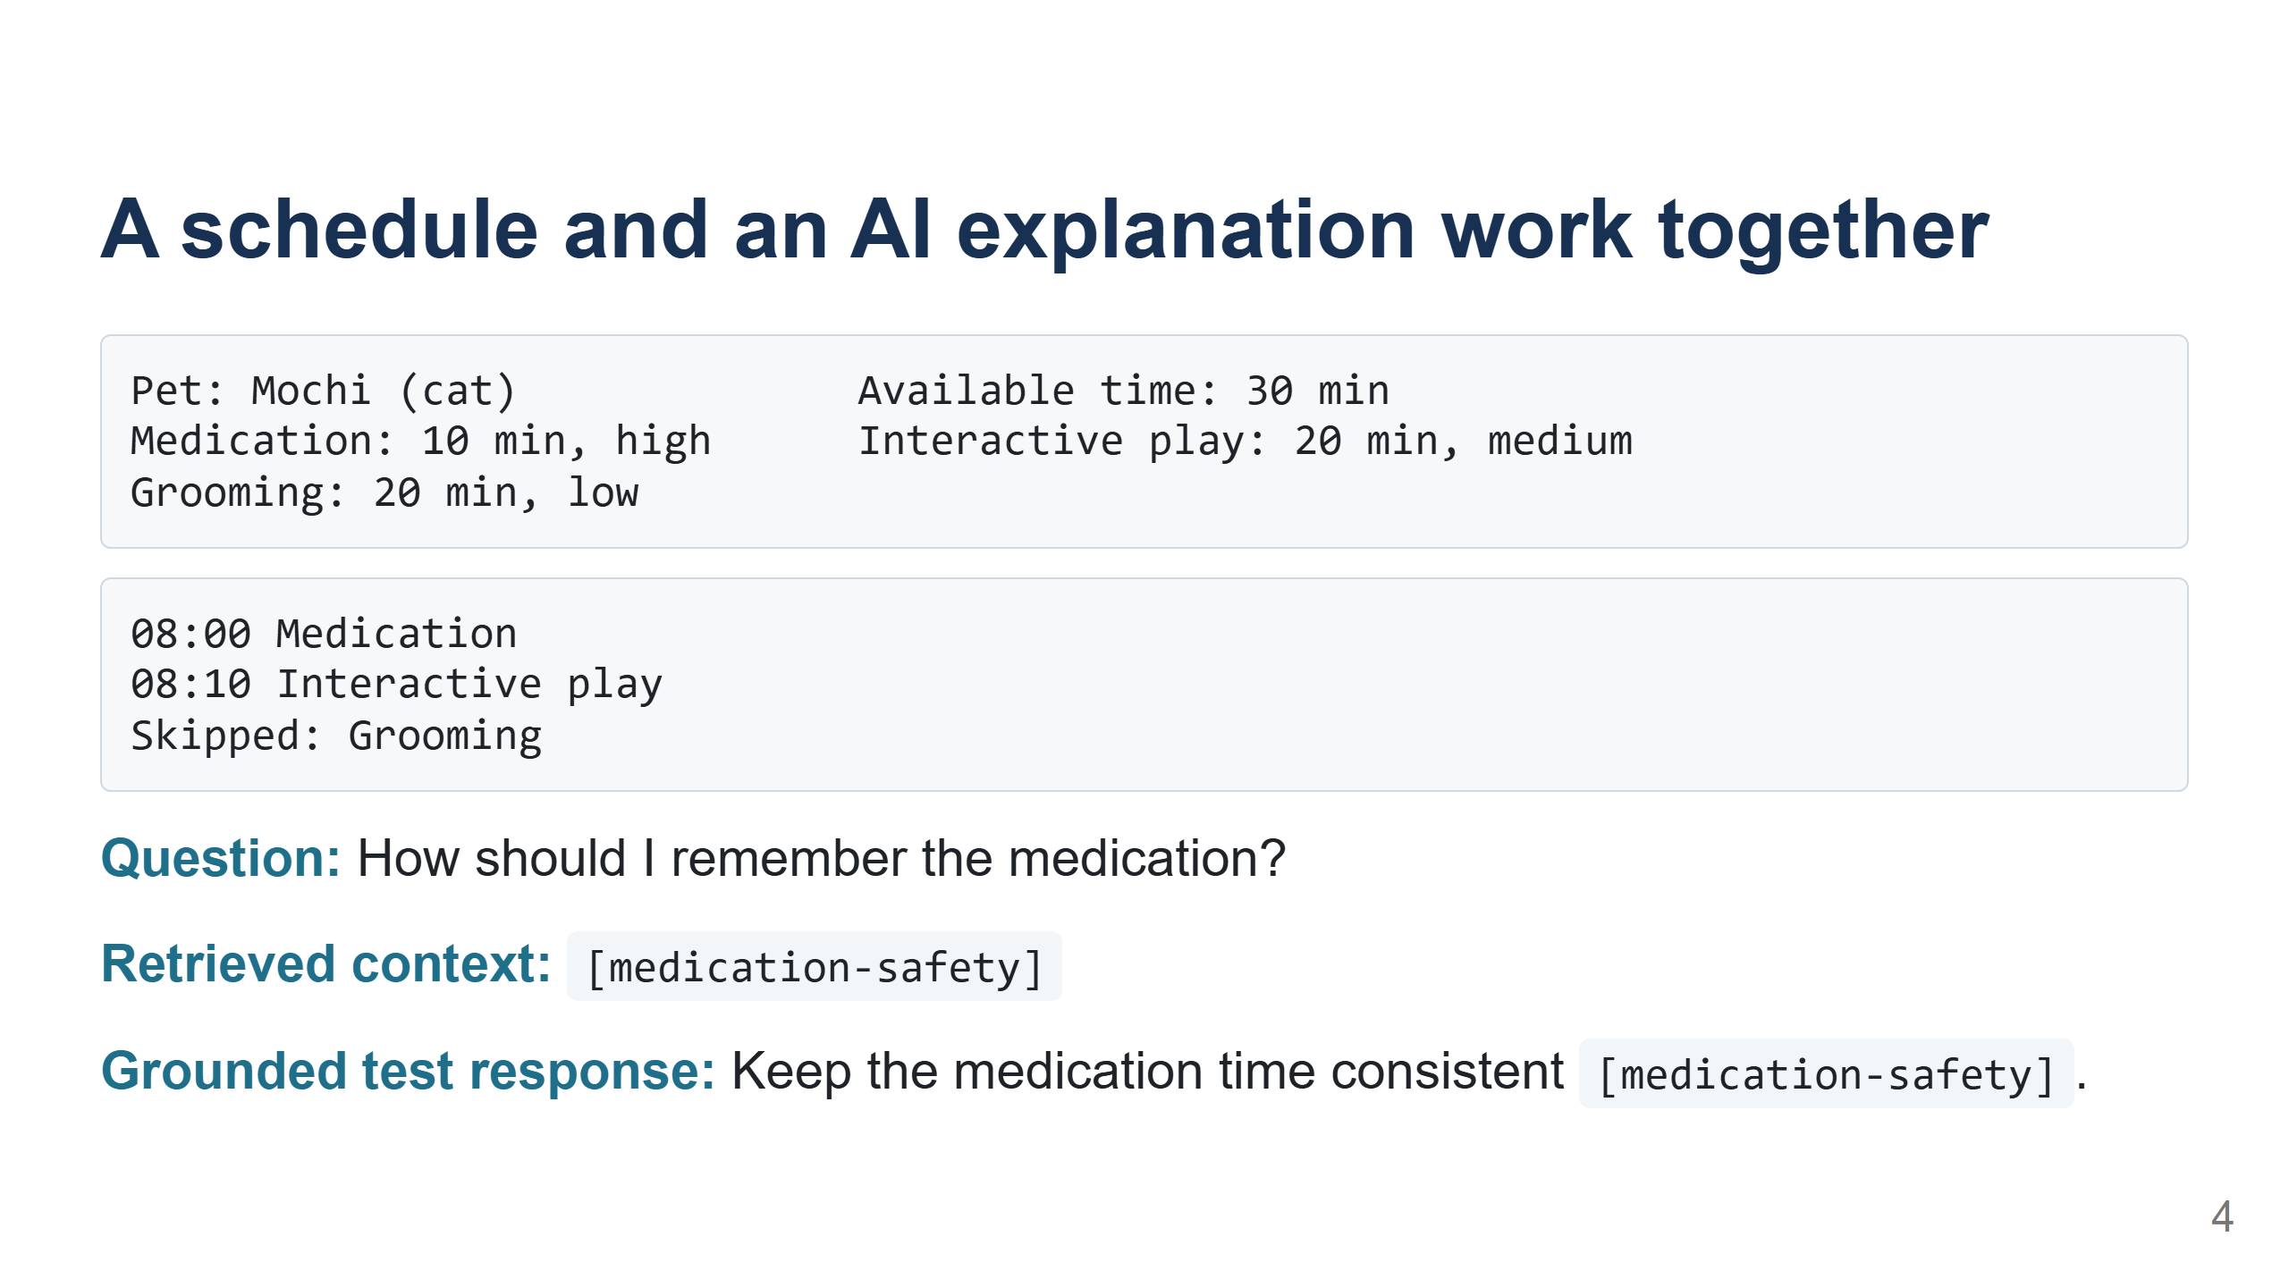
Notes:
Demo the schedule first, then the question. Point out which output comes from deterministic Python and which crosses the AI boundary. Be transparent that the displayed response is the mocked response used by the automated integration test; a live response requires an API key and its wording can vary. [Sources] - https://github.com/hemalekamohanram/codepath-applied-ai-system-project/blob/main/tests/test_pawpal_ai.py - https://github.com/hemalekamohanram/codepath-applied-ai-system-project/blob/main/README.md

Slide 5
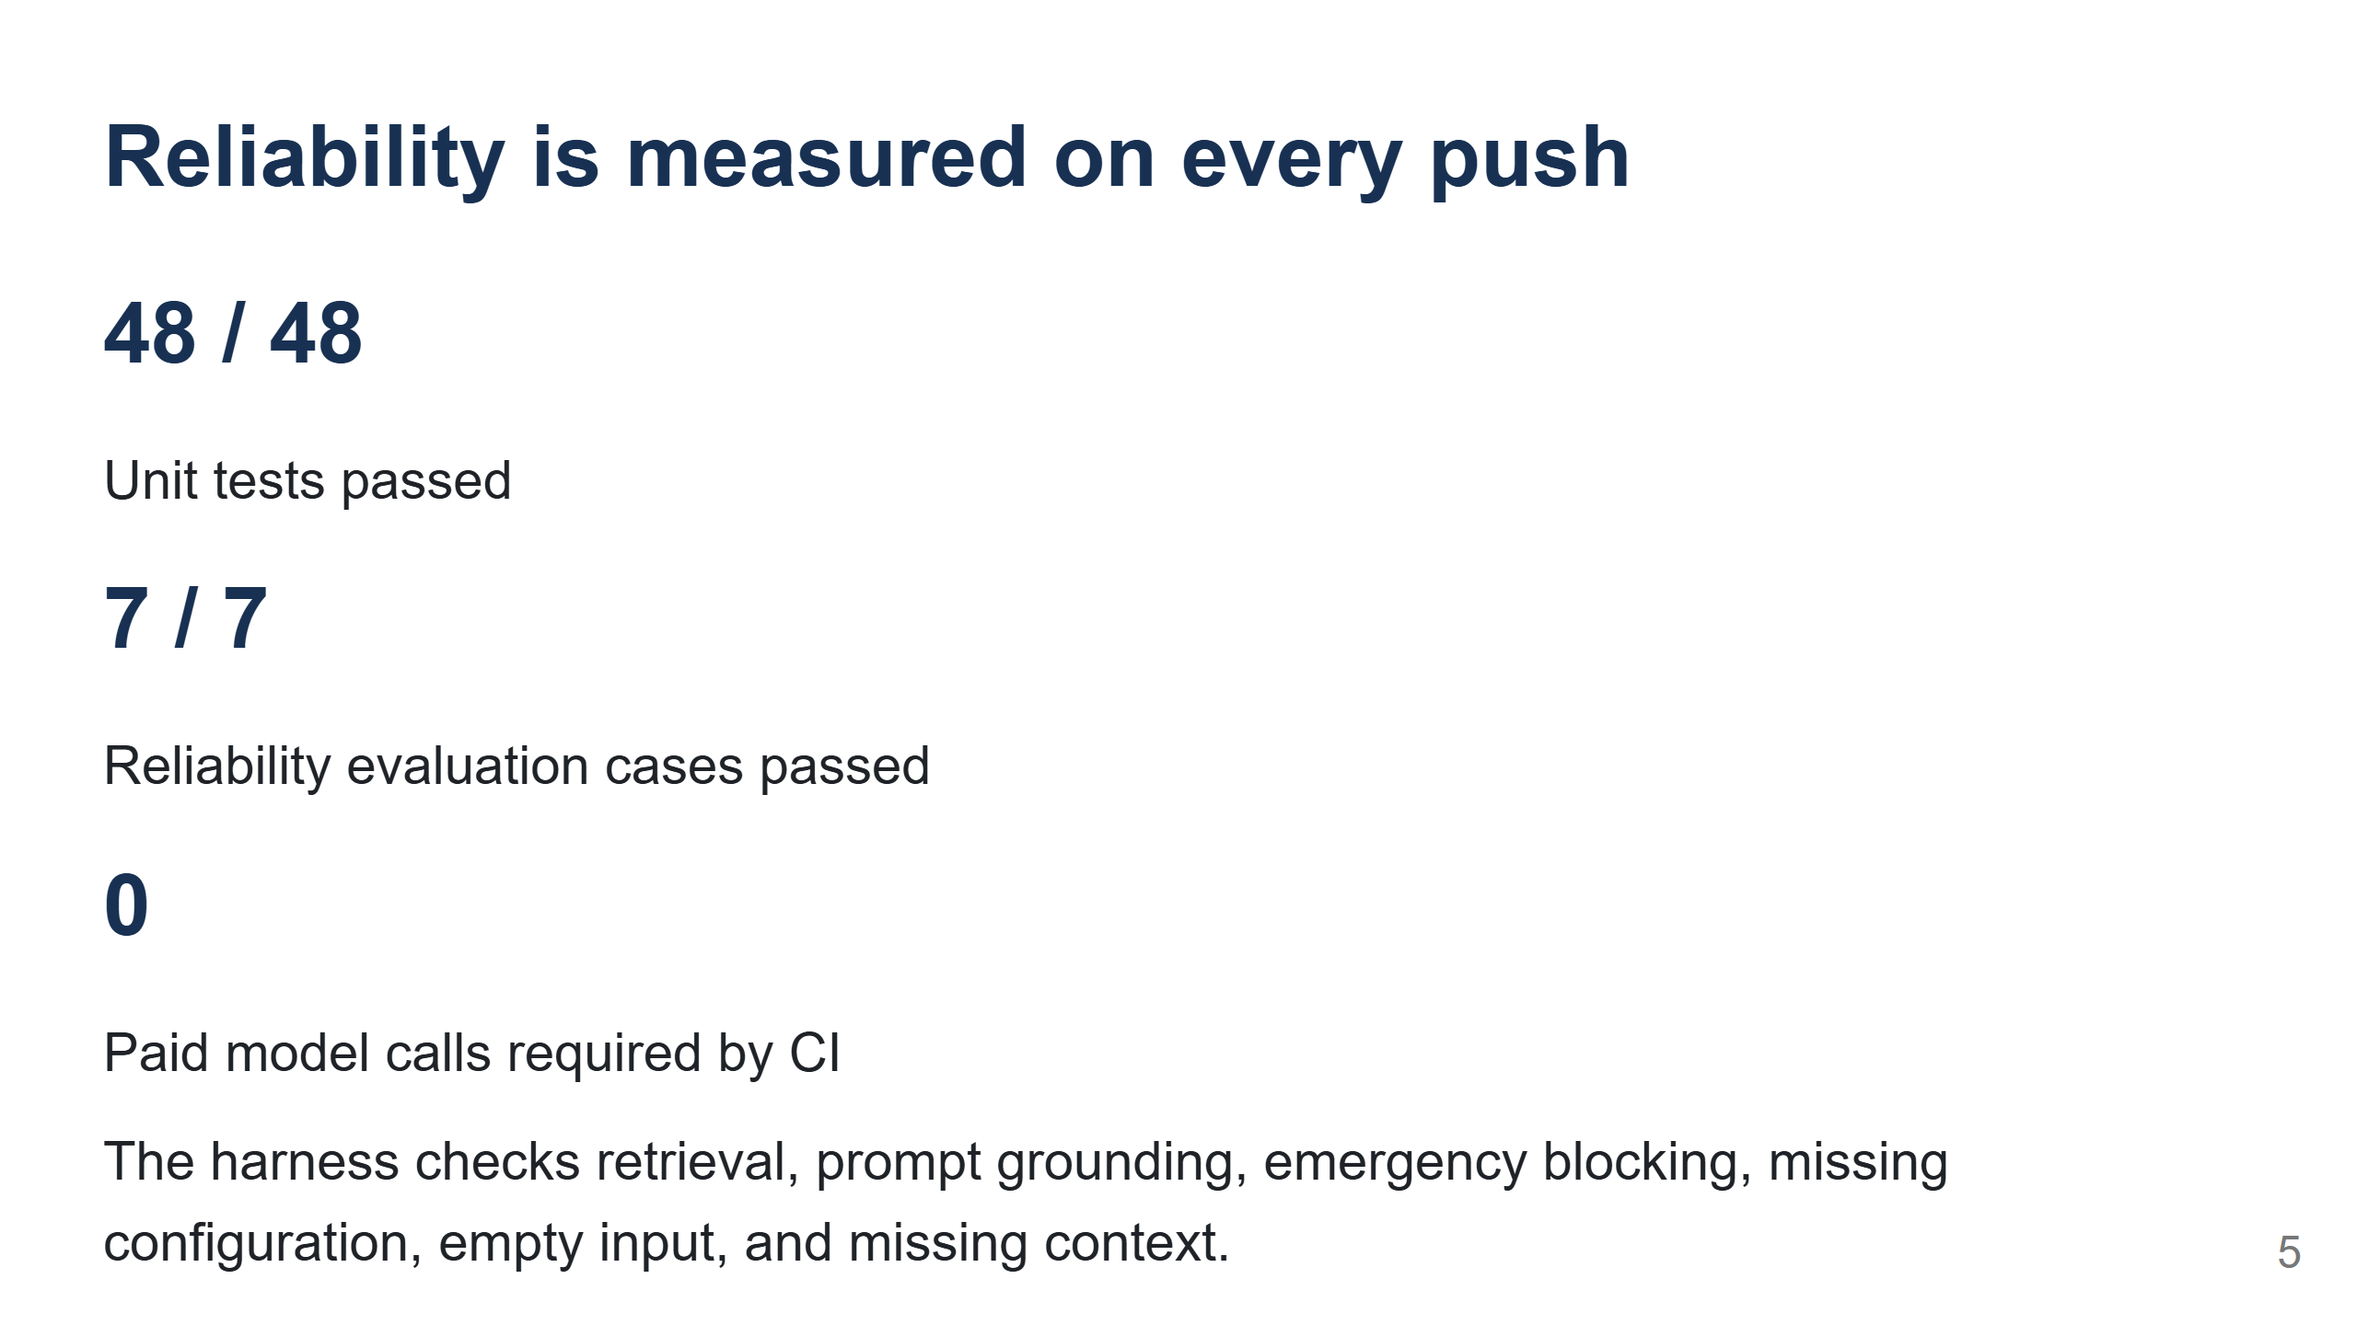
Notes:
Explain why the model is replaced with a fake client in CI: I can verify that the correct context reaches the model boundary without network variation or API cost. Be clear that this does not replace live response-quality evaluation. [Sources] - https://github.com/hemalekamohanram/codepath-applied-ai-system-project/actions/runs/30882975519 - https://github.com/hemalekamohanram/codepath-applied-ai-system-project/blob/main/evaluate.py

Slide 6
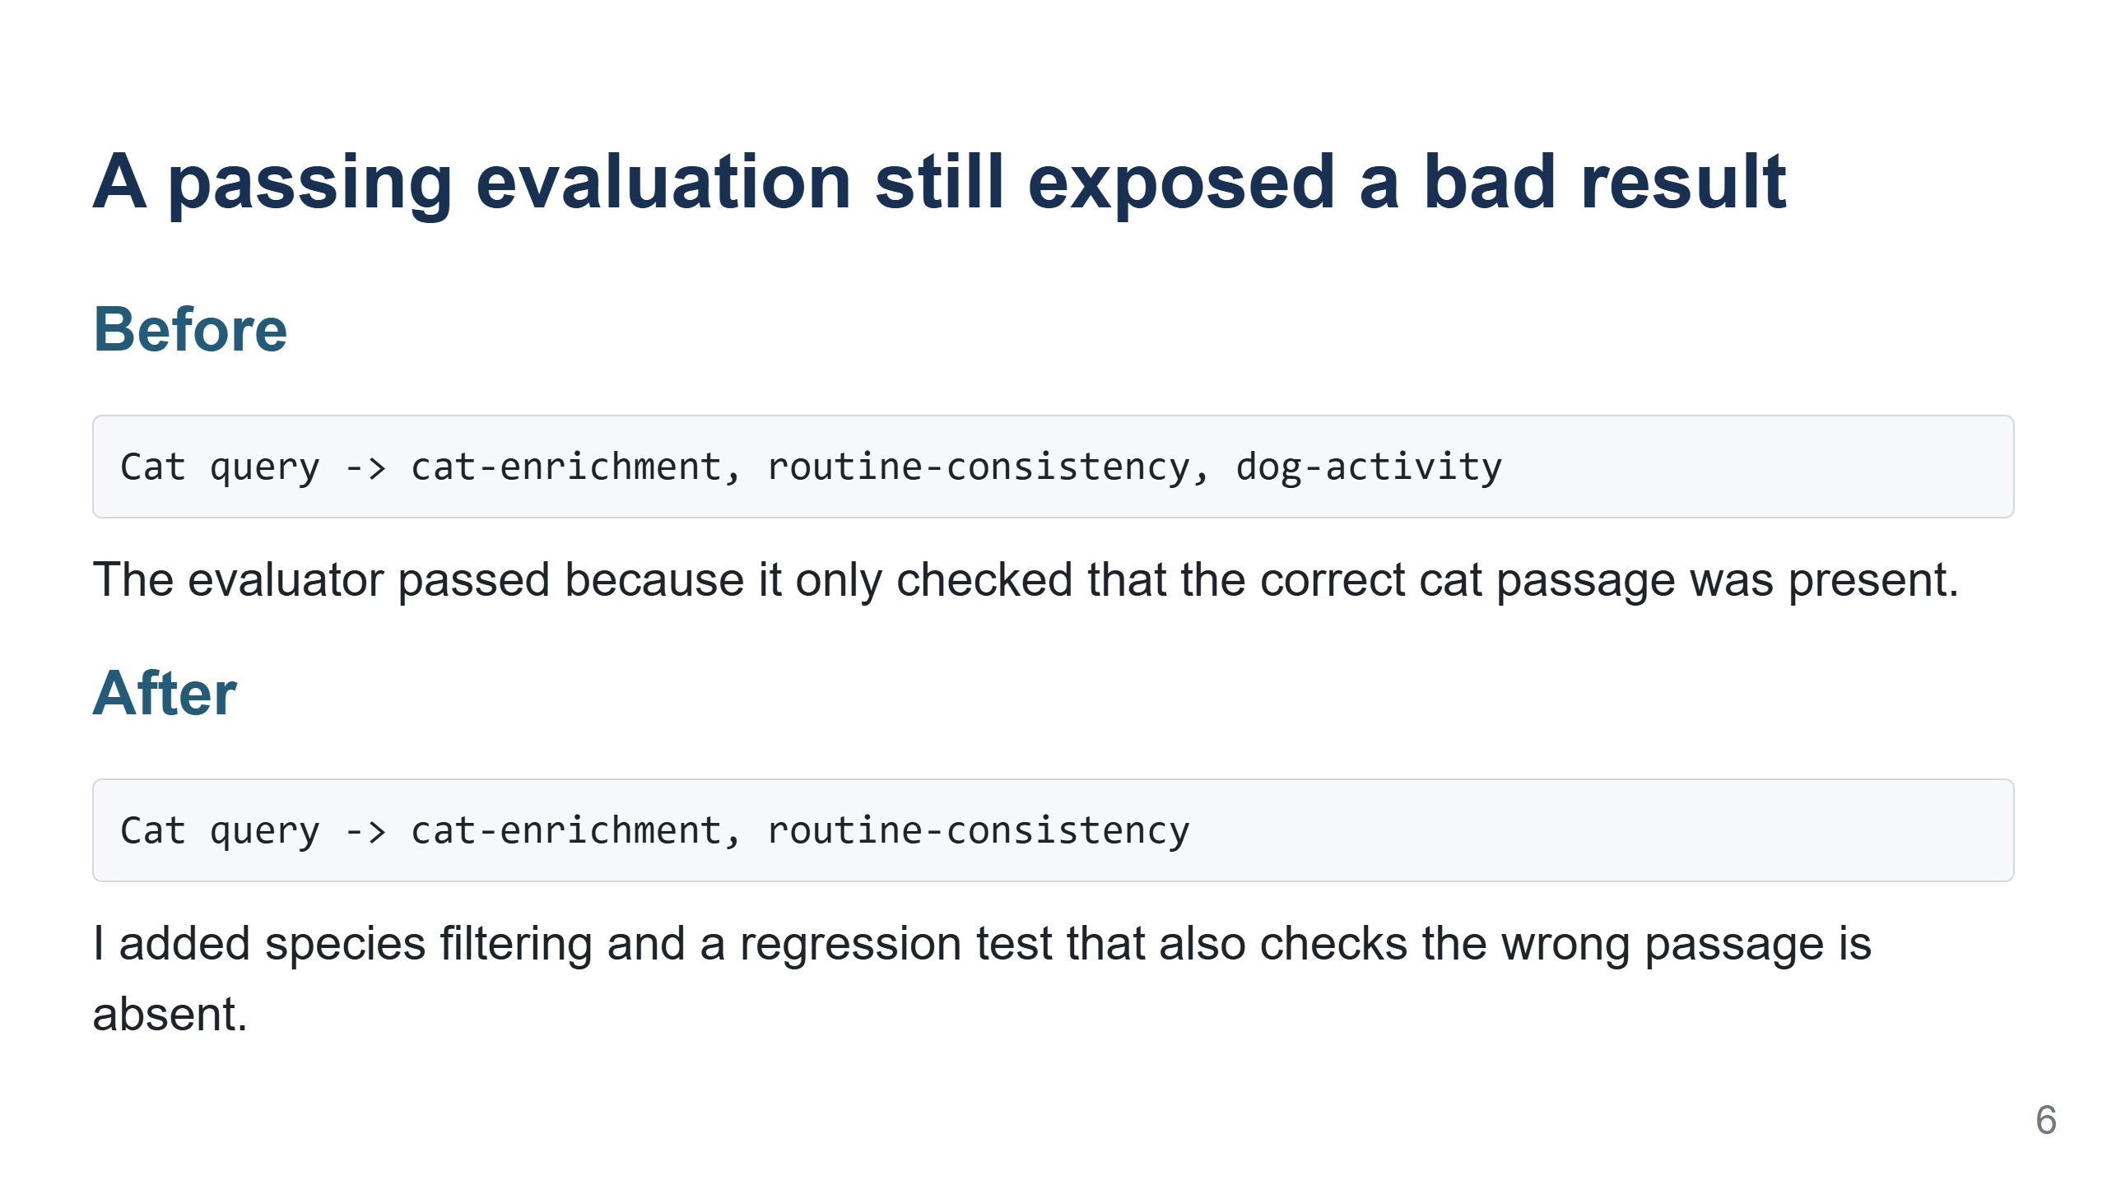
Notes:
This is the most important learning moment. The first total was 7 out of 7, but I read the details and noticed the dog passage. Explain the code fix and why evaluating unwanted behavior is as important as checking expected behavior. [Sources] - https://github.com/hemalekamohanram/codepath-applied-ai-system-project/blob/main/model_card.md - https://github.com/hemalekamohanram/codepath-applied-ai-system-project/blob/main/tests/test_pawpal_ai.py

Slide 7
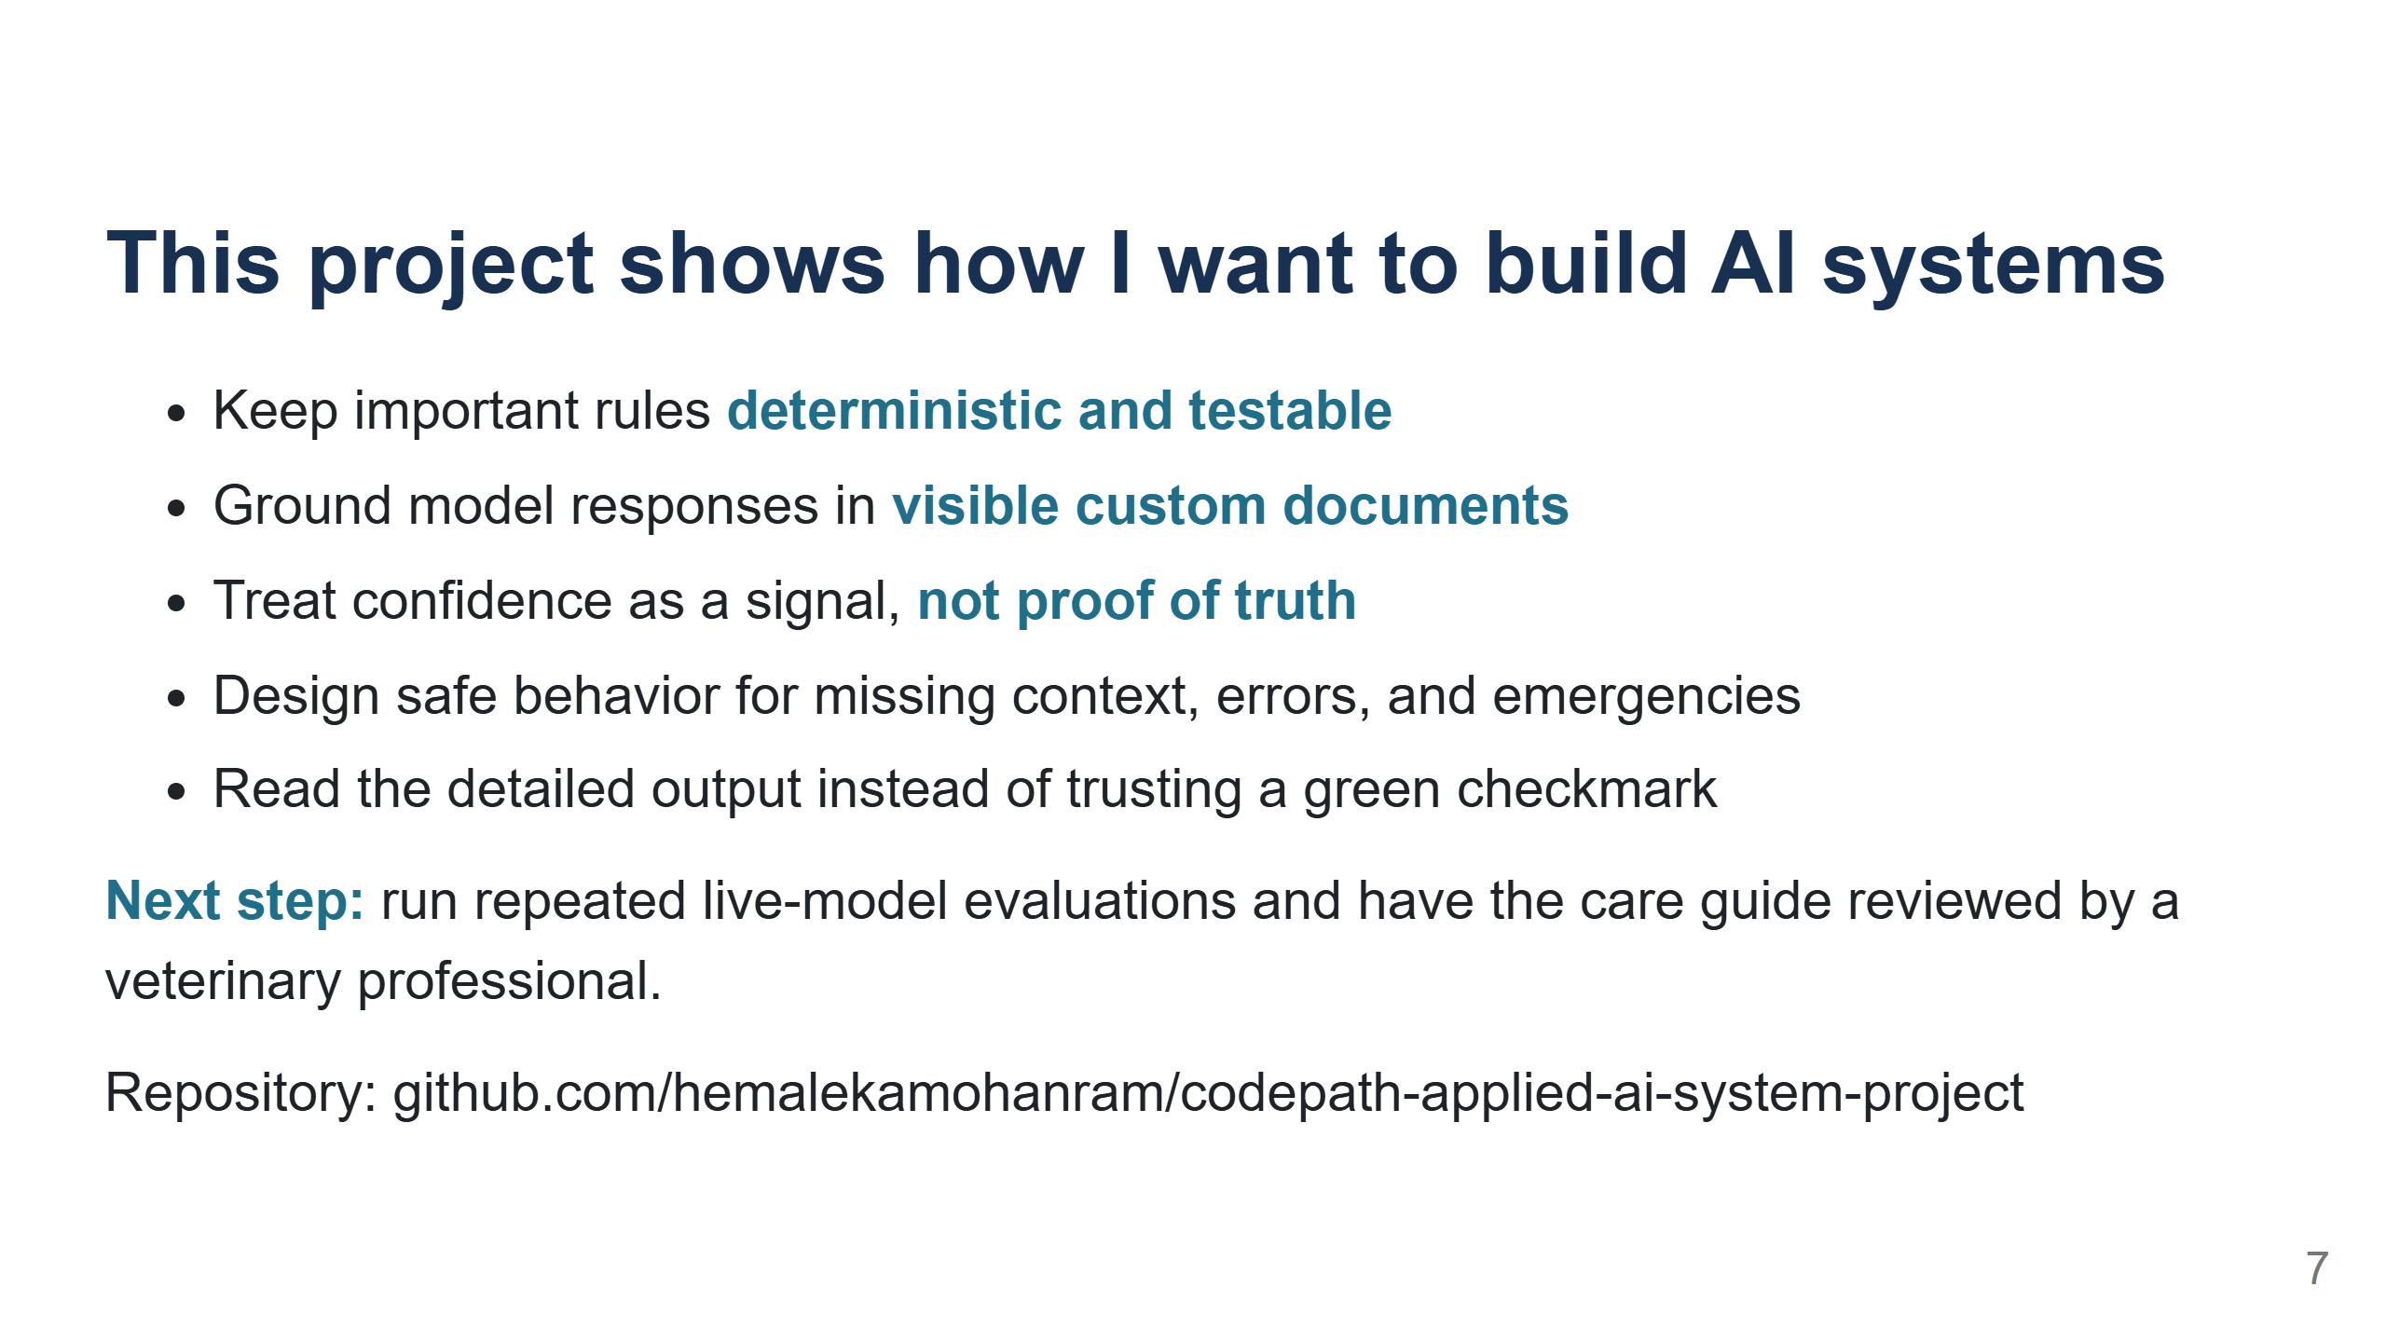
Notes:
Close by connecting the technical choices to what I learned as an aspiring AI engineer. I can build an end-to-end system, test it, find a weakness, fix it, and communicate its limits. The next step is live response evaluation and expert review, not adding more features. [Sources] - https://github.com/hemalekamohanram/codepath-applied-ai-system-project/blob/main/model_card.md - https://github.com/hemalekamohanram/codepath-applied-ai-system-project

