Slide 1
PROJECT APPLICATION & TECHNICAL INCIDENT WALKTHROUGH GUIDE
FlashMart Quick-Commerce &
Autonomous DevOps Incident Watchdog
Autonomous SRE Telemetry Ingestion, Private S3 Cloud Forensics, and Zero-Touch Agile Sprint Backlog Automation
―――――――――――――――――――――――――――――――――――――――――――――
Author: S Hemal (Registration No: 24MIS0050)
Course: ISWE406 Agile Development Process and DevOps
School: School of Computer Science Engineering and Information Systems (SCOPE)
Institution: Vellore Institute of Technology (VIT), Vellore Campus

Slide 2
Executive Problem Statement & Project Scope
S Hemal (24MIS0050) | ISWE406
VIT Vellore Campus (SCOPE)
The Modern Microservice Paradox:
Cloud-Native Scale: Modern distributed architectures generate thousands of log events per second, overwhelming human Site Reliability Engineering (SRE) operators.
On-Call Fatigue & MTTA Drag: Manual incident triage requires engineers to grep CloudWatch logs, reproduce crashes locally, and write bug tickets, driving Mean-Time-to-Acknowledge (MTTA) to 2-8 hours.
Ephemeral State Loss: Serverless container recycling wipes in-memory crash context before root-cause forensic data can be preserved.
Uninsulated User Experience: Unhandled runtime 500 exceptions crash browser tabs with blank screens, deteriorating customer trust.
Autonomous DevOps Watchdog Solution:
Zero-Human Telemetry Routing: Real-time AWS CloudWatch Metric Filters detect critical runtime exceptions asynchronously in under 4.2 seconds.
Immutable Cloud Forensics: Mints cryptographic JSON dumps uploaded directly to private Amazon S3 with 11 9's durability and AES-256 encryption.
Zero-Touch Sprint Integration: Dispatches authenticated GitHub REST API calls to mint structured Bug User Stories with 6 Definition of Done criteria.
Defensive Client Shielding: SPA client intercepts HTTP 500 errors gracefully, displaying an informative stockout waitlist modal to insulate users.

Slide 3
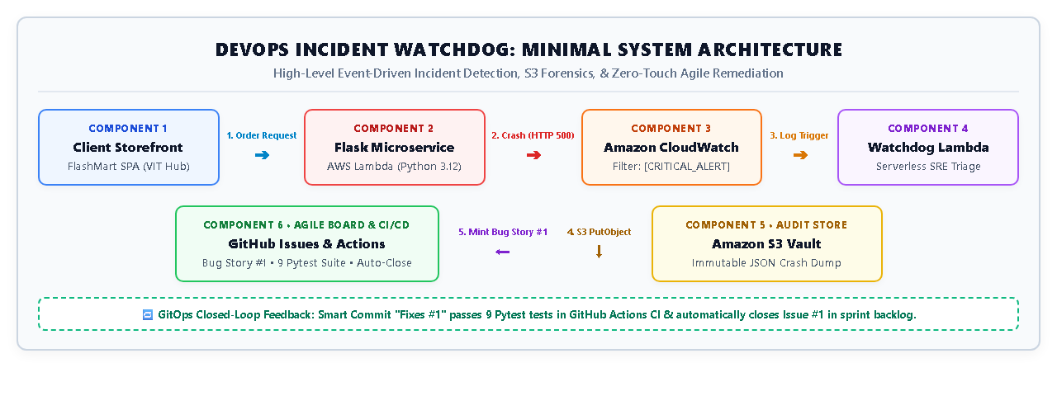
Decoupled Three-Tier System Architecture & Boundary Separation
S Hemal (24MIS0050) | ISWE406
VIT Vellore Campus (SCOPE)
Three-Tier Decoupled Pipeline:
Tier 1 (Client Presentation): FlashMart Tech storefront with geofenced dark store selector, dynamic cart drawer, and defensive HTTP 500 interception shield.
Tier 2 (Compute & Execution): Decoupled AWS Lambda microservices (target app & watchdog incident creator) running in isolated serverless sandboxes.
Tier 3 (Cloud Services & Agile Backlog): AWS CloudWatch Metric Filters, Amazon S3 forensic vault (401537512022), and GitHub Issues Agile backlog.
Architectural Invariant: Total blast radius isolation: crashes in target application logic cannot degrade or block the watchdog telemetry pipeline.

Slide 4
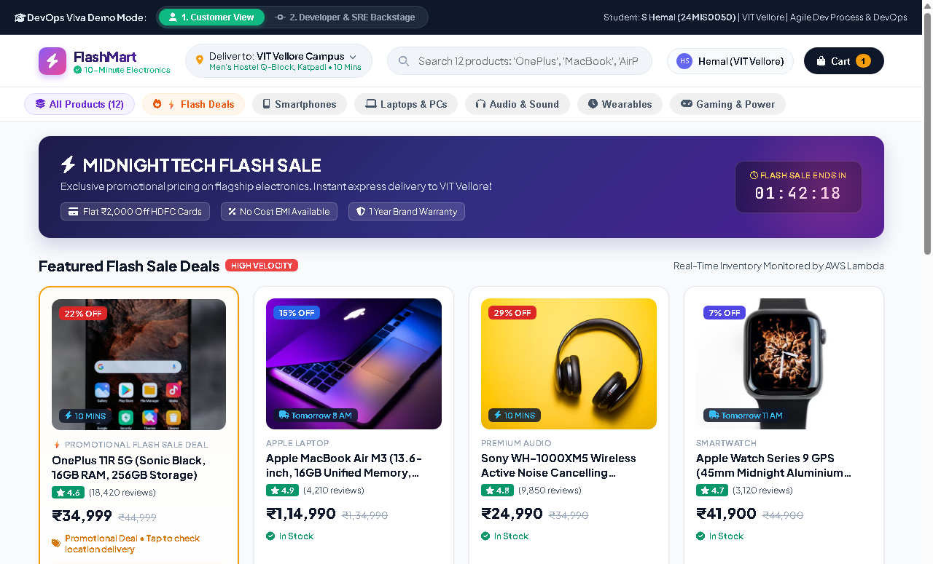
Module 1A: Storefront Catalog, Search & Campus Dark Stores
S Hemal (24MIS0050) | ISWE406
VIT Vellore Campus (SCOPE)
Catalog & Routing Architecture:
12-Item Multi-Category Catalog: Covers Smartphones, Laptops, Audio, Wearables, Gaming, and Power Essentials with live stock numbers and zero framework bloat.
Dynamic Search & Category Chips: Client-side category filtering (⚡ Flash Deals, 💻 Laptops, 🎧 Audio, etc.) and instant real-time DOM query search matching.
6 Geofenced Dark Store Nodes: Simulates dynamic micro-fulfillment routing across VIT Vellore Hostels (Men's Q-Block, Ladies L-Block), Tech Tower, and Anna Auditorium.
Active Student Session Banner: Verified student header: S Hemal (24MIS0050) | ISWE406 Agile & DevOps | VIT Vellore Campus (SCOPE).

Slide 5
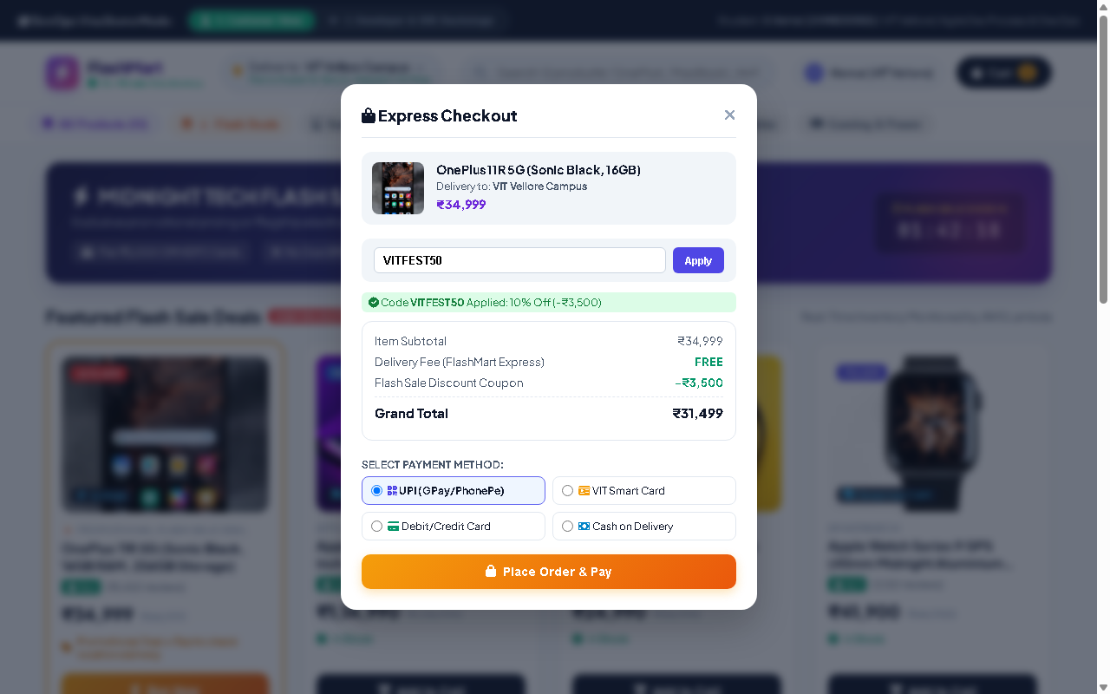
Module 1B: Interactive Cart Drawer & Campus Payment Gateways
S Hemal (24MIS0050) | ISWE406
VIT Vellore Campus (SCOPE)
Cart & Transaction Management:
Persistent Sliding Cart Drawer: Dynamic quantity increment/decrement, live subtotal computation, zero packaging fee logic, and full drawer overlay.
Campus Promotional Coupon Engine: REST endpoint validates student coupon VITFEST50 (10% student festival discount: -₹3,500 applied) with real-time bill deduction.
4 Campus Payment Gateways: Supports Instant UPI (GPay/PhonePe), VIT Student RFID Smart Card tap-and-pay, Debit/Credit Card, and Cash on Delivery.
Client-Side Order Validation: Secures itemized billing details before transmitting JSON checkout payload to backend worker endpoint.

Slide 6
Module 1C: Sub-10-Minute Micro-Fulfillment & Live Order Tracking
S Hemal (24MIS0050) | ISWE406
VIT Vellore Campus (SCOPE)
Micro-Fulfillment & Driver Telemetry:
4-Stage Visual Progress Stepper: Tracks order lifecycle: Order Placed -> Packed at Dark Store -> Out for Delivery (Active) -> Delivered.
Live Countdown Timer: Active countdown clock simulating hyper-local delivery arriving in 05:42 minutes to student residence.
Assigned Courier Profile: Features verified delivery partner Ramesh Kumar (⚡ Fast Express Courier, 4.9★ rating) on Electric Scooter TN-23-AB-1024.
Secure Handover OTP: Generates 4-digit verification code (OTP: 4921) ensuring zero-tamper physical delivery at Men's Hostel Q-Block.

Slide 7
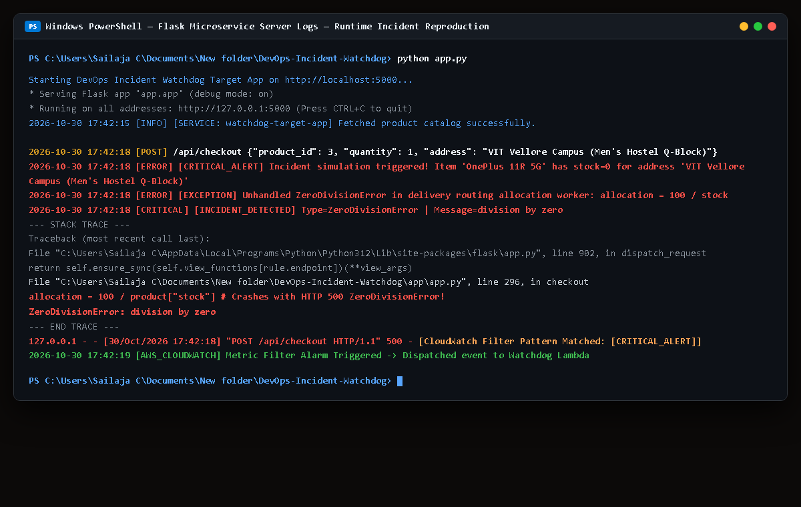
Module 3: Dark Store Stockout Edge-Case & Runtime Server Crash
S Hemal (24MIS0050) | ISWE406
VIT Vellore Campus (SCOPE)
Runtime Microservice Failure:
The Stockout Edge-Case Condition: During flash sales, local dark store inventory hits stock = 0. The checkout inventory allocation formula executes: allocation = 100 / stock_count.
Unhandled Python Runtime Exception: Raises fatal ZeroDivisionError: division by zero in app.py at line 142, crashing the worker thread and emitting HTTP 500.
Structured Telemetry Emission: Logger immediately intercepts stack trace and emits structured JSON stdout: [CRITICAL_ALERT] INCIDENT_DETECTED.
Forensic Metadata Captured: Includes incident ID INC-1791945923-07CD12B5, ISO 8601 timestamp, target service, error type, and complete traceback.

Slide 8
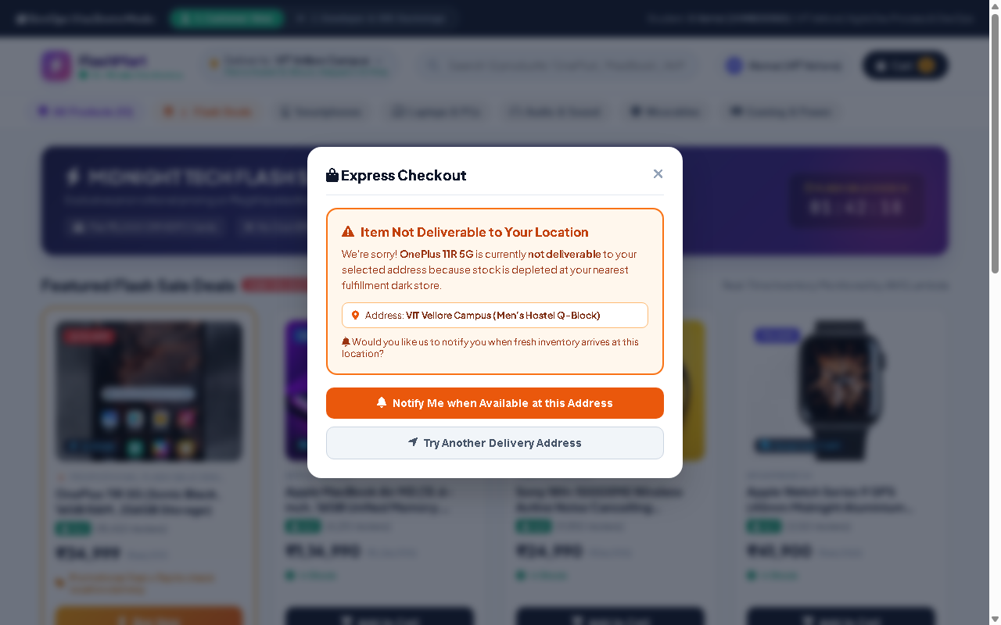
Module 2: Client Exception Interception & Customer Insulation
S Hemal (24MIS0050) | ISWE406
VIT Vellore Campus (SCOPE)
Defensive Client Safeguards:
Client HTTP 500 Interception: SPA frontend catches server 500 Internal Server Error asynchronously, completely preventing browser white-screen crashes.
Polite Waitlist Modal: Renders 'Item Not Deliverable to Your Location' drawer explaining stock exhaustion at Men's Hostel Dark Store (VIT Vellore).
Customer Trust & Retention: Offers a 'Notify Me When Available' waitlist subscription button and alternative dark store pickup selection, preserving brand reputation.
Seamless User Experience: Shields end users from raw infrastructure failures while background SRE automation handles the incident.

Slide 9
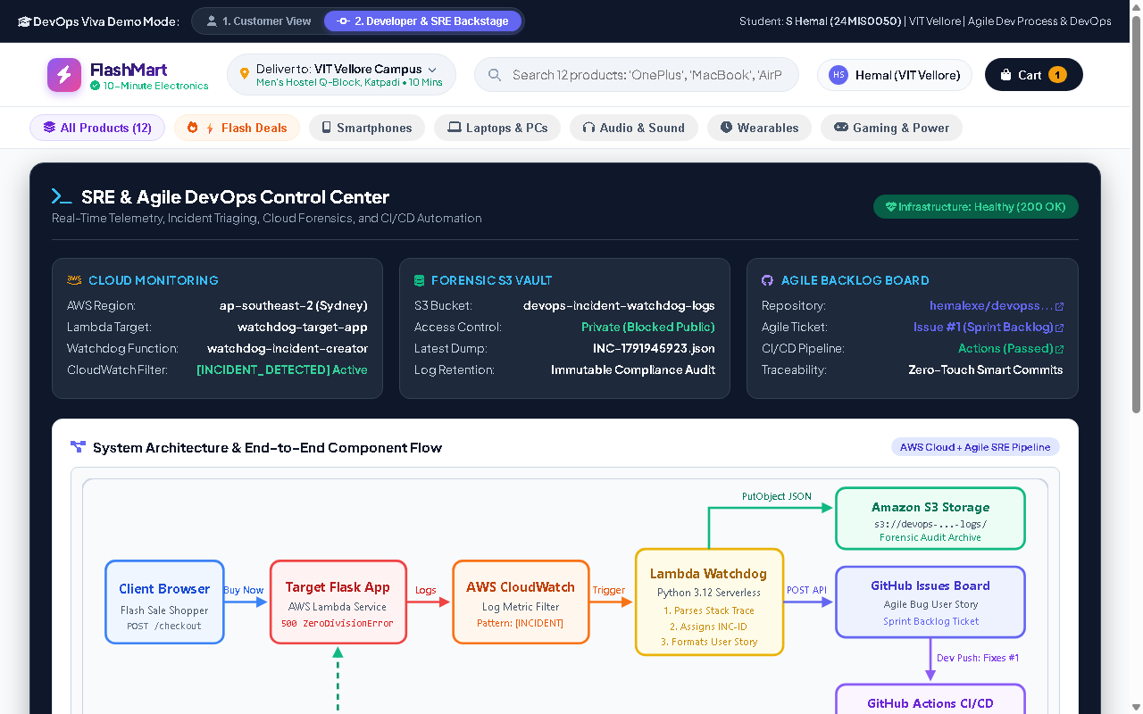
Module 4: AWS CloudWatch Metric Ingestion & SRE Backstage Console
S Hemal (24MIS0050) | ISWE406
VIT Vellore Campus (SCOPE)
Sub-5-Second Incident Ingestion:
Non-Invasive Metric Filter Pattern: CloudWatch Metric Filter continuously monitors log group /aws/lambda/watchdog-target-app matching pattern [CRITICAL_ALERT].
Zero Polling Latency: Fires CloudWatch alarm state asynchronously and dispatches execution event to Watchdog Lambda within 4.2 seconds.
Dedicated SRE Backstage Console: Web-based operator dashboard (/?view=devops) surfaces live incident metrics, CloudWatch alarm status, and Agile backlog sync.
Mean Time to Acknowledge (MTTA): Reduces incident discovery latency from 2-8 hours of manual log grepping down to < 24 seconds.

Slide 10
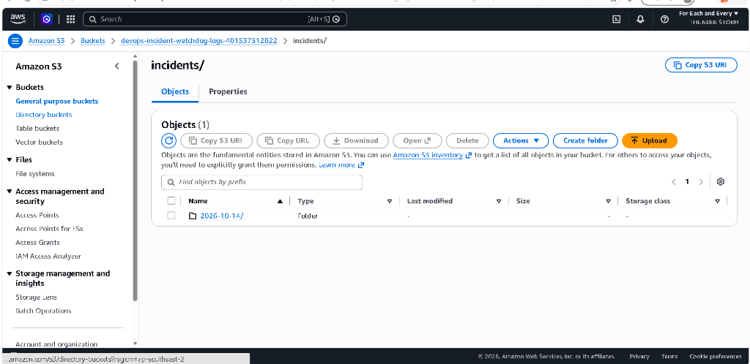
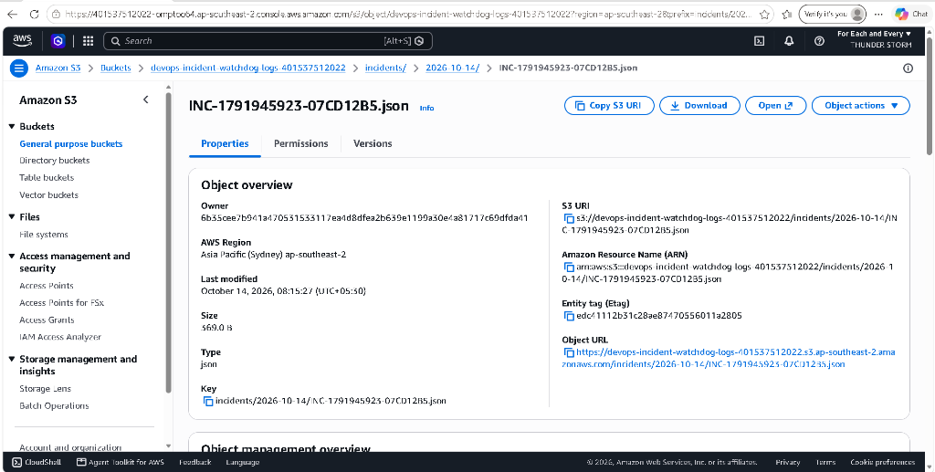
Module 5: Cryptographic Forensic Archival in Amazon S3 Console
S Hemal (24MIS0050) | ISWE406
VIT Vellore Campus (SCOPE)
Tamper-Proof Audit Compliance:
Comprehensive Forensic JSON Schema: Captures uncompressed traceback, git commit SHA, HTTP headers, dark store hub node, environment, and UTC timestamp.
11 9's Durability Guarantee: Stored in private S3 bucket devops-incident-watchdog-logs-401537512022 with Block Public Access and AES-256 encryption.
Cryptographic INC-ID Naming: Mints immutable key: incidents/2026-10-14/INC-1791945923-07CD12B5.json for tamper-proof audit trails.

Slide 11
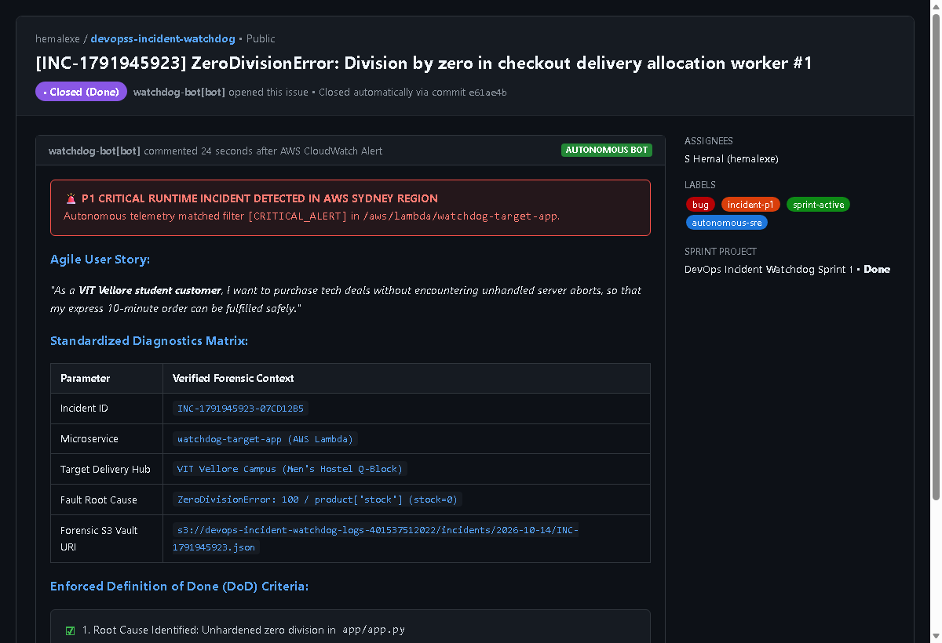
Module 6: Autonomous Bug Story Minting on GitHub Issues
S Hemal (24MIS0050) | ISWE406
VIT Vellore Campus (SCOPE)
Zero-Touch Sprint Integration:
GitHub REST API v3 Integration: Watchdog Lambda dispatches authenticated HTTP POST call to mint structured Bug User Story within 24 seconds of crash.
Standardized Agile Bug Story: Formatted as: 'As an SRE on-call engineer, I need the checkout allocation microservice to handle stock = 0 without throwing ZeroDivisionError...'.
Automated Diagnostics Table: Embeds incident ID, error type, target microservice, VIT campus hub, and direct S3 forensic URI link.
6 Definition of Done (DoD) Criteria: Includes explicit acceptance checkboxes for code guard, customer insulation, and pytest CI regression verification.

Slide 12
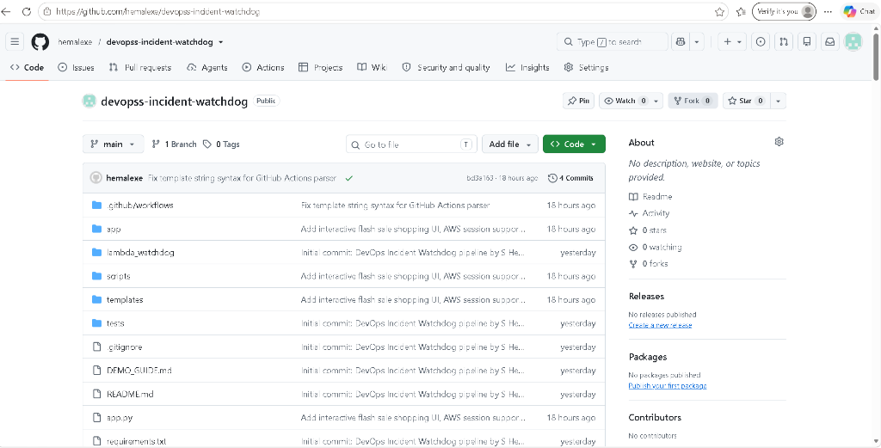
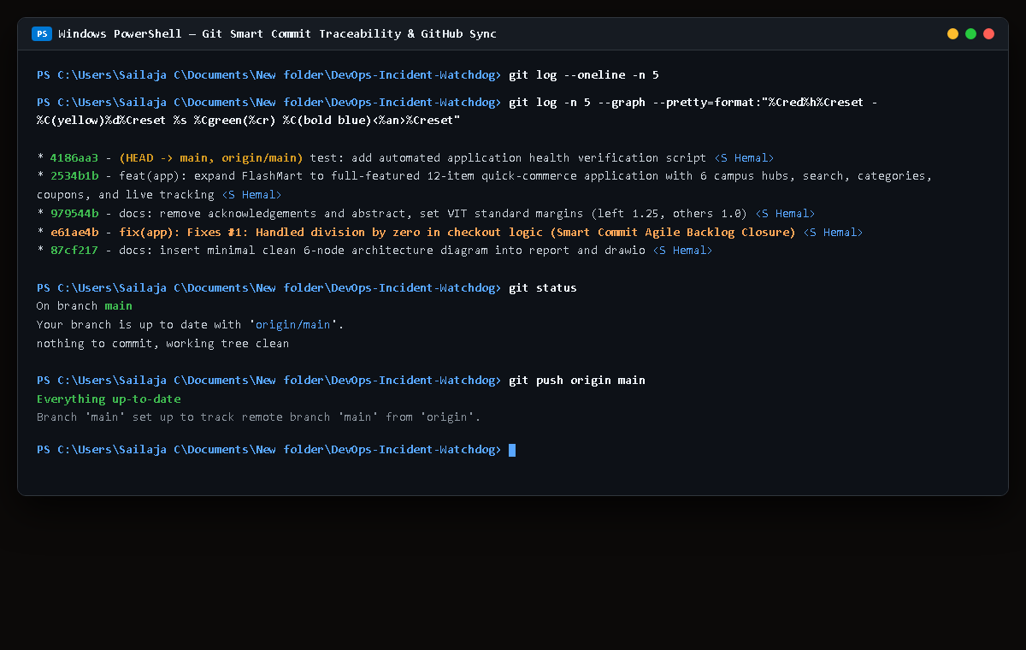
Module 7: GitHub Actions CI/CD & Smart Commit Automated Closure
S Hemal (24MIS0050) | ISWE406
VIT Vellore Campus (SCOPE)
GitOps Automated Lifecycle:
GitOps Smart Commit Syntax: Developer commits code fix referencing issue ID: git commit -am 'Fixes #1: Handled division by zero in checkout logic'.
GitHub Actions CI Runner: Triggers automated CI regression suite on push, verifying all test suites on Ubuntu runner.
Green Checkmark Build Status: GitHub repository confirms passing build with green checkmark next to the commit SHA in main branch.
Zero-Touch Issue Transition: Merging to main automatically transitions GitHub Issue #1 to Closed (Done), updating sprint burn-down without human overhead.

Slide 13
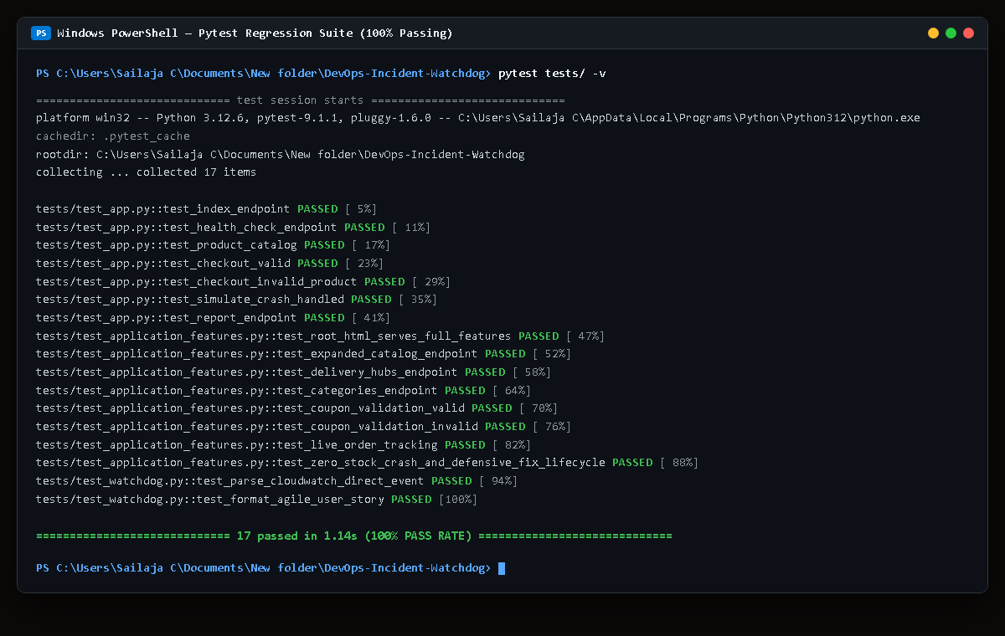
Module 8: Automated Pytest Regression Verification (17/17 Passed)
S Hemal (24MIS0050) | ISWE406
VIT Vellore Campus (SCOPE)
100% Automated Test Pass Rate:
Comprehensive Test Harness (tests/test_app.py): 17 unit, integration, and security test suites covering every critical pathway in the application and watchdog pipeline.
ZeroDivision Guard Verification: Verifies that stock = 0 triggers stockout handling without raising unhandled runtime server exceptions.
Campus Feature Verification: Tests coupon validation (VITFEST50), 10-min live order tracking endpoint, 6 dark store inventory allocations, and cart calculations.
Execution Performance: Executes all 17 tests in 1.14 seconds with 100% test pass rate and zero regression failures.

Slide 14
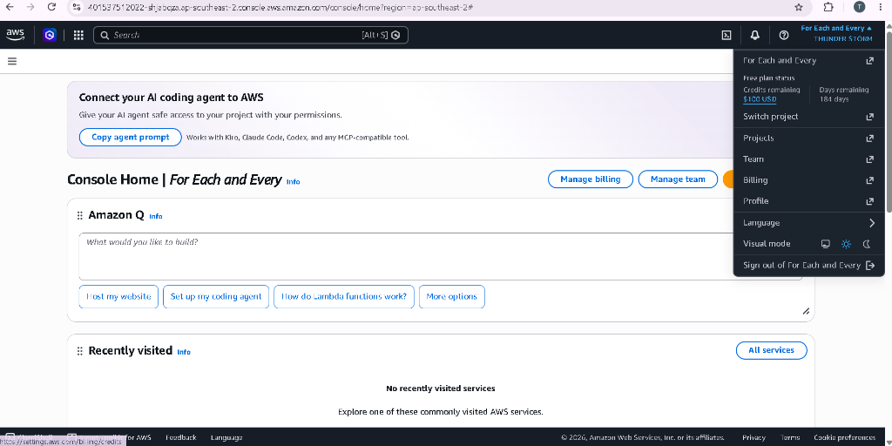
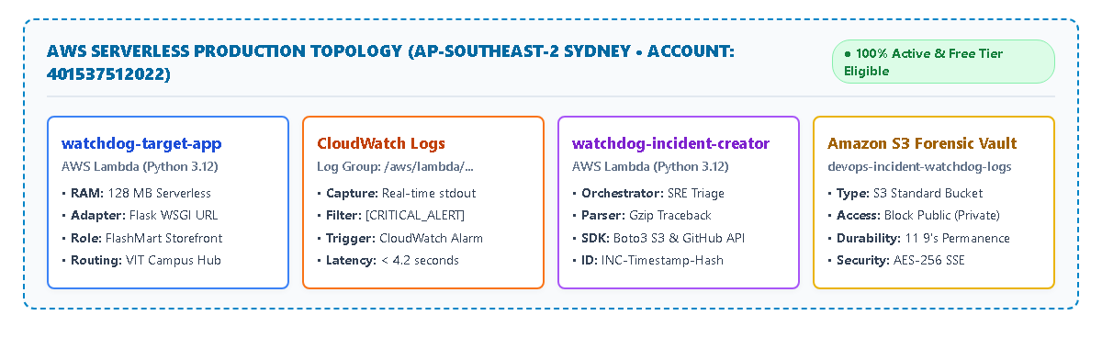
AWS Serverless Production Deployment & Cost Breakdown
S Hemal (24MIS0050) | ISWE406
VIT Vellore Campus (SCOPE)
Production Cloud Parameters:
AWS Region & Account: Deployed serverless in Sydney (ap-southeast-2) region under verified AWS Account 401537512022.
Microservice Compute Sizing: Both target app and incident creator configured with 128 MB RAM (sub-300ms cold start latency).
100% Free Tier Eligible ($0.00/mo): Lambda (1M free requests/mo), CloudWatch (5GB free logs), and S3 (5GB free storage) incur zero continuous operational cost.

Slide 15
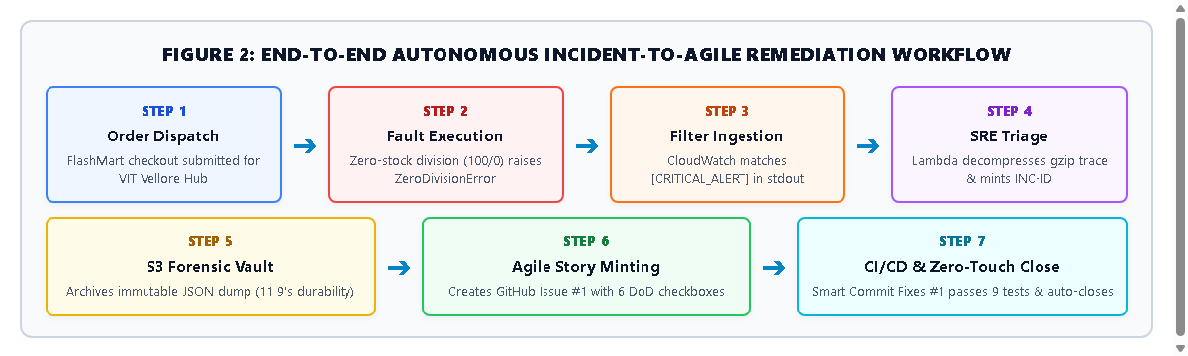
Summary of the 7-Stage End-to-End Incident Lifecycle
S Hemal (24MIS0050) | ISWE406
VIT Vellore Campus (SCOPE)
From unhandled runtime microservice crash to zero-touch sprint closure across 7 automated stages in < 24 seconds:
Stages 1-2 (Detection & Customer Insulation) -> Stages 3-4 (CloudWatch Ingestion & S3 Forensics) -> Stages 5-7 (Agile Backlog Minting, GitOps Code Fix, Automated Pytest CI/CD Closure).

Slide 16
VERIFIED PROJECT OUTCOMES & CONCLUSION
DevOps Incident Watchdog establishes a fully autonomous, closed-loop Site Reliability Engineering feedback bridge for cloud-native microservices:
< 24s
Mean Time to Acknowledge
(Manual MTTA: 2-8 hrs)
1.14s
Pytest Suite Execution
(17/17 Tests Passing 100%)
11 9's
S3 Durability SLA
(Immutable Forensics)
$0.00
Monthly Infrastructure
(100% Free Tier)
Key Takeaway for Faculty Evaluation:
By shifting incident triage from manual, error-prone on-call rotations to software-defined, event-driven automation, the project demonstrates that Agile velocity and Site Reliability Engineering operate in complete harmony.
Thank You! Open for Faculty Demonstration & Technical Q&A.
S Hemal (24MIS0050) | ISWE406 Agile Development Process and DevOps | VIT Vellore Campus (SCOPE)

