Slide 1
Liqueo
Knowledge Discovery & Reuse for Financial Consultants

Slide 2
System Overview
✓ Intelligent knowledge management system
✓ Semantic search using AI embeddings
✓ Industry-specific trend analysis
✓ Engagement recommendation engine
✓ Multiple operating modes for flexibility
✓ Support for multi-format document upload

Slide 3
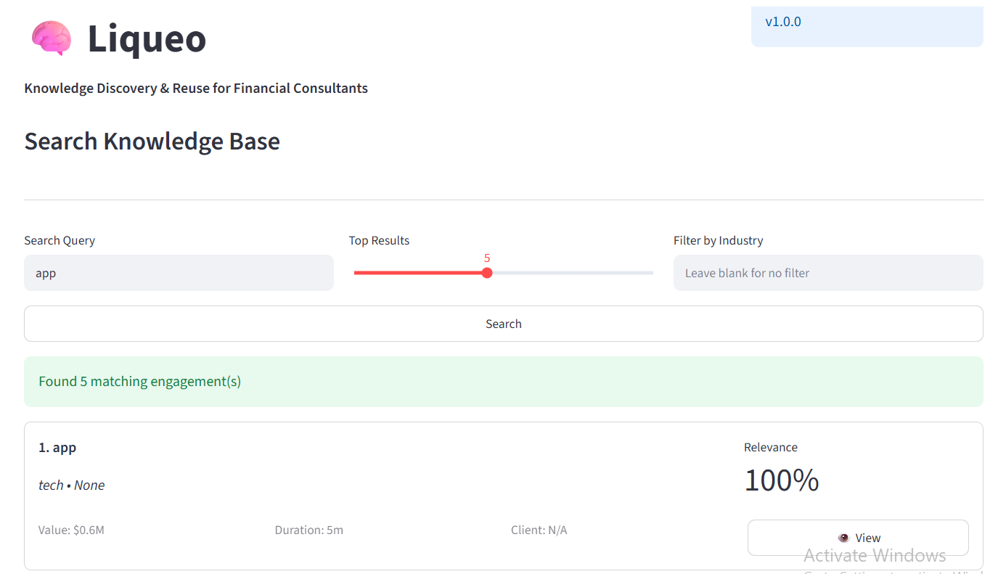
Home Interface
Central hub for all knowledge functions
Clean, professional navigation bar
Quick access to all major modules
Version tracking (v1.0.0)
Consistent branding and layout
Ready for integration into consulting workflows

Slide 4
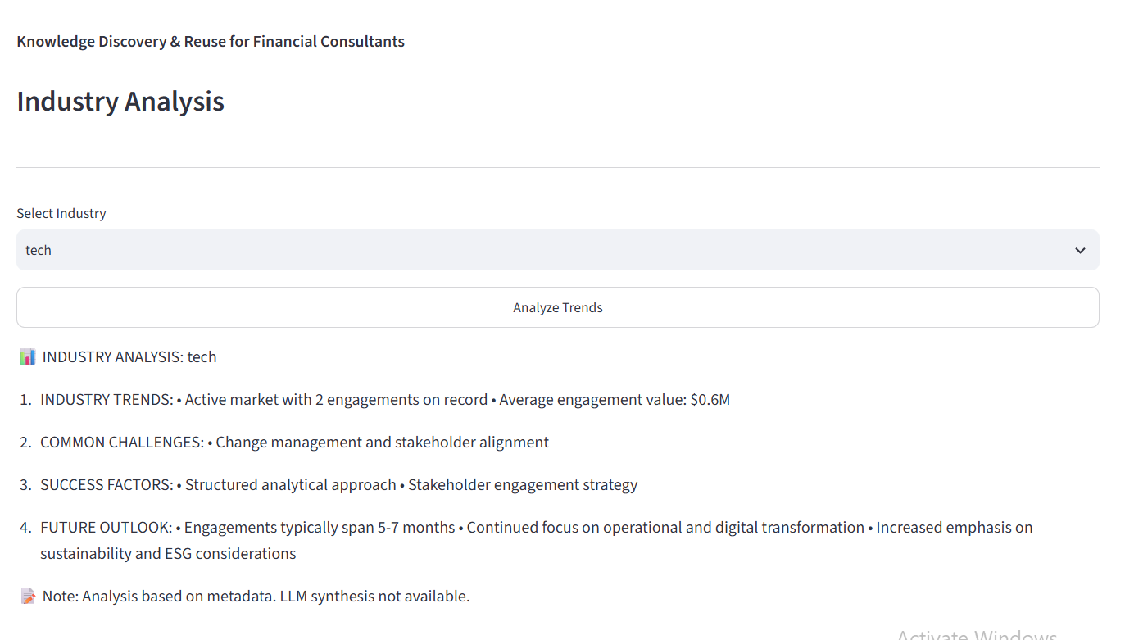
Adding Engagements: Step 1 - Metadata
• Enter engagement title and description
• Select industry (Technology, Finance, etc.)
• Choose transaction type (M&A, Restructuring)
• Input engagement value in millions
• Specify duration in months
• Reference client name for context

Slide 5
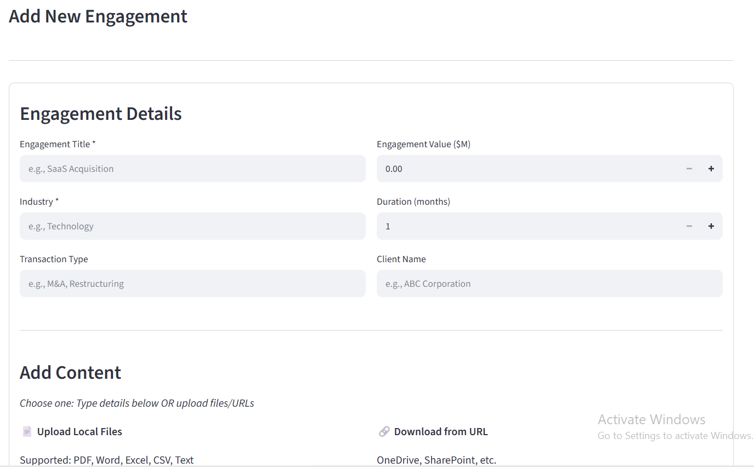
Adding Engagements: Step 2 - Content
• Upload local files (PDF, Word, Excel, CSV, Text)
• Import from cloud services (OneDrive, SharePoint)
• Support for multiple documents per engagement
• Automatic text extraction and indexing
• Asynchronous processing keeps UI responsive
• Full content searchability immediately upon completion

Slide 6
Searching Knowledge Base
• Natural language query support
• Adjustable result count (1-5 matches)
• Optional industry filtering
• Relevance scoring (0-100%)
• Instant results display with metadata
• Semantic + keyword search methods

Slide 7
Search Results Explained
Each result shows:
• Engagement title and industry classification
• Financial value and project duration
• Client organization reference
• Relevance score (% match quality)
• 'View' button for full engagement details
• Ranked by relevance for quick scanning

Slide 8

Industry Analysis
• Select industry to analyze
• Click 'Analyze Trends' for insights
• Get current market activity metrics
• Identify common industry challenges
• Discover proven success factors
• Understand future outlook and opportunities

Slide 9
Analysis Output Example
<b>Technology Industry Analysis:</b>
• Active market: 2 engagements recorded
• Avg value: $0.6M per engagement
• Key challenges: Change mgmt, stakeholder alignment
• Success factors: Analytical approach + stakeholder engagement
• Timeline: Typical 5-7 month engagements
• Focus areas: Digital transformation, operational efficiency

Slide 10
System Architecture
<b>Presentation Layer:</b> Streamlit UI + CLI
<b>Business Logic:</b> Workflow engine, recommendations
<b>Service Layer:</b> AI embeddings, LLM synthesis
<b>Data Layer:</b> JSON-based document storage
Layered architecture ensures scalability and flexibility

Slide 11
Operating Modes
<b>Full Mode:</b> Both APIs available - Maximum capability
Semantic search + AI synthesis for insights
<b>Hybrid Mode:</b> Single API available
Balanced search and synthesis capability
<b>Manual Mode:</b> No APIs - Keyword search only
All documents searchable by title and metadata

Slide 12
Quick Start: 5 Steps
1. <b>Install:</b> Clone repo → pip install requirements
2. <b>Configure:</b> Add API keys to .env (optional)
3. <b>Launch:</b> streamlit run app.py
4. <b>Add Content:</b> Upload your first engagement
5. <b>Search:</b> Find similar engagements instantly
Be productive with your knowledge in minutes!

Slide 13
Best Practices
✓ Use consistent naming for engagements
✓ Include comprehensive metadata
✓ Write descriptive search queries
✓ Use industry filters for focused results
✓ Review industry analysis before proposals
✓ Monitor API usage for cost management

Slide 14
Supported Features
📄 <b>Document Types:</b> PDF, Word, Excel, CSV, Text
🔍 <b>Search Methods:</b> Semantic + Keyword
📊 <b>Analyses:</b> Industry trends, success factors, challenges
💾 <b>Storage:</b> JSON-based, locally persistent
🔄 <b>Deployment:</b> Single-machine, scalable to vector DB
⚡ <b>Performance:</b> Sub-second search on thousands of docs

Slide 15
Production Roadmap
<b>Phase 1-2:</b> Vector database integration (Pinecone/Weaviate)
<b>Phase 3-4:</b> PDF/Word parsing, collaborative features
<b>Phase 5-6:</b> Industry-specific templates, custom embeddings
<b>Phase 7-8:</b> Multi-user permissions, CRM integration
Continuously evolving to meet consultant needs

Slide 16
Support & Contact
📧 Questions: hemalp1434@gmail.com
🐙 Repository: github.com/hemalp143/Liqueo
📖 Documentation: Full guides and examples included
For technical support or feature requests,
reach out to the development team directly.

