Slide 1
LOW-FREQUENCY,LONG-RANGE COMMUNICATION IN CRITICAL SITUATIONS USING LoRa

Slide 2
INTRODUCTION
The vast majority of our planet is covered by water, and exploring and monitoring the underwater environment is crucial for various industries such as marine research, offshore oil and gas, environmental monitoring, and underwater robotics. However, traditional wired communication systems are impractical for these applications due to their limitations in terms of flexibility, mobility, and cost.
Underwater wireless communication using LoRa has emerged as a promising solution to overcome these challenges. It enables the exchange of data and information between submerged devices without the need for physical connections.
In this study, we focus on the design and implementation of an underwater wireless communication system. The goal is to develop a reliable and efficient method for transmitting data underwater enabling real-time communication between underwater devices.

Slide 3
ABSTRACT
Underwater wireless communication is a challenging field that has the potential to revolutionize various industries such as oceanographic research, environmental monitoring, and offshore oil and gas exploration. This project explores the design and implementation of an electromagnetic underwater communication system using the Atmega328 microcontroller which is a included in Iot.
The system consists of a transmitter and a receiver that communicate wirelessly using electromagnetic waves. The transmitter consists of a microcontroller, a signal generator, a voltage amplifier, temperature sensor, heartbeat sensor and an antenna, while the receiver includes a demodulator, a filter, and a microcontroller.

Slide 4
EXISTING METHODOLOGY
Almost no other systems to watch the health conditions of sea navigator while navigating the sea. While there is a wearable device for monitoring his pulse for himself. But an individual within the ground cannot find about the health conditions of person underwater. So, he does not realize the health conditions of the person underwater.
On the other hand, the seawater in different geographical areas is usually different. All of these lead to the unique water properties of seawater water channel. So, it is a difficult task to simulate the water channel of sea water.

Slide 5
PROPOSED METHODOLOGY
Heartbeat sensors offer real-time monitoring of the heart rate, allowing for immediate detection of any abnormal rhythms or fluctuations. This enables timely medical intervention if necessary.
On the other end of the temperature spectrum, temperature sensors can help monitor water temperature to prevent hyperthermia, which occurs when the body overheats.

Slide 6
BLOCK DIAGRAM
Liquid Crystal
Display
Body Temperature sensor
ATmega328
MICRO
CONTROLLER
Water data Communication
Transmitter
Module
Heart beat sensor
Emergency and
Interaction
Switches
WATER as Communication Medium
Water data Communication
Receiver
Module
ATmega328
MICRO
CONTROLLER
Liquid Crystal
Display

Slide 7
HARDWARE DESCRIPTION
Microcontroller
Temperature sensor
Heart beat sensor
Switches
Liquid Crystal Display

Slide 8
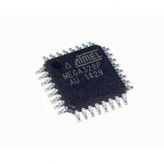
MICROCONTROLLER
ATMEGA 328
The Atmega328 is a single chip microcontroller created by ATMEL.
Specification
Operating voltage [1.8-5.5v]
Operating temperature [-45degree to +80 degree C]
ADC- 10 bit
PWM pins- 6
CPU-RISC 8-Bit AVR
Program memory -32kB
Memory type-Flash

Slide 9
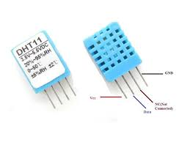
TEMPERATURE SENSOR
Operating Voltage: 3.5V to 5.5V
Operating current: 0.3mA (measuring) 60uA (standby)
Output: Serial data
Temperature Range: 0°C to 50°C
Resolution: Temperature 16-bit

Slide 10
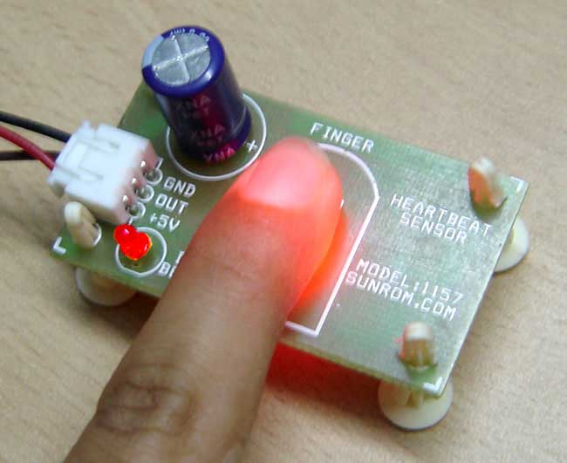
HEART BEAT SENSOR
Microcontroller based SMD design
Heart beat indication by LED
Instant output digital signal for directly connecting to microcontroller
Compact Size
Working Voltage +5V DC

Slide 11
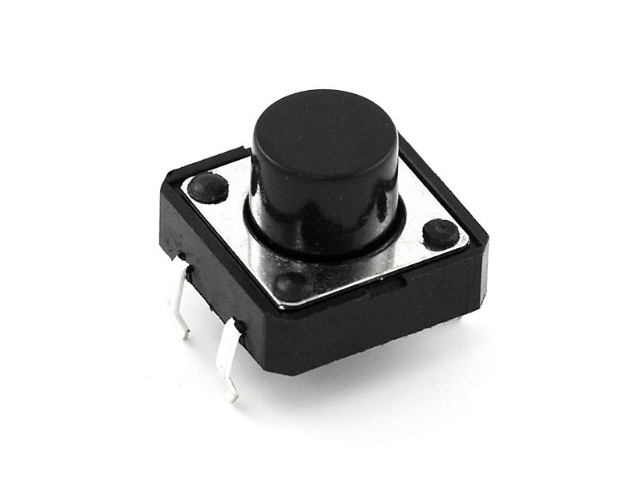
SWITCH
A switch controls an action in a machine or other type of process.
switch is wired normally open or “off” when the button is compressed the electric circuit will connect - the switch will “make” the circuit.

Slide 12
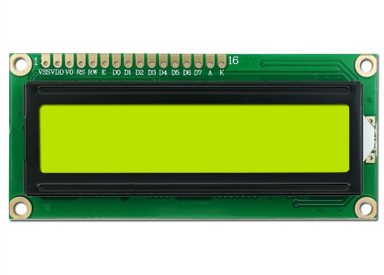
LCD 16 X 2
The 16X2 LCD display is used to monitor the sensor values read by the Arduino board.
It is interfaced with the Arduino UNO by connecting its data pins D4 to D7 with pins 11 down to 8 of the controller respectively.
The RS and E pins of the LCD are connected to pins 13 and 12 of the controller respectively.
The RW pin of the LCD module is connected to the ground.

Slide 13
SOFTWARE DESCRIPTION
Arduino IDE
Embedded C

Slide 14
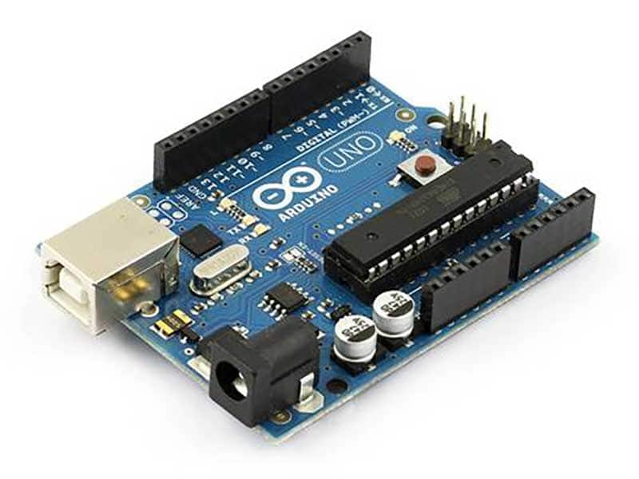
SOFTWARE DESCRIPTION
ARDUINO IDE
Arduino (Integrated Development Environment) is the software for Arduino UNO. It is IDE used for writing code, compiling the code to check if any errors are there and uploading the code to the ARDUINO UNO. It is a open source platform.

Slide 15
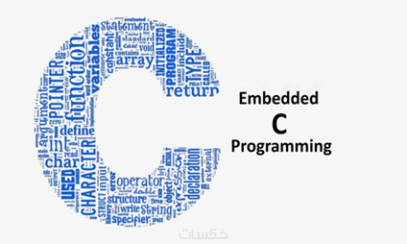
EMBEDDED C
Embedded C language is used to develop microcontroller-based applications.
Embedded C is an extension to the C programming language including different features such as addressing I/O, fixed-point arithmetic, multiple-memory addressing, etc. In embedded C language, specific compilers are used.

Slide 16
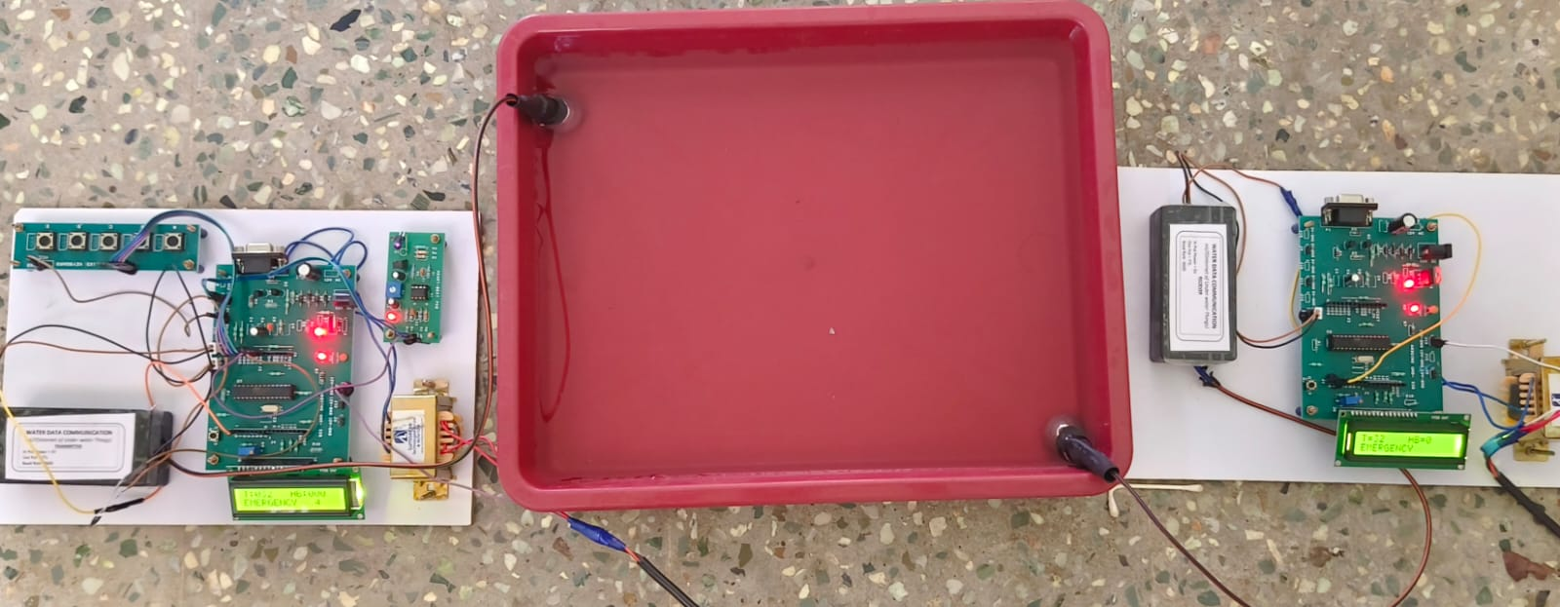
PROJECT RESULT

Slide 17
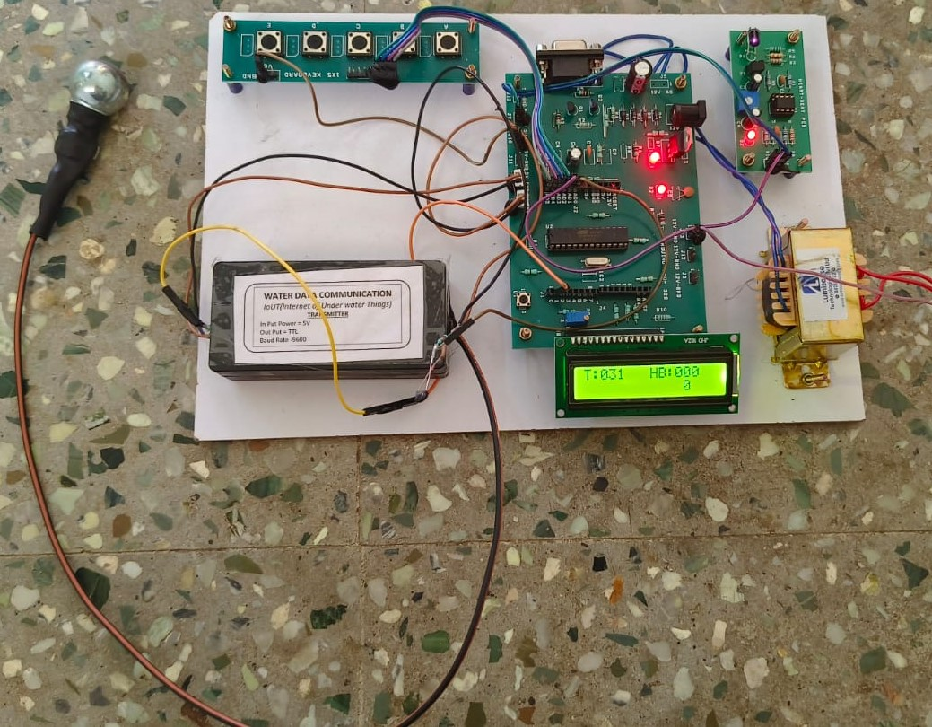
TRANSMITTER

Slide 18
TRANSMITTER
At the beginning, the readings were taken from heart beat sensor and body temperature sensor and displayed on LCD display of transmitter end.
Once we dipped the data communication module in the water, the controller in the transmitter side transmits the data to the receiver side through water via data communication transmission module.

Slide 19
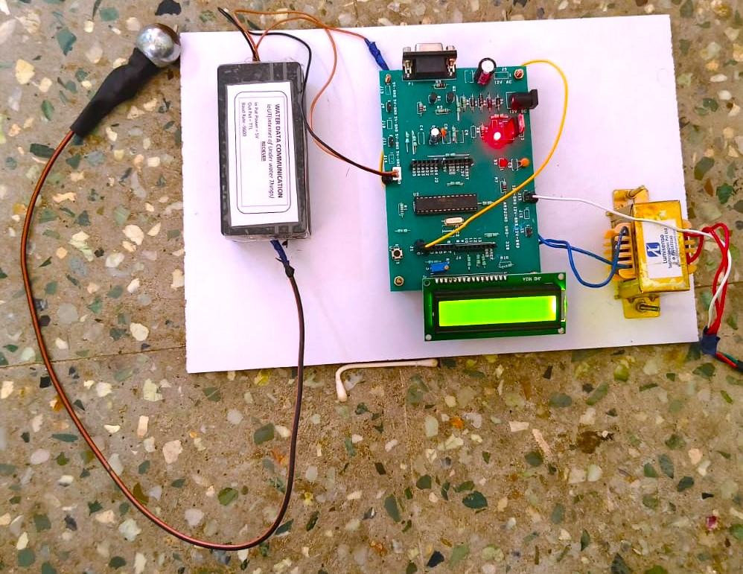
RECEIVER

Slide 20
RECEIVER
Here water will act as a medium between transmitter and receiver. Water data communication receiving module will receive the data and provides to the controller in the receiver section.
Then the data is displayed in the LCD display of the Receiver end.

Slide 21
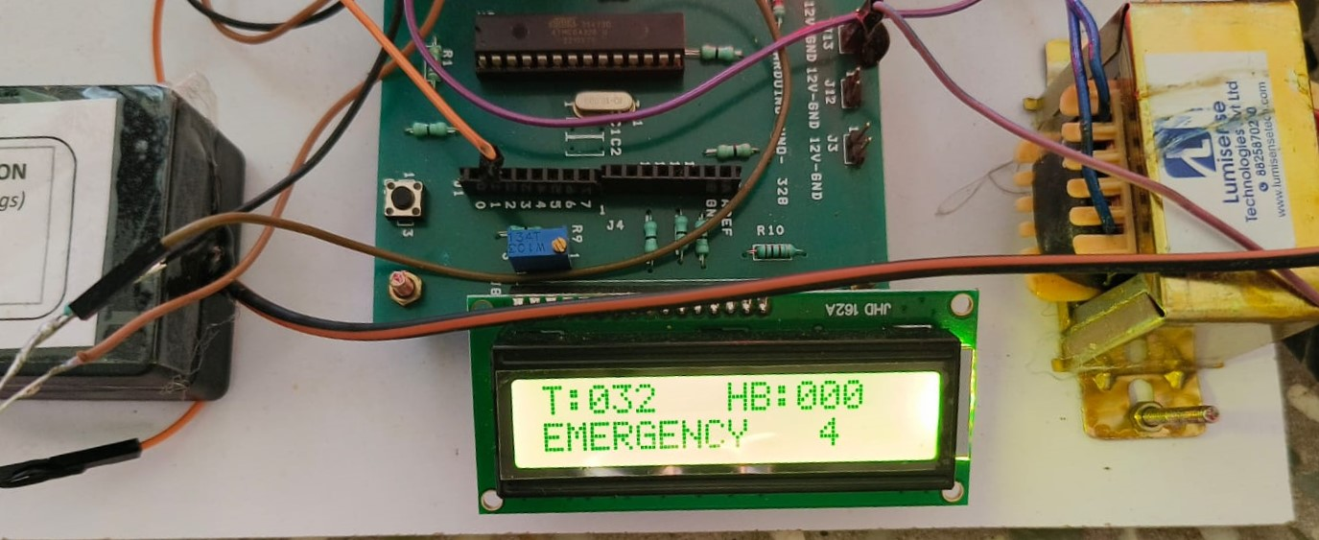
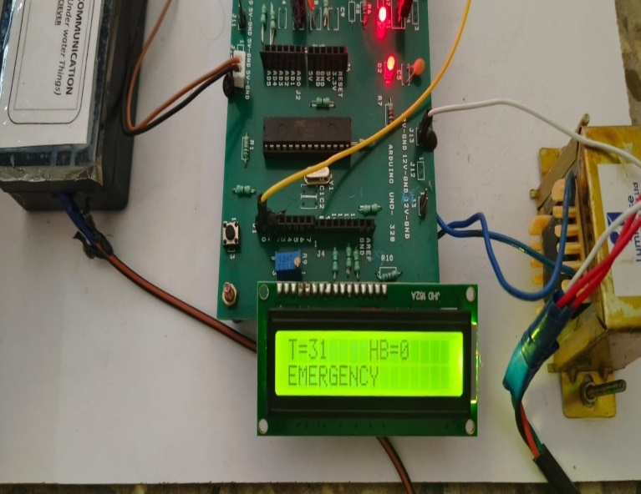
OUTPUT
Transmitter
Receiver

Slide 22
CONCLUSION
While electromagnetic communication is the most commonly used wireless communication technology underwater, other technologies such as acoustic communication and optical communication also show potential.
Underwater wireless communication can be used for applications beyond scientific research and exploration. It has promising potential for military applications such as underwater surveillance and detection, and for commercial applications such as underwater mining and aquaculture.

Slide 23

THANK YOU

